Slide 1
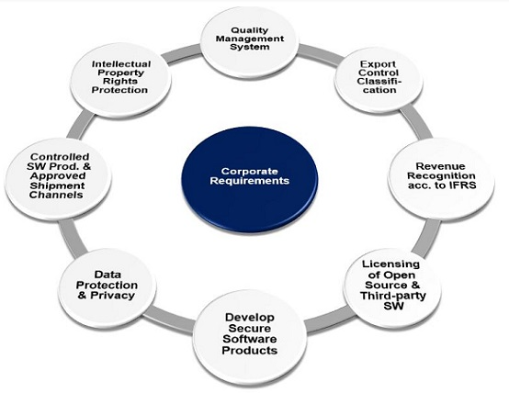
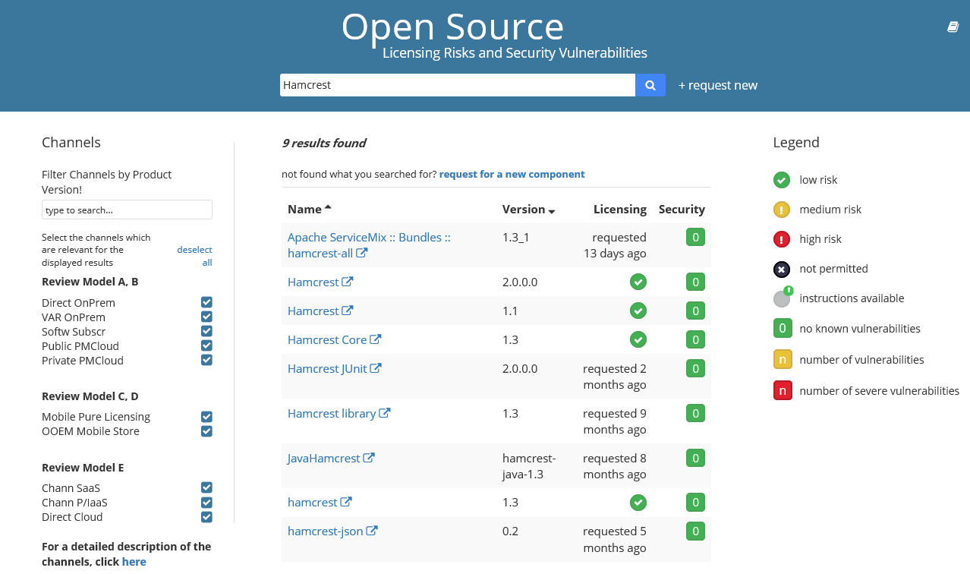
Corporate Requirements and Product Standards Still relevant for Cloud Delivery Channels
Corporate requirements are rules to protect SAP as a company from material damage and all products have to comply.
Product standards (PS) define software qualities which need to be fulfilled by SAP products to enable SAP‘s business model.
Product Owner is responsible for the level of compliance for Product Standards except for corporate requirements and Product Standard Security. The deviations and non-applicability to be maintained in Sirius.
ECCN - any Crypto usage in your code / libraries used?
Licensing of Open Source and Third Party Software clarified? Risk is evaluated per library/component, version and delivery channel
Security - done for your code (e.g. scan via Fortify) and used libraries (Open Source scans e.g. VULAS)
Controlled Software Production – Consider Semantic versioning rules for API compatibility;
use Release API - Rest API to get data from sources like Sirius;
Intellectual Property for your product documented?
QMS - Traceability - are new requirements covered by test cases?

