Slide 1
(Fiori) programming model for XS Advanced Core Data Model driven approach
CDS Entity - HANA and OData annotations
Expose entities as OData Metadata model
namespace com.sap.cc;
@OData.publish : true
context bulletinboard{
@Catalog.tableType : #COLUMN
entity Advertisement {
key AdsId: Integer;
@SearchIndex.text: { enabled: true }
Description: String(255);
@SearchIndex.fuzzy: { enabled: true } Title: String(60);
Contact: association to Person;
};
entity Person {
...
}
}
Enrich by Odata annotations
Enrich by Odata annotations
define your DB model incl. Hana DB annotations
https://bulletinboard-ads.cfapps.sap.hana.ondemand.com /java/odata/v2/sap/ com.sap.cc._.bulletinboard_ui/ Advertisement('4711')?$format=json
Notes:
https://github.wdf.sap.corp/IndustryCloudFoundation/ServiceRequestPrototypCDS
CDS – later CDX
Inhalte wie FuzzySearch können in unserem Umfeld (noch) nicht verwendet werden:
Error: com.sap.hana.di.cds: Annotation "sap.cds::SearchIndex" cannot be used when using HDI [1310012]
https://icbs-ticketing-dev-d060188-ssctepticketartifact-javav4.cfapps.sap.hana.ondemand.com/java/odata/v4/cds_namespace._.context/$metadata
https://bulletinboard-ads.cfapps.sap.hana.ondemand.com/java/odata/v2/sap/com.sap.cc._.bulletinboard_ui/Advertisement('4711')?$format=json
Or ?$skip=0&$top=10

Slide 2
(Fiori) programming model for XS Advanced Core Data Model driven approach
CDS Entity - HANA and OData annotations
CDS Consumption Views – OData and Fiori annotations
namespace com.sap.cc;
@OData.publish : true
context bulletinboard{
@Catalog.tableType : #COLUMN
entity Advertisement {
key AdsId: Integer;
@SearchIndex.text: { enabled: true }
Description: String(255);
@SearchIndex.fuzzy: { enabled: true } Title: String(60);
Contact: association to Person;
};
entity Person {
...
}
}
namespace com.sap.cc;
using com.sap.cc:: bulletinboard as bulletinboard;
using "sap.common::UI" as UI;
@OData.publish : true
context bulletinboard_ui{
@UI.headerInfo : {
typeName : 'Advertisement',
typeNamePlural : 'Advertisements',
typeImageUrl : 'https://host/images/myAdsLogo.jpg',...}
define view Advertisement as
select from bulletinboard.Advertisement {
key AdsId as AdsId,
@UI.lineItem : [{ position:40, label:'Contact Email'}]
Contact.Email, /** requires association definition **/
Description
};
}
Enrich OData model by Fiori annotations for Fiori Element (aka Smart Templates) generation
enrich by Fiori-UI annotations (for Fiori Smart Templates)
Notes:
https://github.wdf.sap.corp/IndustryCloudFoundation/ServiceRequestPrototypCDS
Auf hdbcds ist die Assoziation „Contact.Email“ völlig ok, das würde auf die HANA ohne Probleme gebaut werden. ABER: Die OData Exponierung würde allerdings keine Assoziation mit ausgeben auf der Ebene, was keine Verwendung auf UI-Ebene möglich macht
OData supports read-only; you need to implement Java extensions to implement modifications
Create Fiori Elements and Smart Controls (e.g. Smart Table)
CDX -> Odata Metadata model -> Fiori Elements (aka Smart Templates) verwendet UI5 XML processor, incl. xml view processing @UI5)

Slide 3
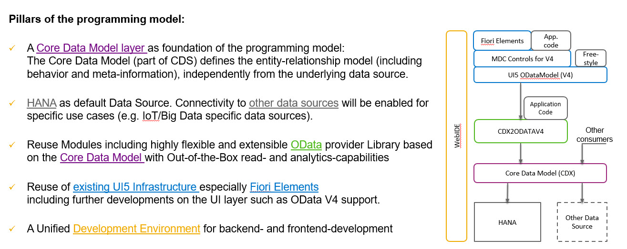
(Fiori) programming model for XS Advanced Target Architecture
Notes:
MDC Controls = Metadata Component Controls – SmartControls auf OData v4
As Fiori support ODataV2 only, They aggreed on supporting OData V2 as well for CDS

Slide 4
Further References
XSA Programming Model Wiki https://wiki.wdf.sap.corp/wiki/display/fioritech/XSA+Programming+Model
XSA Programming Model@DevX - 2016 Target (SAP CP Collaboration Meeting) https://wiki.wdf.sap.corp/wiki/display/HCPCollaboration/HCP+Collab+Meeting+2016-12-05
Tutorial: how to build XSA/CF-fullstack-application based on CDX and Fiori elements https://github.wdf.sap.corp/d037672/mastermta/blob/master/README.md

