Slide 1
Context Map Example
Product
Release
Sprint
BacklogItem
Team
PO
TeamMember
Agile PM Context (e.g. JIRA)
- Core Domain
Identity & Access Context (user mgt, permissions)
- Generic Domain
Tenant
User, Group
Role
Scopes
Collaboration Context (e.g. JAM)
- Supporting Domain
Forum
Calendar
Discussion
Post
…

Slide 2

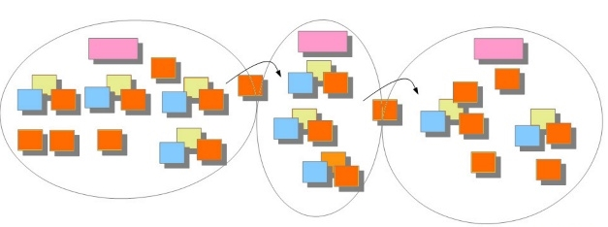
Aggregate / Data
Other subscriber
Order
CMD
Create Order
Order Created
Domain Event
New Order ID + data
Result / output

Slide 3
MS A
MS B
MS C
A
B_{A}
B
A_{B}
C
A_{C}
B_{A}: What A needs from B’s data
C_{A}
C_{B}
B_{C}
events / messages

