Slide 1
Multi-tenant Cloud Applications

Slide 2
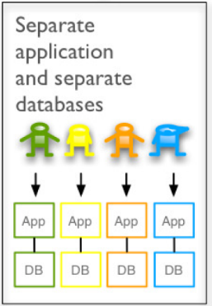
What is a Multi-tenant Application?
Multi-tenant Applications – SAP CP documentation
One application instance can serve requests from multiple customers (SaaS tenants e.g. Nestle)
++ Maintenance of one version only (same code base)
++ Better resource utilization
- - Connect to tenant specific Identity and Access Management (IAM) needed, and
- - all data (incl. master & configuration) must be kept isolated
Tenant specific data
Non multi-tenant application provisioning
Each customer requests separate instances for application and services
No resource sharing, i.e. hosting / HEC model
Notes:
…to prevent accidental as well as intentional harming behavior to the scope of the corresponding customer

Slide 3
Identity and Access Management (IAM)
Multi-tenancy and …

Slide 4

Multi-tenant Applications and ‘User Management'
A customer manages their own set of users and groups in their own 'user management' (= Identity Provider, IdP)
The customer’s users must authenticate against the customer’s IdP to prove their identity
Customer A
Multi-tenant Application
IdP A
Customer B
IdP B

Slide 5
Subaccounts and Identity Zones
SAP Cloud Platform customers require subaccounts (aka tenants) to attach their IdPs via the corresponding Identity Zone of a subaccount
Application consumers consume multi-tenant applications (SaaS use case)
Application providers provide multi-tenant applications which run in a space of the assigned Cloud Foundry Org (PaaS use case)
Global Account (SAP Cloud Platform Customer)
1
0..n
Subaccount (SaaS/PaaS Tenant)
1
1
Identity Zone
0..n
1
Identity Provider (IdP) e.g. SAP Cloud Identity (SCI)
1
0..1
Cloud Foundry Org for application providers (PaaS Tenant)

Slide 6


Identity Zones separate User Management into different Security Realms for XSUAA
Consumer A
XSUAA
SaaS use case
IdP A
SAP Cloud Identity (SCI) [Default IdP]
Consumer B
Id Zone A
Id Zone B e.g. Nestle
Id Zone App Provider
IdP B
Application Provider
(PaaS tenant)
trusted relationship
app organization
Application
PaaS use case
tenant specific requests:
https://<tenant>-<app>.<domain>

Slide 7
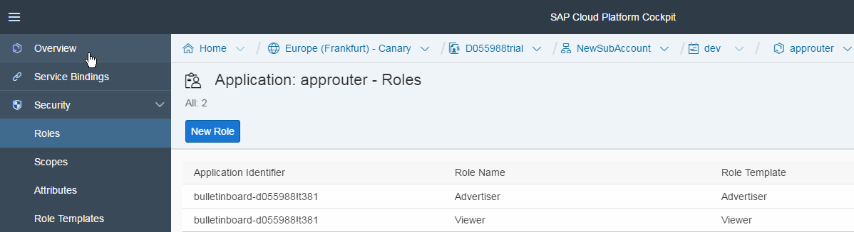
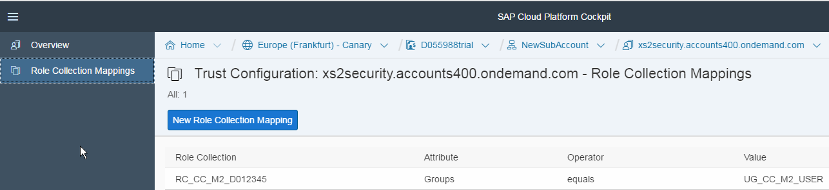
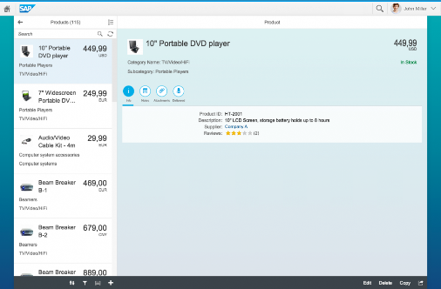
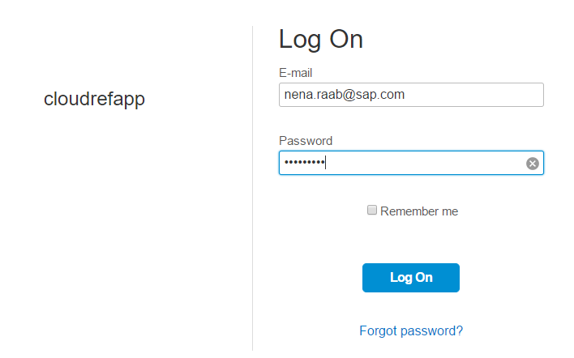
IAM Setup and Administration for Subaccounts (Tenants) SAP CP Cockpit
$XSAPPNAME == <XSAPPNAME>!t<tenant index> == unique app id
Role-Collection mapper for Id Zone cc-course
XSUAA (plan: application)
Id Zone (cc-course)
SAP Cloud Identity (SCI)
Id Zone A
Role Collection RC_CC_M2_D012345
trusted relationship
SAML2 User Group / User ID (e.g. email)
Id Zone B
Tenant specific HTTP request and login
bound to
assigned to CF org
organization e.g. CCCourse
cc-course
MT app router
{ "scope": [
"bulletinboard-d012345!t132.Update",
"bulletinboard-d012345!t132.Display"
],
"zid": „cloudcourse", …
}
MT app
Tenant specific JWT Token
Notes:
In the PaaS Use Case, the Id-Zone of the Subaccount is assigned to the CF Org of the Subaccount
This Id-Zone is taken when creating an XSUAA service with „application“ plan.
XSUAA generates a Tenant index to ensure unique appids in order to separate the different states of authorization management (e.g. nestle has managed their authorizations differently)

Slide 8
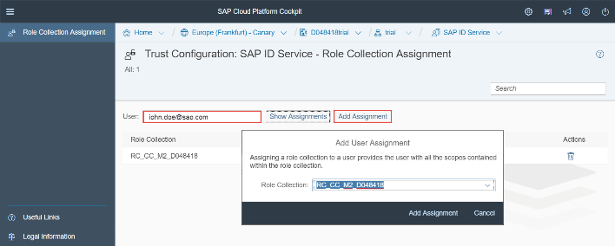
Customer Onboarding and Application Subscription (Tenant Onboarding)
Customer requests (SaaS) tenant (usually brings its own IdP) => get one own Id Zone e.g. „nestle“
Customer establishes trust between XSUAA Identity Zone and customer IdP
Customer subscribes to 1-n apps (=> app authorization model is provisioned in the Id Zone) and configures access mgt
Customer end users call apps https://<tenant id>-<app host>.<cf domain>/<endpoint>
Customer IdP e.g. Nestle IdP or SCI
2
XSUAA
Id Zone
(tenant id = “nestle”)
SAP CP Cockpit via CIS *
Onboarding
3
1
t-id
IdP url
Tenant Onboarding
1
PaaS Tenant Onboarding (manual)
3
Application Subscription
app organization
/tenant/{id}**
Application
4
/api/
* CIS – Commercial Infrastructure Service (CRM)
** POST = subscribe, DELETE = unsubscribe
Notes:
During tenant on-boarding the XSUAA gets information about the dedicated IdP, that should be mapped to the tenand id
./.
During app subscription
the application and the authorization-model of that application (xs-security.json) are now visible in the IDZone of the respective tenant
Tenant callbacks of applications are called

Slide 9
Make your Application Security Setup Tenant-Aware
Getting Started on the Cloud Foundry Platform
How to make your Application Security Setup Tenant-Aware
How to fetch tenant-Id from the JWT token: String tenantId = SecurityContext.getUserInfo().getIdentityZone();
How to make sure that the log context is initialized with the tenant-Id: LogContext.add(“tenant“, tenantId); //TODO: align with Logging Infra team
How to apply the tenant-Id to the downstream service routes
String uriTemplate = “https://{tenantId}- approuter.cfapps.sap.hana.ondemand.com/ads/api/v1/ads/“;
URI url = new UriTemplate(uriTemplate).expand(tenantId); HttpEntity<String> request = new HttpEntity<>(“My Content”);
ResponseEntity<String> response = this.restTemplate.exchange(url, HttpMethod.GET, request, String.class);
WHAT ELSE?

Slide 10
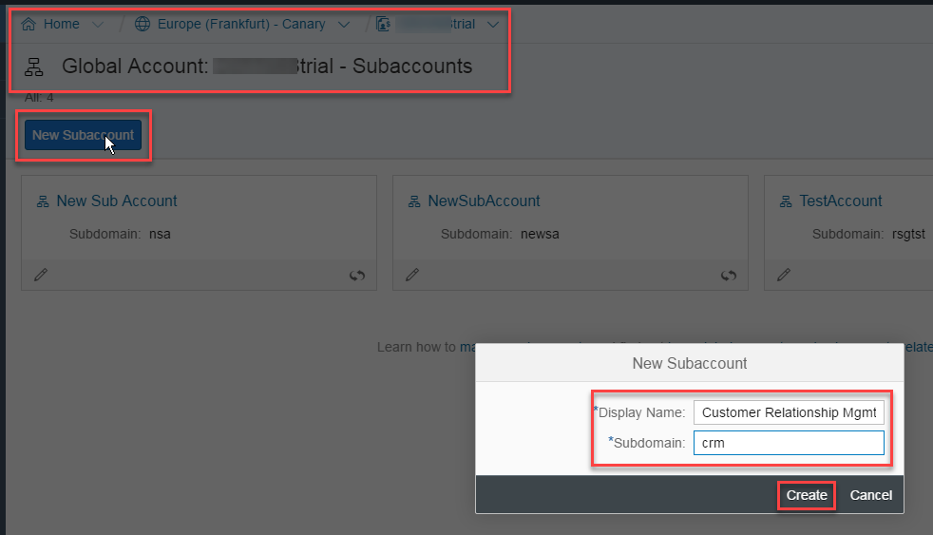
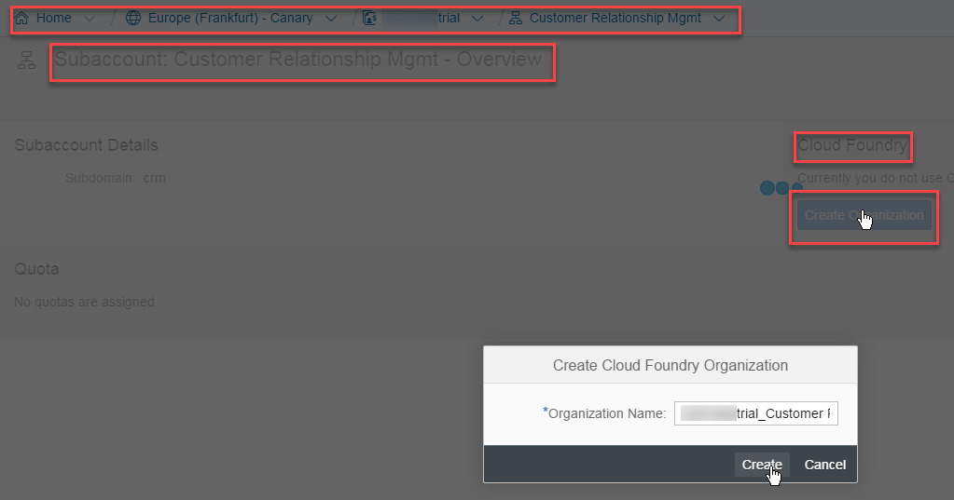

Onboarding as Application Provider on AWS Canary
Create Subaccount (aka “Tenant”) and specify Subdomain - e.g. crm (creates default Trust to SCI )
Create Cloud Foundry Org for Subaccount ( ID Zone “crm” is created automatically ) Note: The Subdomain serves as the Tenant-Id in the Cloud Foundry environment
SAP CP Cockpit
XSUAA
SAP Cloud Identity (SCI) [Default IdP]
1
Id Zone (crm)
my org e.g. crm
Application
2
HOWTO

Slide 11
Excursion: JSON Web Token (JWT)
{
"client_id": "sb-na-6230050b-24ef-4a98-a5ce-77a61653a27f",
"iss": "http://localhost:8080/uaa/oauth/token",
"exp": 1453498324,
"scope": [
"bulletinboard-ads!t27.Display"
],
"user_name": "anyUser@any.com",
"user_id": "b07aaaf8-e704-4080-84cf-aae788162837",
"zid": "cc-course"
}
XSUAA creates tenant index to ensure unique appids in order to separate the different states of authorization management
XSAPPNAME is suffixed with t!<tenant index>
Get tenant id from JWT token („zid“)

Slide 12
Make your Application Security Setup Tenant-Aware (PART 1) (solution-24-2-Enable-Multi-Tenancy)
Use XSUAA application plan and use multitenant approuter (howto)
Configure XSUAA service to trust „foreign“ tenants: Extend xs-security.json: "tenant-mode" : "shared"
Create and bind UAA service instance with application plan that is visible org wide cf create-service xsuaa application uaa-bulletinboard -c security/xs-security.json
Configure Approuter to resolve tenant from URL Update manifest.yml: specify env for approuter: e.g. TENANT_HOST_PATTERN: "^(.*)-bulletinboard-ads-d012345.cfapps.sap.hana.ondemand.com
Specify approuter route per tenant cf map-route <approuter name> <cf domain> -n <subdomain/tenant-id>-<approuter host name>
WebSecurityConfig needs to handle $XSAPPNAME e.g. bulletinboard!t27 String hasScopeUpdate = "#oauth2.hasScopeMatching('" + XSAPPNAME + "(!t\\d+)?." + UPDATE_SCOPE + "')";
Deploy your app and test your application, note: secured endpoints will respond with 403
HOWTO
Notes:
Application plan: XSUAA service instance is visible org wide
Tenant-mode shared => trusts “external” tenants (= tenants which are not equal with the tenant of the CF Org in which the consumed application is running).

Slide 13
[Optional] Provide Subscription Endpoints for Tenants
Implement callbacks for tenant un-/subscription
e.g. prepare db schema, create tenant-specific data/config, …
allow tenant onboarding to call app
Documentation on SAP CP Help
Examples:
https://github.wdf.sap.corp/CF-PROVISIONING/sample-multitenant-application
https://github.wdf.sap.corp/retail-architecture/mt-lookup
xs-security.json
"scopes": [
{
"name": "$XSAPPNAME.callback.write",
"description": "write access to callback",
"grant-as-authority-to-apps": ["tenant-onboarding"]
}
],
…
HOWTO

Slide 14
Data Isolation
Multi-tenancy and …

Slide 15

Aspects and Degrees of Data Isolation
Degrees of (data) isolation (PS-SEC 253)
Shared schema: tables contains tenant discriminator column (e.g. MANDT)
Separate schemas: Each tenant has its own database schema but share a DB (currently recommended approach with HANA instance-manager)
Separate databases (premium approach): Each tenant has its own separated database (by process / physical) to provide “bad neighborhood protection” in terms of data and failure isolation, resource consumption, performance (cache, I/O, …) etc.
Aspects to be considered Customer requirements for: data security/isolation, performance guarantees, extensibility, reliability, disaster recovery (backup and restore),…
MSDN Article: Multi-Tenant Data Architecture
(schemas)
Notes:
References:
Multi-Tenant Data Architecture
https://msdn.microsoft.com/en-us/library/aa479086.aspx
Separate-databases: Each tenant has its own database
+ database security prevents any tenant from accidentally or maliciously accessing other tenants' data
+ easy to extend the application's data model
+ simpler to restore data from backups
- tends to lead to higher costs for maintaining equipment and backing up tenant data.
Separate schemas: Tenants share common database but each tenant has its own set of tables (schema)
+ also secure and economical if implemented properly
+ easy to extend the application's data model
Shared schema: Tenants share common schema and are distinguished by a tenant discriminator column
- per-tenant backup and restore capability might result into data overwrite for all other tenants
- encrypt columns / tables to protect sensitive content
depending on technical and business considerations.
Tradeoff Data volume
Customers have different data volume and scaling needs to work appropriately

Slide 16
Case 1: Tenant Discriminator Column
References
Multi-tenancy annotations in JPA (EclipseLink 2.3)
Multi-tenant Applications” in HCP classic Documentation
import static org.eclipse.persistence.annotations.MultitenantType.*;
@Entity
@Table(name = "advertisements")
@Multitenant(SINGLE_TABLE)
@TenantDiscriminatorColumns({
@TenantDiscriminatorColumn(name = "TENANT_ID"),
@TenantDiscriminatorColumn(name = "TENANT_CODE")})
public class Advertisement {
Notes:
Tradeoff Data volume
Customers have different data volume and scaling needs to work appropriately

Slide 17
Case 2: Tenant Discriminator Schema
Supported by Hibernate e.g. in conjunction with PostgreSQL
References
Tutorial: http://stuartingram.com/2016/10/02/spring-boot-schema-based-multi-tenancy/
Example https://github.wdf.sap.corp/LCA-POCs/lca-core/
public class TenantContext {
final public static String DEFAULT_TENANT = “public";
//gives each thread its own local variable
private static ThreadLocal<String> currentTenant = new ThreadLocal<String>() {
@Override protected String initialValue() {
return DEFAULT_TENANT; //required for initial startup
}};
public static void setCurrentTenant(String tenantId) {
currentTenant.set(tenantId);
}
public static String getCurrentTenant() {
return currentTenant.get(); //provides a dedicated instance
}
public static void clear() {
currentTenant.remove(); // avoid memory leaks by cleaning releasing it for garbage collector
}
}
Initialize TenantContext within HandlerInterceptor (Example) for each request
Notes:
Hibernate natively supports SCHEMA based multi tenancy and requires three main components
CurrentTenantIdentifierResolver - Class responsible for resolving the correct tenant, map tenantId to db schema
MultiTenantConnectionProvider - Class responsible for providing and closing tenant connections
Configuration - Wiring up Hibernate correctly

Slide 18
Case 2: Tenant Discriminator Schema
Hibernate natively supports SCHEMA based multi tenancy and requires three main components
Configuration (Example) Wiring up Hibernate correctly
CurrentTenantIdentifierResolver (Example) Class responsible for resolving the correct tenant, map tenantId to db schema
MultiTenantConnectionProvider (Example) Class responsible for providing and closing tenant connections

Slide 19

Case 3: Separate Schema Using HANA Instance Manager
1. approuter derives tenant from URL
(schemas)
organization
2. get tenant id from JWT token („zid“)
Tenant specific HTTP request
space (prod)
MT app router
MT app
3. get db connect info for tenant
Backing Services
4. read / update data
1. GET request get credentials of tenant specific service instance
2. connect
Instance Manager
Recommendations:
cache credentials and connection info to hana service instance
pool open connections
RESTful API {JSON}
Service
Notes:
Application should cache service instance credentials and open connections should be pooled to minimize the overhead created.

Slide 20

Application Subscription via Instance Manager Explained
App Consumer subscribes to an application
callback ‚new tenant‘ is called
organization
Request via instance manager new db schema
(automatic) notification “onboard tenant”
space (prod)
/tenant/{id}
MT app router
MT app
Backing Services
cf create-/ bind- service
Instance Manager
POST request (async) create
tenant-specific service instance
RESTful API {JSON}
Service Broker
Service
Notes:
Advantage of having one db service instance is to be independent when doing a db upgrade, resulting in better performance for backup /restore and simplifies extensibility.
Status quo: each microsrv has its own db service instances
Data separation from tenants
Only if there are business requirements this needs to be done on the lowest level

Slide 21
DEMO / Examples
POC-Example, with HDI-deployer
https://github.wdf.sap.corp/retail-architecture/mt-hdi-deployer
“Library” https://github.wdf.sap.corp/IndustryCloudFoundation/multi-tenant-library
Example application using this “library”:
https://github.wdf.sap.corp/IndustryCloudFoundation/shoppinglist
Instance Manager Client Library (XSA):
https://wiki.wdf.sap.corp/wiki/pages/viewpage.action?pageId=1884767923

Slide 22
References
Multitenancy for HCP CF - Concept Paper.pdf https://wiki.wdf.sap.corp/wiki/display/IoTArch/Multitenancy
XSA Multi Tenancy – Wiki@SAP https://wiki.wdf.sap.corp/wiki/display/xs2/Multi-Tenancy
MultiTenancy - HCP documentation
Application Managed Service Instances Concept Paper https://wiki.wdf.sap.corp/wiki/display/xs2/Application+Managed+Service+Instances
IoT Wiki: How to use Instance Manager Broker for HANA https://wiki.wdf.sap.corp/wiki/display/IoTArch/How+to+use+Instance+Manager+Broker+for+HANA
Step-by-Step description on how to setup a PaaS-tenant on AWS Canary CF

Slide 23

How to bind to the Instance Manager
CI Server / Deployer
organization
cf create-/ bind- service
cloud controller
VCAP_SERVICES – <managed-service> environment variable contains credentials and connection info (url) to instance manager instance
space (prod)
cf create-/ bind- service
(e.g. managed_hana)
my app
VCAP_SERVICES
Instance Manager Client library for Java
Instance Manager Broker
Backing Services
Instance Manager
RESTful API {JSON}
Notes:
Service Brokers e.g. HANA Service Broker must support registration with multiple Cloud Foundry instances.

Slide 24
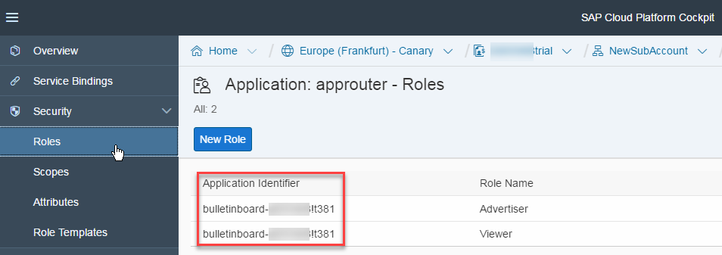
Note that XS APPLICATION NAME = bulletinboard-d012345!<tenant index>
{
… "scope": [
…
"bulletinboard-d012345!t132.Update",
"bulletinboard-d012345!t132.Display"
],
"client_id": "sb-bulletinboard-d048418!t132",
"grant_type": "authorization_code",
"user_name": "P001025",
"iat": 1494351290,
"exp": 1494394490,
"zid": „cc-course",
"xs.system.attributes": {
"xs.saml.groups": [
"cloudrefapp-useradmin",
"UG_CC_M2_USER"
],
"xs.rolecollections": [
"XS_AUTHORIZATION_ADMIN",
"RC_BULLETINBOARD_ADMIN",
"XS_MONITOR_ADMIN"
]
}
}

