Slide 1
Multi-tenant Cloud Applications

Slide 2
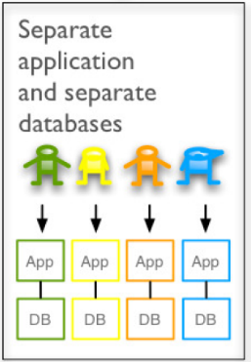
What is a Multi-tenant Application?
Multi-tenant Applications – SAP CP documentation
One application instance can serve requests from multiple customers (SaaS tenants e.g. Nestle)
++ Maintenance of one version only (same code base)
++ Better resource utilization
- - Connect to tenant specific Identity and Access Management (IAM) needed, and
- - all data (incl. master & configuration) must be kept isolated
Tenant specific data
Non multi-tenant application provisioning
Each customer requests separate instances for application and services
No resource sharing, i.e. hosting / HEC model
Notes:
…to prevent accidental as well as intentional harming behavior to the scope of the corresponding customer

Slide 3
Identity and Access Management (IAM)
Multi-tenancy and …

Slide 4


Multi-tenant Applications and ‘User Management'
A customer manages their own set of users and groups in their own 'user management' (= Identity Provider, IdP)
The customer’s users must authenticate against the customer’s IdP to prove their identity
Business Application on CP CF
User Management (external)
Customer A
SaaS Tenant
IdP Customer A
Multi-tenant Application
Customer B
SaaS Tenant
IdP Customer B
Data A
Data B
SAP Cloud Identity (SCI)
Application Provider
PaaS Tenant

Slide 5
Subaccounts and Identity Zones
SAP Cloud Platform customers require subaccounts (aka tenants) to attach their IdPs via the corresponding Identity Zone of a subaccount
Application consumers consume multi-tenant applications (SaaS use case)
Application providers provide multi-tenant applications which run in a space of the assigned Cloud Foundry Org (PaaS use case)
Global Account (SAP Cloud Platform Customer)
1
0..n
Subaccount (SaaS/PaaS Tenant)
1
1
Identity Zone
0..n
1
Identity Provider (IdP) e.g. SAP Cloud Identity (SCI)
1
0..1
Cloud Foundry Org for application providers (PaaS Tenant)

Slide 6
Identity Zones separate User Management into different Security Realms for XSUAA
Platform Services on CP CF
User Management (external)
Onboarding
Service
XSUAA
IdP Customer A
Id Zone A
Id Zone B e.g. Nestle
Id Zone App Provider
SAP Cloud Identity (SCI)
IdP Customer B
Business Application on CP CF
Multi-tenant Application
trusted relationship

Slide 7

Identity Zones separate User Management into different Security Realms for XSUAA
XSUAA
IdP Customer A
SaaS use case
Id Zone A
Id Zone B e.g. Nestle
Id Zone App Provider
SAP Cloud Identity (SCI)
IdP Customer B
app organization
trusted relationship
Application
PaaS use case
tenant specific requests
https://<tenant>-<app>.<domain>

Slide 8
Tenant-Aware Application Security Setup
Platform Services on CP CF
XSUAA
https://any.mt-app.cfapps…/
Business Application on CP CF
Multi-tenant Application Router
Multi-tenant Application
forwards JWT token
https://sap.mt-app.cfapps…/
How to make your Application Security Setup Tenant-Aware

Slide 9
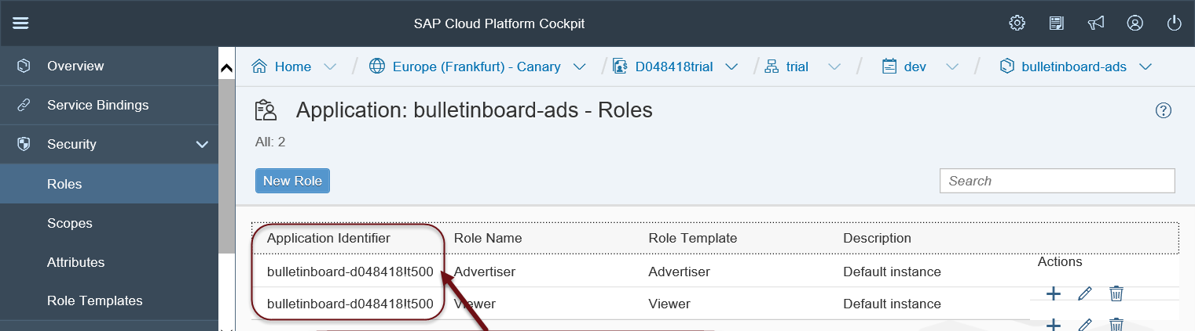
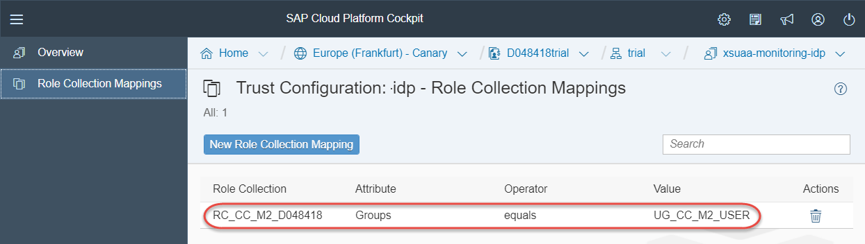
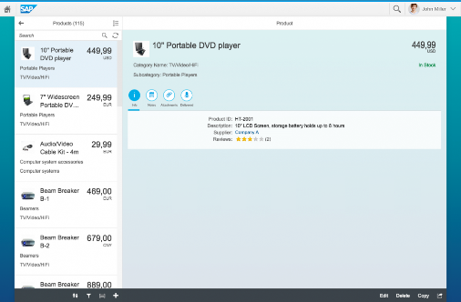
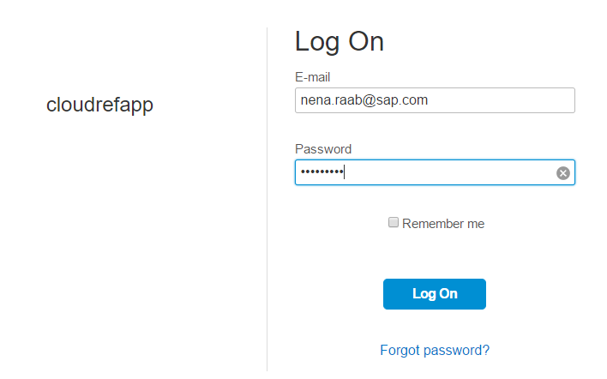
IAM Setup and Administration for Subaccounts (Tenants) SAP CP Cockpit
$XSAPPNAME == <XSAPPNAME>!t<tenant index> == unique app id
Role-Collection mapper for Id Zone d012345trial
XSUAA (plan: application)
Id Zone A
Id Zone (cc-course)
SAP Cloud Identity (SCI)
Role Collection RC_CC_M2_D012345
trusted relationship
SAML2 User Group / User ID (e.g. email)
Id Zone B
Tenant specific HTTP request and login
bound to
assigned to CF org
Trial organization
d012345 trial
MT app router
forwards tenant specific JWT Token
MT app
Notes:
In the PaaS Use Case, the Id-Zone of the Subaccount is assigned to the CF Org of the Subaccount
This Id-Zone is taken when creating an XSUAA service with „application“ plan.
XSUAA generates a Tenant index to ensure unique appids in order to separate the different states of authorization management (e.g. nestle has managed their authorizations differently)

Slide 10
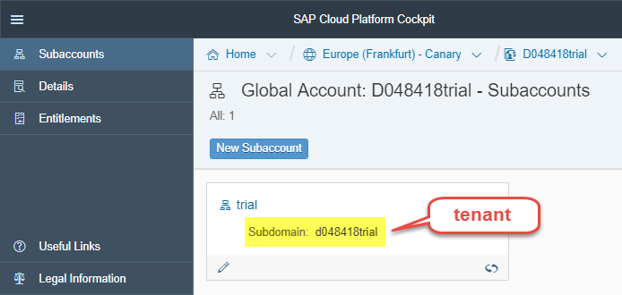
Onboarding as Application Provider on AWS Canary (Tenant Onboarding)
Create Subaccount (aka “Tenant”) and specify Subdomain - e.g. crm (creates default Trust to SCI )
Create Cloud Foundry Org for Subaccount ( ID Zone “crm” is created automatically ) Note: The Subdomain serves as the Tenant-Id in the Cloud Foundry environment
XSUAA
SAP Cloud Identity (SCI) [Default IdP]
Id Zone (App Provider)
your CF organization
Application

Slide 11
Application Subscription
Customer subscribes to 1-n apps (=> app authorization model is provisioned in the Id Zone) and configures access mgt
Platform Services on CP CF
User Management (external)
Onboarding
Service /
Application Subscription
- via CIS -
XSUAA
IdP Customer A
Id Zone A
Id Zone B e.g. Nestle
Id Zone App Provider
SAP Cloud Identity (SCI)
IdP Customer B
Business Application on CP CF
Multi-tenant Application
/tenant/{id}
trusted relationship
** POST = subscribe, DELETE = unsubscribe
Notes:
During app subscription
the application and the authorization-model of that application (xs-security.json) are now visible in the IDZone of the respective tenant
Tenant callbacks of applications are called

Slide 12
Data Isolation
Multi-tenancy and …
Business Application on CP CF
Customer A
SaaS Tenant
Multi-tenant Application
Customer B
SaaS Tenant
Data A
Data B

Slide 13

Case 3: Separate Schema Using HANA Instance Manager
Business Application on CP CF
https://any.mt-app.cfapps…/
Multi-tenant Application Router
Multi-tenant Application
forwards JWT token
Platform Services on CP CF
1. Get db connect info for tenant (during runtime)
Hana Instance Manager
(RESTful API)
2. Read / update data
Service Binding
REST Requests

Slide 14
DEMO / Examples
POC-Example, with HDI-deployer
https://github.wdf.sap.corp/retail-architecture/mt-hdi-deployer
“Library” https://github.wdf.sap.corp/IndustryCloudFoundation/multi-tenant-library
Example application using this “library”:
https://github.wdf.sap.corp/IndustryCloudFoundation/shoppinglist
Instance Manager Client Library (XSA):
https://wiki.wdf.sap.corp/wiki/pages/viewpage.action?pageId=1884767923

Slide 15
Application Subscription via Instance Manager Explained
callback ‚new tenant‘ is called
organization
Request via instance manager new db schema
(automatic) notification “onboard tenant”
space (prod)
/tenant/{id}
MT app router
MT app
Backing Services
cf create-/ bind- service
Instance Manager
POST request (async) create
tenant-specific service instance
RESTful API {JSON}
Service Broker
Service
Notes:
Advantage of having one db service instance is to be independent when doing a db upgrade, resulting in better performance for backup /restore and simplifies extensibility.
Status quo: each microsrv has its own db service instances
Data separation from tenants
Only if there are business requirements this needs to be done on the lowest level

Slide 16

Case 3: Separate Schema Using HANA Instance Manager
1. approuter derives tenant from URL
(schemas)
organization
2. get tenant id from JWT token („zid“)
Tenant specific HTTP request
space (prod)
MT app router
MT app
3. get db connect info for tenant
Backing Services
4. read / update data
1. GET request get credentials of tenant specific service instance
2. connect
Instance Manager
Recommendations:
cache credentials and connection info to hana service instance
pool open connections
RESTful API {JSON}
Service
Notes:
Application should cache service instance credentials and open connections should be pooled to minimize the overhead created.

Slide 17

How to bind to the Instance Manager
CI Server / Deployer
organization
cf create-/ bind- service
cloud controller
VCAP_SERVICES – <managed-service> environment variable contains credentials and connection info (url) to instance manager instance
space (prod)
cf create-/ bind- service
(e.g. managed_hana)
my app
VCAP_SERVICES
Instance Manager Client library for Java
Instance Manager Broker
Backing Services
Instance Manager
RESTful API {JSON}
Notes:
Service Brokers e.g. HANA Service Broker must support registration with multiple Cloud Foundry instances.

