Slide 1

Advertisement
HTTPS / REST
HTTPS
User
AMQP
Statistics
Existing Service
JDBC / SQL
(backing) services
PostgreSQL
ELK
XSA UAA
New

Slide 2
Advertisement
HTTPS / REST
Controller
HTTP Client
HTTPS
User
Domain
Hystrix
MQ Client
AMQP
Statistics
Repository
JPA / Persistence
Existing Service
JDBC / SQL
(backing) services
PostgreSQL
ELK
XSA UAA
New

Slide 3
Local
Tomcat
Browser
Default Service
HTTP / REST

Slide 4
Local
Tomcat
Postman
Hello World Service
HTTP / REST
Controller

Slide 5
Local
Tomcat
Postman
Advertisement Service
HTTP / REST
Controller

Slide 6
Local
Tomcat Servlet Container
Advertisement Service
Postman
(HTTPClient)
Dispatcher Servlet
HandlerMapping
HTTP
Servlet Filter
Handler Interceptor
Controller (RequestHandler)
ExceptionHandler (@ControllerAdvice)
HTTPMessage Converter
Advertisement Service
JUnit (MVC Test)
Dispatcher Servlet
HandlerMapping
Servlet Filter
Handler Interceptor
Controller (RequestHandler)
ExceptionHandler (@ControllerAdvice)
HTTPMessage Converter

Slide 7

Local
Postman
Advertisement Service
HTTPS / REST

Slide 8
Local
Tomcat
Postman
Advertisement
HTTP / REST
Controller
Repository
JPA / Persistence
JDBC / SQL
PostgreSQL

Slide 9
JVM
Mock MVC
JUnit
Advertisement
Controller
Repository
EmbeddedDatabaseConfig
JPA / Persistence
JDBC / SQL
H2 (In Memory)

Slide 10
JVM
Mock MVC
JUnit
Advertisement
Controller
Domain
Repository
JPA / Persistence
JDBC / SQL
H2 (In Memory)

Slide 11
Local
Postman
Advertisement Service
HTTPS / REST
JDBC / SQL
(backing) services
PostgreSQL

Slide 12
Local
Tomcat
Postman
Advertisement
HTTP / REST
Controller
Write log to STDOUT
JUnit
Console

Slide 13
Local
Postman
Advertisement Service
HTTPS / REST
Browser
(backing) services
ELK

Slide 14
Local
Postman
Advertisement
HTTPS / REST
Controller
HTTP Client
HTTPS
User

Slide 15
Local
Postman
Advertisement
HTTPS / REST
Controller
HTTP Client
HTTPS
User
Hystrix

Slide 16
JVM
GetUserCommand
getTimeoutInMs
JUnit Test Class
TestableUserCommand
@Override
sendRequest() {
return responseStub;
}
@Test
set
fakeResponse
set
provokeTimeout
fakeResponse

Slide 17
Local
Postman
Advertisement
HTTPS / REST
Controller
HTTP Client
HTTPS
User
Hystrix
(backing) services
ELK

Slide 18
Local
Postman
Advertisement
Statistics
HTTPS / REST
Controller
MQ Client
Hystrix
AMQP
(backing) services
RabbitMQ

Slide 19
Jenkins
Advertisement
SystemTest
HTTPS / REST
HTTPS
User
AMQP
Statistics
JDBC / SQL
(backing) services
PostgreSQL
ELK

Slide 20
local
Application Router
Postman
/ads
clientid
clientsecret
Authorization Code
/api/v1.0/ads
JWT Token
Advertisement
JWT
(backing) services
XSA UAA

Slide 21
Application Router
Advertisement
local
Security / ServletFilter
Controller
Browser
JWT
/api/v1.0/ads
UserInfo
(backing) services

Slide 22
Statistics
HANA Deployer (node application)
HTTPS / REST
Controller
CDS entities
procedures
StatisticsCounter
roles
CloudDatabaseConfig
.hdiconfig .hdinamespace
JDBC / SQL (insert, update, …)
deploy designtime artefacts
HANA (hdi-shared)
(backing) services
HDI
HANA
JDBC / SQL (create, alter, …)

Slide 23
JVM
JUnit
My Service
External Service
Controller
HTTP Client
Domain
Gateway
Repository
Data Mapper / ORM
JDBC / SQL
H2 (In Memory)

Slide 24
JVM
Mock MVC (or Embedded Tomcat)
JUnit
My Service
External Service
“HTTPS“ / REST
Controller
HTTP Client
Domain
Gateway
Repository
Data Mapper / ORM
JDBC / SQL
H2 (In Memory)

Slide 25
Jenkins
My Service
External Service
System Test
HTTPS / REST
HTTPS /
AMQP
JDBC / SQL
(backing) services
PostgreSQL
ELK

Slide 26
Jenkins
My Service
External Service
Performance Test
HTTPS / REST
HTTPS /
AMQP
JDBC / SQL
(backing) services
PostgreSQL
ELK

Slide 27
Local
1. Builds and deploys WAR file
Tomcat HTTP Server
bulletinboard-ads.war
$ mvn tomcat7:run-war
/
|-- WEB-INF
|-- classes
|-- AppInitializer.class
|-- config
|-- WebAppContextConfig.class
|-- controllers
|-- DefaultController.class
2. Detects WebAplicationInitializer on classpath
3. Instantiates ServletContext with DispatcherServlet
4a. Enables automatic setup of Spring ApplicationContext
4b. enables registration of Spring Web MVC specific components

Slide 28
Tomcat (Servlet Container)
Dispatcher Servlet
HandlerMapping
HTTP / REST
Controller
Servlet Filter
Handler Interceptor
Controller (RequestHandler)
Response
ExceptionHandler (@ControllerAdvice)
Response
HTTPMessage Converter

Slide 29
Tomcat (Servlet Container)
Dispatcher Servlet
HandlerMapping
HTTP / REST
Controller
@validated
Servlet Filter
Handler Interceptor
Controller (RequestHandler)
maps exceptions to http status
Response
ExceptionHandler (@ControllerAdvice)
Response
HTTPMessage Converter

Slide 30


Version Control (Git)
Compile
Unit Tests
Component Tests
Static Code Checks
System Tests
Performance Tests
Manual Tests
Security Scans
Open Source Appr.
Anonymized Data
Monitoring
Analytics
Smoke Tests
Commit
Integration
Acceptance
Production
Auto or manual
Auto or manual
xMake stage build
xMake promote
Nexus staging repository
Nexus release repository

Slide 31
Version Control
Commit
Integration
Acceptance
Production
Artifact Repository

Slide 32
On Premise Applications
On Premise / Cloud Applications today
Cloud Applications in the future
Functional Increase
1
2
3
t
1
2
3 ….
t
1
2
3 ….
t
Major (Yearly) Releases
Quarterly Shipments
Quasi Continuous Delivery

Slide 33
Application Code
CreditCheck
WebShop
Controller
Validator
check
main
delegate
validate
CreditCheckImpl
CreditCheckImpl2
check
check

Slide 34
Application
Code
CreditCheck
WebShop
<<refers>>
CreditCheck cc = new CreditCheckImpl();
CreditCheckImpl
<<instantiates>>

Slide 35
Configuration (Spring)
Code
CreditCheck
AppInitializer
@Component WebShop
<<refers>>
onStartup
ApplicationContext
@Inject CreditCheck cc;
WebShop CreditCheck → CreditCheckImpl
@Component CreditCheckImpl
<<injects>>
<<instantiates>>

Slide 36
Configuration (Spring)
Code
CreditCheck
AppInitializer
@Component WebShop
<<refers>>
onStartup
ApplicationContext
@Inject CreditCheck cc;
WebShop CreditCheck → CreditCheckImpl
@Component CreditCheckImpl
<<injects>>
Test Configuration (Spring)
Test Code
@Configuration
JUnit Test
<<instantiates>>
@Bean CreditCheckMock
TestContext
WebShop CreditCheck → CreditCheckMock
return Mockito.mock(CreditCheck);

Slide 37
Advertisement
PostgreSQL
VCAP_SERVICES
provides
Repository

Slide 38
Advertisement
PostgreSQL
Spring Cloud
Data Source
EclipseLink
VCAP_SERVICES
Spring Data JPA
JPA / Entity Manager / Transaction Manager
provides
Repository

Slide 39
Application
HDI Client
JDBC / SQL (select, insert,…)
deploy designtime artefacts
HANA
(backing) services
HDI
HANA
JDBC / SQL (create, alter, …)

Slide 40

Advertisement
User
HTTPS / REST
JSON to STDOUT
ServletFilter
Statistics
JSON to STDOUT
Logging Library
JSON to STDOUT
logging infrastructure
ELK
Logstash
Elasticsearch

Slide 41

JVM
Advertisement
ComponentTest (JUnit)
create with generated JWT Token
Jenkins
Bulletinboard Application
User
SystemTest (JUnit)
create (POST)
isPremium (GET)

Slide 42
Jenkins
Bulletinboard Application
User
SystemTest (JUnit)
Application Router
Advertisement
create (POST)
isPremium (GET)
Get JWT Token
(backing) services
XSA UAA

Slide 43
Jenkins
SystemTest (Junit)
request auth code
FakeIdP (Muenchhausen System)
SAML 2 assertion
authorization code
authorization code
Application Router
Advertisement
JSessionID
request resource
request resource
resource
resource
(4) auth code
JWT Token
authorization code
XSA UAA

Slide 44






S/4
SAP Cloud Platform
Application Platform Layer
S/4
business services e.g. YaaS, IoT, …
NEO
CF
XSA (on premise)
Technical Platform Layer
Fiori
ABAP
HANA
Fiori
JAVA, HANA XS
ASE, HANA
XSA
Fiori
buildpacks
backing services
Fiori
Java, Node.JS
HANA
Infrastructure Layer
Proprietary (hardware, OS)
Proprietary (hardware, OS)
Proprietary (hardware, OS)
Proprietary
Datacenter / Hosting
Customer

Slide 45
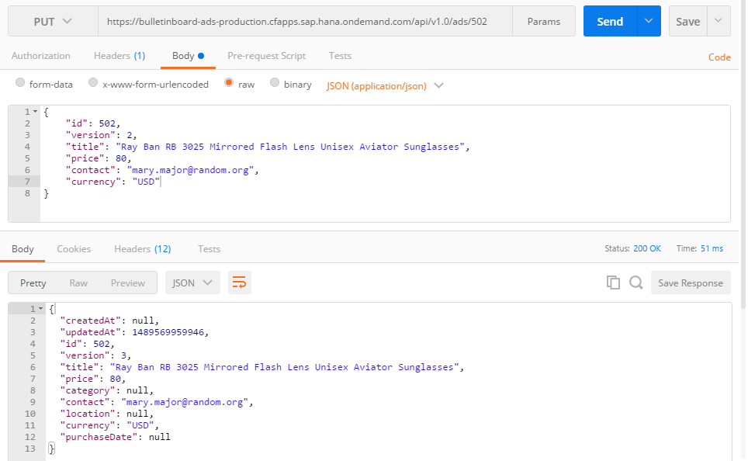
http method
resource id
Request
content type (media type)
Body: content representation JSON (= Javascript Object Notation)
Response
http status code
Body: content of the updated resource PUT overwrites all „modifiable“ fields

Slide 46
1.
JVM
2.
JVM
Embedded Tomcat
Embedded Tomcat
app
app
app
container
JDBC SQL
JDBC SQL
JDBC SQL
DB
DB

Slide 47
Bulletinboard Application
User
Application Router
Advertisement
binding
‘‘xsappname‘‘:‘‘bulletinboard-d012345‘‘
uaa-bulletinboard
uaa-bulletinboard-cc-sap
xsuaa service instances

