Slide 1
Project Presentation of Exploratory Project (CS-302)
On
Comprehensive E-Commerce Platform with Admin Panel
Team:
Debarun Das (2110990411)
Aditya Thakur (2110990102)
Aftab Alam (2110990103)
Akhilesh Stan (2110990120)
Supervised By: Dr. Simarjit Kaur
Department of Computer Science and Engineering,
Chitkara University, Punjab

Slide 2
Introduction
The motive of this PowerPoint presentation is to provide a overview of our e-commerce website project, built using the MERN stack. It will demonstrate our approach to ensuring security, accessibility, and usability, reflecting the practical application of the website.
Project Purpose:
The main goal of the e-commerce website is to provide a platform for users to browse, search, and purchase products online. The admin panel will enable administrators to manage the website, including product listings, user accounts, orders, and analytics. Additionally, the project will incorporate secure payment processing, ensuring a seamless and safe transaction experience for users. The website is designed to be scalable, supporting a growing number of products and users without compromising performance. User-friendly navigation and a responsive design are key components, ensuring accessibility across devices.
2

Slide 3
Problem Statements
User Experience and Navigation:
Users often face difficulties navigating e-commerce websites, leading to frustration and cart abandonment.
Secure Payment Processing:
Security concerns regarding payment processing can deter users from completing purchases.
Scalability and Performance:
E-commerce platforms may struggle with scalability and performance issues as they grow.
3

Slide 4
Tool and Technologies
Front-End:
React.js: For building dynamic user interfaces.
Bootstrap: For responsive and mobile-first design.
Back-End:
Node.js: JavaScript runtime for scalable network applications.
Express.js: Framework for developing web and mobile applications.
Database:
MongoDB: NoSQL database for high performance and scalability.
Authentication:
JWT (JSON Web Tokens): Secure user authentication.
Development Tools:
Visual Studio Code: Source-code editor.
Postman: API development and testing.
4

Slide 5
Features
Frontend Features
Create, Delete and Edit products in Admin Panel.
Browse Products on user end.
Build User Profile Page.
Build Cart Page and Order History Page.

Slide 6
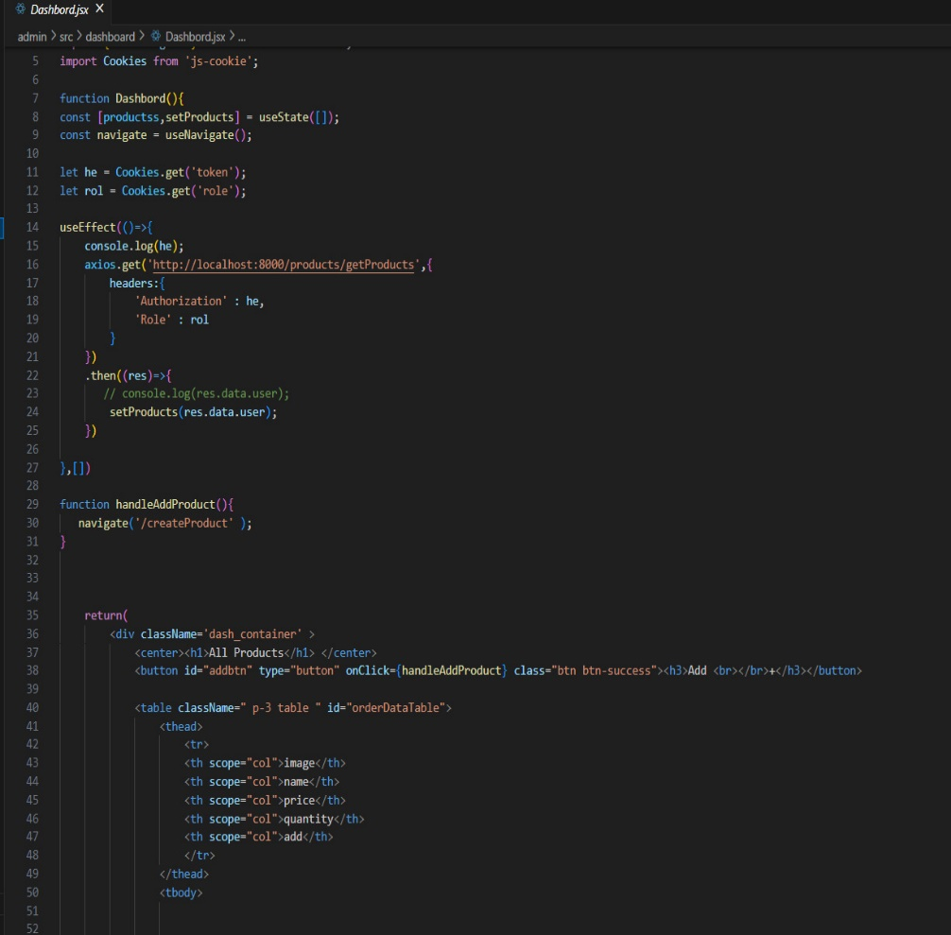
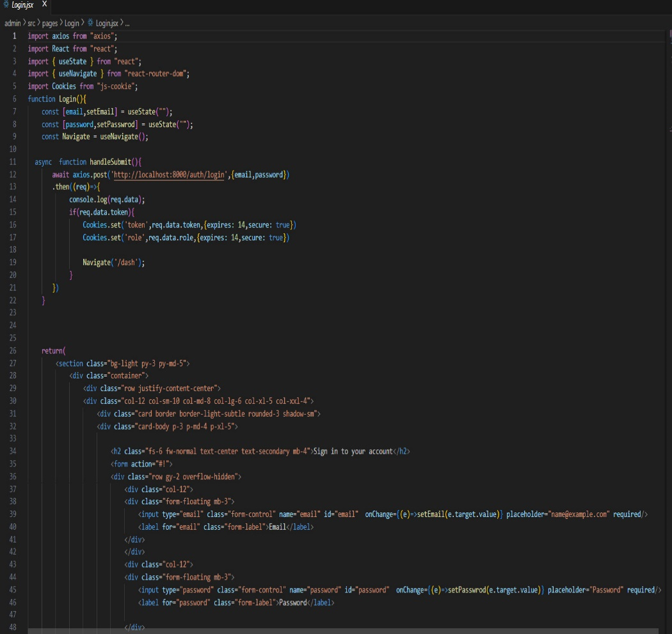
Frontend Code Implementation
6

Slide 7
Features
Backend Features
API TESTING
Create Admin & Admin API Routes
Create User Controller, API Routes
Create Application Controller, API. Routes
Connect With MongoDB Database
Create All Models
Create User Controller, Middleware, Routes

Slide 8
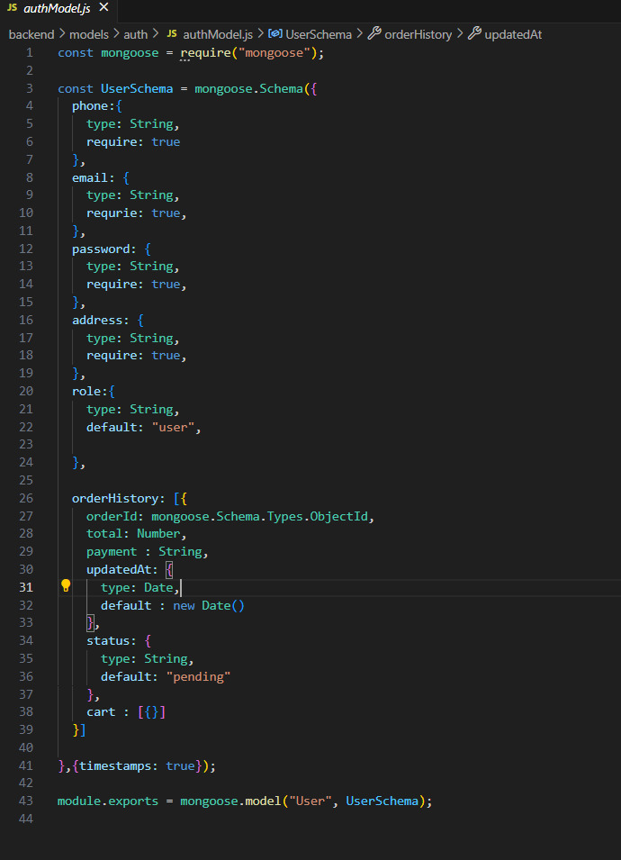
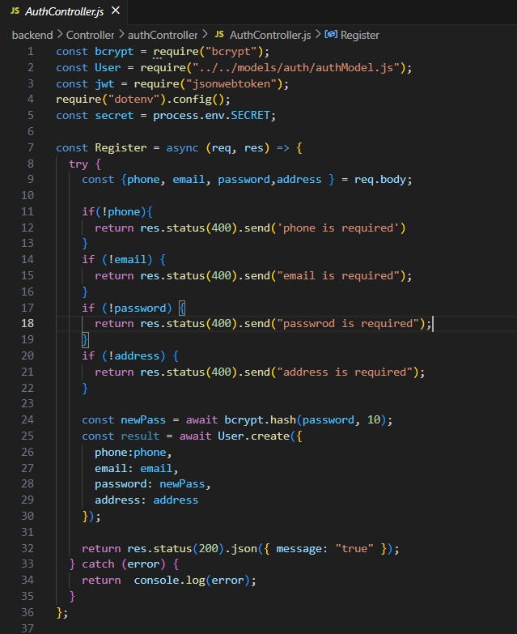
Backend Code Implementation
8

Slide 9
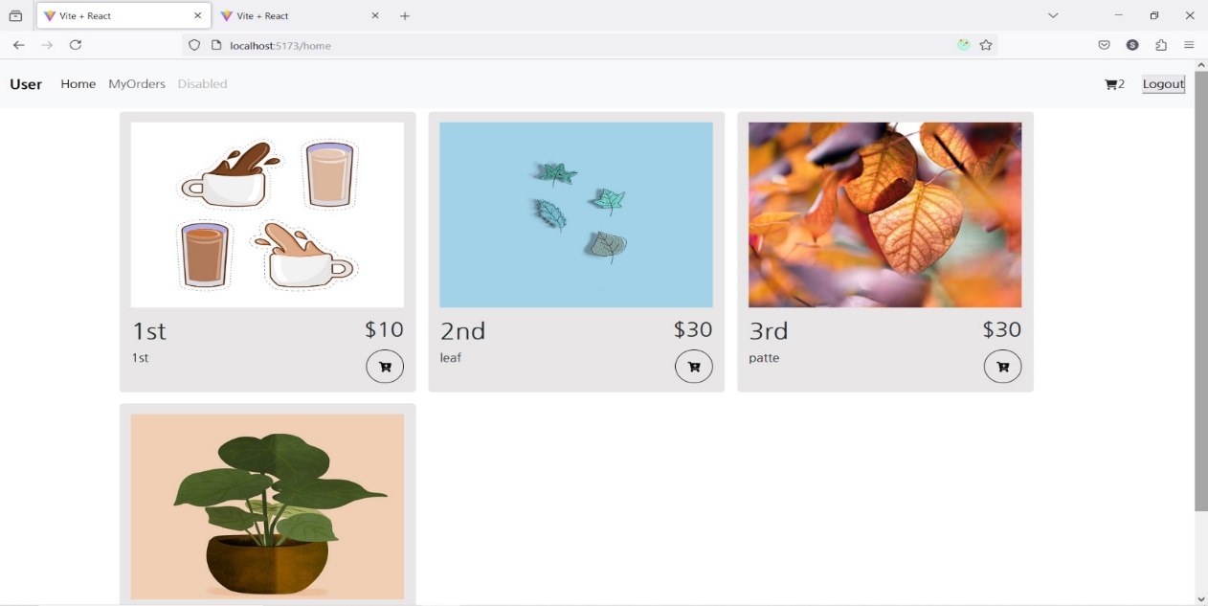
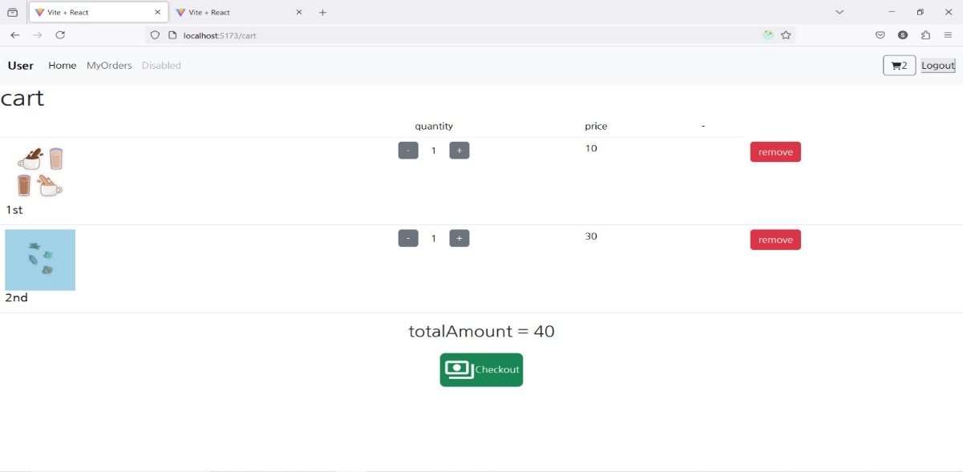
UI
9

Slide 10
Challenges
Database Schema Design:
Challenge: Managing Complex relationships in the database. Solution: Structured Schema using Mongoose.
State Management:
Challenge: Managing global state across components. Solution: Simplifies with Redux Toolkit.
Security
Challenge: Protecting sensitive data.
Solution: Implemented JWT for authentication and data encryption.

Slide 11
Key Learnings
Modular Code: Enhanced maintainability and scalability.
API Design: Improved API functionality and integration.
Performance Optimization: Better handling of database queries and React rendering.

Slide 12
Thank You
12

