Slide 1
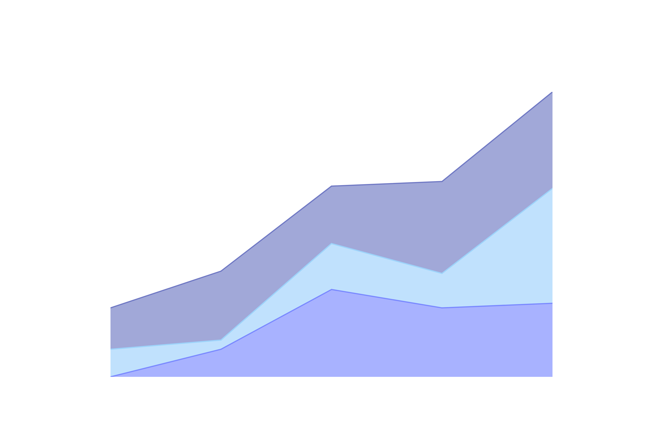
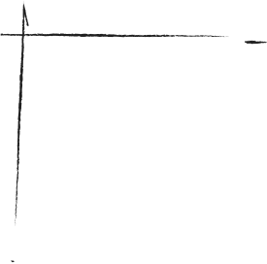
DATA
VISUALIZATON
CSE-214
Debashish Chakraborty

Slide 2
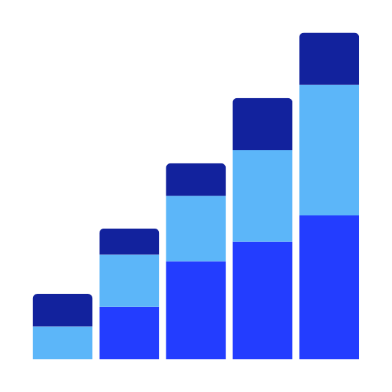

WHY DO WE VISUALIZE DATA?

Slide 3
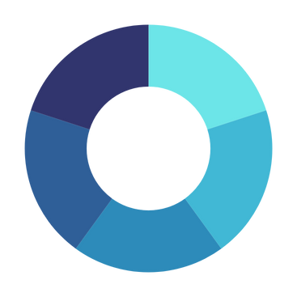
WHY ARE THEY USEFUL?
EASY TO UNDERSTAND AND SHARE
ORGANISE INFORMATION
COMPARE
DATA
ANALYSING PATTERNS

Slide 4

WHY ARE THEY USEFUL?
MAKE DECISIONS
STORYTELLING
EDUCATE OTHERS

Slide 5
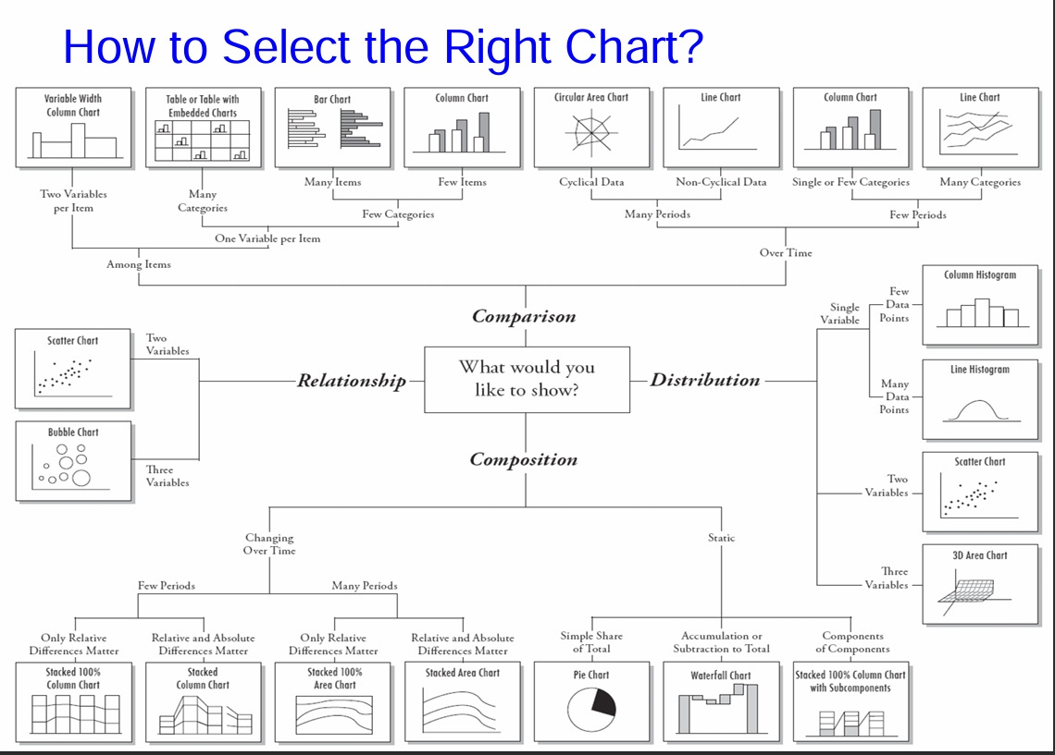

Slide 6
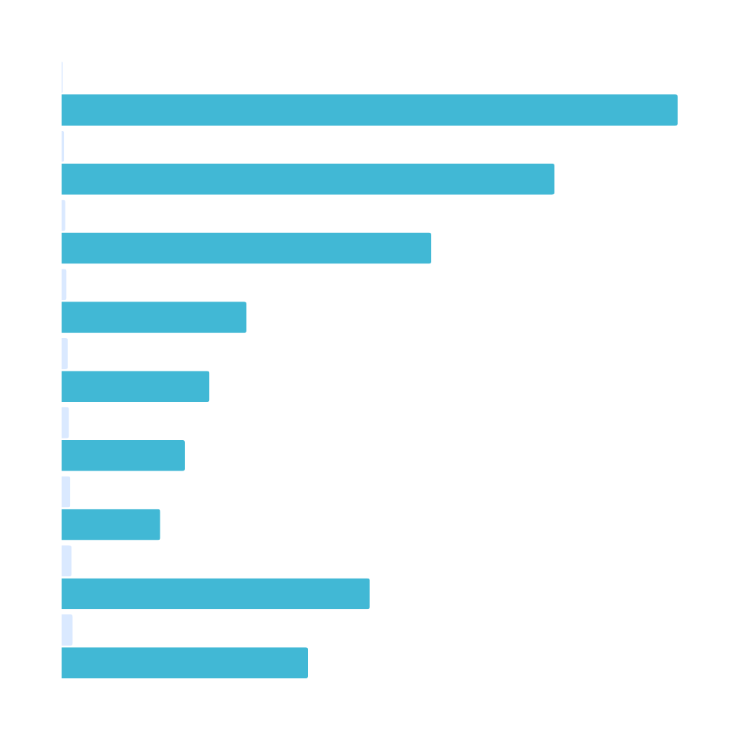
Let’s explore different ways we can represent data!

Slide 7
TABLES
Subject | Number of Students
History | 19
Maths | 27
English | 25
PE | 18
Science | 28
A table is a grid with rows and columns for organising data/information.
Use a table:
Organise detailed numerical or categorical information.

Slide 8
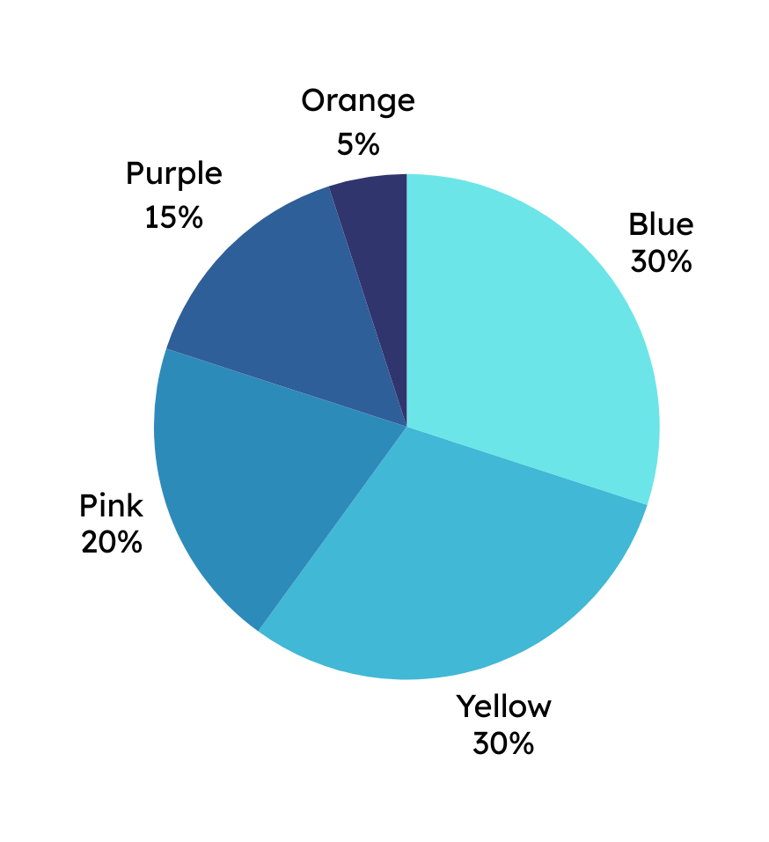
PIE CHART
Represents percentages, with the segments totaling 100%
Use a pie chart:
Show how something is divided into parts.
Showing composition

Slide 9
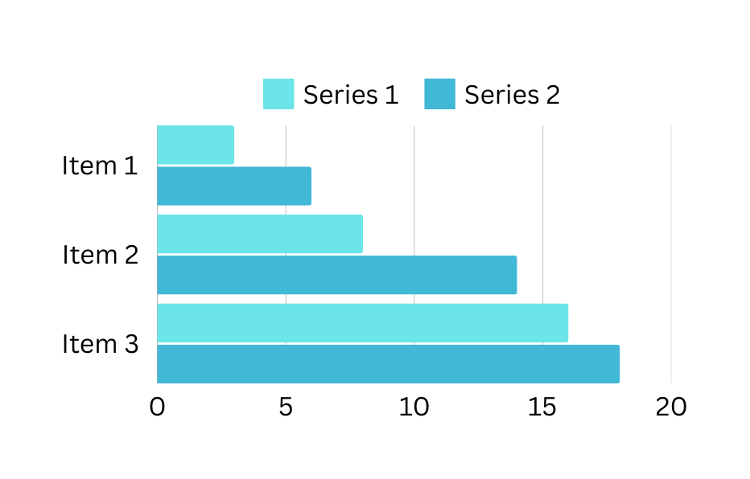
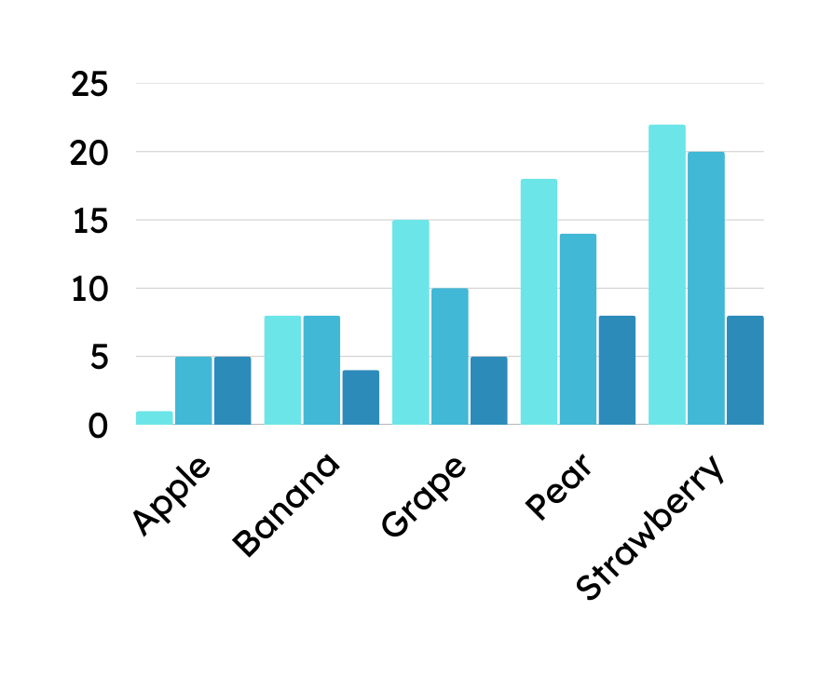
BAR CHART
A bar chart uses bars (vertically or horizontally) to show and compare data.
Use a bar chart:
compare different categories or items.
Vertical column chart - compare 5-6 values.
Horizontal bar chart - compare 7+ values

Slide 10
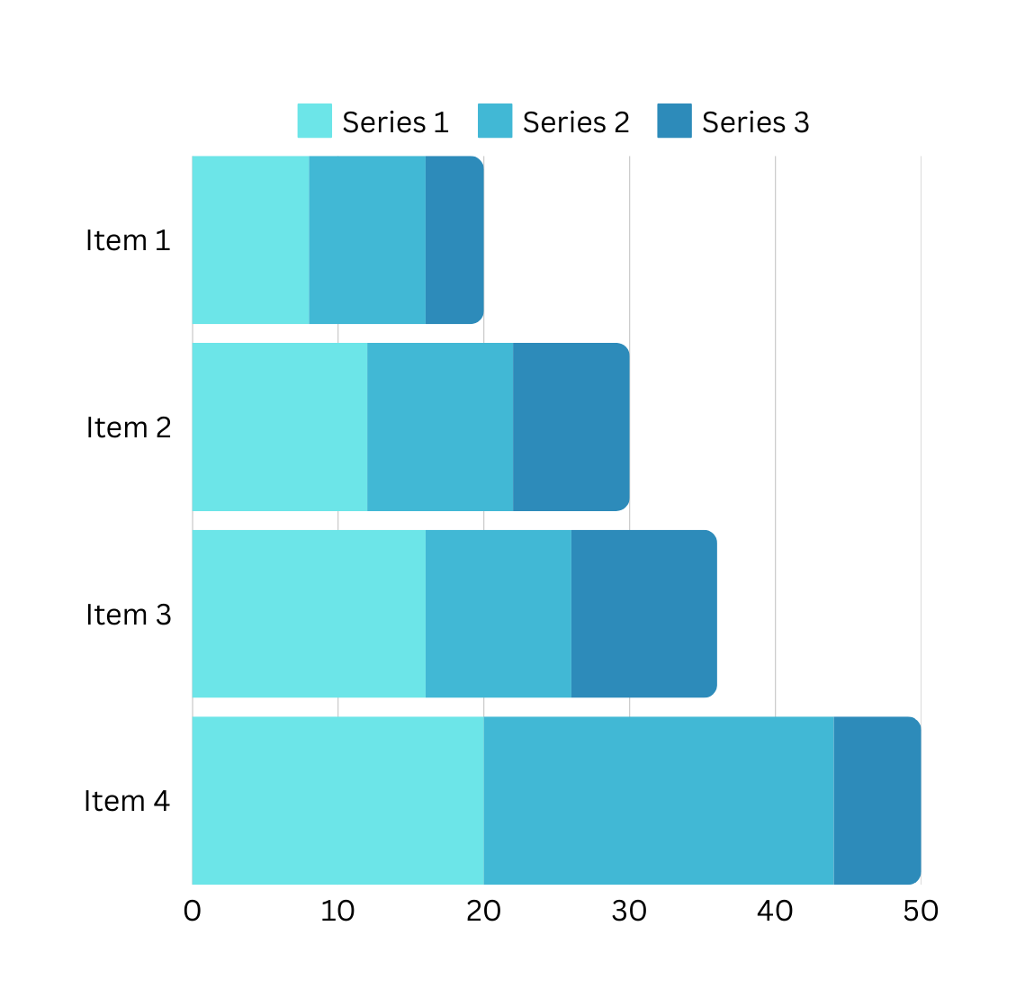
STACKED BAR CHART
A Stacked bar chart is used to compare many items & show the composition of each one.
Use a Stacked Bar Chart:
Components of a whole and compare wholes.
Stacked Bar Chart

Slide 11
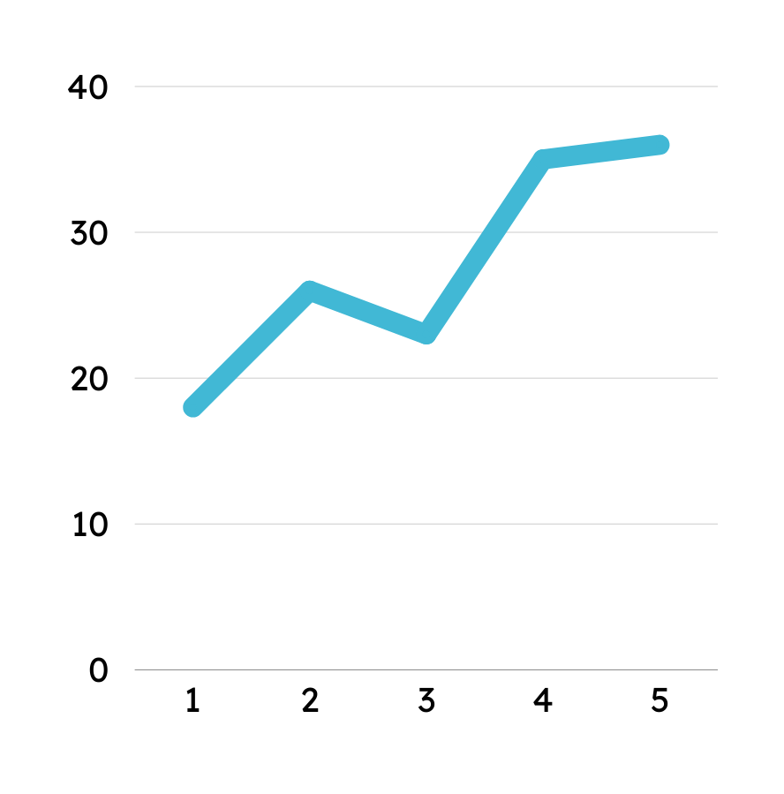
LINE GRAPH
A line graph uses lines to show how data changes over time.
Use a line graph:
To track how something changes over time.
e.g: Sales/revenue over a certain period of time.
Time (hours)

Slide 12
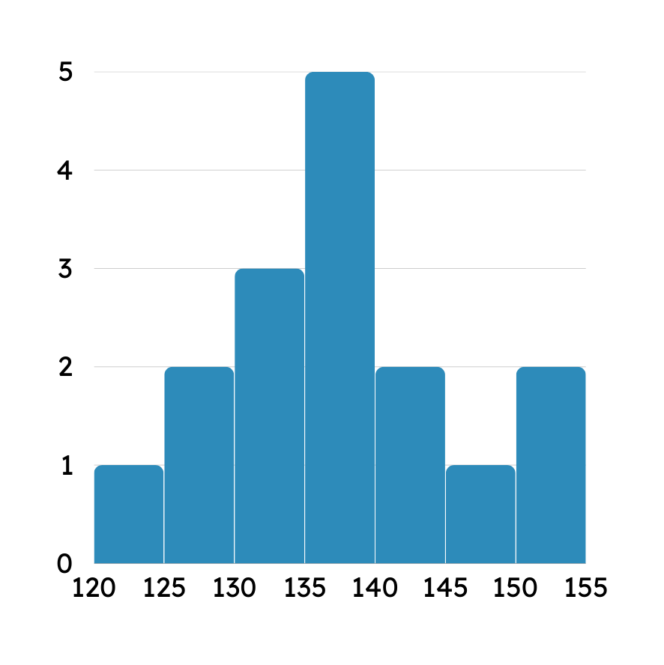
HISTOGRAM
A histogram is like a bar chart but for numbers in ranges
(not categories)
Use a histogram:
Data in different ranges, like measuring the heights of people in your class.
Height (centimetres)

Slide 13
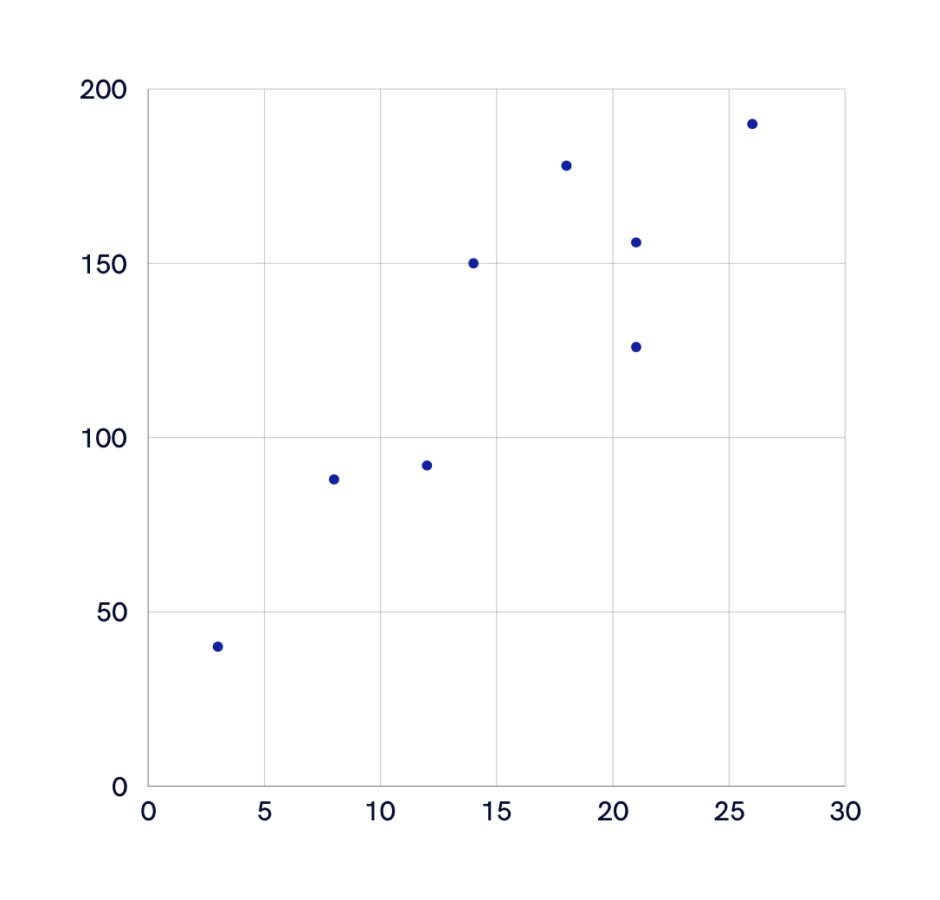
SCATTER PLOT
A Scatter Plot can show relationship between two variables or reveal the distribution trends
Use a scatter plot:
Many data points.
Highlighting similarities and distributions in the data set.
e.g: Correlation between 2 variables, looking for outliers
SCATTER PLOT

Slide 14
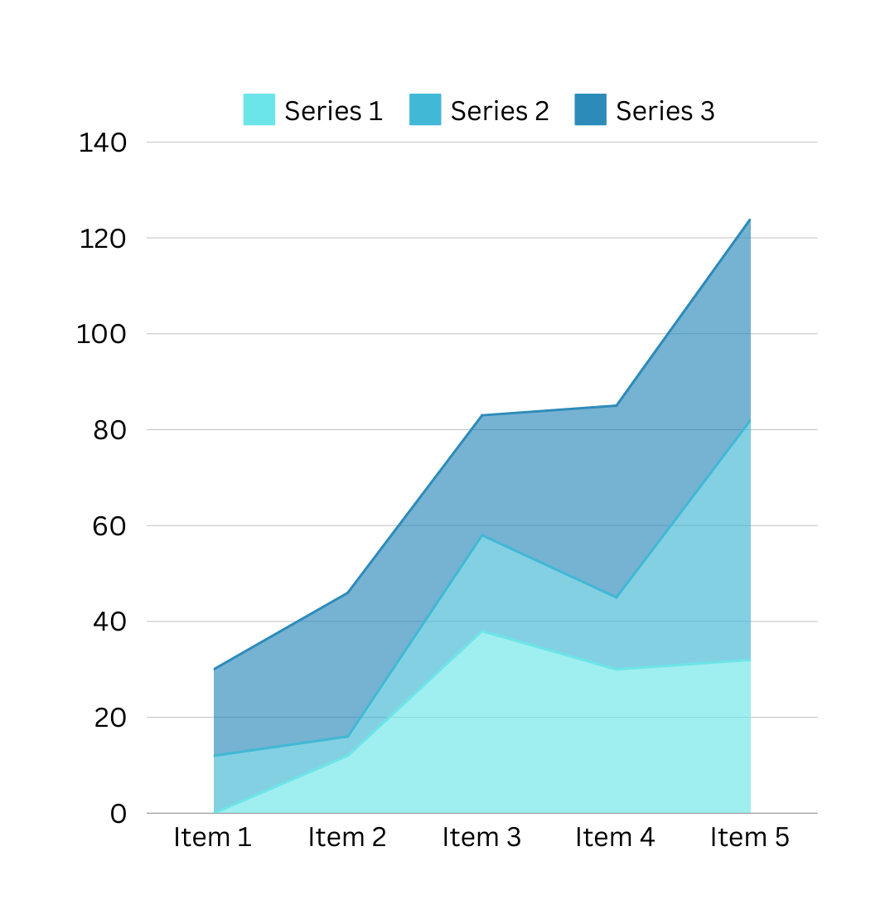
STACKED AREA CHART
A Stacked Area chart is useful to show part-to-whole relationship
Use an Stacked Area chart:
Individual data’s contribution to the total for a given period.
Helps to analyze both overall and individual trend information.
AREA CHART

Slide 15
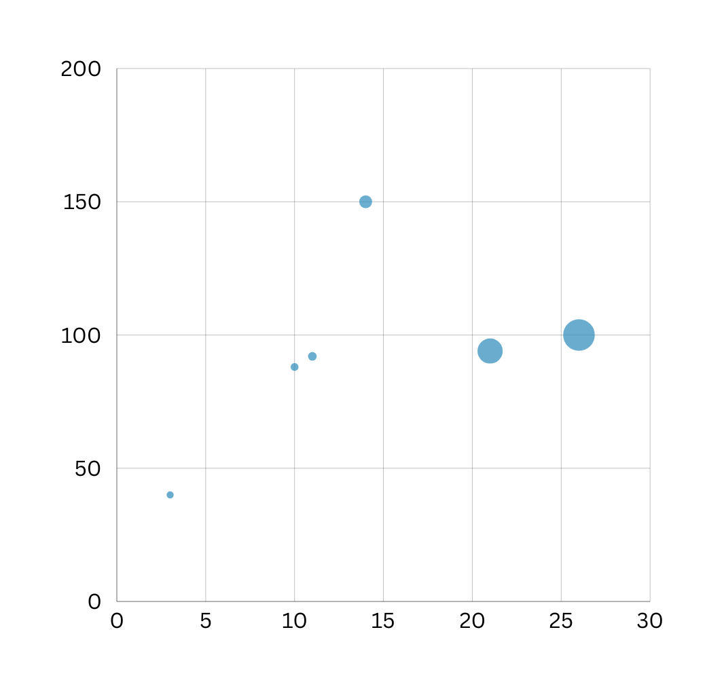
BUBBLE CHART
A Bubble Chart can show relationship between two variables or reveal the distribution trends
Use a bubble chart:
Three or more variables.
Highlighting similarities and distributions in the data set.
e.g: Correlation and differences between 3 or more variables, looking for outliers.
BUBBLE CHART

Slide 16


