Slide 1
ATM Booth Management….

Slide 2
HELLO!
I am Debashish Roy
ID:171-35-2050
I am Janip Al Helal…
ID :171-35-2046

Slide 3
Overview..
#Objective.
#Methodology
#Function
#Features.
#How it works.

Slide 4
Objective
Here we discuss about Objective of our project..

Slide 5
1.This project is base on Bank management..
2.The project is for everyone,specially for freelancer.
3.Project is safe money from other application
4.This project can payment any other bill on daily life ..

Slide 6
Methodology
Bring the attention of your audience over a key concept using icons or illustrations

Slide 7
Methodology
In this project We use some Logical function.
User can choose any option…
The program save all data from registration from of the project.
There is a condition in this program.If you choose mobile banking,and when you withdraw money you have a limit you must have at least 50tk on your account.
After homepage you will show the simple log in system.

Slide 8
Function
Here we discuss about the function of our project.

Slide 9
The function which are use in project…
#include<stdio.h>
#include”register.c”
#include”New log in.c”
#include”MB final.c”
#include”Menu.c”
Built in fumction
1.printf()
2.scanf()
3.If else

Slide 10
Features..
Here we discribe the all faeature of our project…

Slide 11
If you want to Be Unique ,You must have a unique idea.
So we add some unique idea in this project.
Now we discuss about our project features.

Slide 12
Main Features..
#Transfer balance
#Exchange Money
#Bill payment
#Simple Log in system

Slide 13
How it works
Here we discribe the all faeature works in our project…

Slide 14
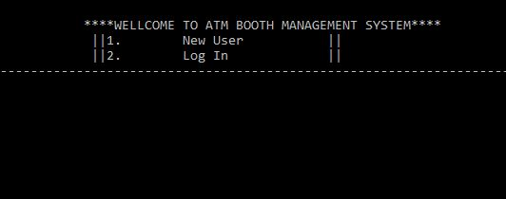
Homepage

Slide 15
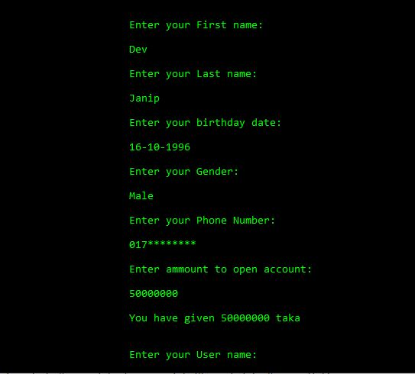
Register Menu

Slide 16
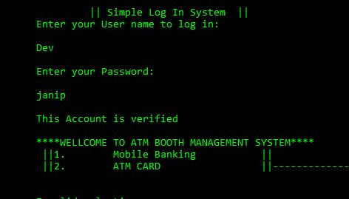
Simple Log in System

Slide 17
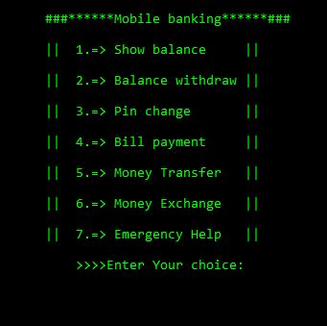
Mobile Banking

Slide 18
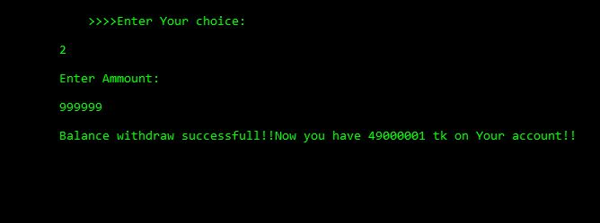
Show balance

Slide 19
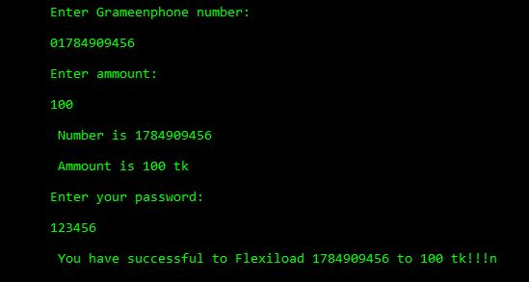
Money transfer

Slide 20
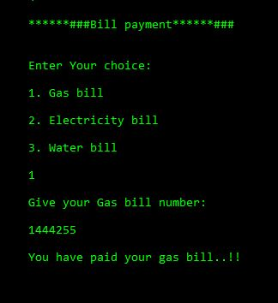
Bill Payment

Slide 21
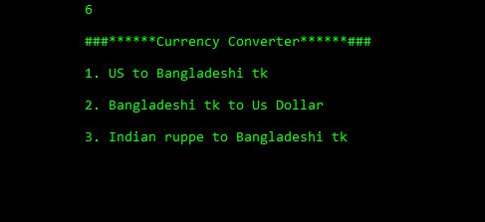
Money Exchange:

Slide 22
Limitation
Here we discribe the limitation of the project…

Slide 23
#You must have register to use this project.
#You must have at least 500tk on your account.
#In registration time you must be open account at least 500tk.

Slide 24
Desktop Project
Place your screenshot here
Here Output screen….

Slide 25
THANKS!
Any questions?
You can See Our in link:
http://codepad.org/0Kw445Rb
http://codepad.org/sVjWVpBY
http://codepad.org/1eKTjJG5

