Slide 1






Expense Tracker
A full-stack web app to track spending, budgets and savings goals
React.js
Node.js
Express.js
MySQL
Chart.js
Presented by Debashish · College project presentation
Notes:
Good morning. Our project is an Expense Tracker: a full-stack web application that helps a person record every rupee they earn and spend, set budgets, automate recurring bills and see their finances in charts. The frontend is built with React, the backend with Node.js and Express, data is stored in MySQL and charts are drawn with Chart.js.

Slide 2


Why we built it
The problem
Our solution
Money moves through UPI, cards, cash and wallets, so no single place shows the full picture
People don't know which categories eat most of their income
Rent, subscriptions and EMIs are easy to forget
Saving for a goal has no clear monthly target
One app for all accounts, with live balances and net worth
Every transaction categorized, searchable and exportable
Monthly budgets with early warnings
Recurring bills recorded automatically
Charts that show trends at a glance
Notes:
Today our money is spread across UPI apps, bank accounts, credit cards and cash, so it's hard to answer simple questions like 'how much did I spend on food this month?'. Bills like rent and subscriptions repeat every month and are easy to forget, and savings goals have no clear plan. Our Expense Tracker brings all accounts into one place, categorizes every transaction, warns before budgets are exceeded, records recurring bills automatically and turns the data into charts.

Slide 3
Project objectives
1
Record every transaction
2
Show where money goes
Income, expenses and transfers across multiple accounts, with categories and notes.
Category-wise breakdowns and monthly trends using interactive charts.
3
Control spending
4
Automate the routine
Monthly budgets per category with progress and over-spend alerts.
Recurring transactions (salary, rent, SIPs) are posted on their due dates.
5
Plan savings
6
Keep data secure
Goals with a target amount and date, and the monthly saving required.
Personal accounts with hashed passwords and token-based authentication.
Notes:
These are the six objectives we set at the start of the project. Each one maps to a module of the application, which we'll see on the next slide.

Slide 4






Key features
Accounts
Transactions
Budgets
Bank, card, cash, UPI wallet, investment and loan accounts with live balances and net worth.
Add, edit, search and filter; transfers between accounts; bulk delete and CSV export.
Monthly limit per category, progress bars, pace warnings and a 3-month average.
Recurring
Savings goals
Reports & charts
Daily, weekly, monthly or yearly items posted automatically when due.
Target and date, contributions, and the monthly amount needed.
Dashboard with cash flow, spending split, net worth trend and top payees.
Notes:
The application has six main modules. Accounts holds every place money lives. Transactions is the core ledger. Budgets set monthly limits. Recurring handles repeating items like rent and salary. Goals tracks savings targets. And the dashboard and reports pages summarize everything with charts. There is also a categories page and a settings page for currency, timezone and password.

Slide 5
Complete technology stack
Component | Technology | Why we used it
Frontend | HTML, CSS, JavaScript | Page structure, styling and browser logic
Framework | React.js | Reusable components and fast single-page navigation
Backend | Node.js | Runs JavaScript on the server, so one language end to end
Backend framework | Express.js | REST API routes, middleware for authentication and errors
Database | MySQL | Tables with foreign keys keep related data consistent
Charts | Chart.js | Interactive bar, line and doughnut charts with tooltips
Supporting libraries: mysql2 (database driver), bcryptjs (password hashing), jsonwebtoken (JWT), Zod (validation), React Router, Vite (build tool)
Notes:
This is the complete stack. HTML, CSS and JavaScript form the frontend, organized with React components. The backend is Node.js with the Express framework exposing a REST API. Data is stored in MySQL, and Chart.js draws the charts. We also used a few supporting libraries: mysql2 to talk to MySQL, bcrypt to hash passwords, JSON Web Tokens for login sessions and Zod to validate input.

Slide 6

System architecture
Client · Browser
Server · Node.js
Database · MySQL
React.js components & pages
React Router (navigation)
Chart.js charts
HTML · CSS · JavaScript
Express.js REST API
JWT auth middleware
Zod input validation
Recurring-transaction engine
8 relational tables
Foreign keys + cascades
DECIMAL money columns
Indexed by user and date
HTTP · JSON
JWT token
SQL queries
mysql2 pool
One deployment: Express serves the built React app and the /api routes from the same server, and the browser talks only to that server.
Notes:
The system follows a three-tier architecture. The React app runs in the browser and calls the server using HTTP requests with JSON. Each request carries a JWT token proving who the user is. The Express server validates the input, checks the token, and runs SQL queries on MySQL through a connection pool. In production, the same Express server also serves the built React files, so we deploy a single web service plus a database.

Slide 7
Database design (MySQL)
users
accounts
Relationships
id, name, email, password_hash, currency, timezone
id, user_id, name, type, opening_balance, color, archived
Every table belongs to a user (user_id → users.id)
A transaction links to an account, an optional destination account (transfers) and a category
Deleting a user cascades to all their data
Balances aren't stored; they're calculated from transactions, so they can never go out of sync
Money uses DECIMAL(14,2), never floating point
categories
transactions
id, user_id, name, kind (income / expense), color, icon
id, user_id, type, amount, date, account_id, to_account_id, category_id, payee
budgets
recurring
id, user_id, category_id, amount (monthly limit)
id, user_id, type, amount, frequency, interval_count, next_date, end_date
goals
id, user_id, name, target_amount, saved_amount, target_date
Notes:
The database has seven tables, all linked to the users table, so every row belongs to exactly one user. Transactions are the heart of the schema: each one points to an account, optionally a destination account for transfers, and a category. An important design choice is that account balances are not stored. They're calculated from the opening balance plus all transactions, so they can never become inconsistent. Money is stored as DECIMAL so there are no rounding errors.

Slide 8





How adding an expense works
STEP 1
STEP 2
STEP 3
STEP 4
STEP 5
STEP 6
User fills the form
API request
Authenticate
Validate
Save to MySQL
Refresh UI
Amount, date, account, category and payee in a React modal
fetch() sends POST /api/transactions with the JWT token
Express middleware verifies the token and loads the user
Zod checks every field; the account and category must belong to the user
Parameterized INSERT into the transactions table
React reloads data; balances and Chart.js charts update
Every other action (editing, budgets, goals) follows the same path: React → Express → MySQL → React.
Notes:
Here is the life of one request. The user fills the add-expense form. React sends a POST request to the API with the login token. Express middleware verifies the token, then Zod validates every field, and the server checks that the chosen account and category belong to this user. The data is saved with a parameterized INSERT, which prevents SQL injection. Finally React reloads the data and the charts redraw.

Slide 9
REST API endpoints
Resource | Operations
/api/auth | POST register · POST login · GET me · PUT profile, password · DELETE account
/api/accounts | GET list with balances · POST · PUT /:id · PATCH /:id/archive · DELETE /:id
/api/categories | GET · POST · PUT /:id · DELETE /:id
/api/transactions | GET (search, filters, pagination) · POST · PUT · DELETE · bulk-delete · export CSV
/api/budgets | GET ?month= (with amount spent) · PUT (create or update) · DELETE /:id
/api/recurring | GET · POST · PUT /:id · PATCH /:id/active (pause/resume) · DELETE /:id
/api/goals | GET · POST · PUT /:id · POST /:id/contribute · DELETE /:id
/api/reports | GET /dashboard · GET /summary?months=3|6|12|24
All routes except register and login require the header Authorization: Bearer <token>
Notes:
The backend exposes a REST API with eight resources. Each follows the usual pattern: GET to read, POST to create, PUT to update, DELETE to remove. The reports endpoints compute all dashboard and chart data in SQL so the browser receives ready-to-draw numbers.

Slide 10

Core logic
Live account balance
Recurring-transaction engine
Calculated in one SQL query instead of being stored:
Runs whenever the dashboard, transactions or recurring page loads
Finds rules whose next_date is today or earlier
Inside a MySQL transaction, advances next_date only if it hasn't changed (so two requests can't post twice)
Inserts one transaction per missed date, so nothing is skipped if the app wasn't opened
Handles month ends: 31 Jan + 1 month = 28/29 Feb
opening_balance + SUM(
CASE
WHEN income THEN +amount
WHEN expense THEN -amount
WHEN transfer out THEN -amount
WHEN transfer in THEN +amount
END)
Net worth = sum of all account balances.
Notes:
Two pieces of logic are worth explaining. First, the account balance is computed with one SQL query: the opening balance plus income, minus expenses and outgoing transfers, plus incoming transfers. Second, the recurring engine. When the user opens the app, it finds every recurring rule that is due, and inside a database transaction it moves the next date forward and inserts the missed transactions. The compare-and-set update makes sure that if two requests arrive together, the same bill is never recorded twice.

Slide 11


Reports & charts with Chart.js
Bar chart
Income vs expenses for each month
Doughnut chart
This month's spending split by category
Line chart
Net worth at the end of each month
Progress bars
Budget used and savings-goal progress
Charts follow light/dark mode and show exact amounts on hover.
Notes:
The reports module uses Chart.js through the react-chartjs-2 wrapper. A grouped bar chart compares income and expenses per month; this one uses illustrative numbers. A doughnut chart shows how this month's spending splits across categories, a line chart shows net worth over time, and progress bars show budgets and goals. The user can switch between 3, 6, 12 and 24 months, and every chart has hover tooltips.

Slide 12
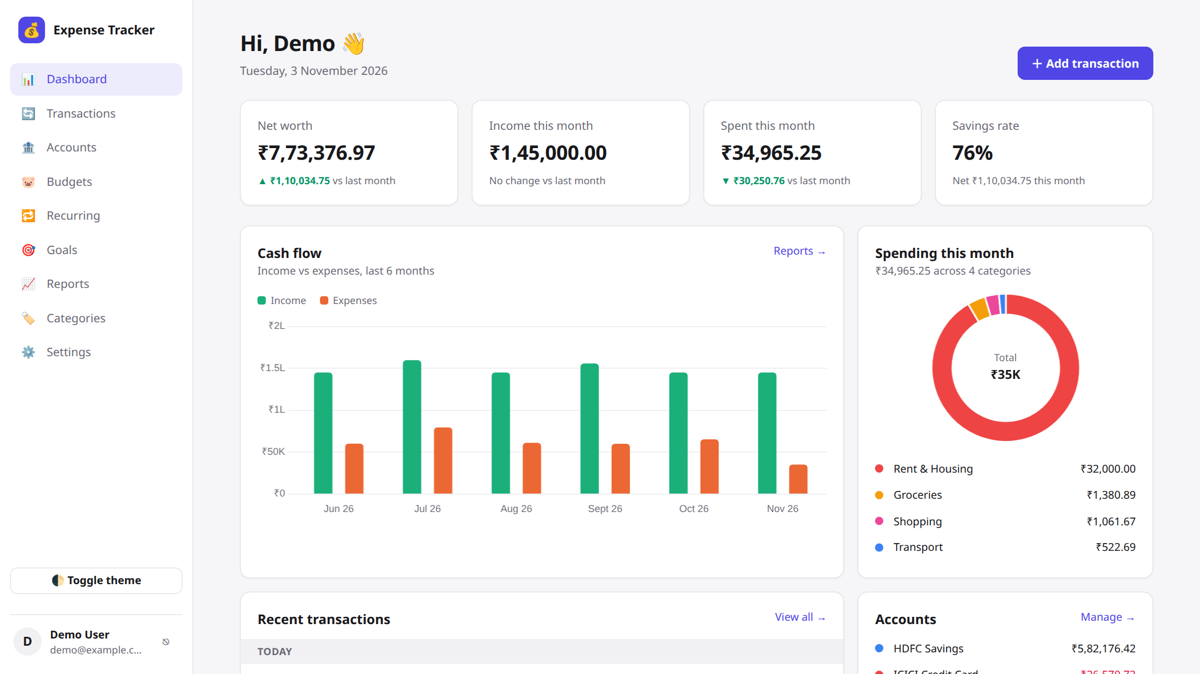
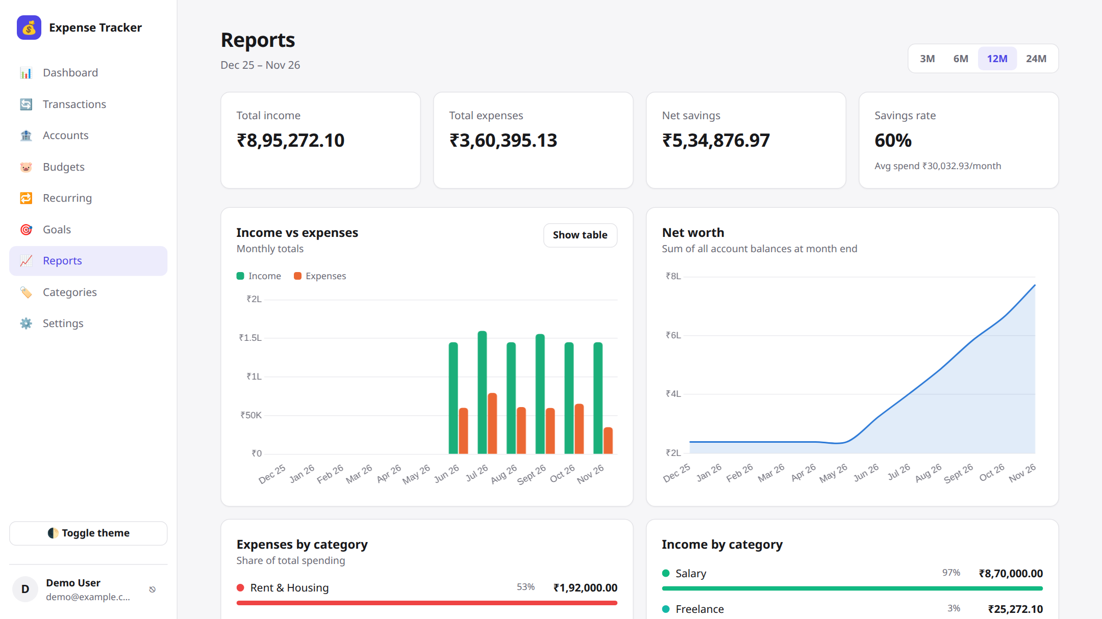
Application screens
Dashboard
Reports
Net worth, this month's income and spending, savings rate, cash-flow chart and spending doughnut
Totals for 3–24 months, income vs expenses, net-worth trend and category breakdown
Notes:
These are screenshots of the running application with the demo data. On the left is the dashboard, which summarizes the month: net worth, income, spending, savings rate, a cash-flow bar chart and a doughnut of spending by category. On the right is the reports page, where the user can pick a 3, 6, 12 or 24-month range.

Slide 13
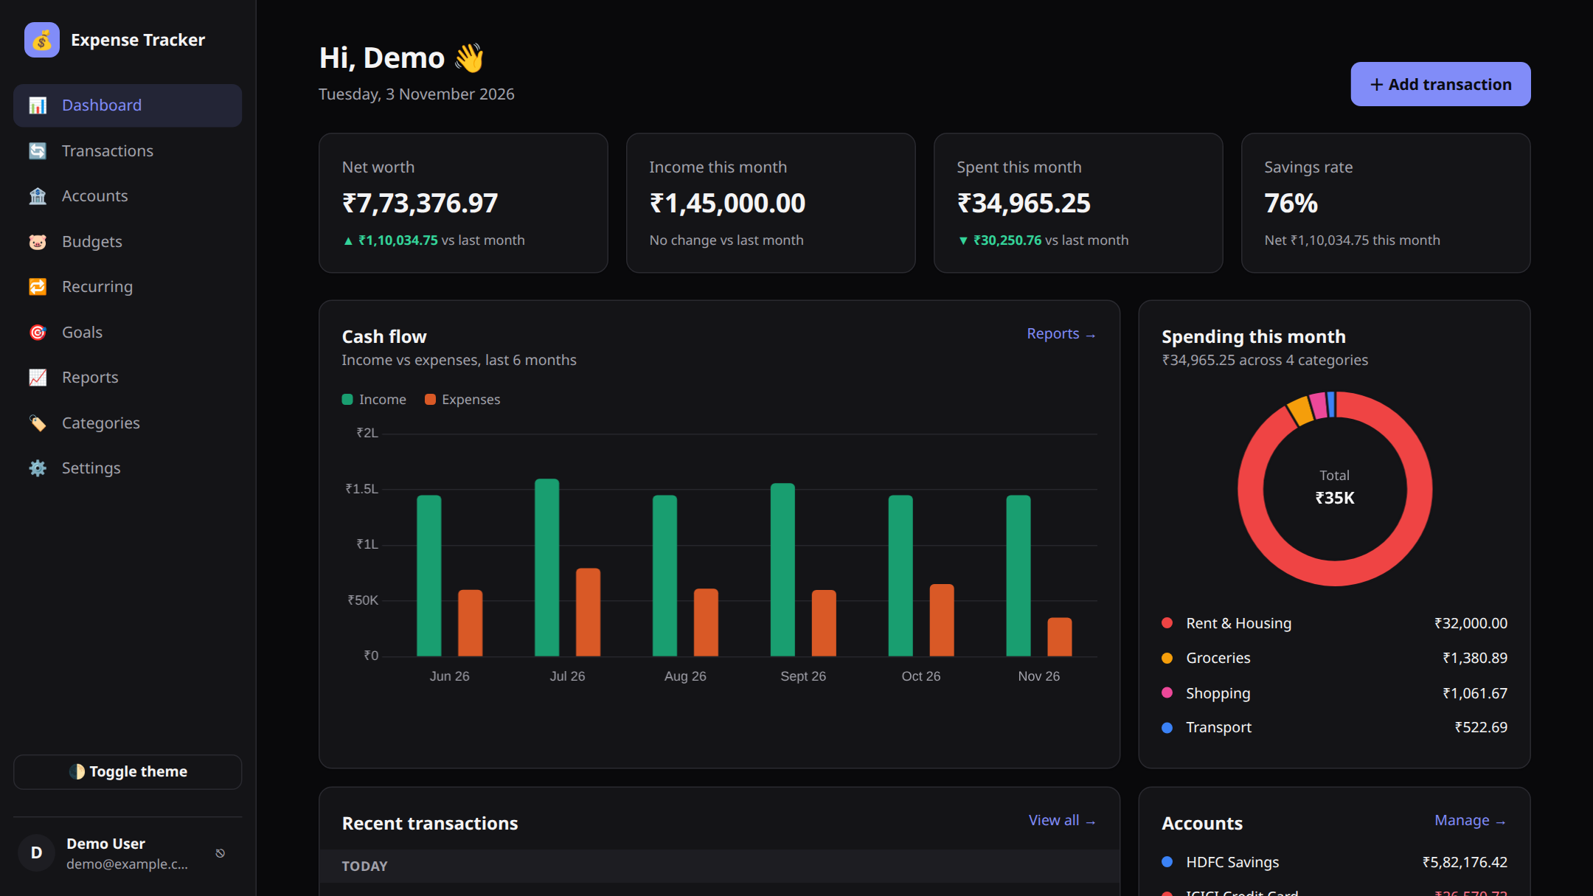
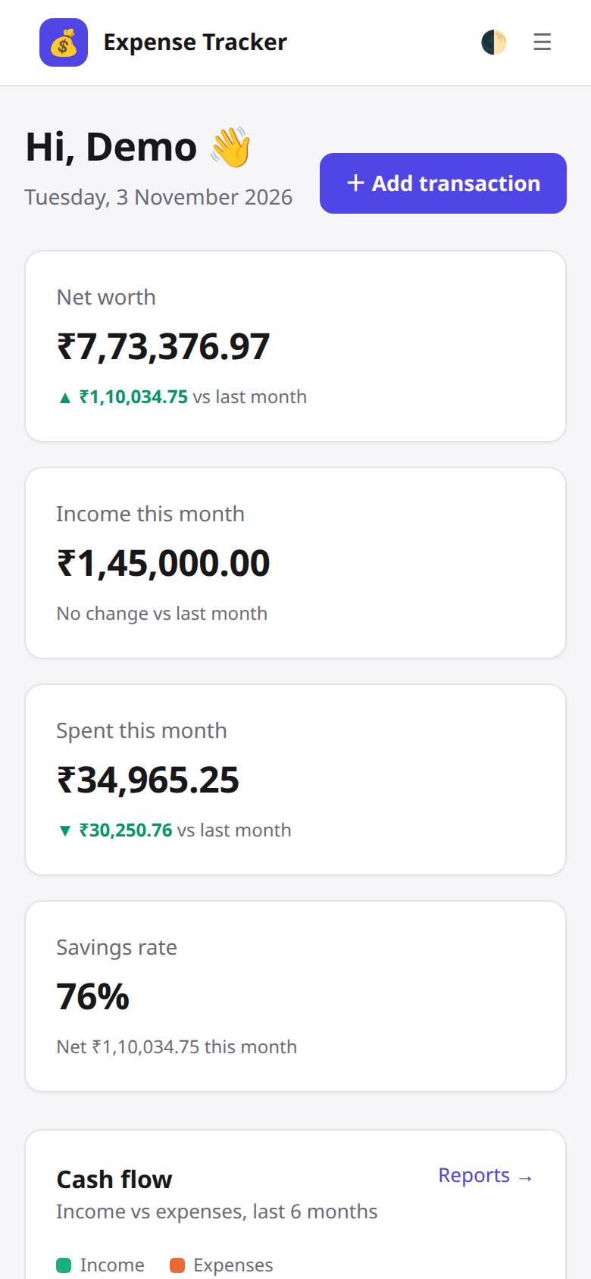
Responsive design & dark mode
Dark mode: one click in the sidebar; charts recolor automatically
Phone layout
Notes:
The interface is responsive. On a phone the sidebar becomes a menu button and the cards stack vertically, as you can see on the right. All colors are CSS variables, so switching to dark mode recolors the whole app, including the Chart.js charts.

Slide 14






Security measures
Password hashing
JWT authentication
Passwords are stored only as bcrypt hashes (12 rounds), never in plain text.
Signed tokens expire after 30 days; every API route checks the token.
Data isolation
SQL injection safe
Every SQL query is filtered by user_id, so users can only see their own data.
All queries use parameterized statements (?) via mysql2.
Input validation
Safe CSV export
Zod schemas validate every request body on the server.
Cells starting with = + - @ are escaped to block spreadsheet formula injection.
Notes:
Because this is financial data, security was a priority. Passwords are hashed with bcrypt. Logins produce a signed JWT that every API call must carry. Every query includes the user's id, so one user can never read another's data. We use parameterized queries to prevent SQL injection, validate all input on the server with Zod, and escape CSV exports so they can't inject formulas into Excel.

Slide 15
Test cases
Module | Test case | Expected result | Result
Authentication | Sign in with a wrong password | Error “Invalid email or password”; no token issued | ✓ Passed
Authentication | Call an API route without a token | 401 Unauthorized, “Please sign in” | ✓ Passed
Transactions | Add an expense of ₹450 to a bank account | Balance drops by ₹450; it appears in the list and charts | ✓ Passed
Transactions | Transfer between two accounts | One account decreases, the other increases; net worth unchanged | ✓ Passed
Budgets | Spend more than a category's limit | Progress bar turns red and shows the amount over | ✓ Passed
Recurring | Create a monthly rule starting 3 months ago | Three transactions are created, next date moves to next month | ✓ Passed
Validation | Submit an amount of 0 or an invalid email | Request rejected with a clear message | ✓ Passed
Run as an automated browser test (Puppeteer + Chrome) against the MySQL database; all cases passed.
Notes:
These are the main test cases, covering authentication, transactions, transfers, budgets, the recurring engine and input validation. We ran them as an automated browser test against the real MySQL database, and all of them passed. For example, a monthly rule that started three months ago created exactly three transactions, and reloading the page didn't create duplicates.

Slide 16






Future enhancements
Statement import
Mobile app
Reminders & alerts
Upload CSV or PDF statements and categorize automatically
React Native app sharing the same Express API
Email or push notifications for bills and budget limits
Multi-currency
Shared budgets
Smart insights
Accounts in different currencies with live exchange rates
Family or roommate groups with split expenses
Auto-categorization rules and AI spending tips
Notes:
There is plenty of room to extend the project: importing bank statements, a mobile app using the same API, reminders for bills, multi-currency support, shared family budgets and smarter automatic categorization.

Slide 17


Thank you
Questions?
A complete full-stack app: React UI, Express REST API, MySQL database
Covers the full money cycle: record, budget, automate, save, analyze
Secure by design: hashed passwords, JWT, per-user data isolation
Notes:
To conclude: we built a complete full-stack expense tracker with a React frontend, an Express REST API and a MySQL database, with Chart.js for analytics. It covers the whole money cycle, from recording transactions to budgeting, automating bills, saving for goals and analyzing trends, and it was designed with security in mind. Thank you. We're happy to take questions.

