Slide 1
Pricing Calculator
User Manual

Slide 2
Table of Contents
Contents | Purpose | Slide Number
Application Access | How to access Application | 3
Features / Operations / Activities | Create New Request 1.1 Calculate and Save 1.1.1 Navigation Home , Edit and Search Scree Search Old Request 2.1 Edit Old Request / Create New Version Calculate and Save | 4
Application landing Page | Create New Request Search Old Request | 5
Create New Request | Initiate a new request | 5
Search Old Request | Retrieve and view previously submitted requests | 5
Use Case - Lift and Shift your S/4 System | Generate Opportunity ID | 6- 7 - 8
Use Case - Lift and Shift your S/4 System | Calculate and Save | 9
Input Required for Work Package | Lift and Shift your S/4 System Upgrade and Migrate your older S/4 HANA Conversion and Migration of ECC | 10
Guideline for Inputs | Lift and Shift your S/4 System Upgrade and Migrate your older S/4 HANA Conversion and Migration of ECC | 11 -12
Base Line | Lift and Shift your S/4 System | 13
Base Line | Upgrade and Migrate your older S/4 HANA | 14
Base Line | Conversion and Migration of ECC | 15
Actions at Version Screen | Calculate , Reset and Home Page | 16 -17-18-19
Search Previous Requests / Versions | Search Old Request / Opportunity ID / Versions | 20-21-22
Edit / New Version | Edit Old Request / Create New Version | 23-24

Slide 3

Table of Content
BTP Application Launchpad / URL

Slide 4

Features / Operations / Activities
Selection of Choice
1. New Request
1.1 Work Package Selection
1.2 Calculation
1.3 Detail
2. Search Request
Search
2.1 Edit

Slide 5


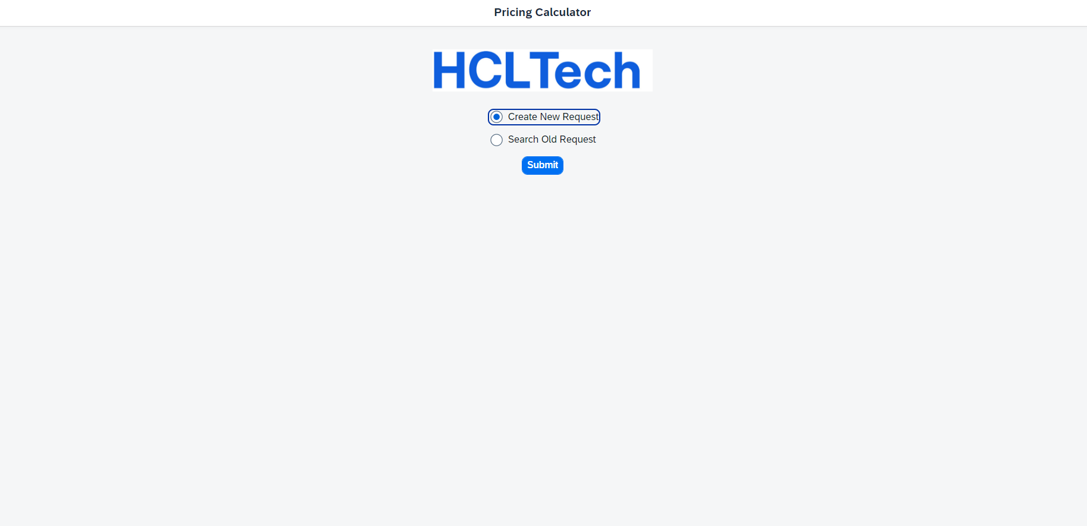
Selection of Choice
Landing Page
Steps
Open the Application using Tile or URL shared
Landing Page will be opened as welcome screen. Serves as the starting point for interaction with the platform.
Choose respective option / scenario below .
Create New Request: Select this option to initiate a new request.
Search Old Request: Use this feature to retrieve and view previously submitted requests.
Application Landing Page / Screen Image 1

Slide 6

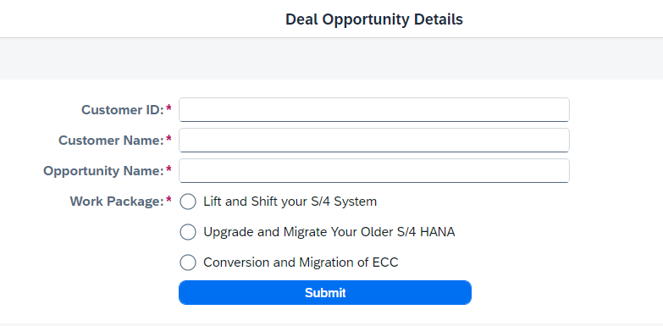
Selection of Choice
1. New Request
Generate Opportunity ID
Provide the mandatory information in the respective fields:
Customer ID: Enter the unique identifier for the customer. (Max length: 6)
Customer Name: Input the registered name of the customer.
Opportunity Name: Indicate the name associated with the opportunity.
Work Package:
Lift and Shift your S/4 HANA
Upgrade and Migrate your older S/4 HANA
Conversion and Migration of ECC
Application Page / Screen Image 2

Slide 7
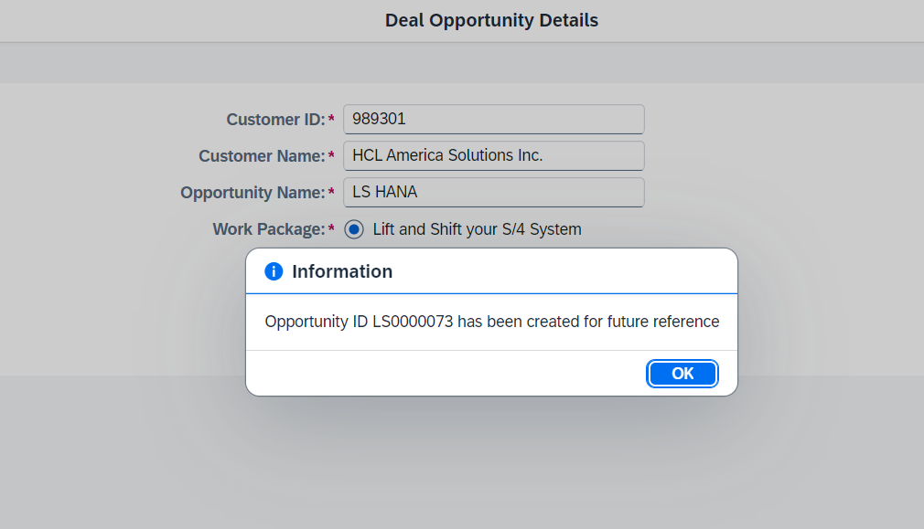
Selection of Choice
New Request
Package Selection
Lift and Shift your S/4 System
Opportunity ID
Once successfully submitted with all the inputs from user, a unique Opportunity ID will be generated. This Id will be used for future reference.
Please make a note of this ID for your records.
* Repeat same step for different Work Package.
Application Page / Screen Image 3

Slide 8
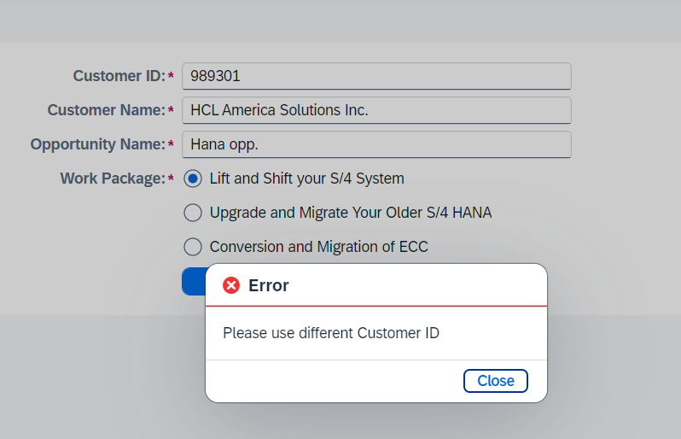
Selection of Choice
New Request
Package Selection
Lift and Shift your S/4 System
Opportunity ID
Users will receive an error message, if there is any duplicate details found in the system.
* Repeat same step for different Work Package.
Application Page / Screen Image 4

Slide 9
New Request
Calculation
Calculate and Save
Selection of Choice
Opportunity ID
Depending on the below work package choice, calculation inputs and screen parameters will be different.
Lift and Shift your S/4 System
Upgrade and Migrate your older S/4 HANA
Conversion and Migration of ECC

Slide 10
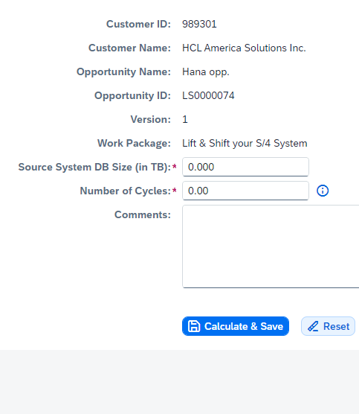
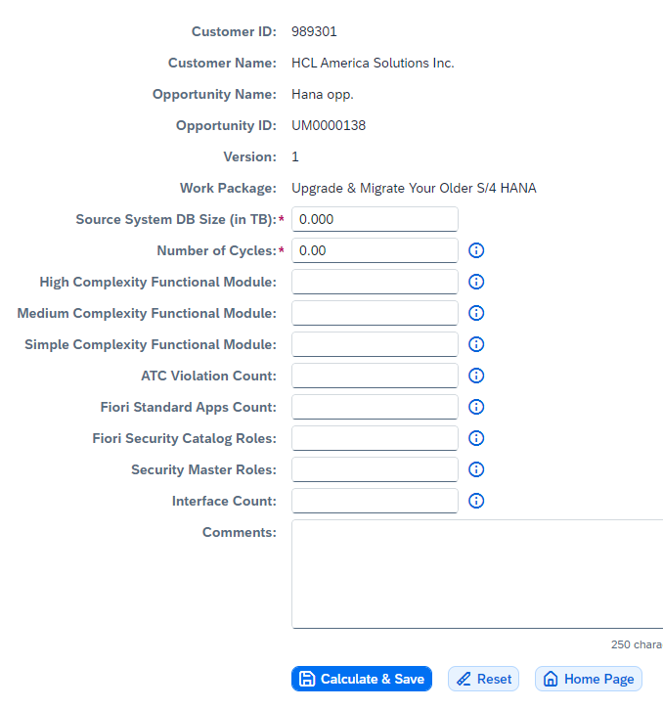
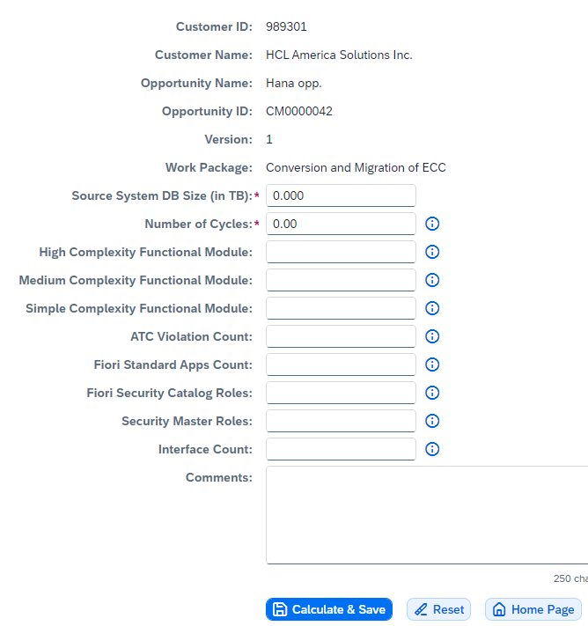
Selection of Choice
New Request
Opportunity ID
Calculation
Calculate and Save
Lift and Shift your S/4 System
Upgrade and Migrate your older S/4 HANA
Conversion and Migration of ECC
Application Page / Screen Image 5

Slide 11
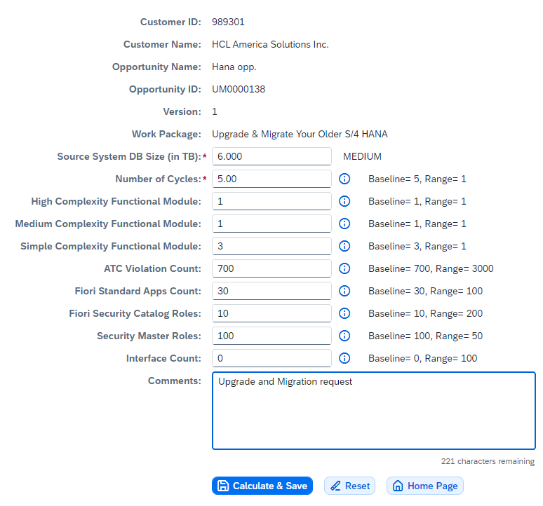
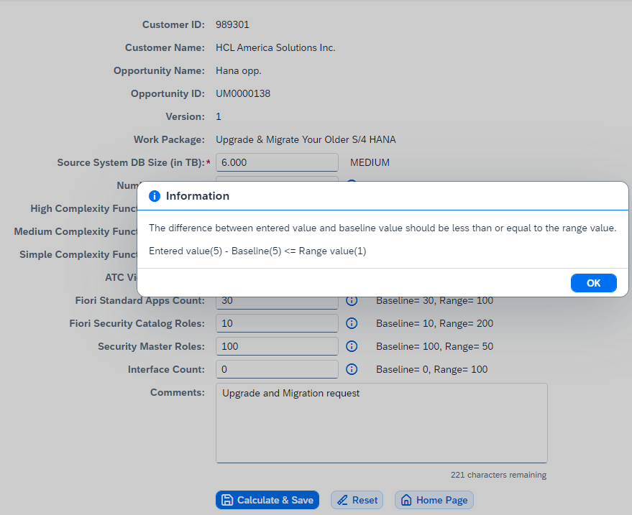
Selection of Choice
New Request
Opportunity ID
Calculation
Calculate and Save
Based on the Source System DB size input, the system will populate the base line and range value for each input field.
Users must follow those Base line and provide valid input.
On wrong input, input fields will show error, which will be gone once with valid data input.
Each field is equipped with an Information (i) Button adjacent to it.
Clicking on this button will provide guidance on the accepted values and formats for the respective field.
Utilize this feature to ensure that all the data entered confirms to the required standards.
Application Page / Screen Image 6

Slide 12
Selection of Choice
New Request
Opportunity ID
Calculation
Calculate and Save
Decimal Type (Up to 3 places)
Decimal Type (Up to 2 places)
Numeric Type Input
Alpha-Numeric Type Input ( Maximum length: 250 characters )
Application Page / Screen Image 7

Slide 13
Selection of Choice
New Request
Opportunity ID
Calculation
Calculate and Save
Base Line Reference for Lift and Shift your S/4 System
Source System DB Size (in TB) | SMALL (1-3) |  | MEDIUM (4-7) |  | LARGE (8-10)
 | Base Line Value | Range Value | Base Line Value | Range Value | Base Line Value | Range Value
Number of Cycles | 3 | 1 | 5 | 1 | 6 | 1
For all the scenarios, logic behind maximum and minimum input
The difference between entered value and baseline value should be less than or equal to the range value.
e.g. Entered value - Baseline <= Range value

Slide 14
Selection of Choice
New Request
Opportunity ID
Calculation
Calculate and Save
Base Line Reference for Upgrade and Migrate Your Older S/4 HANA
Source System DB Size (in TB) | SMALL (1-3) |  | MEDIUM (4-7) |  | LARGE (8-10)
 | Base Line Value | Range Value | Base Line Value | Range Value | Base Line Value | Range Value
Number of Cycles | 4 | 1 | 5 | 1 | 6 | 1
High Complexity Functional Module | 1 | 1 | 1 | 1 | 1 | 1
Medium Complexity Functional Module | 1 | 1 | 1 | 1 | 1 | 1
Simple Complexity Functional Module | 2 | 1 | 3 | 1 | 3 | 1
ATC Violation Count | 500 | 3000 | 700 | 3000 | 1000 | 3000
Fiori Standard Apps Count | 15 | 100 | 30 | 100 | 50 | 100
Fiori Security Catalog Roles | 5 | 200 | 10 | 200 | 15 | 200
Security Master Roles | 50 | 50 | 100 | 50 | 150 | 50
Interface Count | 0 | 100 | 0 | 100 | 0 | 100
For all the scenarios, logic behind maximum and minimum input
The difference between entered value and baseline value should be less than or equal to the range value.
e.g. Entered value - Baseline <= Range value

Slide 15
Selection of Choice
New Request
Opportunity ID
Calculation
Calculate and Save
Base Line Reference for Conversion and Migration of ECC
Source System DB Size (in TB) | SMALL (1-3) |  | MEDIUM (4-7) |  | LARGE (8-10)
 | Base Line Value | Range Value | Base Line Value | Range Value | Base Line Value | Range Value
Number of Cycles | 4 | 1 | 5 | 1 | 6 | 1
High Complexity Functional Module | 2 | 1 | 2 | 1 | 2 | 1
Medium Complexity Functional Module | 2 | 1 | 2 | 1 | 2 | 1
Simple Complexity Functional Module | 2 | 1 | 5 | 1 | 5 | 1
ATC Violation Count | 2000 | 3000 | 4000 | 3000 | 8000 | 3000
Fiori Standard Apps Count | 150 | 100 | 300 | 100 | 500 | 100
Fiori Security Catalog Roles | 10 | 200 | 20 | 200 | 30 | 200
Security Master Roles | 50 | 50 | 100 | 50 | 150 | 50
Interface Count | 0 | 100 | 0 | 100 | 0 | 100
For all the scenarios, logic behind maximum and minimum input – The difference between entered value and baseline value should be less than or equal to the range value.
e.g: Entered value - Baseline <= Range value

Slide 16
Selection of Choice
New Request
Opportunity ID
Actions
Actions at Version Screen
Application Page / Screen Image 11

Slide 17

Selection of Choice
New Request
Opportunity ID
Calculation
Actions
Finalizing and Managing Your Request Once you have completed all fields, you have the following options:
Calculate & Save: By clicking the Submit button, your inputs will be saved, and you will be directed to the Output Screen.
Reset: This option clears all current values, allowing you to start afresh.
Home Page: Select this to return to the main dashboard at any point in the process.
Please note that after submission, you retain the ability to edit your inputs at a later stage if necessary.

Slide 18
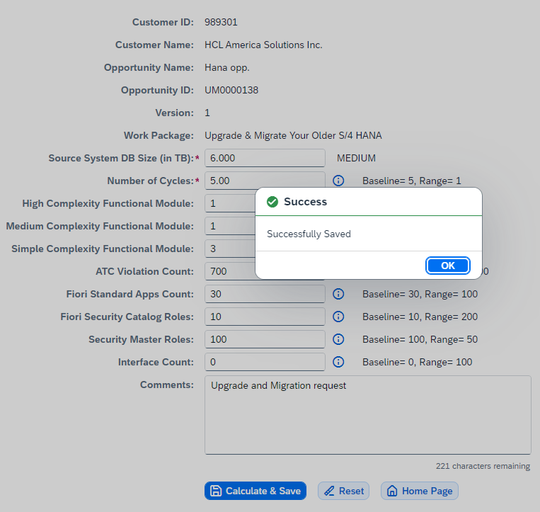
Selection of Choice
New Request
Opportunity ID
Calculation
Calculate and Save
Upon pressing the "Calculate and Save“
A save message will be displayed signifying successful entries in the system along with all the corresponding input values provided.
This entry is now available for subsequent processing and reference.
Application Page / Screen Image 8

Slide 19
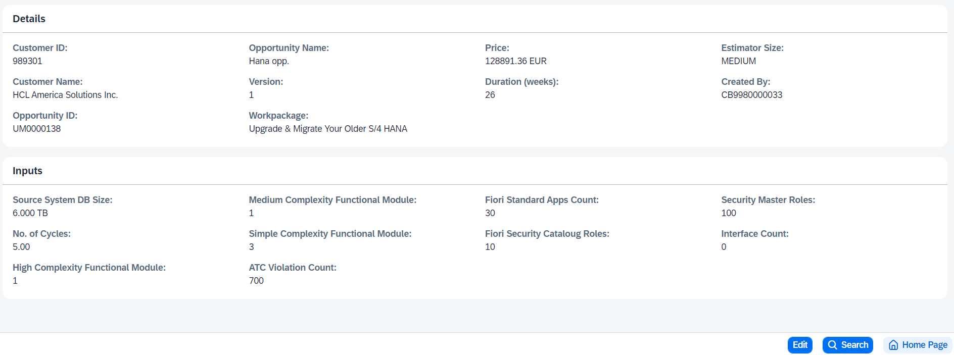
Selection of Choice
New Request
Opportunity ID
Version
Output / Result
Price and Duration
User can find all the details, that was provided and submitted to the system in the previous screen
Application Page / Screen Image 9

Slide 20
Selection of Choice
New Request
Opportunity ID
Search
Search Previous Version
Application Page / Screen Image 11

Slide 21
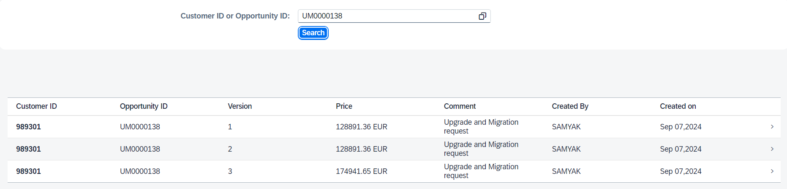
Selection of Choice
New Request
Opportunity ID
Search
Customer ID or Opportunity ID
Users can search their requests by providing customer Id or opportunity Id
Results all versions have been created so far.
2. Review a particular version in detail
Select the desired version from the list.
Directed to the Output Screen for the complete detail information view of that version.
Application Page / Screen Image 10

Slide 22
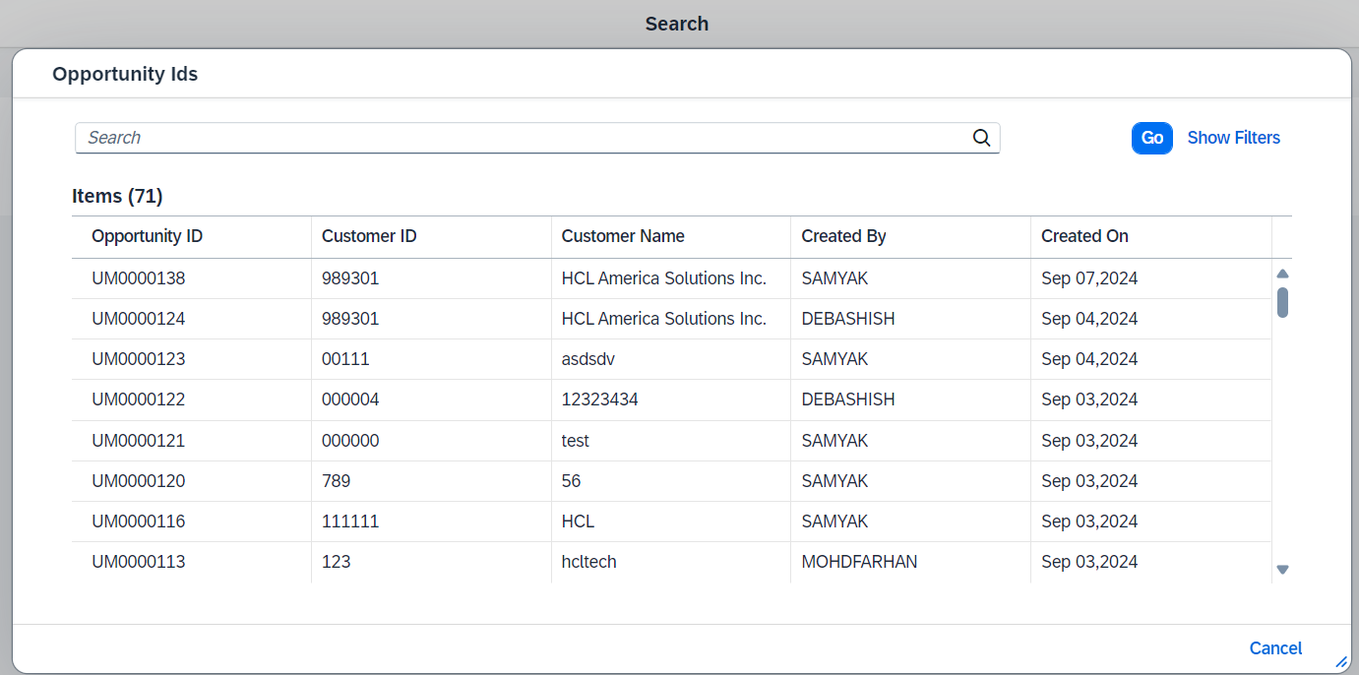
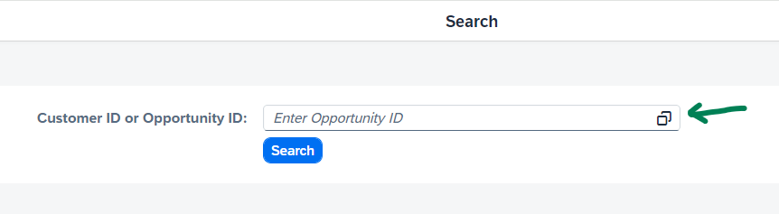
Selection of Choice
New Request
Opportunity ID
Search
Customer ID or Opportunity ID
Alternatively, by clicking on the F4 help button, a comprehensive list of all created requests will be displayed.
Application Page / Screen Image 11

Slide 23
Selection of Choice
New Request
Edit
EDIT / New Version Process
Application Page / Screen Image 11

Slide 24
Selection of Choice
New Request
Opportunity ID
Search
Customer ID or Opportunity ID
Edit
Provision to edit by creating new version.
Edit option has been provided in the detail page.
On edit click
Navigate to the calculate page with pre-filled existing data. User can modify those and submit.
By editing the existing record, a new version will be generated.
Application Page / Screen Image 11

Slide 25
THANK YOU

