Slide 1
IBM University Engagement Project Submission
“Exploring the Power of Agentic AI with IBM Granite and LangFlow”

Slide 2
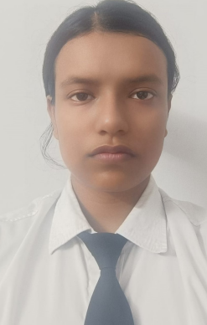
Project Tile – Fitness Buddy – AI Health Coach
Domain of Project – Artificial Intelligence (AI), Generative AI, and Health & Fitness Technology.
Student Name | Recent Passport Photo | Email ID | Mobile number [WhatsApp]
DEBASHREE MONDAL |  | debmon03kol@gmail.com | 6290643312

Slide 3
Problem Statement - No.13 - Fitness Buddy
The challenge - In today’s fast-paced world, many individuals struggle to maintain a healthy lifestyle due to lack of personalized guidance, time constraints, and inconsistent motivation. Traditional fitness solutions often require expensive subscriptions, in-person consultations, or rigid schedules that don't adapt to personal preferences or daily routines.
There is a growing need for an accessible, friendly, and intelligent virtual assistant that can provide on demand fitness advice, healthy lifestyle suggestions, and basic nutrition guidance—all tailored to individual needs and available at any time.
Fitness Buddy aims to solve this problem by offering a conversational, AI-powered health and fitness
coach that can:
Recommend home workouts and routines based on user input.
• Provide motivational tips and daily fitness inspiration.
• Suggest simple, nutritious meal ideas.
• Encourage habit-building and consistency.
Technology: Use of IBM cloud lite services /IBM Granity is mandatory.

Slide 4
Proposed Solution - Fitness Buddy – AI Health Coach
Fitness Buddy is a conversational AI-powered health and fitness coach built with Python (Flask) and IBM watsonx.ai (Granite model). It provides personalized fitness guidance through a clean chat interface accessible from any browser.
The backend uses IBM's ibm/granite-4-h-small model via the ibm-watsonx-ai SDK to generate tailored responses. A carefully crafted system prompt sets the coach's persona — warm, encouraging, and knowledgeable — while a rolling conversation history (last 6 turns) maintains context across the session.
Key capabilities of the solution:
• Home Workout Recommendations – Personalized routines based on fitness level, available time, and equipment
• Nutrition Guidance – Pre/post-workout meal ideas, macros, healthy eating tips
• Motivation & Inspiration – Daily tips, 7-day challenges, habit-building strategies
• Multi-turn Conversation – Context-aware replies using conversation history
• REST API – Clean /api/chat, /api/health, /api/suggestions endpoints
• Responsive UI – Dark-mode chat interface with quick-start suggestion chips
The frontend is built in vanilla HTML/CSS/JavaScript — lightweight and framework-free — communicating with the Flask backend over a REST API. IBM Granite powers all AI reasoning, personalization, and natural language generation.

Slide 5
Technology Used
IBM watsonx.ai – Cloud AI platform used to access and deploy IBM Granite models via the ibm-watsonx-ai Python SDK. Handles model inference, authentication, and scalable deployment on IBM Cloud Lite (free tier).
IBM Granite Model (ibm/granite-4-h-small) – The core AI engine that powers all natural language understanding, personalized fitness recommendations, nutrition guidance, and motivational responses.
Python (Flask 3.x) – Lightweight web framework serving the REST API backend. Handles /api/chat, /api/health, and /api/suggestions routes. Gunicorn is included as an optional production server.
Flask-CORS – Enables cross-origin requests between the frontend and backend.
Python-dotenv – Loads IBM API credentials and application configuration from a local .env file.
HTML / CSS / JavaScript (Vanilla) – Frontend chat interface. No framework required — dark-mode, responsive, with auto-resizing textarea and typing indicator.
GitHub – Version control and public repository hosting for project submission.

Slide 6
Components Used in Fitness Buddy –
1) Chat Input – The user types fitness questions, goals, or meal queries directly into the browser-based chat textarea. Supports multi-line input and keyboard shortcuts (Enter to send).
2) IBM watsonx.ai SDK (ibm-watsonx-ai) – Core component that authenticates with IBM Cloud using an API key, instantiates the ModelInference client, and sends the assembled prompt to the Granite model.
3) IBM Granite Model – ibm/granite-4-h-small – IBM Granite language model hosted through watsonx.ai. Generates conversational responses, fitness recommendations, nutrition suggestions and motivational guidance based on user input and system instructions.
4) Chat Output – The Flask /api/chat endpoint returns the AI reply as JSON. The frontend renders it as a chat bubble with a typing indicator animation before display.
5) System Prompt Component – A carefully crafted persona prompt that defines Fitness Buddy's role, tone, and boundaries (warm coach, no medical diagnoses). Prepended to every model call.
6) Conversation History – Rolling window of the last 6 turns sent with each request to give the model context awareness across a multi-turn session.

Slide 7
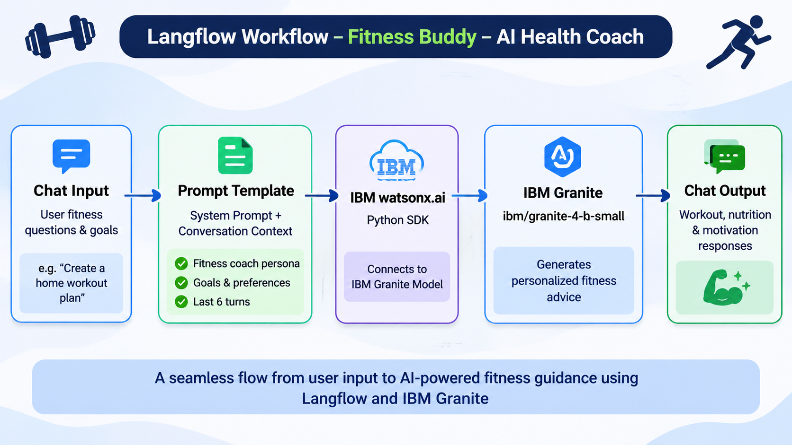
Langflow workflow -

Slide 8
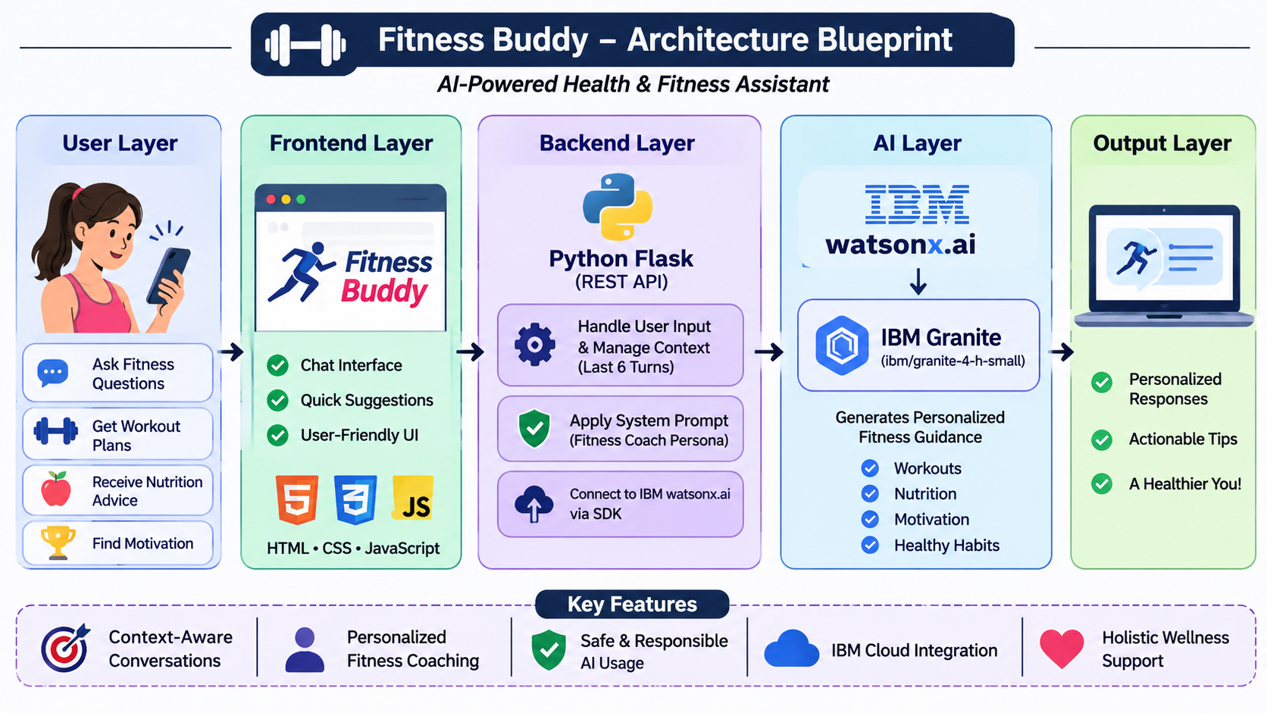
Architecture blueprint

Slide 9
Role of IBM Granite AI in Fitness Buddy
IBM Granite AI as the Fitness Coach Engine
Core Intelligence – IBM Granite (ibm/granite-4-h-small) acts as the conversational AI engine, generating fitness-related responses based on user queries.
Personalization – Uses information shared by users, such as fitness goals, activity levels, and dietary preferences, to provide relevant suggestions.
Context Awareness – The last six conversation turns are included in each API request to maintain conversational continuity.
Persona-Driven Coaching – A system prompt guides Granite to respond in a warm, friendly, encouraging, and supportive manner.
Multi-domain Assistance – Provides home workout recommendations, nutrition guidance, motivational tips, and healthy habit suggestions.
Dynamic Response Generation – Generates responses based on user input and conversation context instead of relying entirely on fixed responses.
IBM Cloud Integration – Uses IBM watsonx.ai and the IBM watsonx.ai Python SDK to access the Granite model.

Slide 10
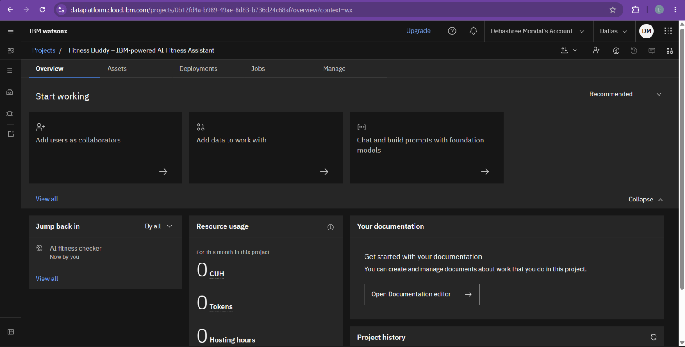
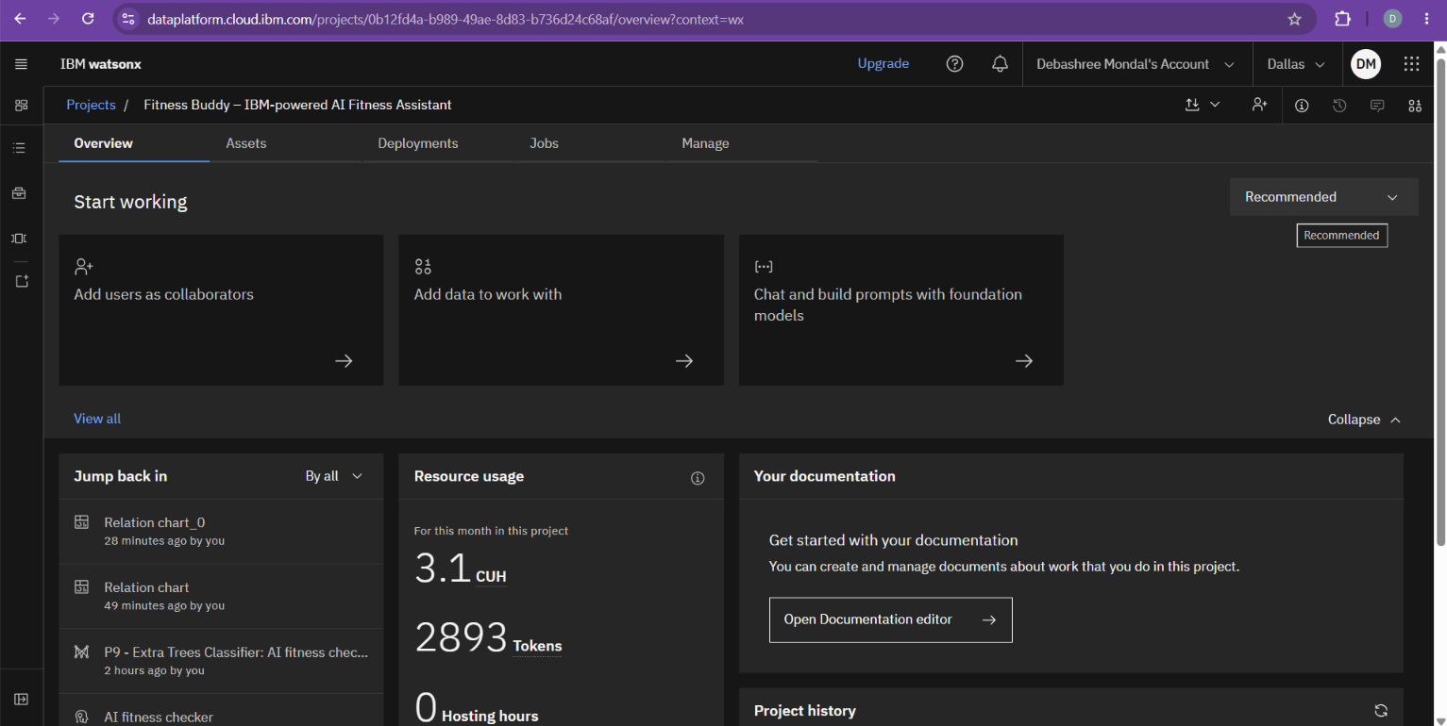
Token Usage
Only 2893 token are used for the project (as for practice I made different demo project)
Before Prompt
After the Prompt
·
·
·

Slide 11
Novelty and Uniqueness
The proposed Nutrition Agent stands out by combining Agentic AI, RAG, and personalization into a single intelligent system.
1. Conversational AI Coaching – Uses IBM Granite to provide interactive fitness guidance instead of relying only on static workout information.
2. Context-Based Personalization – Uses user-provided fitness goals, activity levels, available time, and dietary preferences to generate relevant suggestions.
3. Continuous Conversation Context – Maintains the last six conversation turns to provide more consistent and context-aware responses.
4. Multi-Domain Fitness Assistance – Combines home workout recommendations, nutrition guidance, motivation, and healthy habit-building in one application.
5. Persona-Driven Interaction – Uses a carefully designed system prompt to make responses friendly, encouraging, and supportive.
6. Lightweight Web-Based Solution – Uses Python Flask, HTML, CSS, and JavaScript to provide a simple browser-based interface without requiring a dedicated mobile application.
7. IBM Granite Integration – Uses IBM watsonx.ai and the IBM watsonx.ai Python SDK to generate AI-powered fitness recommendations and conversational responses.
Fitness Buddy transforms general fitness guidance into an interactive, accessible, and context-aware AI fitness coaching experience.

Slide 12
Git Hub Link
Please create public github repository (Enable Add README button while creating repository) with format –
Please test and Paste the working Github URL –
https://github.com/DebashreeMondal/AICTE-PROJECT
·
·
·

Slide 13
·
Future Scope
1.Integration with Wearables & Health Devices – The system can be integrated with smartwatches and fitness trackers to collect data such as daily steps, calories burned, heart rate, and sleep patterns. This will enable Fitness Buddy to provide more personalized workout and nutrition recommendations based on users' activity levels and fitness progress.
2.AI-Powered Voice Assistant & Multilingual Support – Future enhancements can include voice-based interaction and support for multiple languages. Users will be able to communicate naturally in their preferred language, improving accessibility and making Fitness Buddy more inclusive for people from diverse linguistic backgrounds.
3. Progress Tracking & Fitness Dashboard – A dashboard can be introduced to track workout consistency, daily activity, fitness goals, and progress over time.
4. Personalized Diet and Workout Planning – The system can be enhanced to generate structured weekly workout schedules and meal plans based on individual preferences, fitness levels, and available resources.
5. Mobile Application Development – A dedicated Android or iOS application can make Fitness Buddy more accessible and convenient for users.
·
·

Slide 14
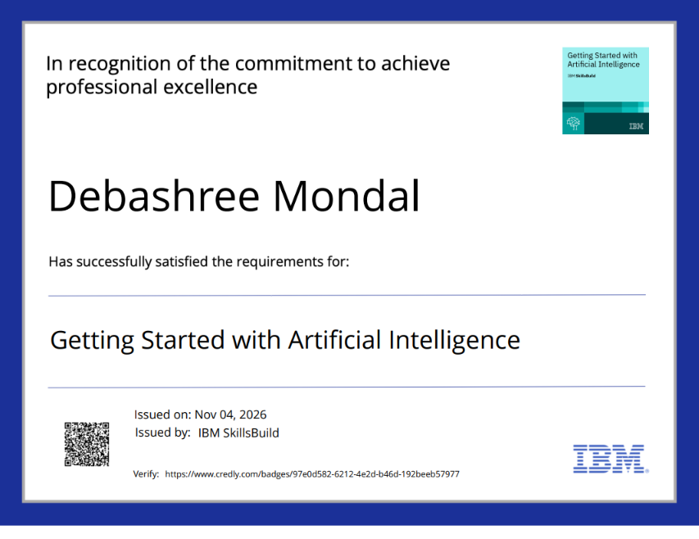
Certificates Earned:

Slide 15
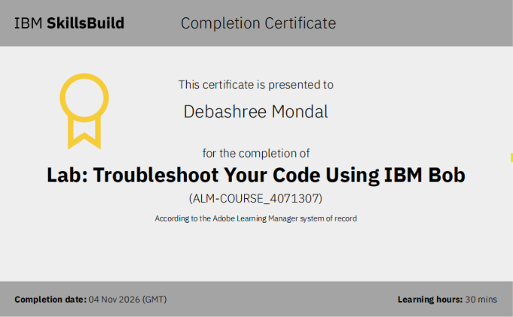
Certificates Earned:​

Slide 16


