Slide 1
BLOOD MANAGEMENT SYSTEM

Slide 2


Introduction
This project recommends that the system can be expanded by
allowing donors to register online and be a system user, and these donors will
be informed about the planned blood donation activities through the online
system. We will also be looking forward to linking hospitals and their
requirements and availability directly into our system.
Traditionally, blood management relied on manual record-keeping systems, which were often prone to errors, inefficiencies, and inconsistencies. However, the advent of Information Technology (IT) solutions, particularly Database Management Systems (DBMS), has revolutionized blood management practices. A DBMS offers a structured and centralized platform for storing, organizing, and managing vast amounts of blood-related data, streamlining operations, enhancing transparency, and improving patient safety.
This paper aims to explore the utilization of DBMS in blood management processes, highlighting its role in optimizing donor management, inventory control, transfusion tracking, quality assurance, and regulatory compliance. By providing a comprehensive overview of DBMS functionalities and their applications in blood management, this paper seeks to underscore the importance of IT solutions in modern healthcare settings and their potential to drive efficiency and innovation.The following sections will delve into the specific aspects of blood management that can benefit from DBMS implementation, including donor management, inventory control, transfusion tracking, quality assurance, and security measures. Each section will discuss the challenges associated with traditional blood management practices, the benefits of using a DBMS, and examples of successful implementation in real-world healthcare settings.

Slide 3


Problem Statements
Effective blood management is crucial for healthcare organizations to ensure
the availability of safe and adequate blood products for patient care. However,
traditional blood management practices often suffer from various inefficiencies
and challenges that can impact patient safety, operational efficiency, and
regulatory compliance.
The issues are as follows:-
Manual Record-Keeping
Limited Accessibility and Visibility
Data Analysis Challenges
Regulatory Compliance Issues
Security Risks
Inefficient Donor Management
Inventory Control Challenges
Transfusion Tracking Limitations

Slide 4
Proposed Solutions
To address the challenges faced in traditional blood management practices, the
proposed solution involves the implementation of a Database Management
System (DBMS) tailored specifically for blood management processes. The
DBMS will serve as a centralized, secure, and scalable platform for storing,
organizing, and managing blood-related data, offering numerous benefits over
traditional paper-based systems.
The steps involved are:-
Implementation of a Specialized DBMS
Comprehensive Data Management
Donor Management Module
Inventory Control Module
Transfusion Tracking Module
Quality Assurance and Compliance Module
Security Measures
User Training and Support

Slide 5


Explore Our Website:

Slide 6
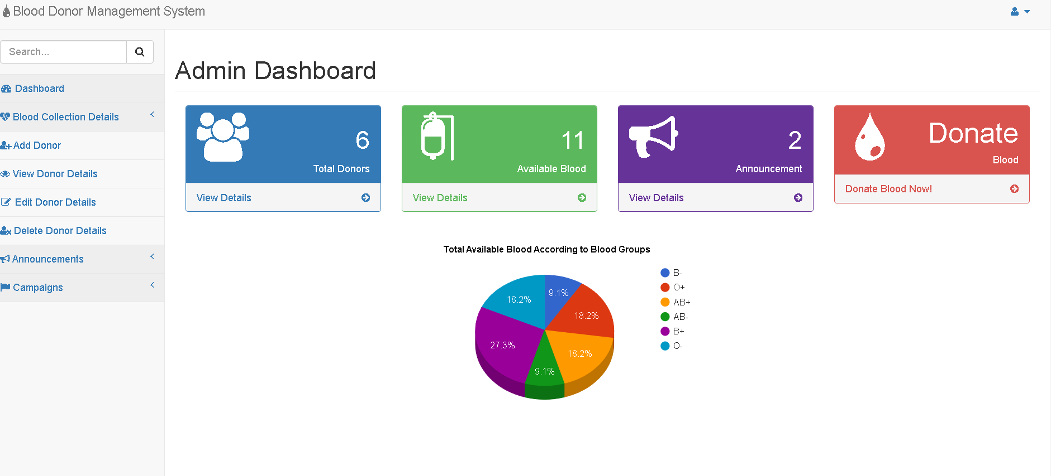
The Home Page

Slide 7

CONCLUSION
Based on results, We concluded that online blood bank management system is much better than the manual system. The findings showed that respondents prefer to use online blood bank management system rather than
the manual system because it offers many advantages and benefits that lead to its effectiveness, and efficiency.

Slide 8
FUTURE SCOPE
In view of the findings, we recommend that implementation of online blood bank management system with the help of DBMS. This project recommends that the system can be expanded by allowing donors to register online and be a system user, and these donors will be informed about the planned blood donation activities through the online system. We will also be looking forward to linking hospitals and their requirements and availability directly into our system. We also want to link this to whole system to the management grid of hospital chains and research chains for further help and growth.

Slide 9

Thanks!
Any lingering curiosities please mail us at the official mail of uppalroy127020027@gmail.com

