Slide 1
Project Organize
Organize your notes, schedules and study material which will save your time.

Slide 2
Objective:
In this mordern age we communicate a lot through the network known as Internet we download and upload many things
As we download many things to find the right material is very time taking.
This software organize all your study material documents, notes and all your study links.
It is also have a basic calculator and scheduler for smooth flow

Slide 3
Interface
It is having 5 compoents:
Study material organizer
Notes creator and organizer
Study Link organizer
Basic Calculator
Activity scheduler

Slide 4
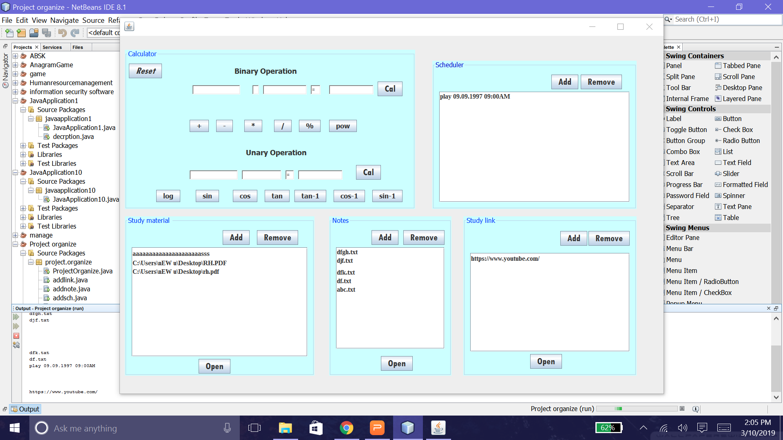
The whole Interface

Slide 5
Study material Organizer
It can store the links of the files
You can directly open the on clicking on open button
You can add or remove any file in the list
Advantages:
It save your file browsing time
Any type of file can be included

Slide 6
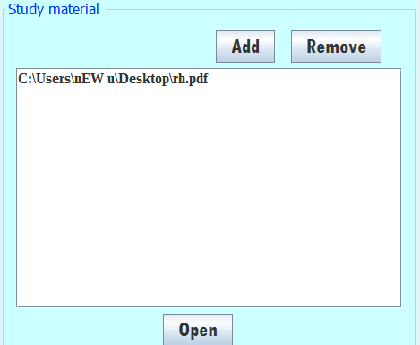
Study material Organizer

Slide 7
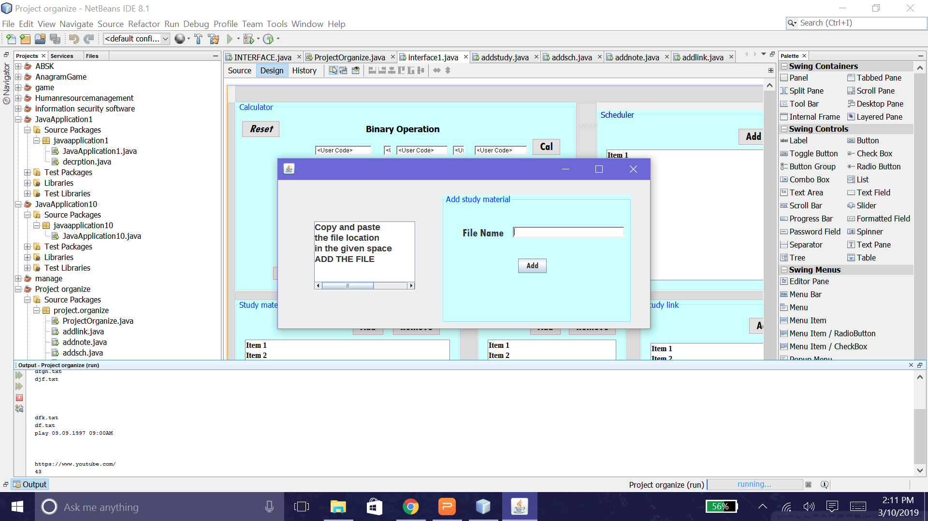
Study material Organize adding files

Slide 8
Notes Organizer
If you are reading something interesting and you want to note down something you like
Create a txt file and write the interesting thing you studied.
Advantages:
If you are not having pen and paper this is the best way to write notes.
No overload of storing and finding the note files

Slide 9
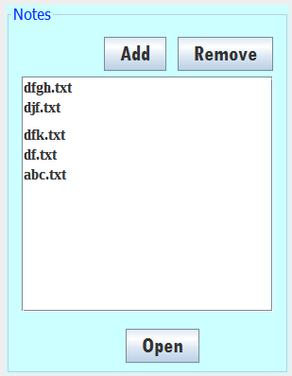
Notes Organizer

Slide 10
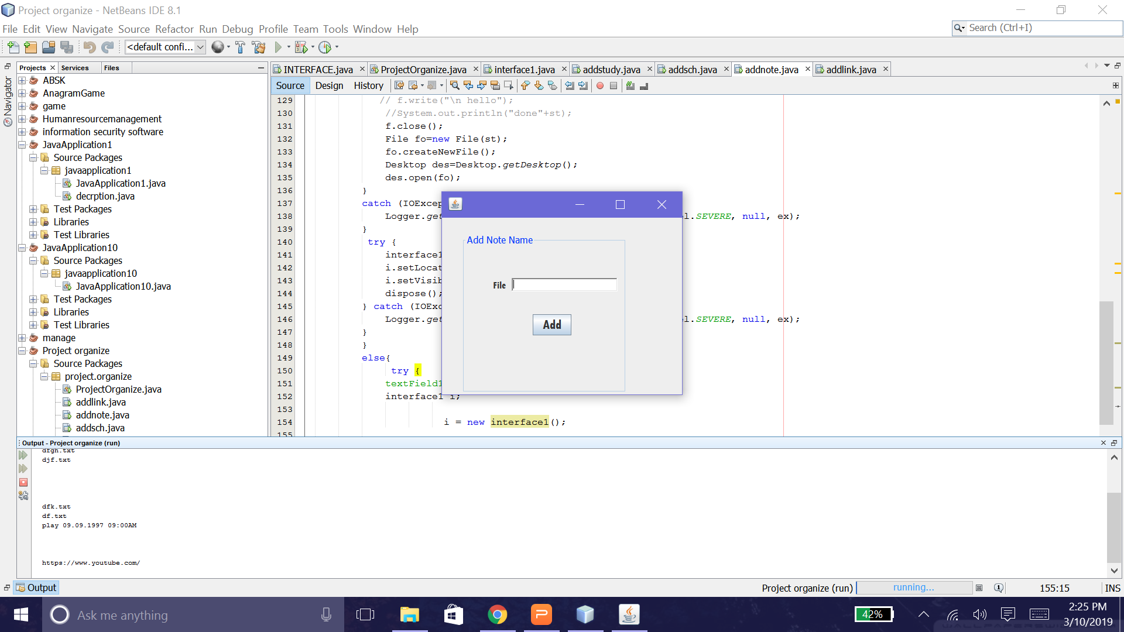
Notes Organizer adding file

Slide 11
Study Link organizer
You visit a fantastic website which have awesome content
Save the link in the study link organizer
Advantage:
Forget the website name directly open the link in your default browser
No time wasting in finding the website again

Slide 12
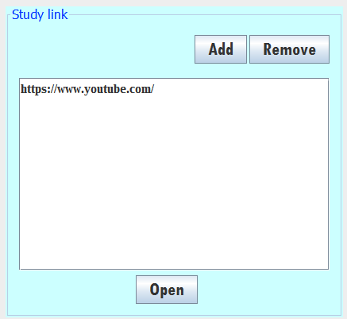
Study Link organizer

Slide 13
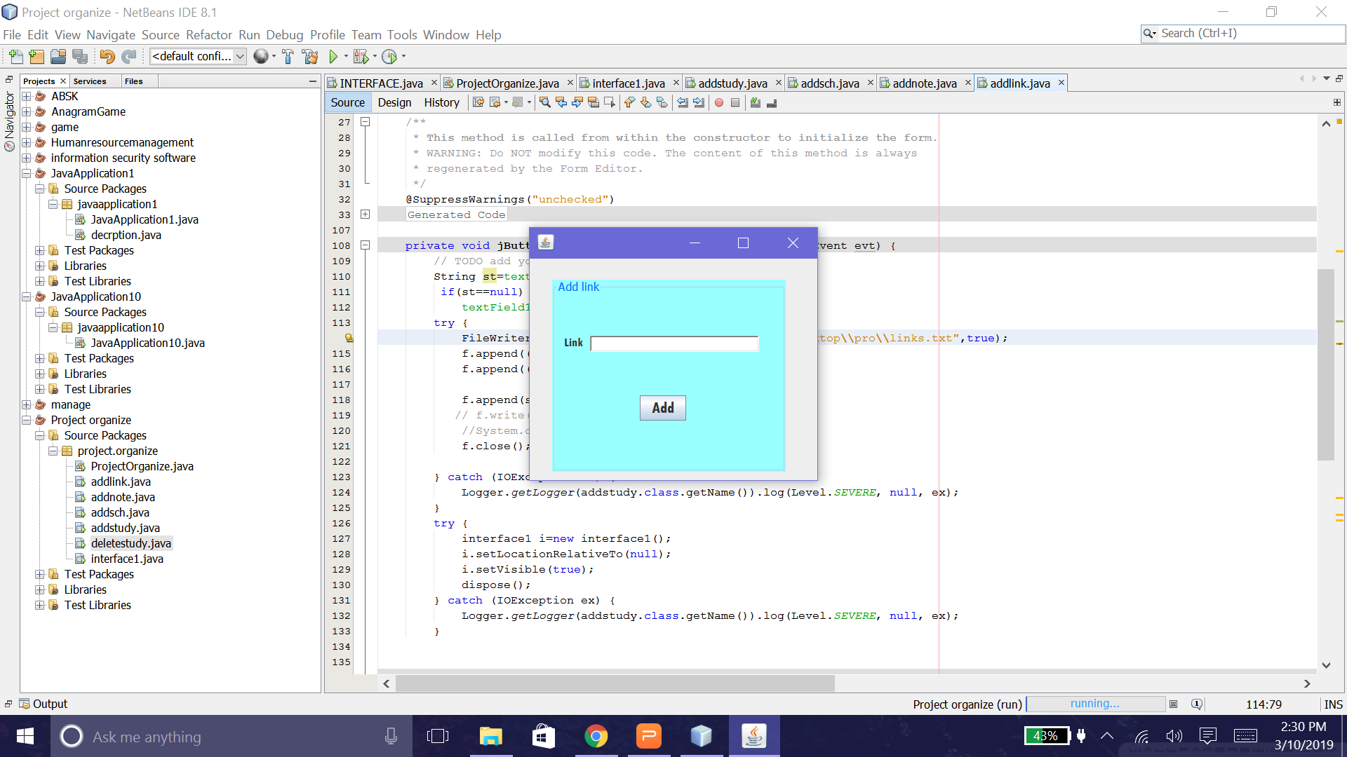
Study Link organizer adding website link

Slide 14
Basic Calculator
A basic calculator on which you can operate binary as well as unary operator
Binary operation from sum to power of two numbers
Unary operation from log to trignometry function
Advantage:
It will be really handy for quick calculation

Slide 15
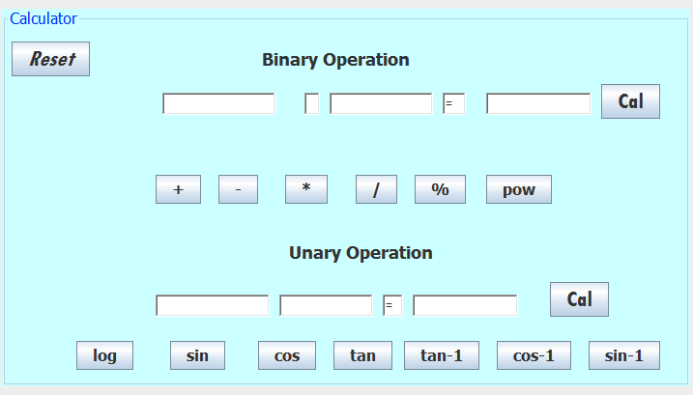
Basic Calculator

Slide 16
Activity scheduler
Really hard to remember the activities you had to do, activity scheduler can do it for you
Give the schedule title, date, time and add to the scheduler
Advantages:
You can yourself track your activities
Nothing to remember.

Slide 17
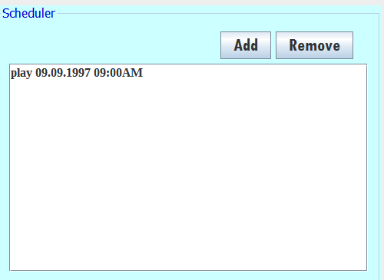
Activity scheduler

Slide 18
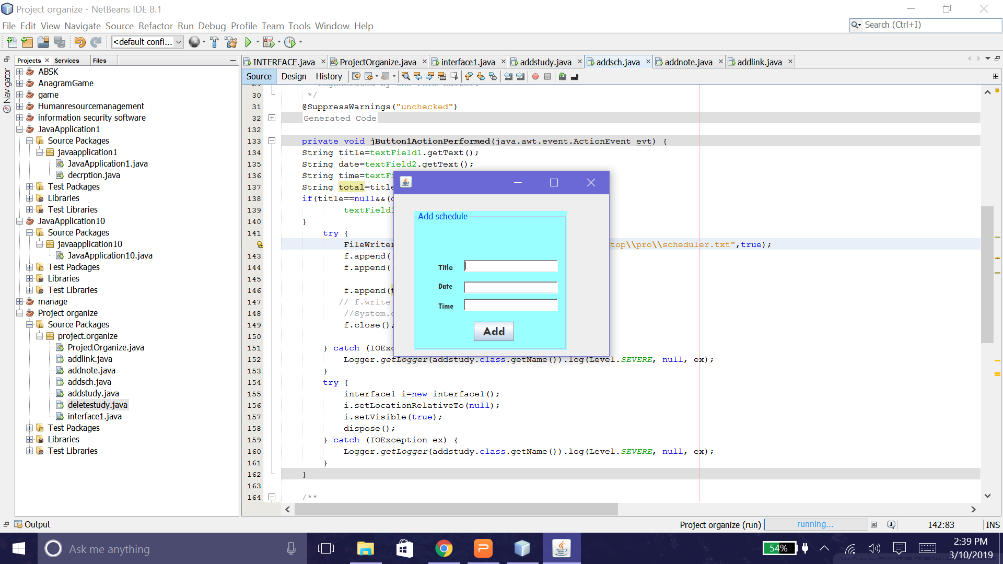
Activity scheduler adding schedule

