Slide 1
BY:
DEBASMITA SAHU (2320520037)
GAME APPLICATION
HANGMAN GAME

Slide 2
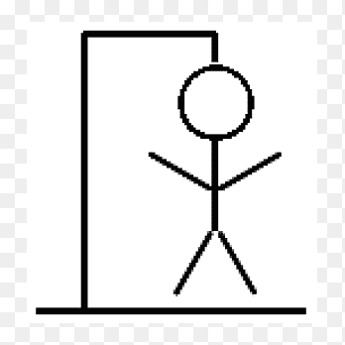
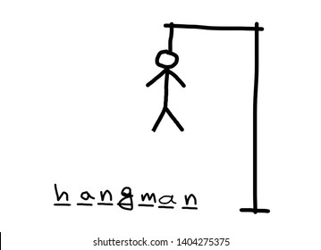
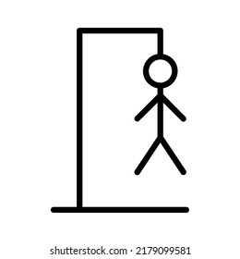
INTRODUCTION
It’s a simple hangman game.
The player has to guess the letter in the word. If you get a wrong word, a body part will be added to the hangman.
The player can view “How to play” by clicking on “How to play” button.
The hangman body will be displayed as an image.

Slide 3
MODULES
BUTTONS WHICH TIGGERS ON ACTION WHEN CLICKED : the buttons for “How to play” and 26 letters buttons.
DISPLAY A POP-UP MESSAGE : Basically, a message about wrong or right guess.
DISPLAY AN IMAGE : The hangman body will be an image.
PLAY A SOUND FILE : I will play a background music to let the player enjoy my app.

Slide 4
HOW TO PLAY
There will be an array which will have a collection of words and my app will choose one of those words by a random way.
Then, it will be shown on the screen like this( _ _ _ _ _ _ ) according to the number of letters in the word.
You (the player) has to guess the word, what will be ?
Then, you should enter any letter of the word, you have guessed and then click check.
If this letter is correct or if it is present at any position of the word, my app will display a pop-up message (GOOD GUESS !) and if it is wrong or the letter is not present in the word, it will display (BAD GUESS !).
If you enter 10 letters wrong, you will be dead means you will lose the game.

Slide 5
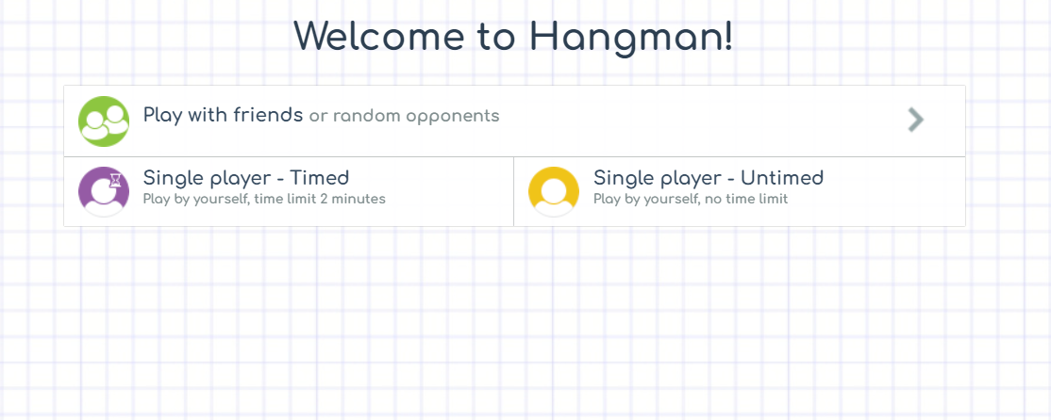

Slide 6
SCOPE OF THE PROJECT
The scope of this project is to polish our skills and for entertainment purpose.
After developing the proposed features, I will try to enhance some functionalities like
1. Saving the best score for each player (the count of word it guesses)
2. Add time to know how long the player take to guess the word.
3. Try to turn it into a beautiful interface.

Slide 7
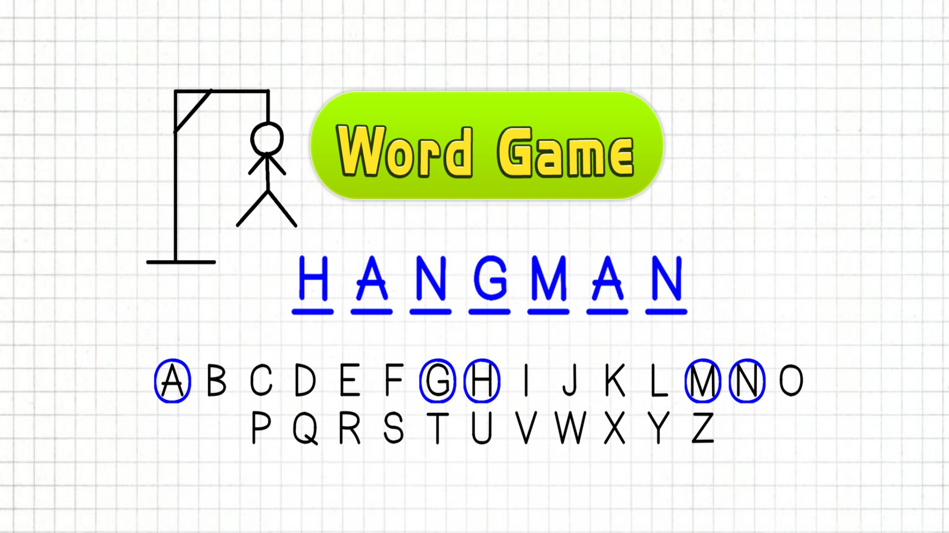
SAMPLE USER INTERFACE

Slide 8
THANK YOU !

