Slide 1



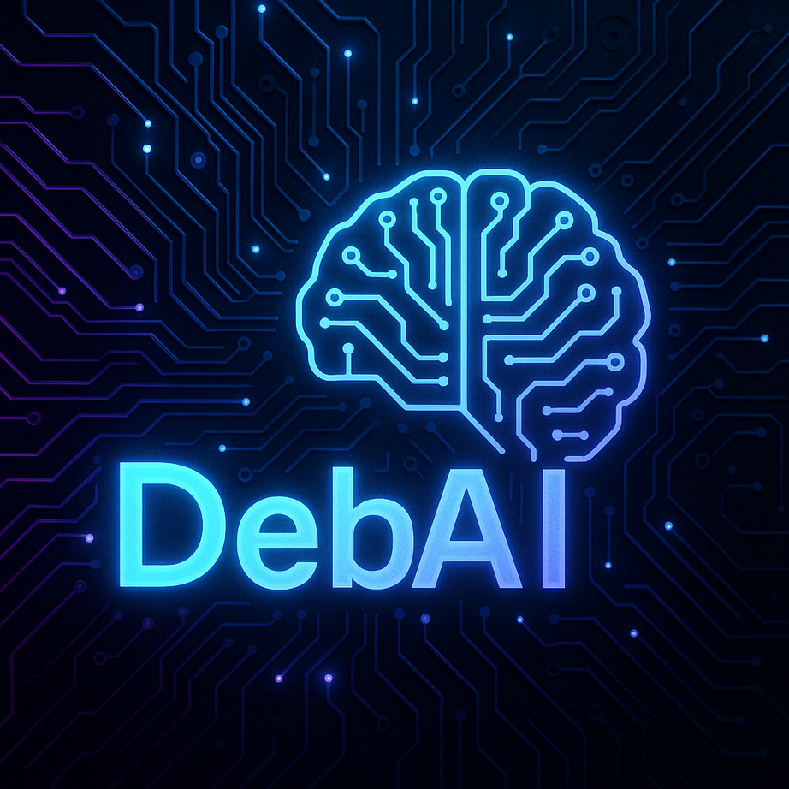
DebAI
💬 DebAI: Cyberpunk OCR + AI Chat Assistant
A futuristic application combining Image/PDF text extraction with conversational AI.
👩‍💻 Developed By: Debasmita Bose
🛠 Powered by: Streamlit • Ollama • Tesseract • pdfplumber
🔥Secure with Modern UI

Slide 2


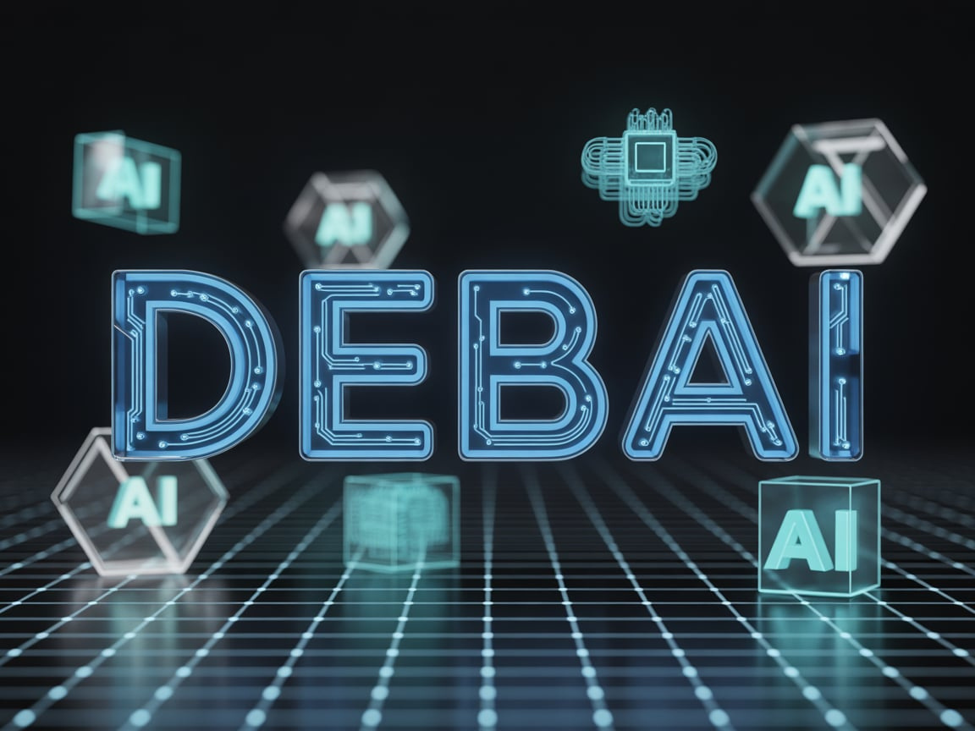
Table of Contents
Introduction & Motivation
Major Features
System Architecture
User Interface Experience
Installation , Deployment & Commands
A Video Demonstrating My Chatbot Function
Overall What We Got to See In DebAI
Conclusion & Future Enhancements
Thank You

Slide 3
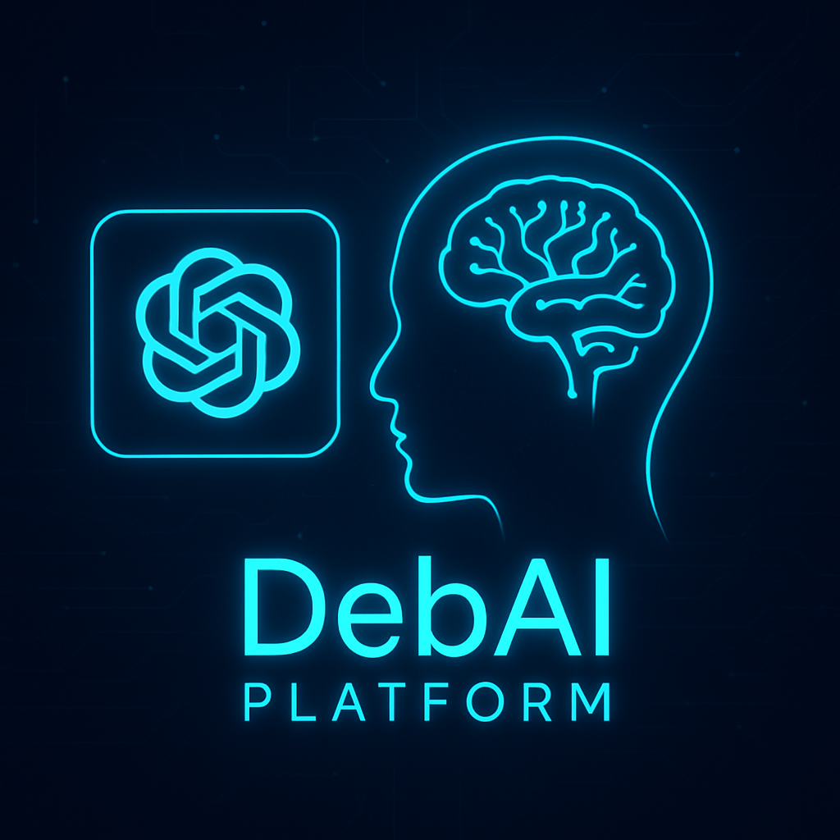
Introduction & Motivation
Digital documents & images often contain valuable text that is:
Hard to search
Hard to copy
Not machine-readable
DebAI solves this by:
✔ Converting real-world text → Digital text
✔ Automating response generation
✔ Supporting research, accessibility, and productivity

Slide 4

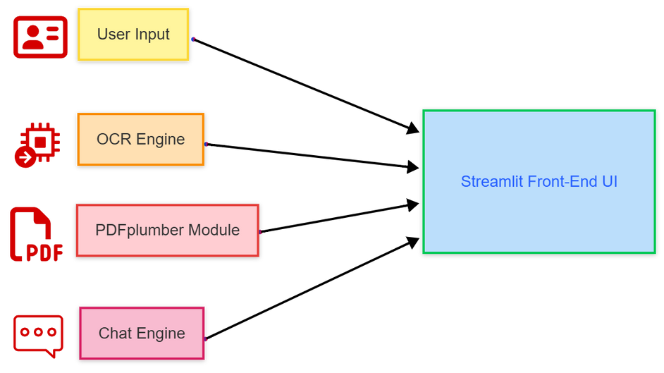
Major Features
Streamlit : Used to build the interactive user interface quickly without requiring advanced front-end development.
Tesseract OCR : Responsible for extracting text from images using powerful open-source OCR capabilities.
pdfplumber : Reads and extracts digital text directly from PDFs and automatically switches to OCR if the text is not selectable.
Pillow (PIL) : Handles image loading, processing, and display inside the application.
Ollama (Model: gemma3:1b) : Provides fully offline conversational AI intelligence, ensuring privacy and security for the user’s data.
Streamlit Session State : Manages chat history and OCR text persistence to ensure smooth interaction between multiple actions.

Slide 5

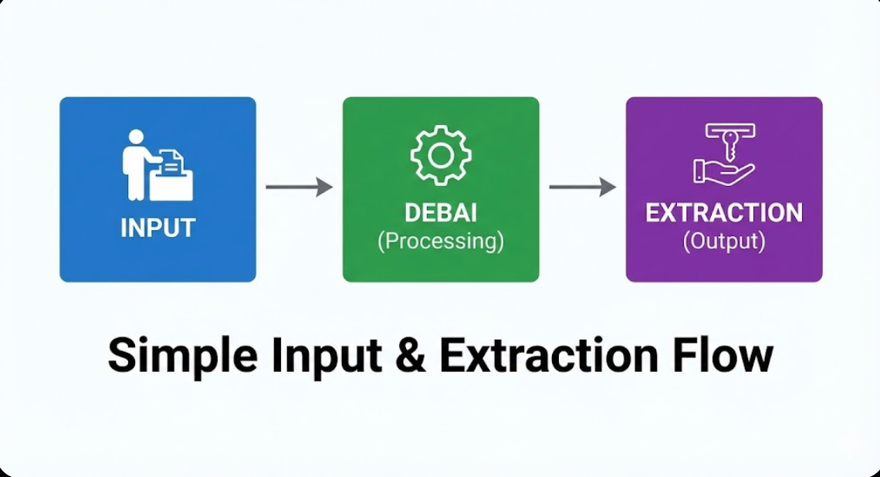
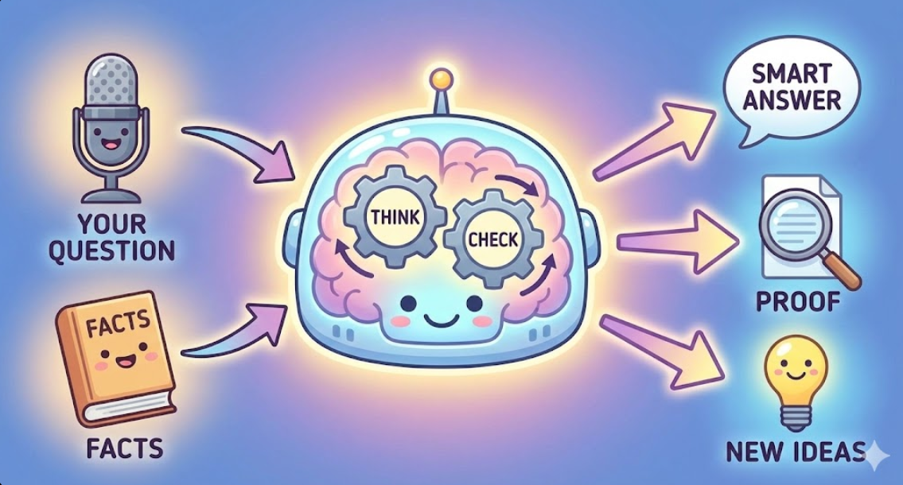
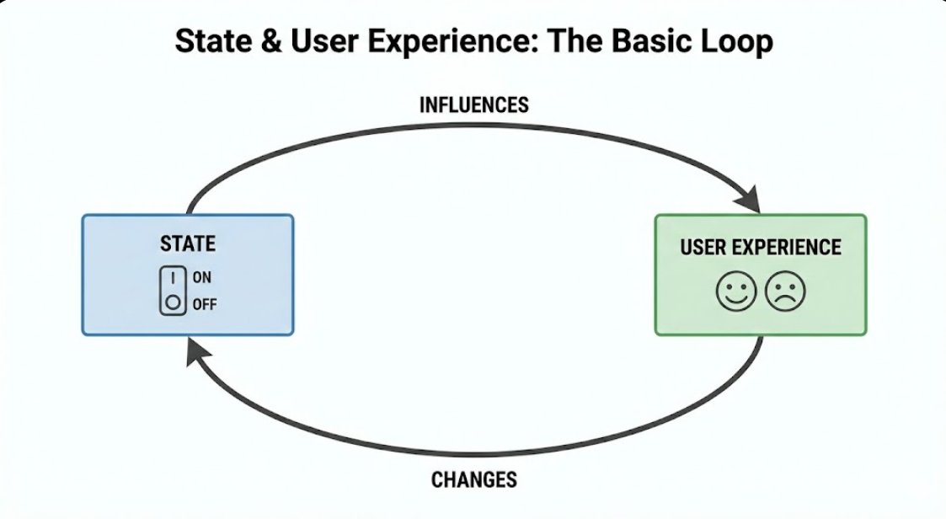
System Architecture
DebAI starts by allowing users to upload images or PDF files. It then extracts readable text using advanced OCR technology, ensuring that even text locked inside scanned documents becomes accessible and usable.
Once the text is extracted, DebAI forwards it into the chat context, where a local AI model intelligently processes the information. It generates real-time responses, enabling meaningful and interactive conversations based on the uploaded content.
DebAI maintains chat history and extracted content through session management, making the interaction smooth and continuous. The system ensures a seamless workflow even when users switch between OCR tasks and chat responses frequently.

Slide 6

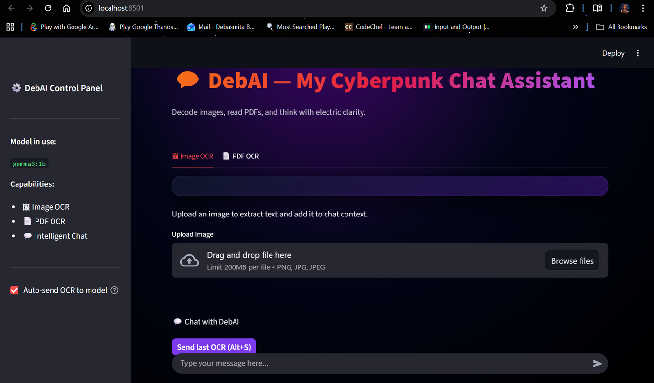
Modern Cyberpunk Theme -
The interface uses neon gradients, glowing card containers, and futuristic styling to create an immersive and attractive user experience.
User Interface Experience
01
Sidebar Control Panel -
All essential settings — such as model information and the auto-send OCR toggle — are placed in the sidebar for quick accessibility without interrupting workflow.
02
Smooth Chat Flow -
Messages appear in proper conversation order with the input box placed at the bottom, ensuring the chat feels natural and easy to follow.
03
Interactive Visual Feedback -
Dynamic elements like generating badges, real-time streaming responses, and visual success alerts help users understand the system’s state instantly.
04

Slide 7

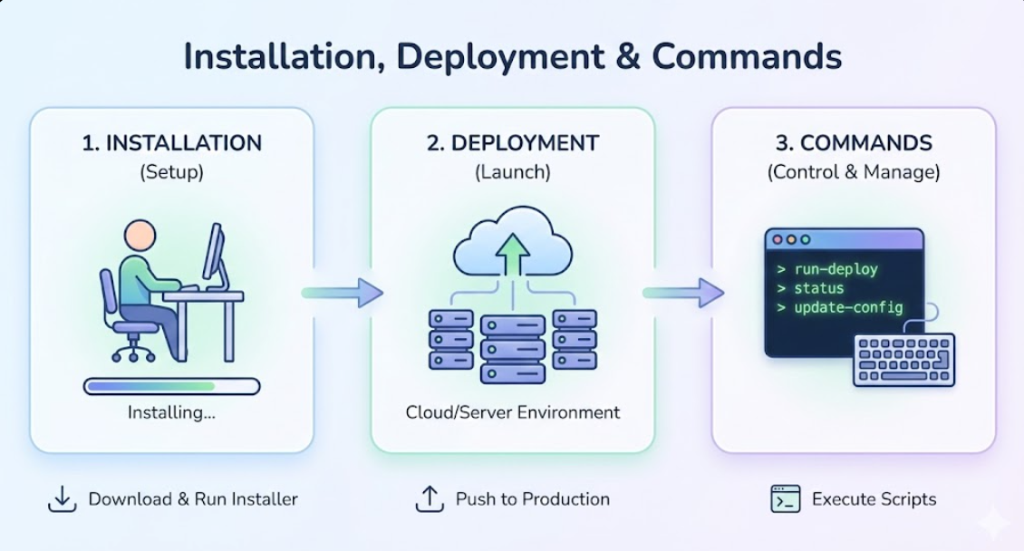
Installation, Deployment & Commands
To run DebAI successfully, users need Python 3.10 or above, along with the Tesseract OCR engine installed at the correct path, and optionally Ollama for local AI inference. Essential dependencies such as Streamlit, Pillow, pytesseract, and pdfplumber must be installed via pip.
Once setup is complete, the application can be launched simply through the command streamlit run AI.py. The system operates fully offline, making it ideal for secure and private data environments where cloud-based OCR or AI services are not permitted.

Slide 8
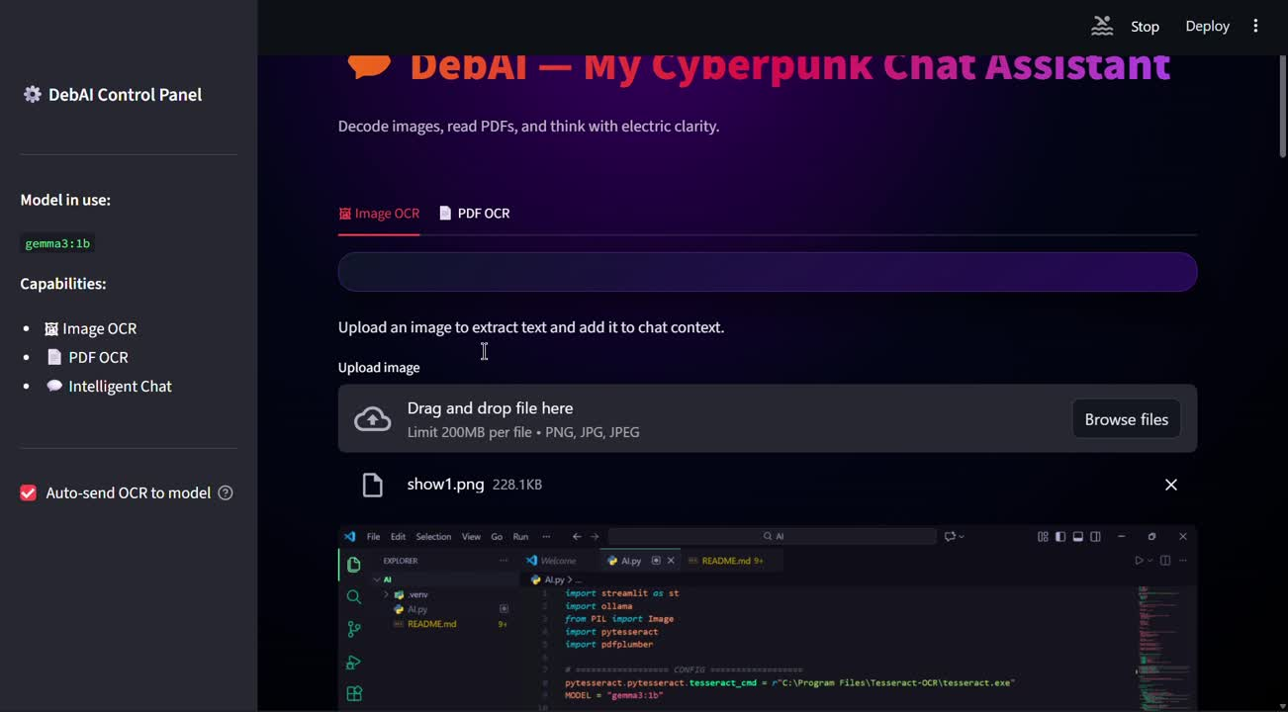
A Video Demonstrating My Chatbot Function

Slide 9

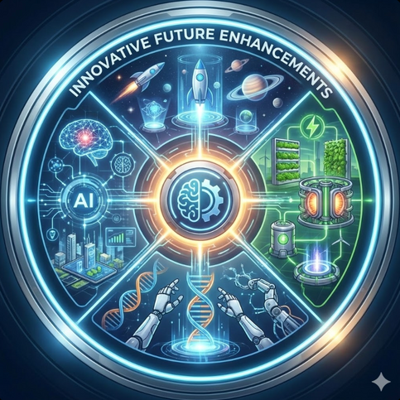
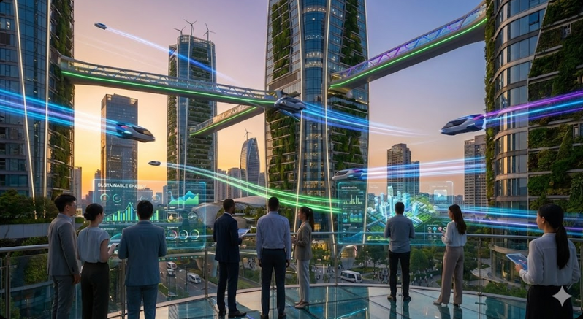
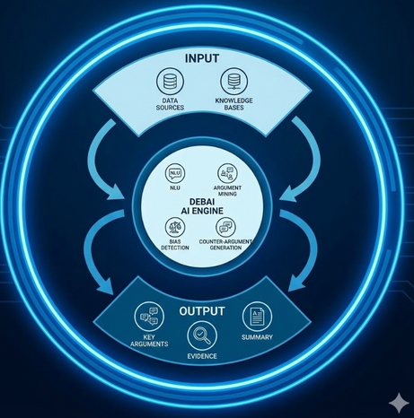
Overall What We Got To See In DebAI
DebAI is a futuristic AI assistant that intelligently extracts, understands, and interacts with text from images and PDFs through a secure offline interface.
Innovative Future Enhancements
Futuristic
Vision
Intelligent
Capabilities
Smart System Architecture

Slide 10




Conclusion & Future Enhancements
DebAI successfully merges OCR technology with conversational AI to create a powerful, user-friendly tool for smarter document understanding.
Secure & Offline Advantage -
Since DebAI runs completely offline with local AI processing, it ensures data privacy and protects confidential content without depending on cloud servers.
Improved Interaction & Usability -
Cyberpunk-themed interface and real-time streaming responses deliver a smooth and engaging user experience, making the tool enjoyable as well as efficient.
Document Accessibility -
By converting images and scanned PDFs into editable and searchable text, DebAI makes information easier to access, analyze, and reuse across different applications.
Vision for Future Development -
The system aims to grow further with features like multilingual OCR, voice-based interaction, automatic summarization, model switching, and expanded AI capabilities.

Slide 11


Thank You
Boost your results with DebAI.
Thank You for Joining the Future with DebAI ⚡
Feel free to ask anything — I’m ready to decode your curiosity! 💬🤖

