Slide 1

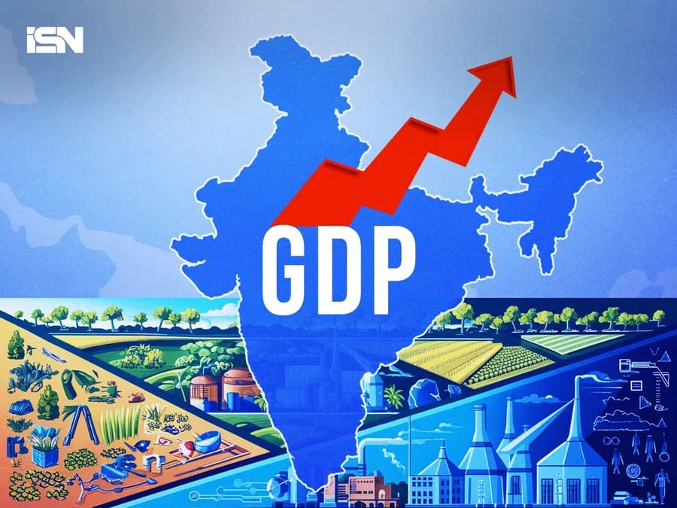
  Presented by DataDesh
  Resilience and Reform:
  India’s 60-Year Economic Journey
Members-
Debasmita Praharaj (Team Leader/Presenter)
Goldy Pattanayak (Data Developer)
Mitali Madhusmita (Data Analyst)
Sanchita Panda (Researcher)
  Abhijeet Barik (Visualiser)

Slide 2
Objective:
  1991- LPG Reforms
  2008-Global financial crisis & India's response
  2016-Demonetization & digital economy push
  2017-GST Implementation
  2020-COVID-19 Pandemic & Atmanirbhar Bharat comparison of India's GDP with China

Slide 3
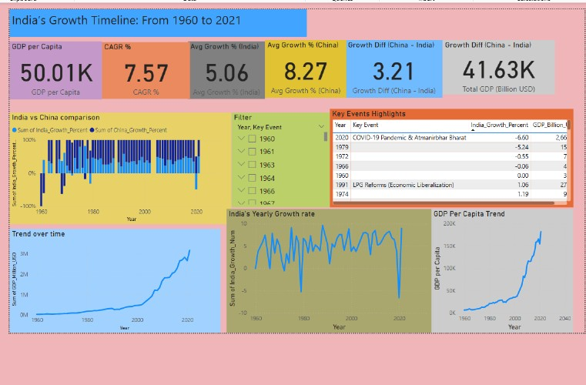
  Key Highlights (KPI Cards)
  GDP per Capita: ₹50.01K
  CAGR: 7.57%
  Avg Growth (India): 5.06% | China: 8.27%
  Growth Gap: 3.21%
India’s steady long-term expansion shows resilience, supported by diversification in services and digital innovation.

Slide 4
  Long-Term Trend (1960–2021)
  GDP grew steadily till 1991, then surged post-liberalization.
  Dips in 2008 (global crisis) and 2020 (COVID-19) show external impacts.
  Despite shocks, India rebounded quickly, driven by strong domestic demand.

Slide 5
  Key Economic Events
Year | Event | Impact
1991 | LPG Reforms | Market liberalization, FDI inflow
2008 | Global Financial Crisis | Temporary slowdown
2016 | Demonetization | Push for digital economy
2017 | GST Launch | Simplified tax regime
2020 | COVID-19 & Atmanirbhar Bharat | Economic resilience efforts

Slide 6
  India vs China
  China outpaced India post-1980s via industrialization.
  India caught up through IT & service-led growth post-2000s.
Gap narrowing as India focuses on innovation, digital infrastructure, and global services.

Slide 7
  GDP per Capita & Growth Rate
  GDP per capita shows strong post-2010 acceleration.
  Growth rate fluctuates but trends upward long-term.
Improved living standards and productivity gains reflect inclusive development.

Slide 8
  Conclusion & Insights
  India evolved from an agrarian to a diversified economy.
  Crises triggered reforms and adaptability.
  Story of resilience, reform, and reinvention.
Data visualization via Power BI brings six decades of growth into clear perspective.

Slide 9

  Thank you very much!

