Slide 1
CUSTOMERS
LIKE YOU
Product recommendations & customer segmentation
UCI Online Retail II | Truncated SVD with PCA comparison
Project results from the local notebook environment
Notes:
Introduce the project and explain that results are from the current local notebook run.

Slide 2
01 | Problem & data
Two business questions, one transaction history
PRODUCT DISCOVERY
CUSTOMER GROUPS
Can purchase patterns suggest products beyond a global best-seller list?
Can similar purchase patterns reveal useful groups for merchandising?
1,067,371
802,965
2 sheets
raw transaction rows
rows after cleaning
2009–10 and 2010–11
Cleaning removed cancellations, invalid quantities/prices, missing customer IDs, specified non-product codes, and invalid dates. Duplicate rows were identified but not removed.
CUSTOMERS LIKE YOU • 02
Notes:
Both workbook sheets were combined. Duplicate rows were identified in profiling but not removed.

Slide 3
02 | From transactions to a sparse matrix
Chronological holdout tests recommendations on later purchases
TRAIN
TEST
EVALUATION
684,357 rows
Through 9 Oct 2011, 12:49
118,608 rows
From 9 Oct 2011, 12:50
1,913 eligible customers
44,729 held-out pairs
TRAINING-ONLY CUSTOMER × PRODUCT MATRIX
5,484
4,537
417,809
98.32%
customers
products
nonzero entries
sparsity
MEMORY
LEAKAGE CONTROL
Dense estimate: 189.83 MB | Sparse estimate: 4.88 MB
Product filtering and matrix fitting use training data only.
CUSTOMERS LIKE YOU • 03
Notes:
The matrix is based on training data. Eligible held-out products must be in the training catalogue and not previously purchased by that customer.

Slide 4
03 | Why Truncated SVD?
Represent sparse purchase behavior with compact latent factors
TRUNCATED SVD — PRIMARY
PCA — COMPARISON
• Works directly on sparse, uncentered matrix
• Compresses customer–product patterns
• Product factors support cosine similarity
• Fitted with 50 components
• Cumulative explained variance: 34.8584%
• Fit time: approximately 0.31 seconds
Interpretation note
PCA explained variance and the SVD energy-based reconstruction-error estimate are different metrics; they should not be compared as if they were the same measure.
CUSTOMERS LIKE YOU • 04
Notes:
PCA explained variance and SVD's energy-based reconstruction error are not directly equivalent quality metrics.

Slide 5
04 | Component-count experiment
More retained components reduce the estimated reconstruction error
0.90
0.877
0.846
AT k = 50
0.790
Approx. error: 0.7905
Estimated factor storage: 3.82 MB
Fit time: 0.30 seconds
0.80
0.729
0.70
0.641
Error is estimated from retained singular-value energy, not a full explicit matrix reconstruction.
0.60
10
20
50
100
200
Components (k)
CUSTOMERS LIKE YOU • 05
Notes:
The estimated relative reconstruction error falls from about 0.877 at 10 components to about 0.641 at 200.

Slide 6
05 | Recommendation results
SVD outperformed the popularity baseline in the historical holdout
+2.93 pp
SVD model
20.33%
absolute Hit Rate@10 lift
+16.8%
Best-seller baseline
17.41%
relative improvement
1,913 eligible customers | Scoring time: 28.97 seconds
Hit Rate@10 = share of customers with at least one eligible held-out product in their top 10 recommendations.
CUSTOMERS LIKE YOU • 06
Notes:
This is historical offline evidence, not proof of business lift.

Slide 7
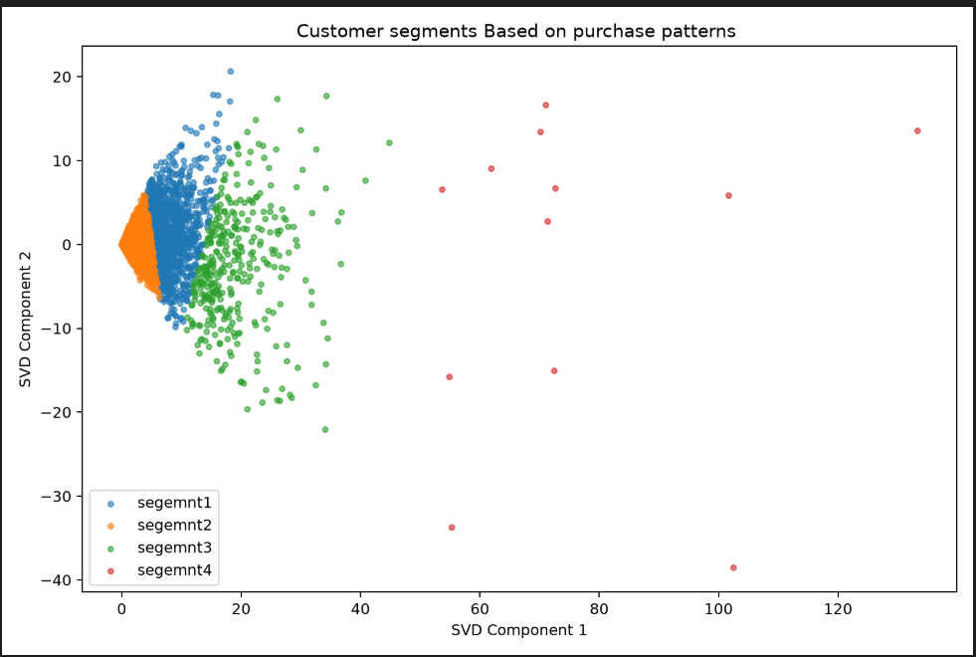
06 | Customer segments
Four KMeans groups in a two-component SVD projection
Segment 1
Segment 2
1,114 customers
Leading products: 84077, 85123A, 85099B
4,005 customers
Largest group; products include 23366, 37410, 16014
Segment 3
Segment 4
353 customers
Products include 21212, 85099B, 84077
12 customers
Very small group; interpret cautiously
ACTUAL SVD CUSTOMER PROJECTION
Customer segment figure: customer_segments.png. Country summaries are available in the notebook. No customer IDs are shown here.
CUSTOMERS LIKE YOU • 07
Notes:
Segment 4 contains only 12 customers and should not be generalized.

Slide 8
07 | TAKEAWAYS & NEXT STEPS
Promising offline signal.
Not yet a proven business outcome.
1. Pilot
2. Measure
3. Review
Compare SVD recommendations with the best-seller baseline.
Track clicks, conversion, revenue per session, and product coverage.
Reassess the small segment and refresh the model as behavior changes.
Validate commercial impact in a controlled pilot before broad deployment.
CUSTOMERS LIKE YOU • 08
Notes:
SVD showed a higher historical Hit Rate@10 than baseline, but commercial value remains unproven.

