Slide 1

Project Report
on
California Housing Price Prediction
Submitted by
Debatri Roy
PGP DS MAR 2021 cohort 1

Slide 2
Contents
Business Scenario…………...……………………………………………………..3
Objectives……..…………………………………………………………………….…4
Data Availability………………………………………………………………….....5
Data Exploration / Data Mining………………………………………………6
Additional Data Fields Introduced…………………………………………..7
Statistical Algorithm Execution……………………………………………….8
Conclusion………………………………………………………………………….....9

Slide 3
Business Scenario
The US Census Bureau has published California Census Data which has 10 types of metrics such as the population, median income, median housing price, and so on for each block group in California.
The dataset also serves as an input for project scoping and tries to specify the functional and nonfunctional requirements for it.
The project aims at building a model of housing prices to predict median house values in California using the provided dataset.
This model would learn from the data and be able to predict the median housing price in any district, given all the other metrics.
Districts or block groups are the smallest geographical units for which the US Census Bureau publishes sample data (a block group typically has a population of 600 to 3,000 people).
There are 20,640 districts in the project dataset.

Slide 4
Objectives
The objectives of this project are:
To build a model of housing prices to predict median house values in California using the provided dataset.
To train the model to learn from the data to predict the median housing price in any district, given all the other metrics.
To predict housing prices based on median income and plot the regression chart for it.
I have done this project in two parts:
First part contains data analysis and cleaning as explained in EDA and data cleaning.
Second is training of machine learning models explained in Training Machine Learning Algorithms.

Slide 5
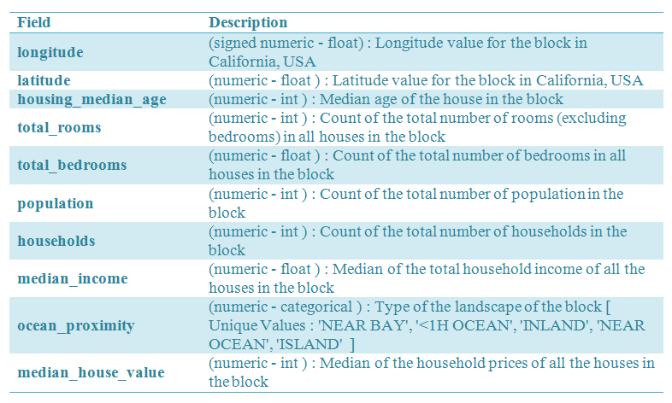
Data Availability
The dataset contains 20640 rows and 10 columns.

Slide 6
Data Exploration / Data Mining
I have done the exploratory data analysis and done following manipulations on data:
Creating new features
Removing outliers
Transforming skewed features
Checking for multicoliniearity

Slide 7
Additional Data Fields Introduced
In this project, I have defined a new feature “income_cat” which is income category and used it for Stratified sampling technique.

Slide 8
Statistical Algorithm Execution
Here, I have trained various machine learning algorithms like:
Linear Regression
Ridge Regression
Support Vector Regression
Gradient Boosting Regression
Stacking of various models

Slide 9
Conclusion
So, in this project, I have built a housing price prediction model to predict median house values in California by using the provided dataset.
I have predicted housing prices based on median income and plotted the regression chart for it.
The process of building this model includes extracting relevant features from California housing price data, performing the dimensional reduction, and training the model respectively.
The advantage of this model is that it can improve the prediction accuracy and effectively avoid the overfitting phenomenon when the dataset contains noise or too many features.
At the same time, this model is able to produce more stable results.
The outcomes obtained by the model are very promising.

