Slide 1
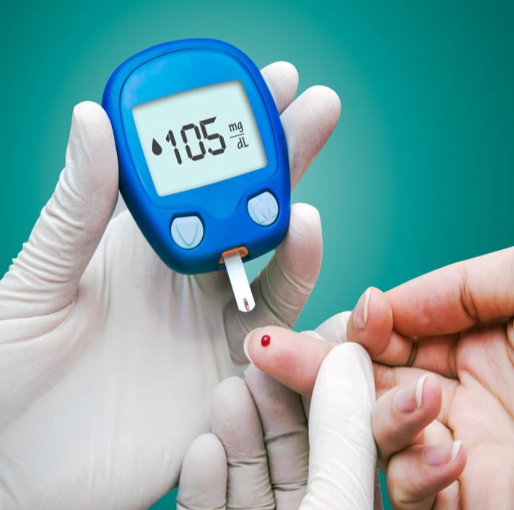

Project Report On Healthcare
Submitted by
Debatri Roy
PGP DS MAR 2021 cohort 1

Slide 2
Contents
Business Scenario…………...………………………………………………………………………………….3
Objectives………………………………………………………………….……………………………………4-5
Data Availability…………………………………………………………..........................................6
Data Exploration/ Data Mining Summary……………………………………………………………7
Statistical Algorithm Execution……………………………………………………………………………8
Summary of Models……………………………………………………………………………………………9
Conclusion…………………………………………………………………………………………………..10-11

Slide 3
Business Scenario
NIDDK (National Institute of Diabetes and Digestive and Kidney Diseases) research creates knowledge about and treatments for the most chronic, costly, and consequential diseases.
The dataset used in this project is originally from NIDDK.
The objective is to predict whether a patient has diabetes or not, based on certain diagnostic measures included in the dataset.
Build a model to accurately predict whether the patients in the dataset have diabetes or not.
The datasets consists of several medical predictor variables and one target variable (Outcome).
Predictor variables includes the number of pregnancies the patient has had, Glucose, Blood Pressure, Skin Thickness, Insulin, their BMI, Diabetes Pedigree Function, Age, Outcome(0,1).

Slide 4
Objectives
The objective of this project is to predict whether a patient has diabetes or not, based on certain diagnostic measures included in the dataset.
To attain this, we will:
Perform descriptive analysis. We have to understand the variables and their corresponding values.
Check if there is any missing values in the Glucose, BloodPressure, SkinThickness, Insulin and BMI.
Visually explore these variables using histograms and treat the missing values accordingly.
Create a count (frequency) plot describing the data types and the count of variables.
Check the balance of the data by plotting the count of outcomes by their value.
Create scatter charts between the pair of variables to understand the relationships.
Perform correlation analysis.
Devise strategies for model building.
(Contd.)

Slide 5
Objectives
Apply an appropriate classification algorithm to build a model.
Compare various models with the results from KNN algorithm.
Create a classification report by analyzing sensitivity, specificity, AUC (ROC curve), etc.
Create a dashboard in tableau by choosing appropriate chart types and metrics useful for the business. The dashboard must entail the following:
Pie chart to describe the diabetic or non-diabetic population
Scatter charts between relevant variables to analyze the relationships
Histogram or frequency charts to analyze the distribution of the data
Heatmap of correlation analysis among the relevant variables
Create bins of these age values: 20-25, 25-30, 30-35, etc. Analyze different variables for these age brackets using a bubble chart.

Slide 6
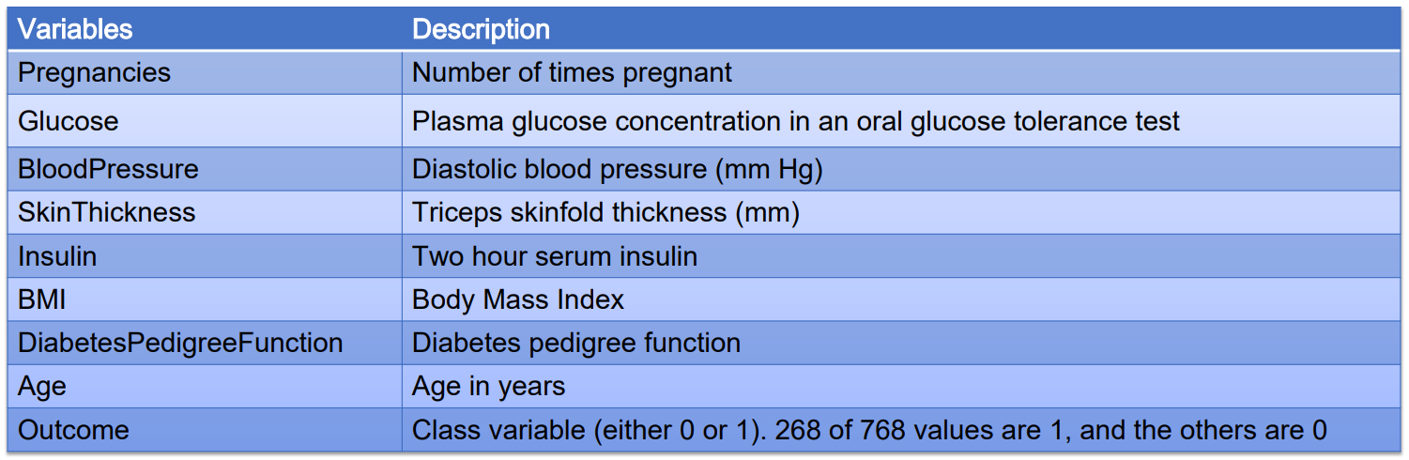
Data Availability
The datasets consists of several medical predictor variables and one target variable (Outcome). Predictor variables includes the number of pregnancies the patient has had, their BMI, insulin level, age, and more.
The dataset contains 768 rows and 9 columns.
The Outcome ‘0’ indicates the patient is ‘Non-Diabetic’ and ‘1’ indicates the patient is ‘Diabetic’.

Slide 7
Data Exploration/ Data Mining Summary
I have done Data Exploration by following steps:
Performed descriptive analysis.
Checked if there is any missing values in the Glucose, BloodPressure, SkinThickness, Insulin and BMI.
Visually explored these variables using histograms and treat the missing values accordingly.
Created a count (frequency) plot describing the data types and the count of variables.
Checked the balance of the data by plotting the count of outcomes by their value.
Created scatter charts between the pair of variables to understand the relationships.
Performed correlation analysis.
Visually explored correlation values by using heat map.
Devised strategies for model building.

Slide 8
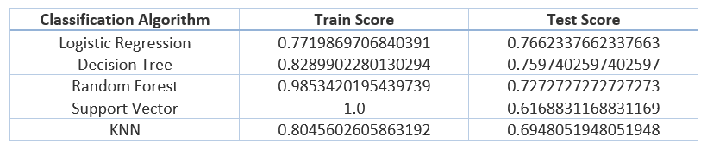
Statistical Algorithm Execution
The Classification Algorithms are used:
Logistic Regression
Decision Tree
Random Forest
Support Vector
KNN
The above table shows the Train and Test score of different Classification Algorithms.

Slide 9
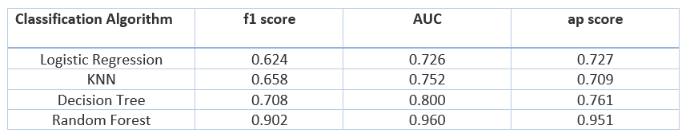
Summary of Models
The below table shows the f1 score, Average Precision Curve (AUC), Average Precision (ap) score of different Classification Algorithms:

Slide 10
Conclusion
So, in this project, I have:
Predicted whether a patient has diabetes or not, based on certain diagnostic measures included in the dataset.
Performed Descriptive Analysis.
Checked if there is any missing values in the Glucose, BloodPressure, SkinThickness, Insulin and BMI.
Visually explored these variables using histograms.
Created a count (frequency) plot describing the data types and the count of variables.
Checked the balance of the data by plotting the count of outcomes by their value.
Created Scatter charts between the pair of variables to understand the relationships.
Performed Correlation analysis.
Devised strategies for model building.
Applied an appropriate classification algorithms to build a model.
(Contd.)

Slide 11
Conclusion
Compared various models with the results from KNN algorithm.
Created a classification report by analyzing Sensitivity, Specificity, AUC (ROC curve), etc.
Created a dashboard in tableau by choosing appropriate chart types and metrics useful for the business. The dashboard entailed the following:
Pie chart to describe the diabetic or non-diabetic population
Scatter charts between relevant variables to analyze the relationships
Histogram or frequency charts to analyze the distribution of the data
Heatmap of correlation analysis among the relevant variables
Create bins of these age values: 20-25, 25-30, 30-35, etc. Analyze different variables for these age brackets using a bubble chart.
The link of tableau project: Capstone Project_PGP-Healthcare_NIDDK | Tableau Public

