Slide 1
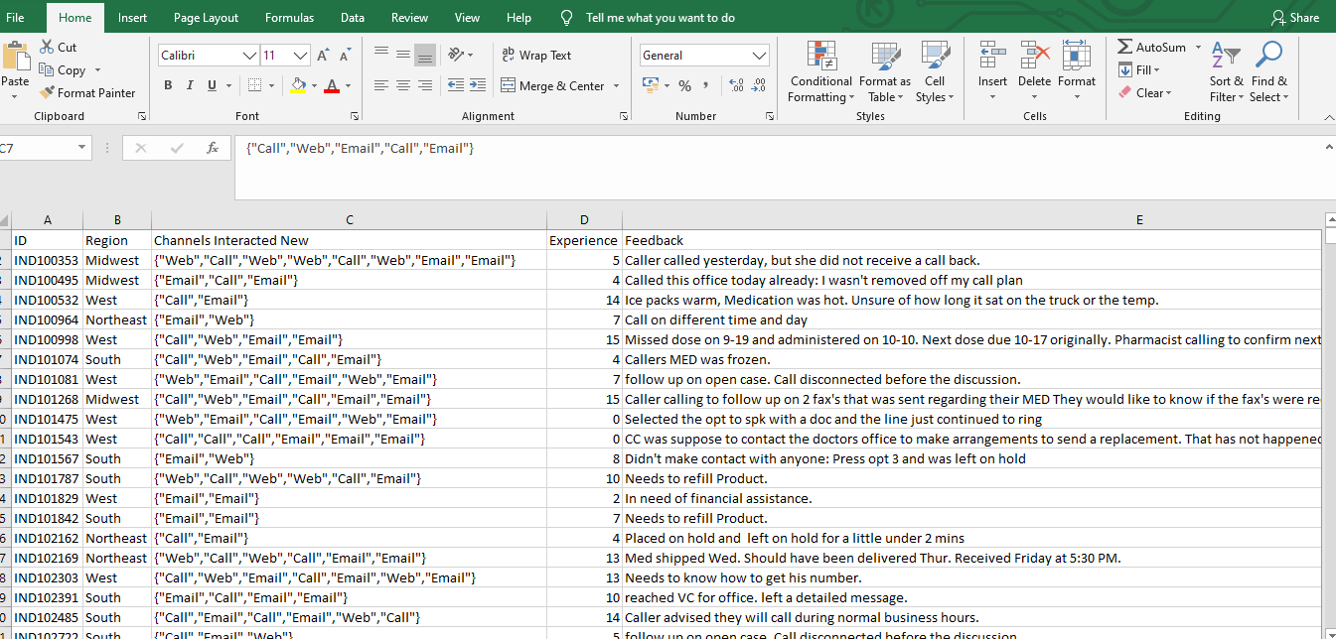
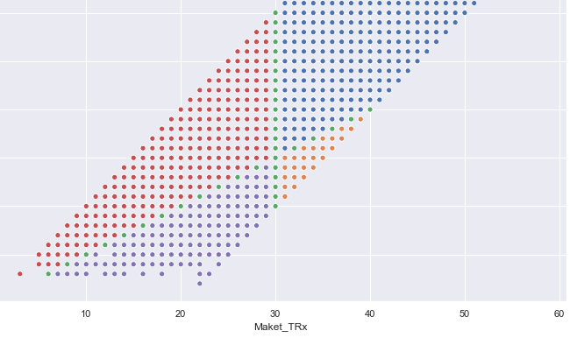
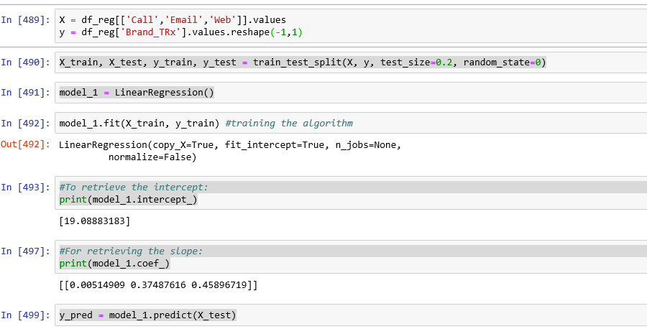
A. Study on segmentation of HCPs B. Optimization of interaction channels

Slide 2
AGENDA
What am I trying to solve?
My hypothesis
Approach
Insights

Slide 3



What are we trying to solve?
3 Questions!!
What is the equation or hypothesis I’m trying to investigate?
Healthcare Practitioners have been the primary target of pharma companies. In the first half of this problem statement, we will try to understand which group of doctors need to be targeted to yield better sales. Since we are talking indirect sales here, our response would be measured in how many new prescriptions the practitioner writes. In the later part we have tried to sequence interactive channels in such a way that it yields the maximum sales. Our first hypothesis would be to investigate whether segmentation of healthcare practitioners actually lead to us finding a group which will help us increase total number of prescriptions. Our second hypothesis is that interaction channels play a major part in increasing number of prescriptions.
Is the data I have adequate to address these questions?
The data should be enough to answer all our questions. Having said that, we need to have a proper approach of featuring and transforming the data to deal with challenges like missing values in at least 3 of the features, huge scale of the feature ‘experience’, etc.
How can I design a study that addresses these questions?
That would bring us to the next slide and further into the discussion.
Our hypothesis: I. HCPs with higher number of Brand Prescriptions need to be targeted along with HCPs with Higher Potential, because they can be potential prescription writers.
II. With more interactions, the number of prescriptions will grow, thus impacting sales yield.

Slide 4

Approach
Group is homogenous across zip level.
We added two more features to the data. A ratio of BrandTRx to MarketTRx and a total spending on all communication channels for one particular HCP
Formulary Coverage came out to be a very significant variable for HCP Segmentation as well. To test this, we divided the HCPs into 4 buckets.
Experience also came out to be a significant variable. So, we divided the scale of 15 into Great, Good and Bad.
.

Slide 5
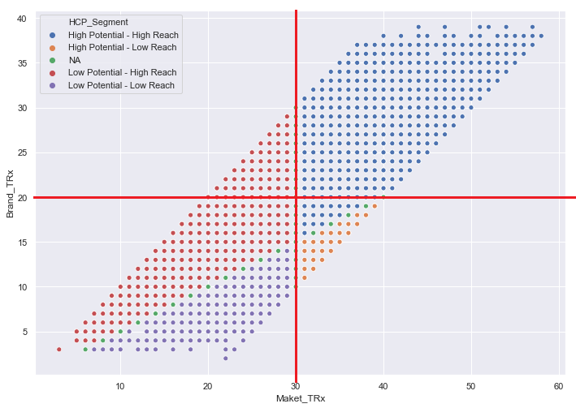
Insights!
Q-1 : High market reach, high prescribing habit for brand.
Q-2 : Low market reach, low prescribing habit for brand
We should focus 30% of our efforts here to maintain the sales
We should not waste our efforts here.
We should focus 5% of our efforts here to maintain the sales
Q-4 : High market reach, low prescribing habit for brand.
We should focus 65% of our efforts here to increase the sales
Q-3 : Low market reach, high prescribing habit for brand

Slide 6



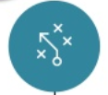
In order to test our second hypothesis, we tried to check the correlation between our #interaction channels and #Brand_Rx. The correlation came out to be somewhat low. Even after fitting our regression line, the Rsquare value came out to be considerably low, urging that our model might not be statistically significant, i.e, the variation in the number of interactions, does not successfully explain the variance in the BrandTRx.
Probably for this particular drug, the Formulary status or the formulary coverage is very important, hence the sales has seen a direct correlation with increasing formulary coverage percentage. The feature ‘coverage’ has a very high correlation ( >90%) with BrandTRx
Model with only the interactive channels is showing a very poor Rsquare value of 0.003936 and hence in our search for a better model to predict our data more effectively, we have added the feature “Coverage”, upon which it gives a Rsquare value of 0.95. The optimum mix for it being BrandTRx = Constant + 0.29976804 * Coverage + 0.36205692 * Call + 0.21853685 * Email + 0.29450629 * Web.
I would strongly recommend using the “Formulary Coverage” for this study or studies of similar drugs. The dependency can be explained as, keeping all the interactive channels to 0, for every 0.29% increase in Formulary Coverage, the increase in BrandTRx would be 1 unit.

