Slide 1
Nintendo Challenge: Group Project
Karlo, Damla & Debbie
Data Science & AI
Batch 32

Slide 2

The Challenge
No easy way for gamers or developers to explore Nintendo games
Gamers: find best games (price, reviews, scores)
Developers: understand what makes a game successful

Slide 3
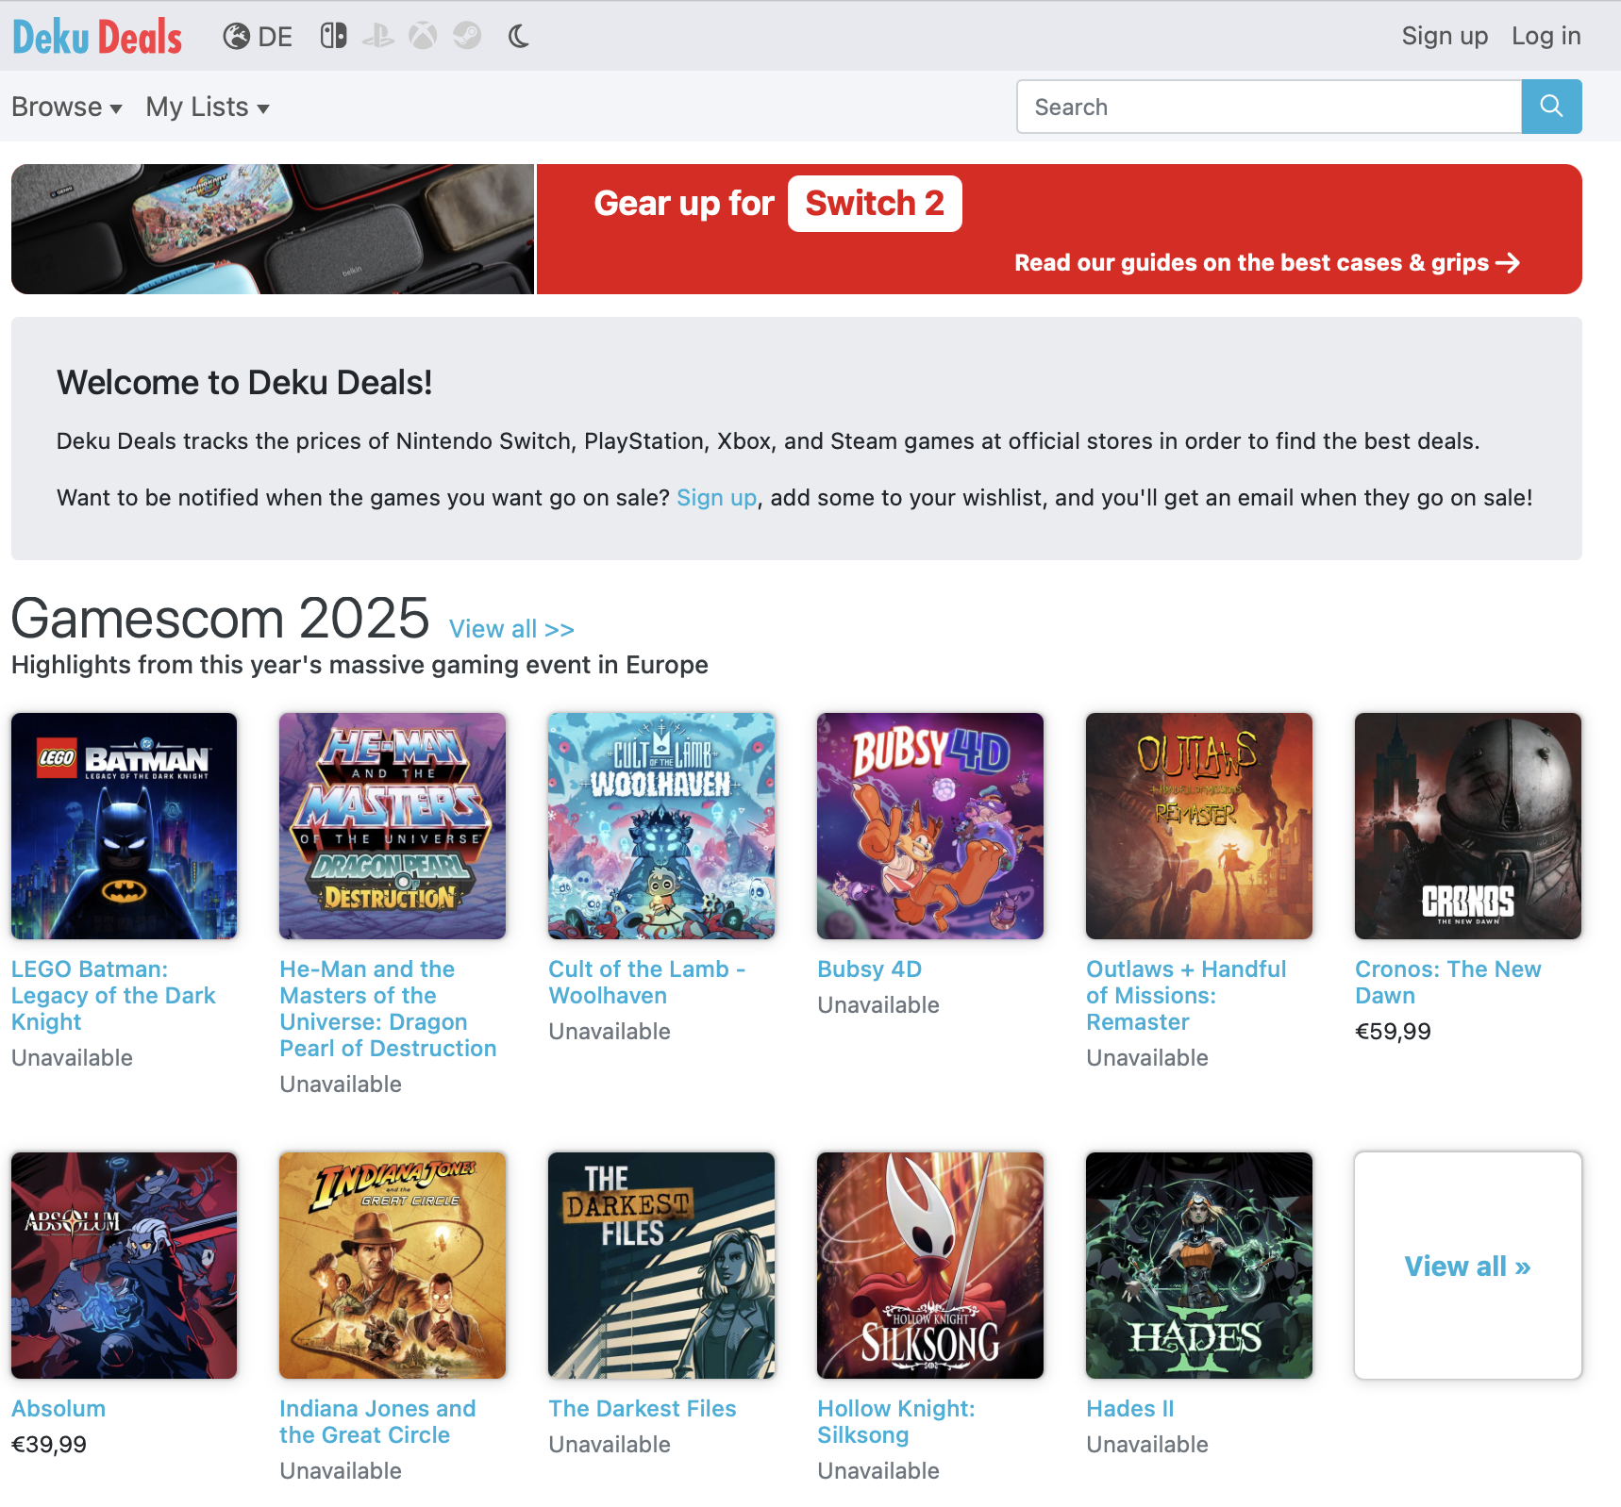
Our Solution
Dashboard for gamers & developers
Insights into 22,000+ Nintendo games
Data scraped from DekuDeals website

Slide 4
Our Solution
Dashboard for gamers & developers
Insights into 22,000+ Nintendo games
Data scraped from DekuDeals website
Dashboard Demo!

Slide 5
The Challenge
No easy way for gamers or developers to explore Nintendo games
Gamers: find best games (price, reviews, scores)
Developers: understand what makes a game successful

Slide 6
The Challenge
No Easy way for gamers or developers to explore Nintendo games
Gamers: find best games (price, reviews, scores)
Developers: understand what makes a game successful

Slide 7
Data Science Workflow
Data Collection
BeautifulSoup
Data Cleaning
Numpy, Pandas
Data Visualization
Plotly, Matplotlib, Seaborn
Dashboard
Streamlit

Slide 8
Learnings
Applied everything from Modules 1–3:
Python, APIs, Web scraping
Statistics, Visualization
Dashboard deployment
Learned how to collaborate and build end-to-end in 3 days

Slide 9
Thank You for Your Attention
Questions?

