Slide 1
Exploratory Data Analysis on Zomato Dataset
Data Cleaning, Exploration & Visualization
Presented by: Deborah Deva Kirubai M

Slide 2
Introduction
The Zomato dataset contains information about restaurants, ratings, cuisines, and pricing across India.
In this analysis, we clean, explore, and visualize the data to extract insights about restaurant trends.
The dataset contains 211,944 restaurant records with 26 columns. Some key observations:
Missing Values:
establishment, zipcode, cuisines, timings, and highlights have missing values.
zipcode has a high number of missing values.

Slide 3
Introduction
Data Types:
Most columns are either numeric or categorical.
aggregate_rating should be numeric (it is currently stored as float).
Potential Cleaning Steps:
Handle missing values appropriately.
Drop unnecessary columns (url, opentable_support as it mostly contains 0.0).
Convert categorical columns into useful formats.

Slide 4
Data Cleaning
Removed unnecessary columns (url, opentable_support, zipcode, country_id).
Filled missing values in categorical columns (establishment, cuisines, timings, highlights) with 'Unknown’.
Converted aggregate_rating to numeric.
Converted aggregate_rating to numeric.
Replaced -1 with 0 in delivery and takeaway for consistency.

Slide 5
Exploratory Data Analysis (EDA)
The distribution of ratings.
The top cuisines.
The most common price range for restaurants.
The number of restaurants offering delivery vs. dine-in. ​​

Slide 6
Insights from Exploratory Data Analysis (EDA)
Rating Distribution: Most restaurants have ratings between 3.5 to 4.5, with a spike at 0.0, indicating many unrated restaurants.
Popular Cuisines: North Indian, Chinese, and Fast Food are the most common cuisines
Price Range: Majority of restaurants fall in affordable price categories (1 & 2).
Delivery & Takeaway: More restaurants offer delivery than takeaway, highlighting the demand for food delivery services.

Slide 7
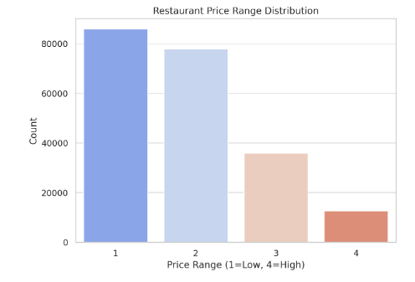
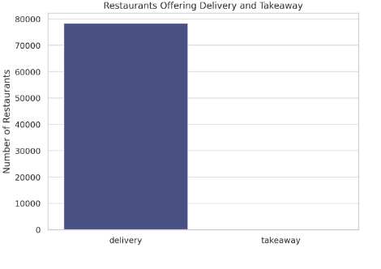
Visualizations

Slide 8
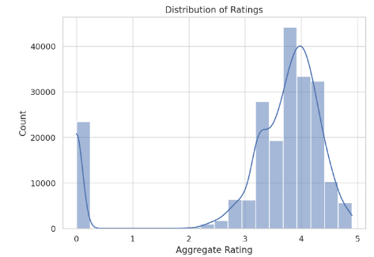
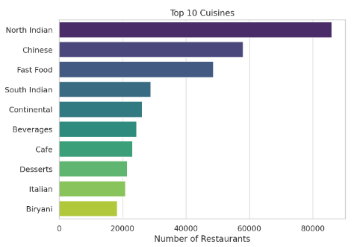
Visualizations

Slide 9
Conclusion
• High-rated restaurants tend to be in premium price ranges
• Popular cuisines include North Indian, Chinese, and Fast Food
• Cost and ratings have a moderate correlation
• Cleaning data is essential for meaningful insights

