Slide 1
LOAN PORTFOLIO ANALYTICS
Loan Applicant Credit Risk and
Approval Readiness Score
A clear scorecard for sorting 981 loan applications, built from real underwriting signals, presented as data, then insight, then a business decision.
Notes:
Good morning everyone. Today I will walk through how we cleaned, scored, and studied 981 loan applications, and what that means for how we handle new applications going forward.

Slide 2
THE USE CASE
Can we tell how ready an applicant is for approval?
A lender wants to know how ready each applicant looks for approval, before a loan officer opens the file. We cleaned the raw data and built an Approval Readiness Score for every applicant.
Important: There is no real approval or denial result in this data. This score is our best estimate of approval readiness. It is a triage tool, not a guarantee of a bank decision.
981
100
79.4%
6.2%
applications scored
point scorecard
score High readiness
score Low, need review
2
Notes:
Because there is no historical approval outcome in this data, we cannot train a real prediction model. We say that plainly up front instead of overselling what the score can do.

Slide 3
STEP 1: DATA CLEANING
Six problems found, and fixed, in the raw file.
1
Mixed up labels
2
Missing values
Gender written two ways. Property area had 14 misspellings of 3 real places.
Seven columns had gaps, including income, loan amount, and credit history.
3
Mixed data types
4
No target column
Dependents mixed numbers with text like 3+, blocking normal math.
No real approval result exists, so we built our own readiness score.
5
Unclear units
6
Possible repeats
Loan amount was stored in thousands. We converted it to real currency.
We checked for duplicate applications. We found none.
3
Notes:
Every good analysis starts with clean data. These six problems, if left alone, would have quietly distorted every chart in this deck.

Slide 4
STEP 2: THE SCORECARD
A 100 point score, built from five factors
40
25
20
10
5
pts
pts
pts
pts
pts
Credit History
Loan to Income
Stability
Employment
Area
Important: Credit History alone is 40 of the 100 points, on purpose. This means the final score will often follow the credit history pattern closely. That is expected, not a flaw.
Bands: High is 70 or more (fast track). Medium is 50 to 69 (standard review). Low is under 50 (extra documents).
Why build a scorecard, not a machine learning model?
There is no real approval outcome in the data to train a model on, so we built clear, expert weighted rules instead. If real approval history becomes available later, this can be upgraded to a trained model.
4
Notes:
Each weight reflects normal lending judgment, not a statistical model, since we have no outcome data to fit a model to.

Slide 5
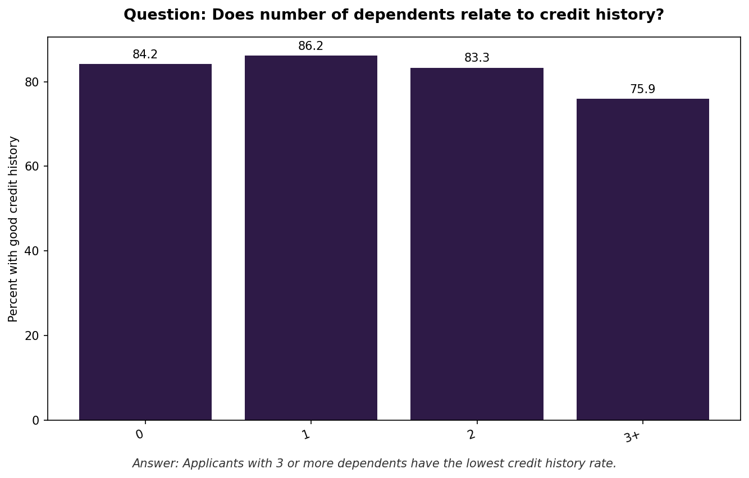
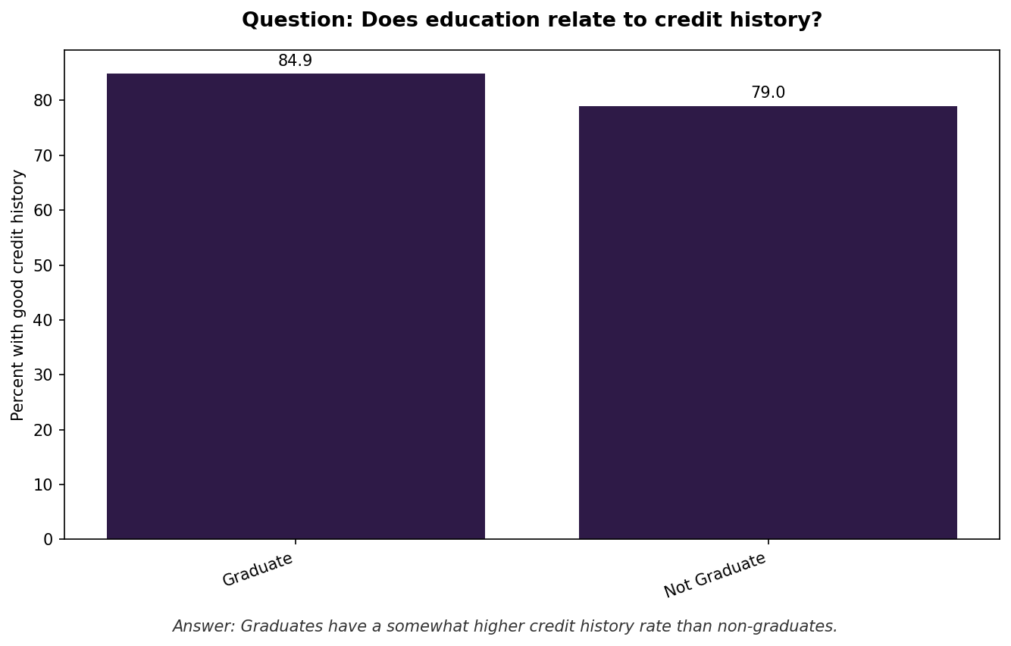
FINDING 1 OF 6
Who has good credit history, by group
Applicants with 3 or more dependents have the lowest credit history rate, at 75.9%. Self-employed applicants and graduates both score above average.
BUSINESS DECISION
Add an extra income check for applicants with 3 or more dependents. Do not add extra checks for self-employed status alone.
5
Notes:
We split credit history rate by five groups. The biggest gap by far is number of dependents, not gender or marriage as some might expect.

Slide 6
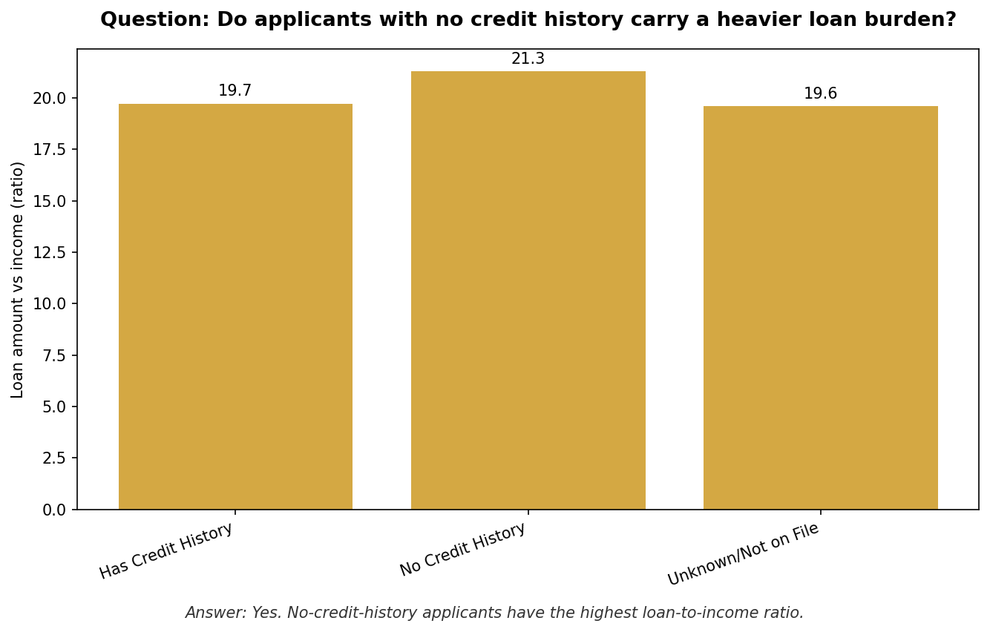
FINDING 2 OF 6
Applicants with no credit history carry a heavier loan burden
What we found
No-credit-history applicants have the highest loan burden score, 21.3 versus 19.7 for applicants with a known credit history.
BUSINESS DECISION
Set a stricter loan to income limit for applicants with no credit history, instead of approving based on income alone.
6
Notes:
This confirms a real, if modest, risk signal. The least verifiable applicants are asking for slightly more relative to what they earn.

Slide 7
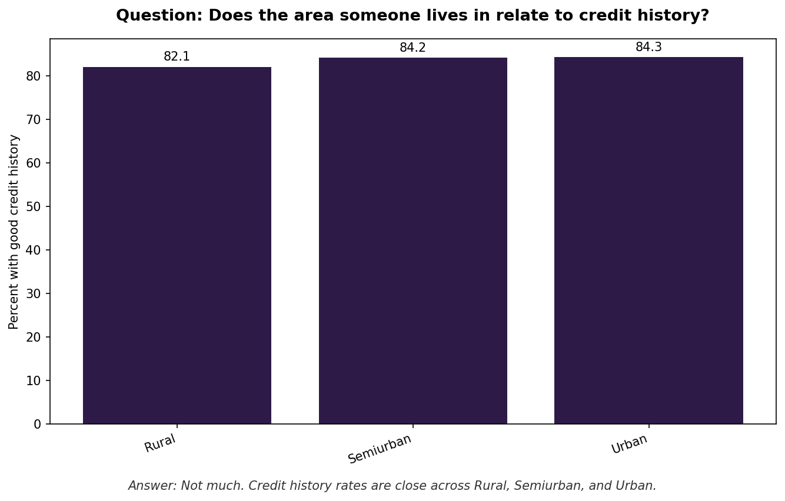
FINDING 3 OF 6
Location barely affects credit history
What we found
Credit history rates are close across Rural, Semiurban, and Urban applicants, within about 2 points of each other.
BUSINESS DECISION
Do not price loans differently by area based on assumed risk. Rural and semiurban applicants deserve the same standard terms as urban applicants.
7
Notes:
Geography is not a useful stand in for risk here. Any area based pricing difference would not be supported by this data.

Slide 8
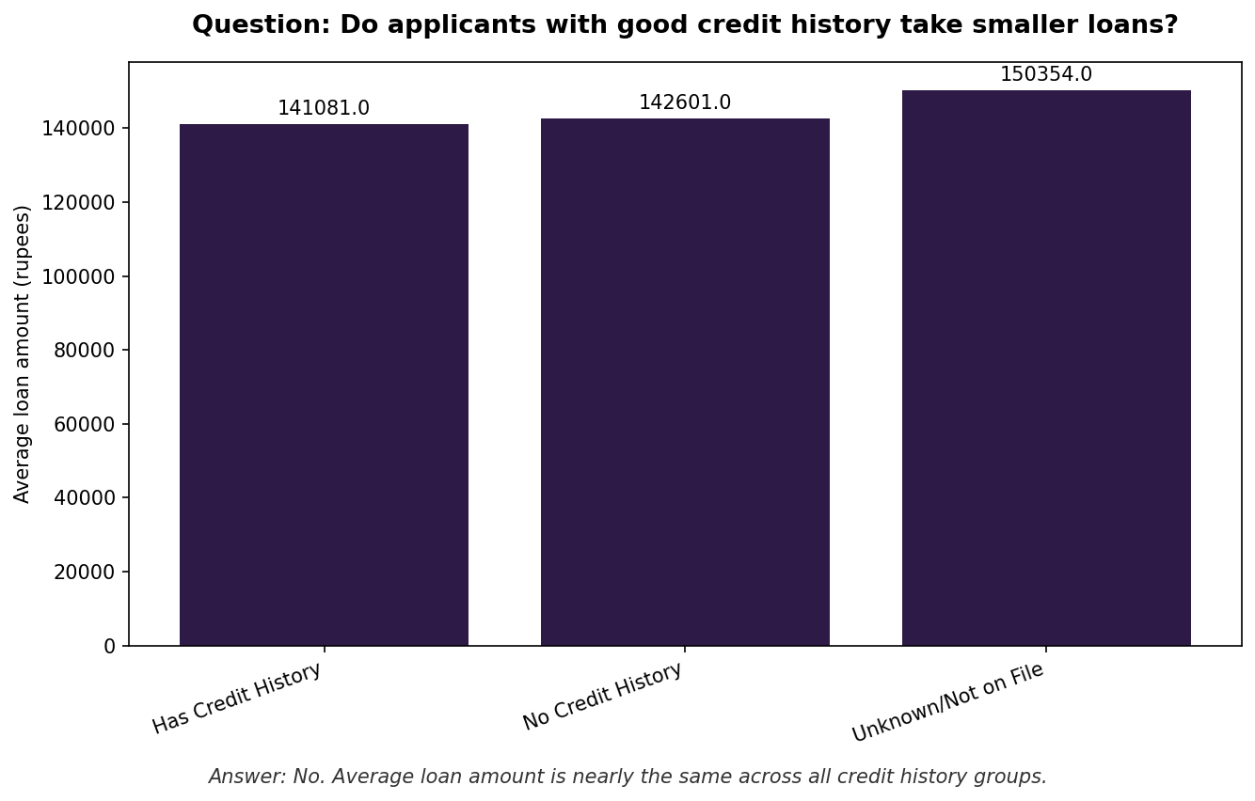
FINDING 4 OF 6
Loan size does not predict credit history
What we found
Correction: We expected smaller loans to line up with good credit history. Average loan amount is nearly identical across all three groups here.
BUSINESS DECISION
Do not use loan size as a stand in for credit risk. Screen using the credit history field directly, not the size of the loan requested.
8
Notes:
This is a case where the data did not support our first assumption. We report that honestly instead of forcing the expected pattern.

Slide 9
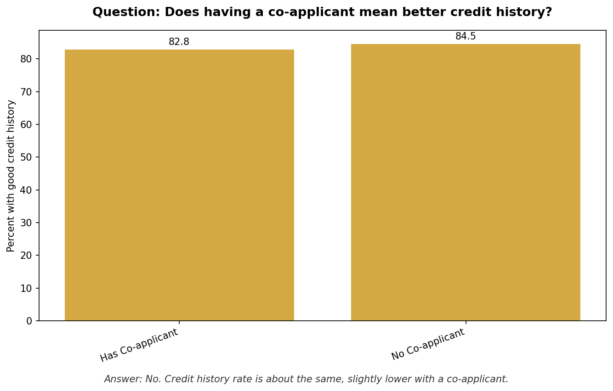
FINDING 5 OF 6
A co-applicant does not clearly lower risk
What we found
Correction: Applicants with a co-applicant do not show better credit history. The rate is actually slightly lower, and their loan requests are bigger.
BUSINESS DECISION
Do not automatically fast track applications with a co-applicant. Review them with the same care as any other application.
9
Notes:
We expected a co-applicant to signal lower risk. The real data shows the opposite direction, so we do not build that assumption into the score.

Slide 10
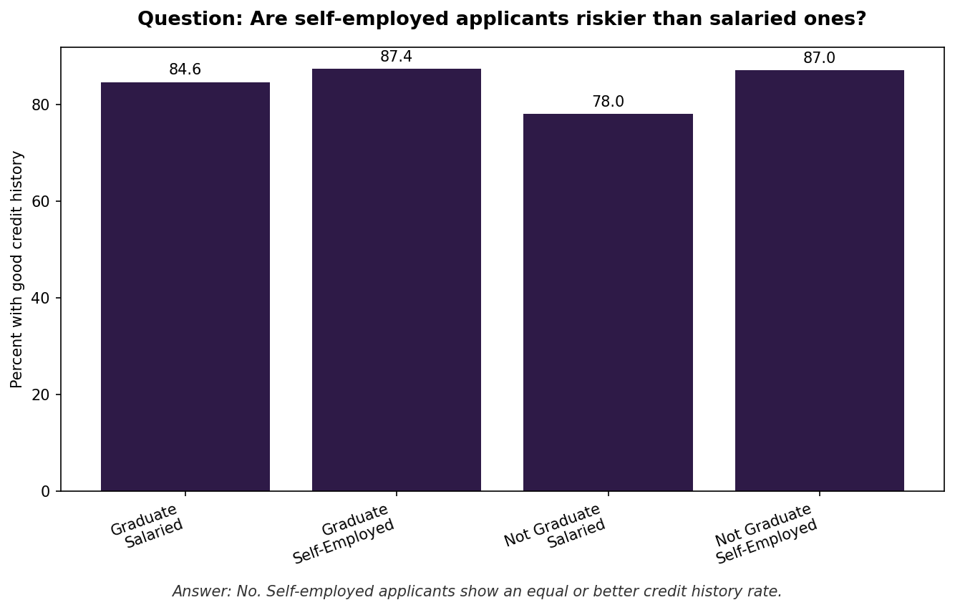
FINDING 6 OF 6
Self-employed applicants are not riskier here
What we found
Correction: Self-employed applicants show an equal or better credit history rate than salaried applicants, not worse as often assumed.
BUSINESS DECISION
Drop the assumption that self-employed applicants need harsher credit screening. Still verify their income documents, but not due to higher risk.
10
Notes:
Another case where the common assumption did not hold up. Self-employed applicants are not showing worse credit history in this data.

Slide 11
THE BUSINESS DECISION
Sort applicants by score band. Do not treat every case the same.
1
Fast track High (79.4%)
Score 70 or above. About 4 in 5 applicants. Give them a lighter, faster approval path.
2
Standard review for Medium (14.4%)
Score 50 to 69. A normal human review. The score flags them, a person decides.
3
Extra documents for Low (6.2%)
Score under 50, mostly no credit history cases. Ask for more proof, do not auto reject.
11
Notes:
This is the payoff. Instead of treating every application the same way, the score sends most applicants down a fast path and saves manual work for the small group that actually needs it.

Slide 12
THE STORY, IN ONE SLIDE
Data, then insight, then decision
DATA
INSIGHT
DECISION
981 applications, cleaned. Six problems fixed. Credit history gaps kept as a signal, not erased.
Six checks done. Credit history and loan burden matter. Area, loan size, co-applicant, and self-employment do not, once checked.
Sort by band. Fast track 79%, review 14%, verify the last 6% by hand.
→
→
12
Notes:
The whole project in one frame. Clean data, six honest checks, and a real decision about how we route applications.

