Slide 1


Temporary Note Sharing App
Guided By: Avani Khokhariya
Made by: Debdoot Manna

Slide 2
Content of the Presentation
Problem Statement
Solution Overview
User Flow
Technical Architecture
Security Features
Key Differentiators
Use Cases
Demo
Implementation Timeline
User Feedback & Metrics
Next Steps
Department of Computer Science & Engineering ,CSPIT

Slide 3
Problem Statement
The Challenge
Sharing sensitive information securely is difficult
Emails and messaging apps store data indefinitely
Users need a way to share information that automatically disappears
Existing solutions are often complex or lack security features

Slide 4
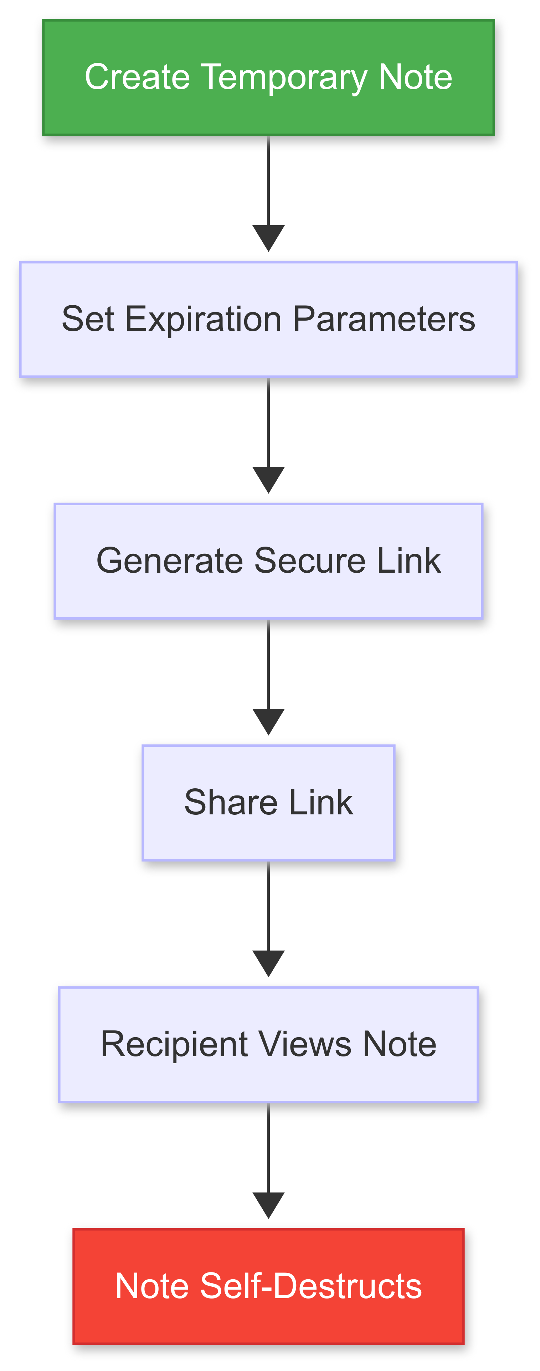
Solution Overview
Our Solution: Temporary Note Sharing App
Create notes that self-destruct after viewing or a set time period
Secure end-to-end encryption
No account required
Simple, intuitive interface
Mobile-friendly design

Slide 5
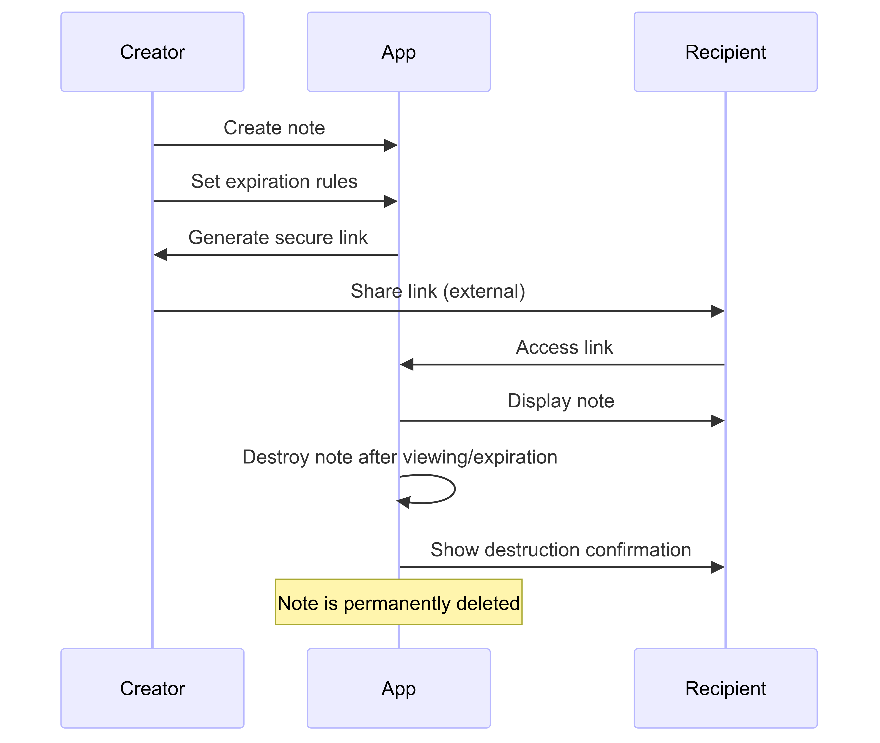
User Flow
How It Works
User creates a note with sensitive information
User sets expiration parameters (time-based or view-based)
System generates a secure, unique link
User shares the link with intended recipient(s)
Recipient opens the link to view the note
Note is automatically destroyed after viewing or time expiration

Slide 6
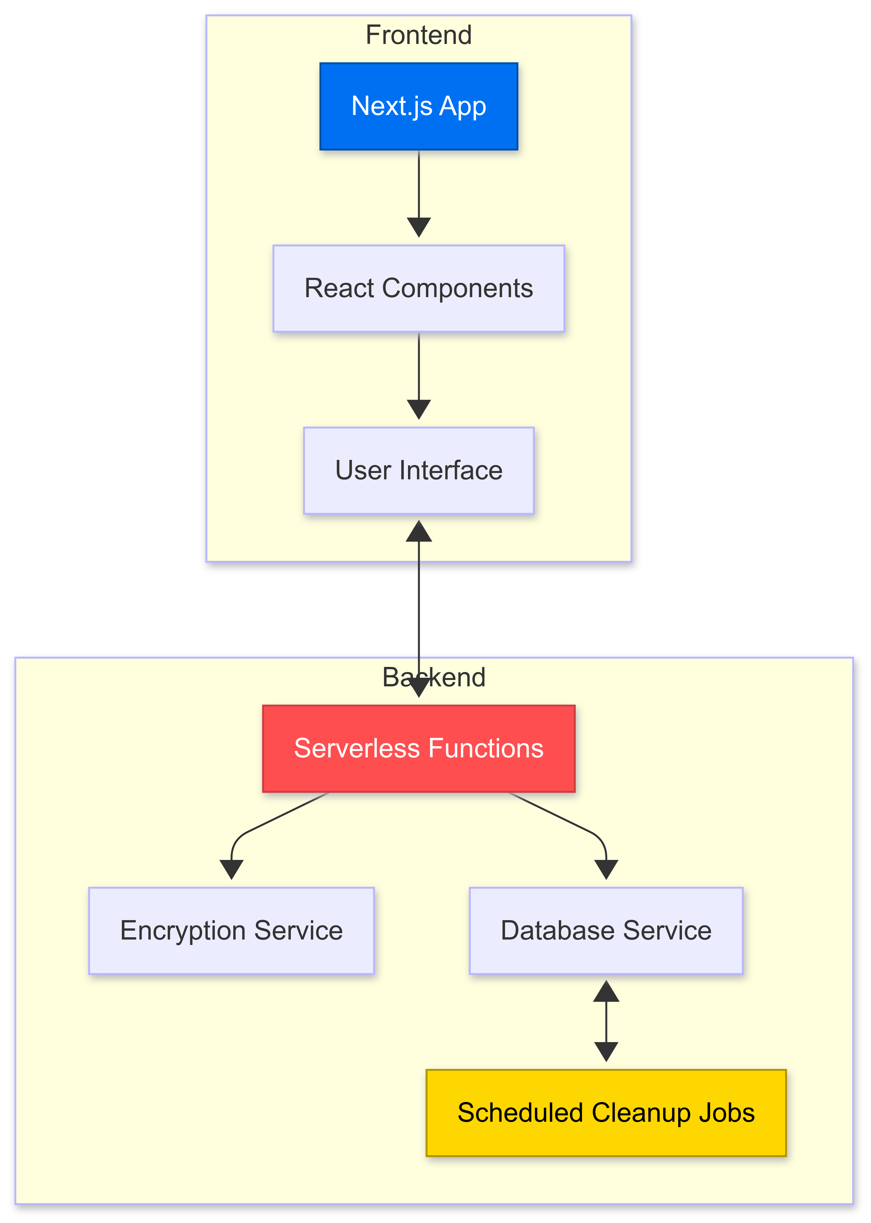
Technical Architecture
Behind the Scenes
Next.js frontend for responsive UI
Serverless backend functions
End-to-end encryption
Temporary database storage with automatic cleanup
No user data retention

Slide 7
Security Features
Security First Approach
End-to-end encryption
No plaintext storage of note content
Automatic data destruction
No tracking or analytics
Optional password protection for notes
HTTPS-only access

Slide 8
Key Differentiators
What Sets Us Apart
Simplicity: No accounts, no complications
Security: End-to-end encryption by default
Flexibility: Multiple expiration options
Privacy: No data retention or tracking
Accessibility: Works on all devices

Slide 9
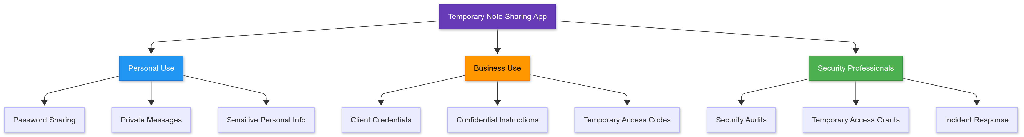
Use Cases
Perfect For:
Sharing passwords and credentials
Sending sensitive financial information
Sharing temporary access instructions
Communicating confidential business information
Personal messages that shouldn't be stored permanently

Slide 10
Demo..!
Go to https://temp-note-share.vercel.app/
Try it (also available in dark mode)

Slide 11
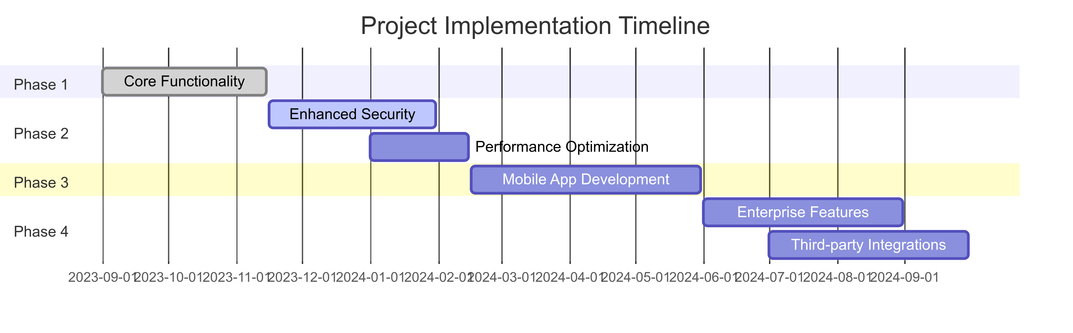
Implementation Timeline
Project Roadmap
Phase 1: Core functionality (complete)
Phase 2: Enhanced security features (in progress)
Phase 3: Mobile app development
Phase 4: Enterprise features and integrations

Slide 12
User Feedback & Metrics
What Our Users Say
95% of users found the app intuitive to use
Average note creation time: under 30 seconds
89% of users would recommend to colleagues
Most requested feature: scheduled note delivery

Slide 13
Next Steps
Moving Forward
Expanding encryption options
Implementing file attachment support
Developing mobile applications
Adding enterprise management features
Exploring API integrations

Slide 14
User Feedback & Metrics
https://temp-note-share.vercel.app/
https://github.com/DebdootManna/temp-note-share

