Slide 1
Analysis of Binding Sites of SOX Family Transcription FACTORs
Debduth Bardhan Pijush

Slide 2
SOX FAMILY
A family of transcription factors organized together by the presence of the HMG-box binding domain (part of protein)
The Sox genes are organized together because it has the HMG-box of a gene responsible for initiation of male sex-determination (SRY)
Sox = SRY-related HMG box
The family regulates cell fate decisions during development
Sex determination and neuronal development

Slide 3
Telomeres
The region of a repetitive sequence (TTAGGG) at the end of a chromosome
Protects the chromosome from fusing with other chromosomes and deterioration
A decrease in telomere length happens over aging
11 kb at birth to 4 kb in old age
Sox2 is responsible for pluripotency of embryonic (undifferentiated) and neural stem cells
Telomerase, an enzyme that replenishes the telomere cap of the DNA, present only in certain types of cells like stem cells

Slide 4
Hypotheses
Are there binding sites of Sox family transcription factors near the end of the chromosome?
If so, are the shorter binding sites in that region?
Since these regions go through much insertion and deletions, perhaps shorter binding sites would be present in the telomeric region?
Is there any link to the location of the transcription factors’ last binding site to the number of binding sites on the chromosome for the specific transcription factor?

Slide 5
Methods
MotifDb used to gather the position frequency matrices for H.sapiens from the Sox family and the jolma2013 database
Only Sox2, 7, 8, 9, 10, 14, 15, 18, 21 present in the database
Sequence logos used to represent each transcription factor’s binding site sequence based on the PFM (Sox9 shown to the right)
UCSC database wasused for the H.sapiens genome
Biostrings package was used to match the transcription factor sequences to each respective chromosome’s sequence

Slide 6
What data was collected
From the matching of the TFBS sequence to the chromosome:
The counts of matches were collected (number of binding sites)
The start site of the last binding site for each TF was collected – weighted by the length of the chromosome, giving a percentile
The length of each transcription factor’s binding site

Slide 7
RESULTS

Slide 8
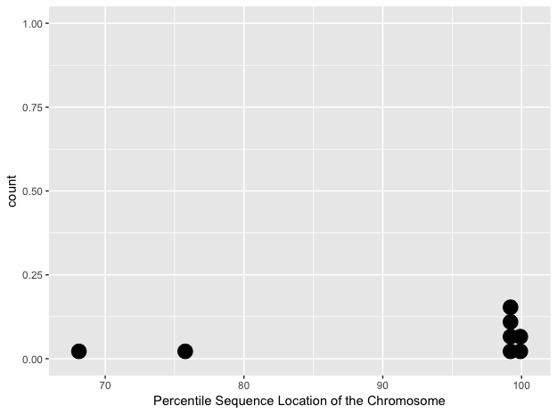
Start sites
Sox2, Sox14, Sox21, Sox8, Sox9 and Sox18 all had start sites in the last 1 or 2 percentile of the chromosome, compared to the others.
This is near the telomere
A t-test was ran between those 6 transcription factors against the others, giving a p-value of 0.08738 , meaning that it would be significant if the alpha value were considered to be 0.1.
Larger sample size needed of all the Sox family (better database)

Slide 9
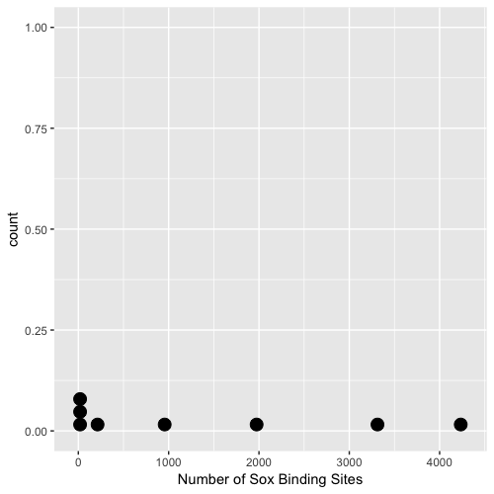
Binding Site Count
Sox8, Sox10, and Sox15 had less than 50 binding sites each for their respective chromosomes

Slide 10
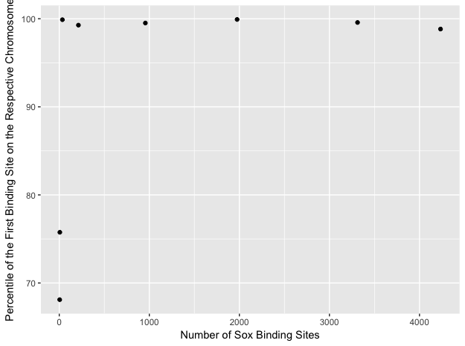
Relationship between location on chromosome and number of binding sites?
Does not appear to have much of a relationship
Coefficient of Determination was found to be 0.228
The transcription factors with sites near the end of the chromosomes varied in number of binding sites

Slide 11
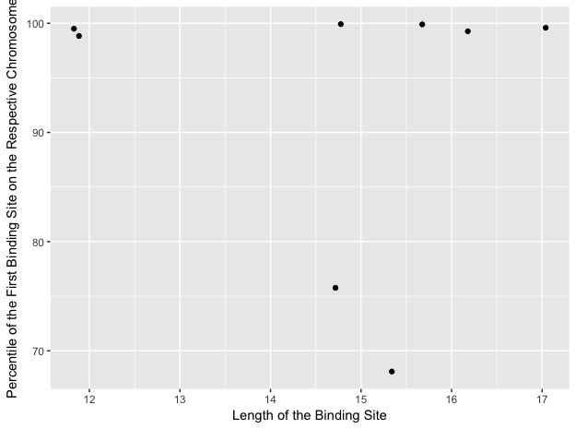
Relationship between Location on chromosome and Length of binding site?
R^2 = 0.005, extremely uncorrelated

Slide 12
Conclusion
There are a considerable number of Sox family transcription factors that are located near the telomeres
Gives indication that they might be related
But, the length of the binding sequences have no correlation with the location of the last binding site
There is no correlation between the number of binding sites for each transcription factor and the location of the last binding site

