Slide 1
TEAM 5
INSIGHTS
Analysis of the Bank Dataset

Slide 2
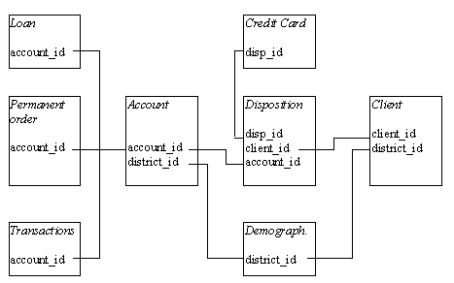
DATASETS OVERALL INSIGHTS:
Each account has both static characteristics (e.g. date of creation, address of the branch) given in relation "account" and dynamic characteristics (e.g. payments debited or credited, balances) given in relations "permanent order" and "transaction".
Relation "client" describes characteristics of persons who can manipulate with the accounts.
One client can have more accounts, more clients can manipulate with single account; clients and accounts are related together in relation "disposition".
Relations "loan" and "credit card" describe some services which the bank offers to its clients;
More than one credit card can be issued to an account,
At most one loan can be granted for an account.
Relation "demographic data" gives some publicly available information about the districts (e.g. the unemployment rate); additional information about the clients can be deduced from this.
account.shape (4500, 4) Each record describes static characteristics of an account
district.shape (77, 16) Each record describes demographic characteristics of a district
loan.shape (682, 7) Each record describes a loan granted for a given account
disposition.shape (5369, 4) It relates client with an account, describes the rights of clients to operate accounts
per_order.shape (6471, 6) Each record describes characteristics of a payment order
transaction.shape (1056320, 10) Each record describes one transaction on an account
client.shape (5369, 3) Each record describes characteristics of a client
credit_card.shape (892, 4) Each record describes a credit card issued to an account
Transaction[‘type’] NAN values are replaced with withdrawl
- YYMMDD(Men) and - YY50+MMDD (Women)

Slide 3
Ranked attributes based on :
Evaluator:weka.attributeSelection.InfoGainAttributeEval
0.47367 3 Client_Age
0.12299 8 Acct_District_ID
0.11712 7 Client_District_ID
0.09685 25 Trans_Avg_Balance
0.01591 6 Acct_YearOpened
0.00791 9 District_A3
0.00704 23 Loan_Status_II
0.00306 5 Acct_Frequency
0.00301 26 Disp_Add_Users
0.00291 24 Loan_Status_II
0.0019 4 Client_Sex
0 District_A4
0 District_A5
0 Acct_ID
0 District_A13
0 District_A12
0 District_A14
0 District_A16
0 District_A15
0 District_A11
0 District_A7
0 District_A6
0 District_A8
0 District_A10
0 District_A9
Distribution of Values:
Prague = 1%
Central_Bohemia = 16%
South_Bohemia = 10%
West_Bohemia = 13%
North_Bohemia = 13%
East_Bohemia = 16%
South_Moravia = 18%
North_Moravia = 14%

Slide 4
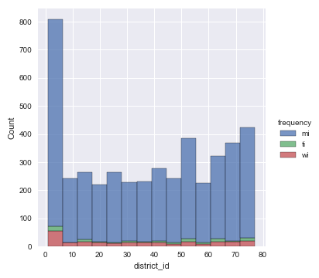
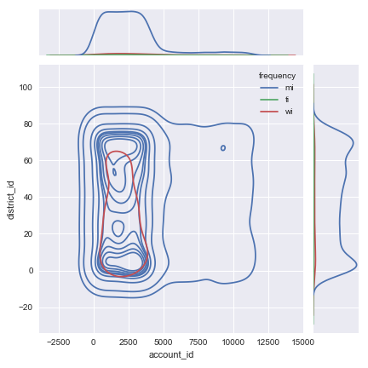
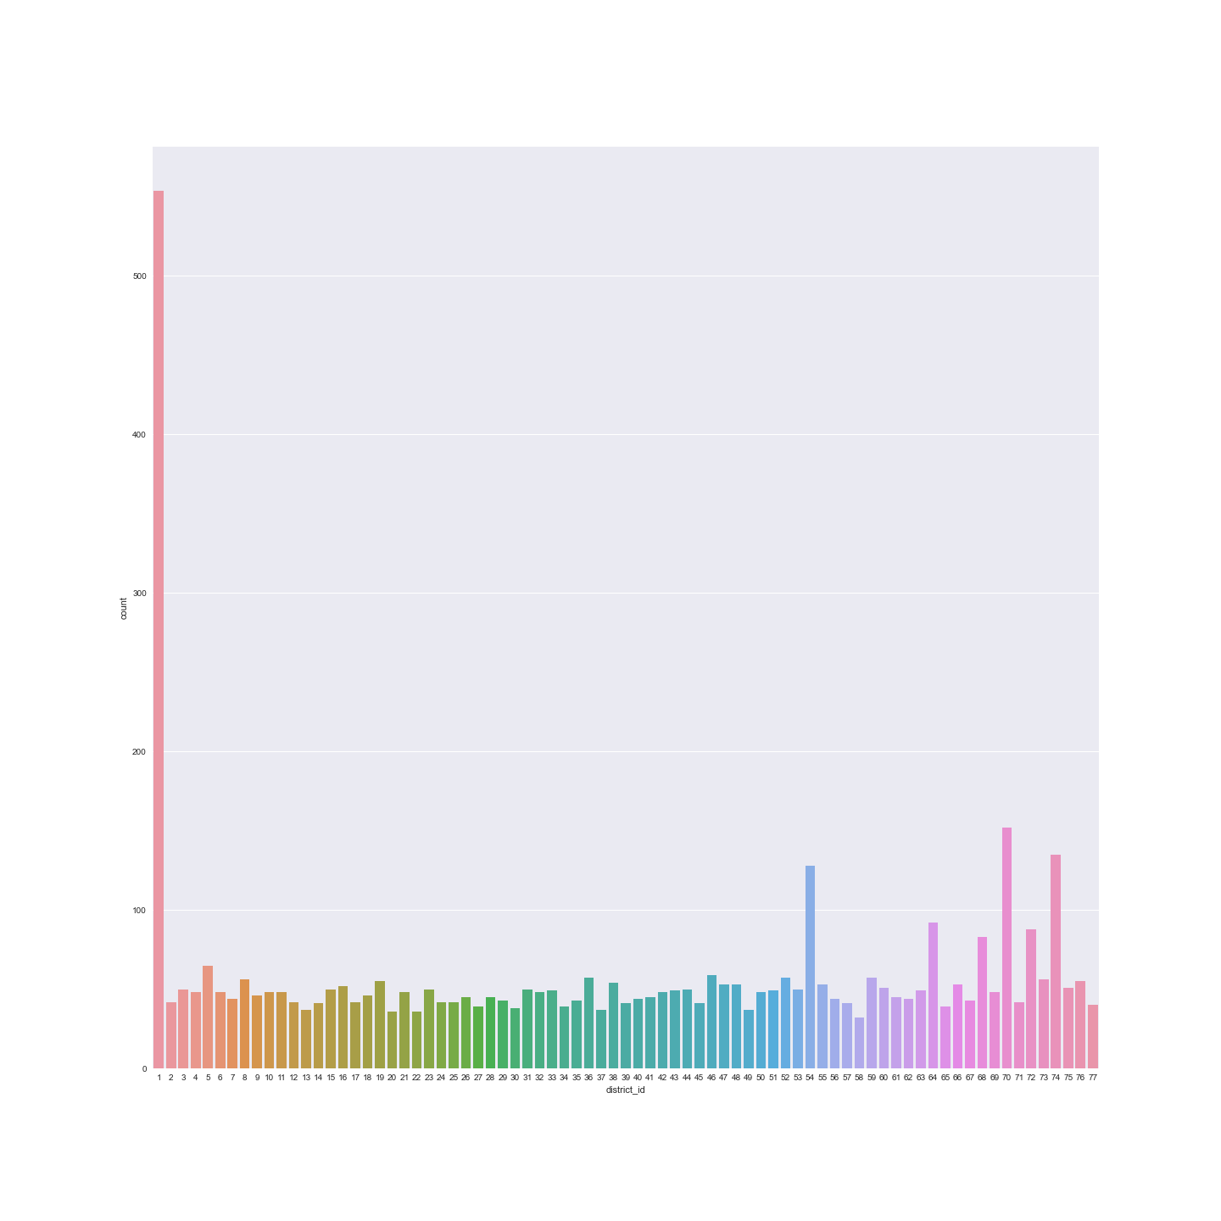
Account dataset insights
→UNIQUE VALUES:
account_id 4500
district_id 77
frequency 3
date 1535
→OF ALL TYPES OF STATEMENT
ISSUANCE MONTHLY ISSUANCE IS MAX
count 4500
top mi
freq 4167

Slide 5
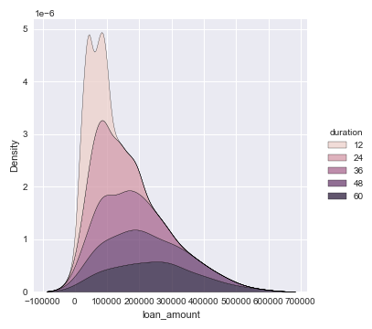
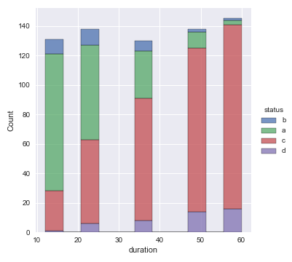
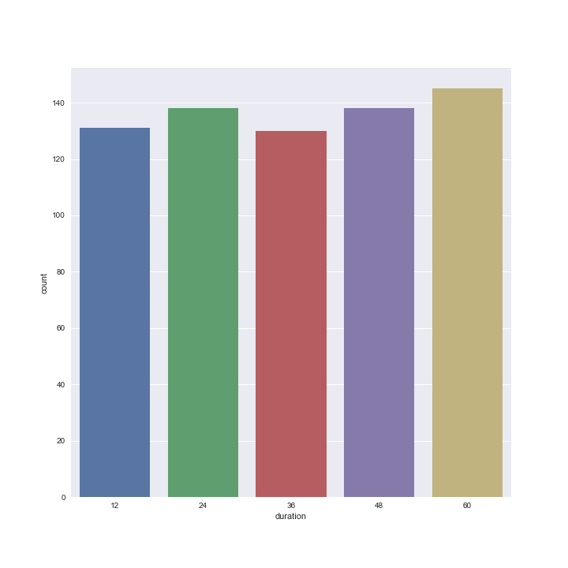
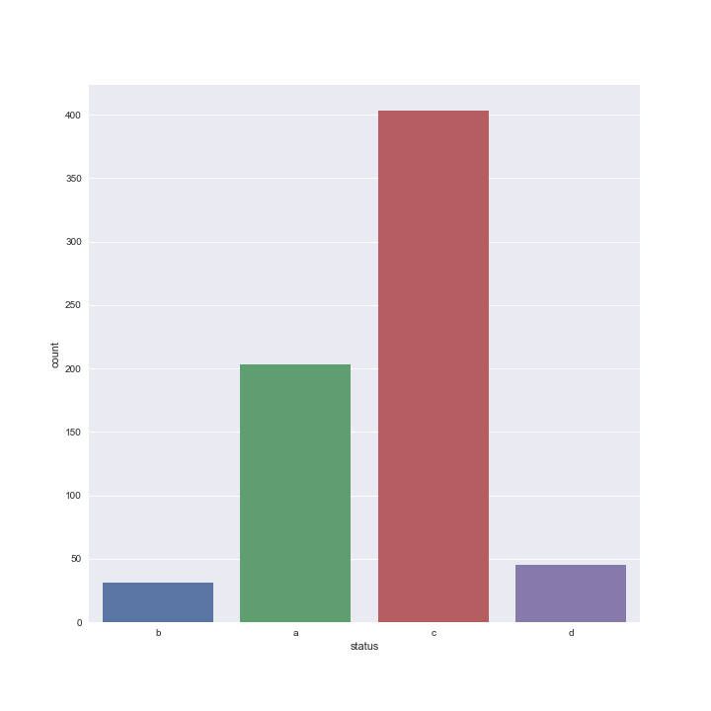
Loan dataset insights:
Average
Loan payment(monthly wise): 3934.00
Loan amount:116928.00
Loan duration: 36 months
Status maximum is ‘c’ i.e. running contract

Slide 6
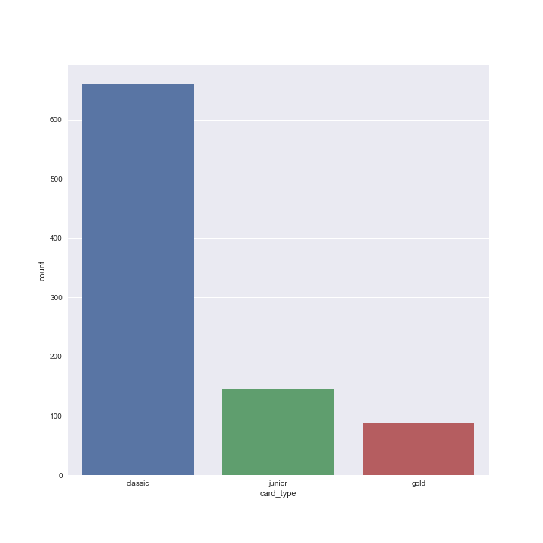
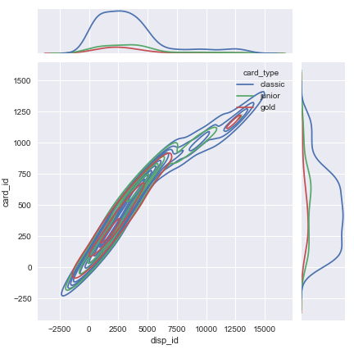
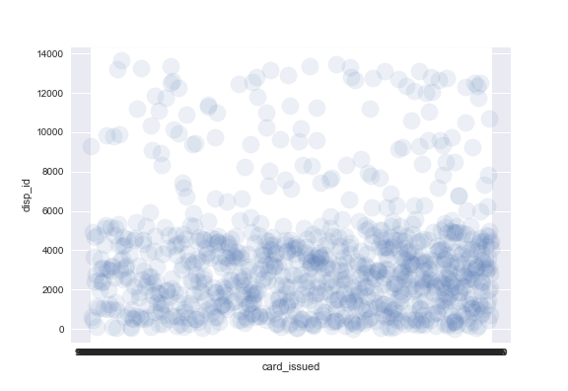
Credit_Card dataset insights:
Unique values:
card_id 892
disp_id 892
card_type 3 (Classic,Gold,Junior)
card_issued 607

Slide 7
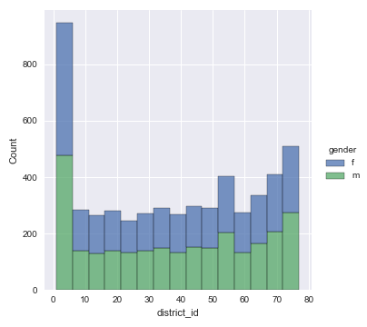
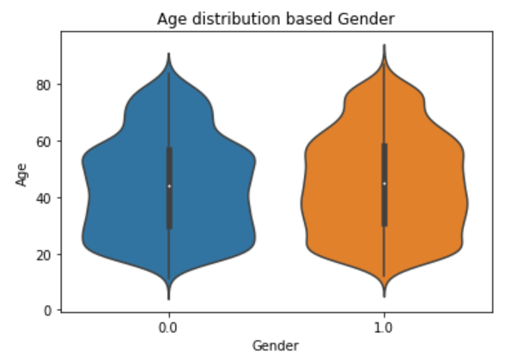
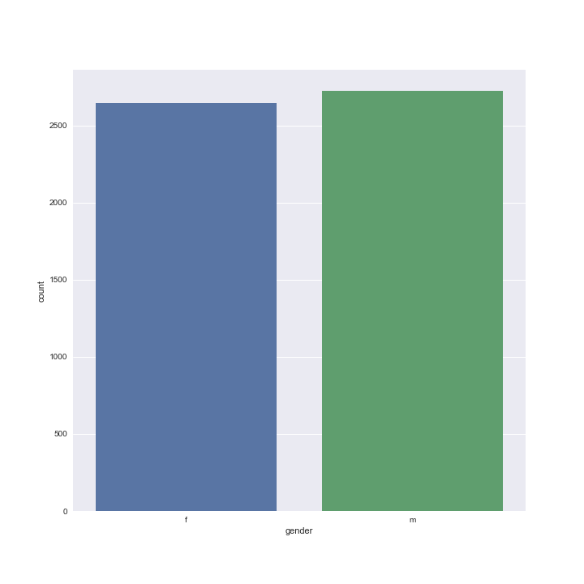
Client dataset insights:
UNIQUE:
client_id 5369
birth_number 4738
district_id 77
gender 2
OUT OF (5369, 4)
People from the ages of 20 to 60 happens to be the most number of clients for he bank.
May be this age group should be considered for different marketing strategies.
Both, Male and Female Clients are present in equal numbers.
Also, they happen to have almost similar median and Age Distribution.

Slide 8
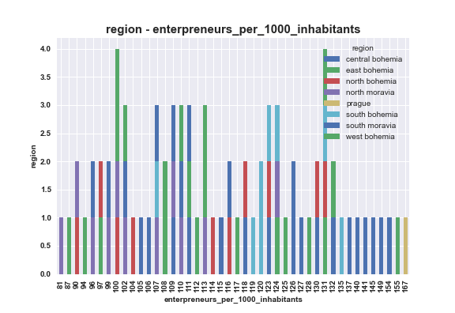
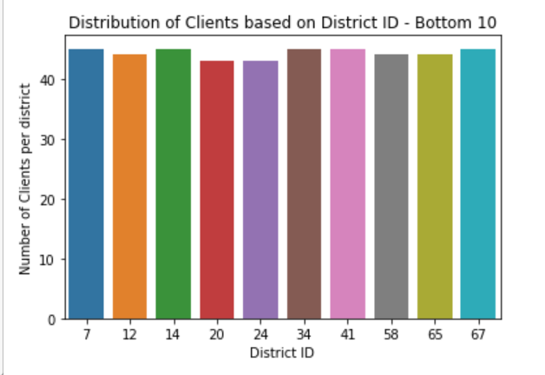
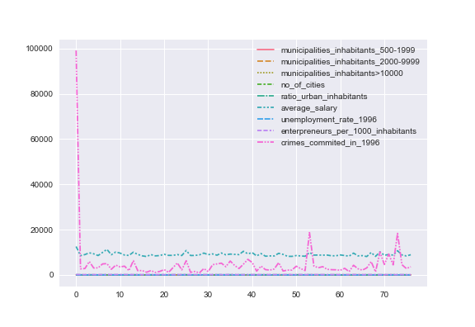
District dataset insights:
district.shape (77, 16)
Average:
no_of_inhabitants:1.088710e+05
municipalities_inhabitants<499:22
municipalities_inhabitants_2000-9999:4
ratio_urban_inhabitants:59.80
average_salary:8814
enterpreneurs_per_1000_inhabitants:113
crimes_commited_in_1996:3040
District ID – 20 and 24 happens to have the least number of Distinct Client.

Slide 9
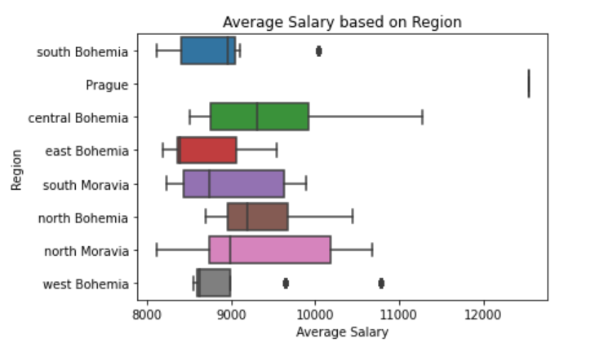
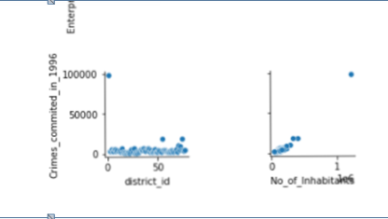
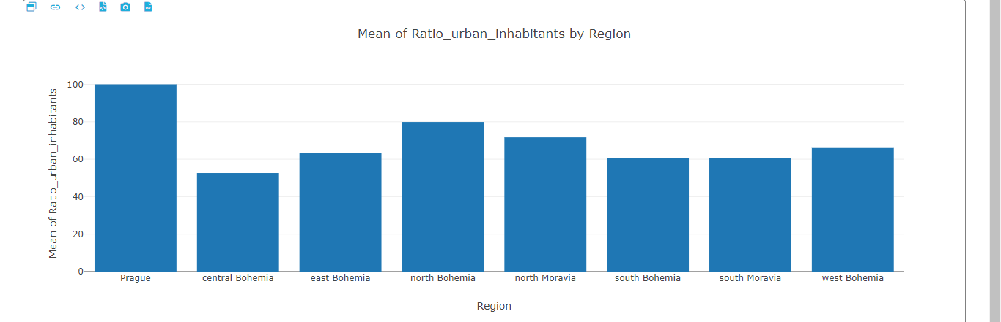
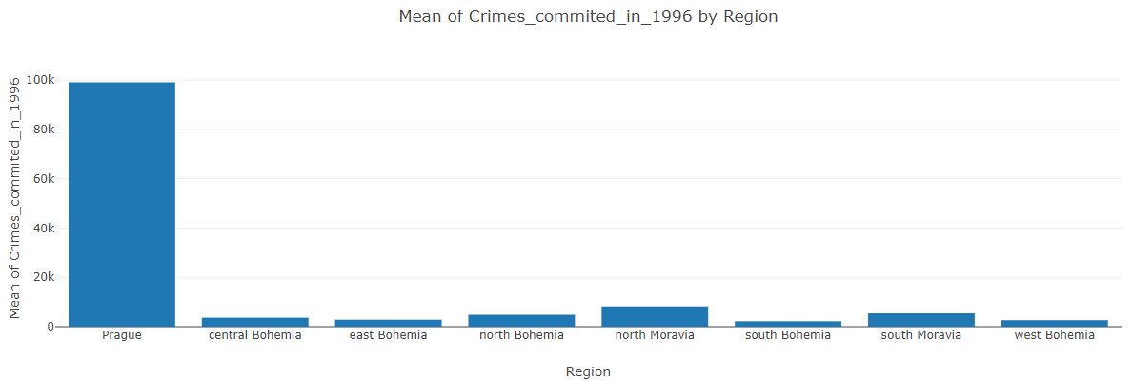
As seen from the boxplot, there happens to be Salary outliers from west and south Bohemia region.
We also don’t have any boxplot for Prague Region. This indicates there exists only 1 salary for the whole Prague Region.
There also exist only one district in Prague which is Hl.m. Praha. That means, only 12541 is maintained as salary for Prague. This seems to be a data entry error in CRM system.
There seem to be a positive correlation between Crime Committed and Urban Inhabitants, specially or citizens of Prague.
It would not be advisable for any Financial institution to open a new branch in a Region with High Crime Rate there by compromising Security.

Slide 10
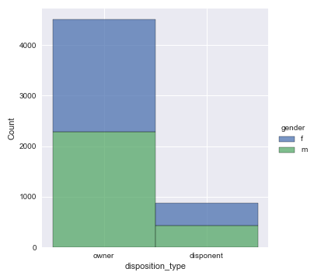
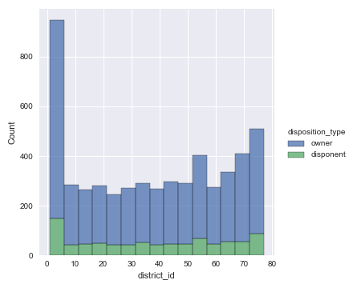
Disposition-district dataset insights:
disp_id 5369
client_id 5369
account_id 4500
disposition_type 2
birth_number 4738
district_id 77
gender 2

Slide 11
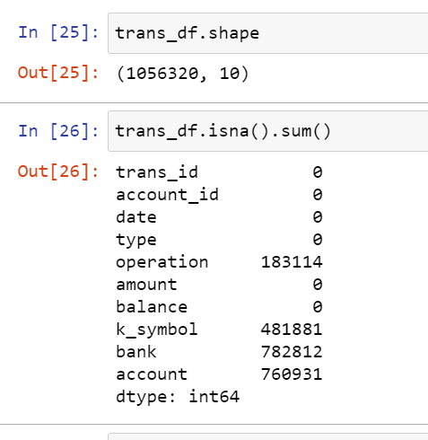
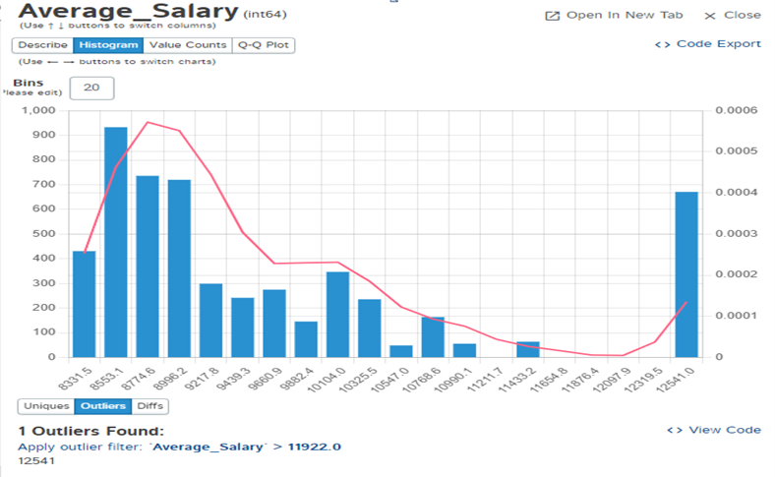
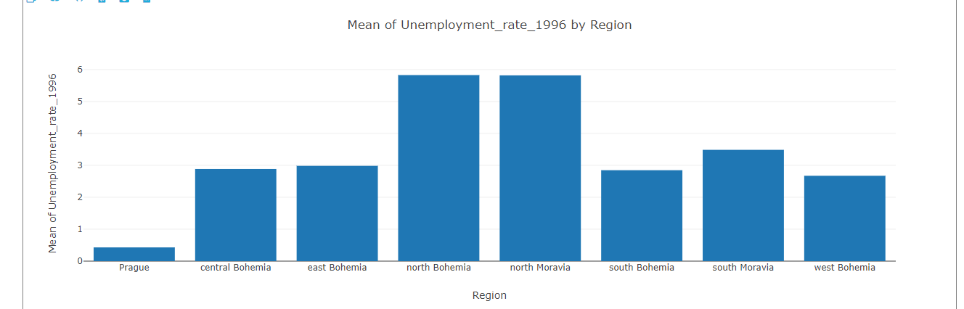
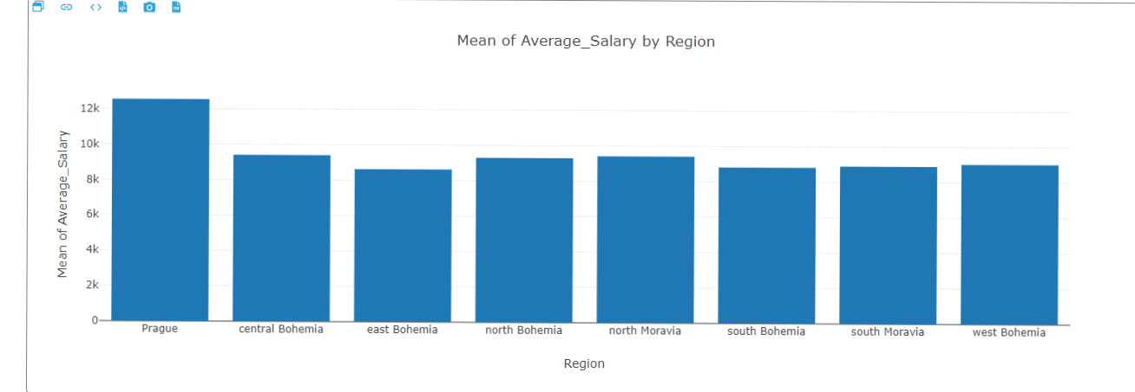
Transaction dataset insights:
There are more than 1 Million records in Transaction Table.
Transaction table is the only table which has Null values.
More than 70% of the data in the respective fields – ‘bank’ and ‘account’ are Null.
There are many fields like – ‘k_symbol’, ‘type’, ‘operation’ in Transaction dataset which have their categorical features categorized in CZECH language. These need to be renamed for better understanding.
There are some categories which are not named and hence should be represented by Unknown.
Most of the Salary of Clients lie between 8000 to 10990 unit currency.
There is an Outlier with Salary – 12541.

Slide 12
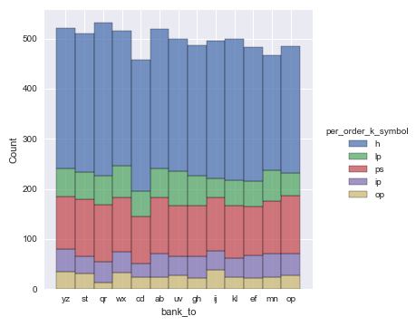
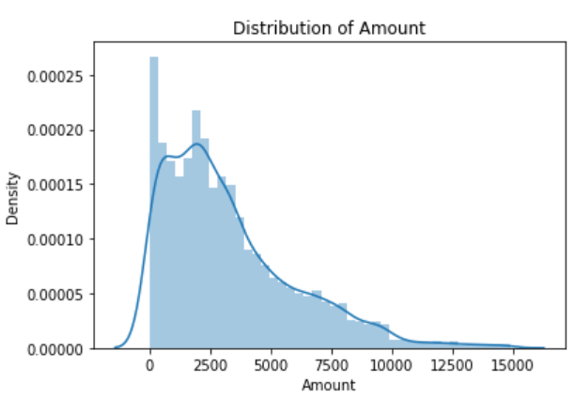
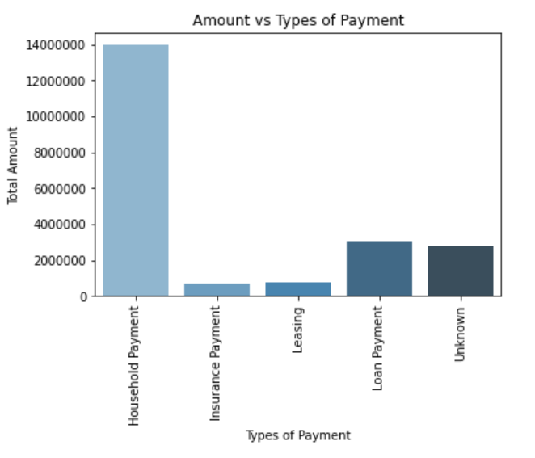
Permanent_order dataset insights:
account_id 3758
district_id 77
Frequency 3
account_date 1468
order_id 6471
bank_to 13
account_to 6446
per_order_amount 4412
per_order_k_symbol 5
The debited Amount from The Orders table follows a Right Skewed Pattern where a major chunk of debits is less than 7500 unit currency.
More than 65% of debited Amount is for the type - Household Payment.
And, least debited Amount , which is 3.24% of Amount is for Insurance Payment.

Slide 13
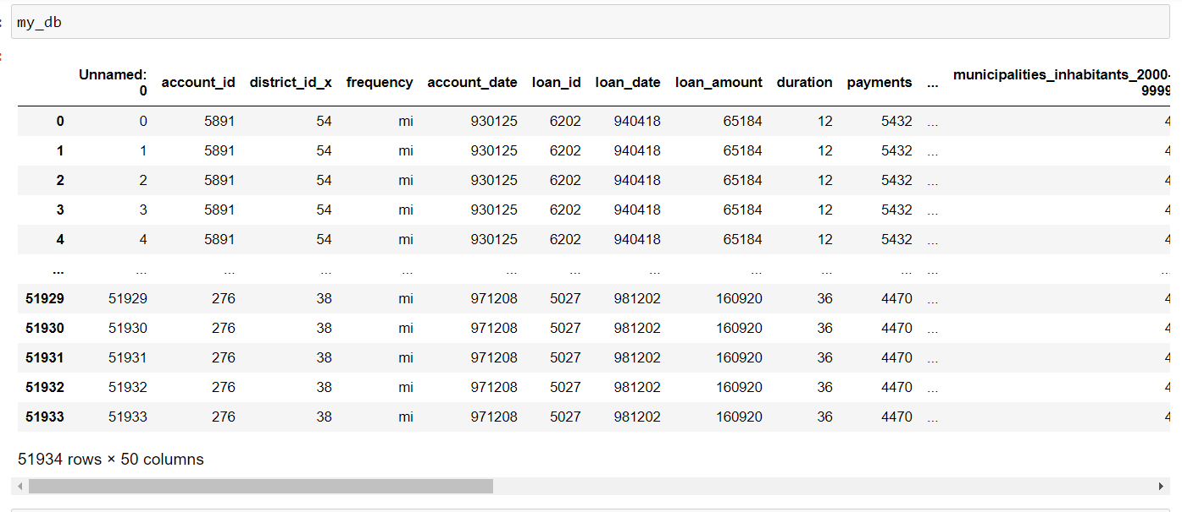
MERGED DATASET:
Index(['account_id', 'district_id_x', 'frequency', 'account_date', 'loan_id', 'loan_date', 'loan_amount', 'duration', 'payments', 'status', 'order_id', 'bank_to', 'account_to', 'per_order_amount', 'per_order_k_symbol', 'trans_id', 'transaction_date', 'transaction_type', 'operation', 'transaction_amount', 'balance', 'k_symbol', 'recepient_bank', 'recepient_account', 'disp_id', 'client_id', 'disposition_type', 'birth_number', 'district_id_y', 'gender', 'card_id', 'card_type', 'card_issued', 'district_name', 'region', 'no_of_inhabitants', 'municipalities_inhabitants<499', 'municipalities_inhabitants_500-1999', 'municipalities_inhabitants_2000-9999', 'municipalities_inhabitants>10000', 'no_of_cities', 'ratio_urban_inhabitants', 'average_salary', 'unemployment_rate_1995', 'unemployment_rate_1996', 'enterpreneurs_per_1000_inhabitants', 'crimes_commited_in_1995', 'crimes_commited_in_1996'], dtype='object')
SHAPE: (51934, 50)

Slide 14
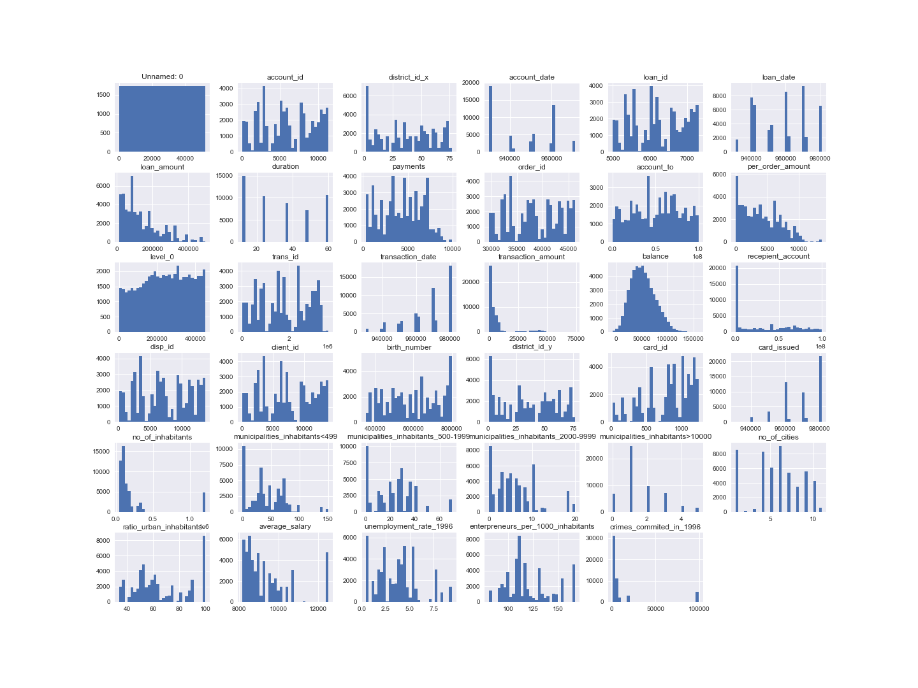
Seaborn histplot:

Slide 15
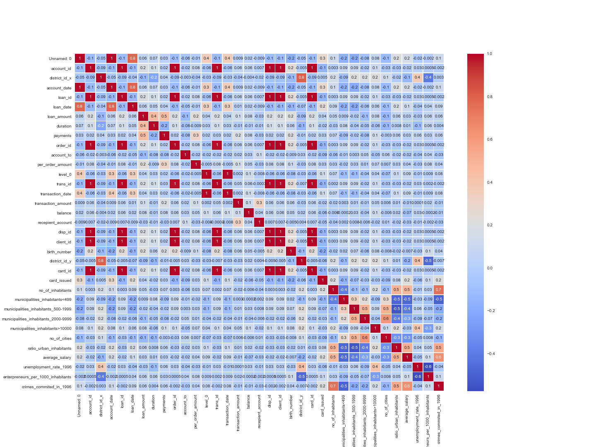
Heatmap:

Slide 16
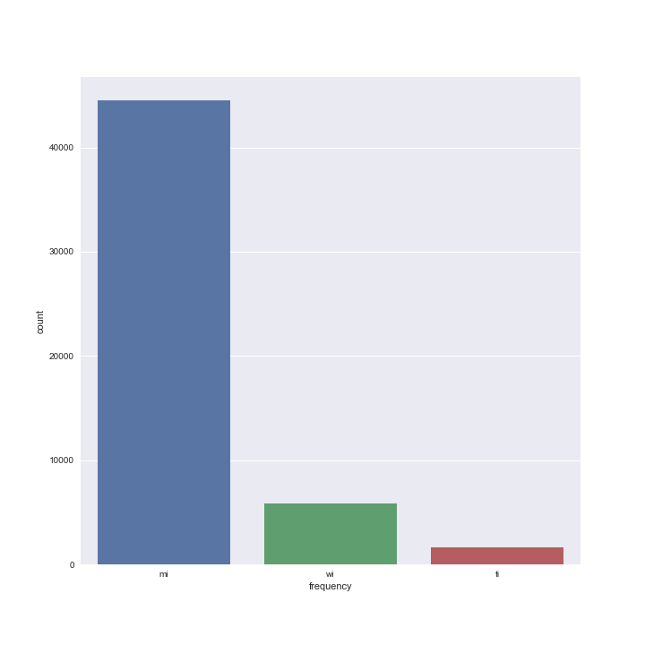
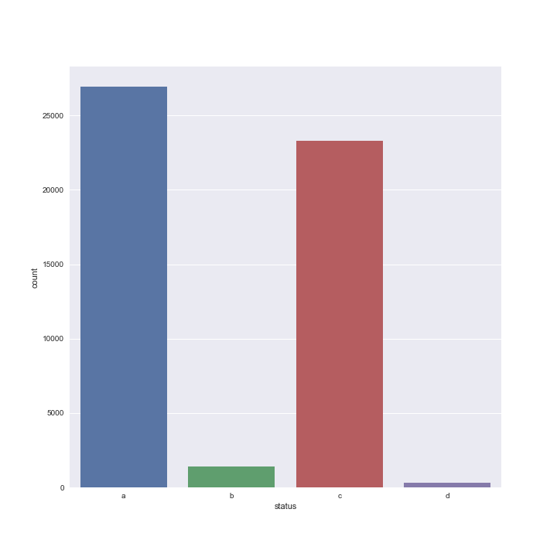
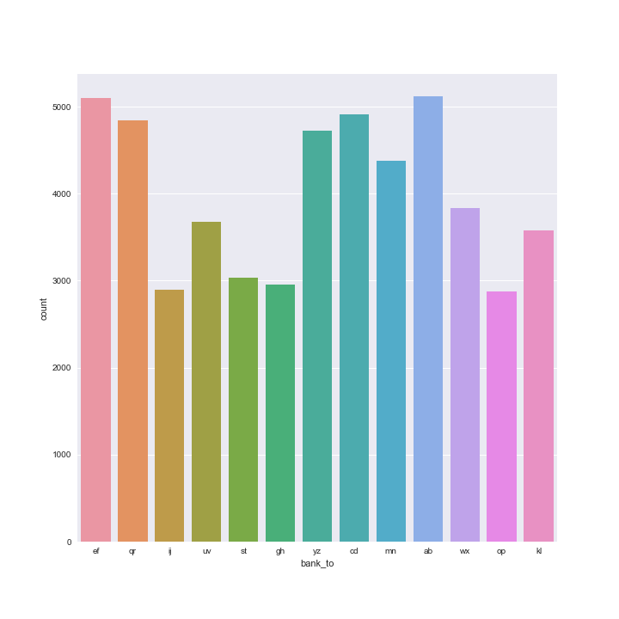
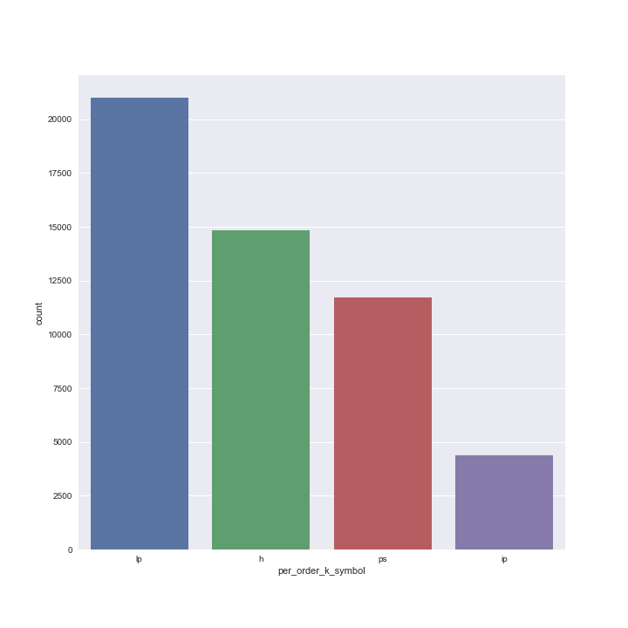

Slide 17
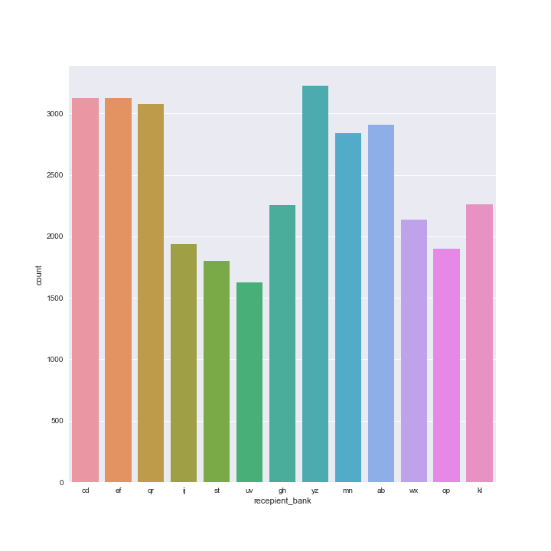
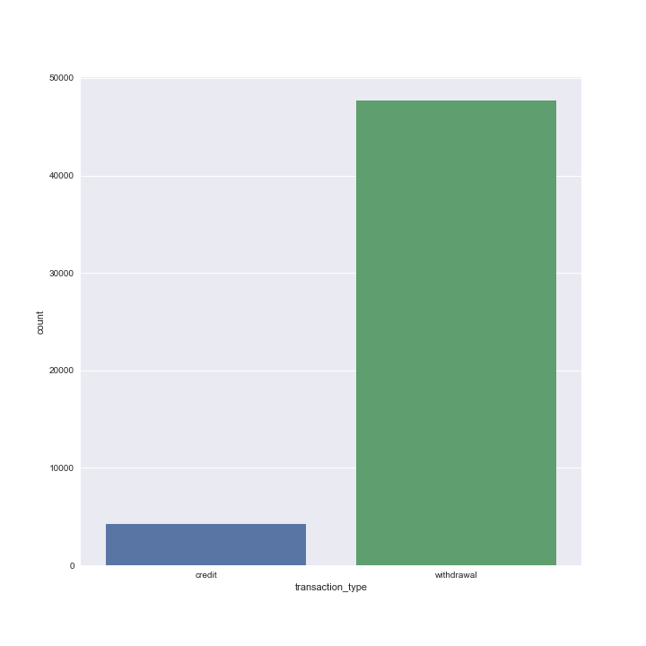
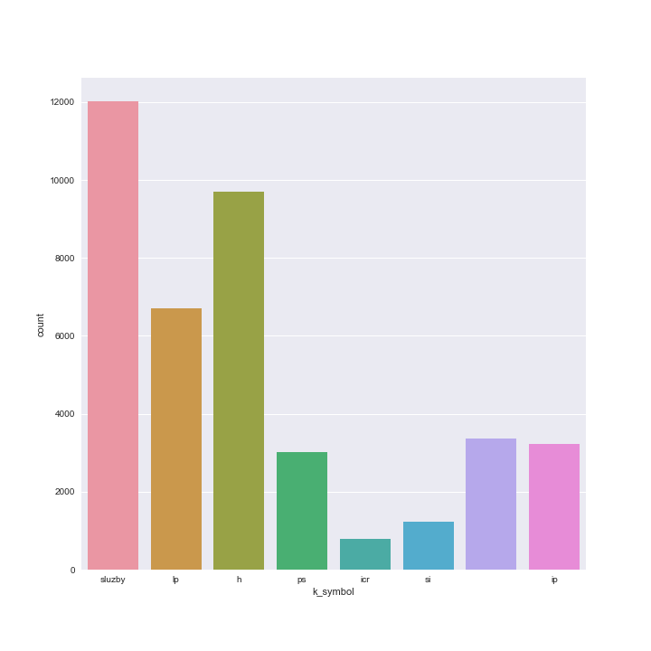
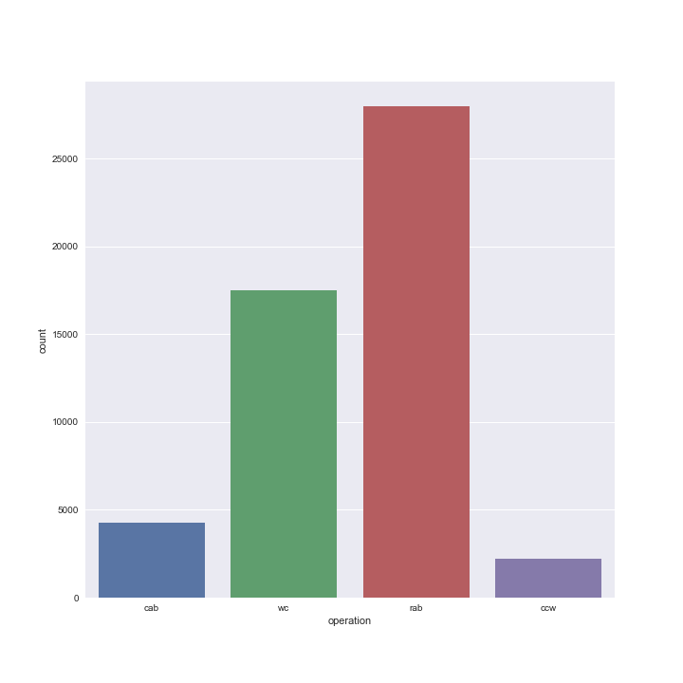

Slide 18
