Slide 1
Home Credit: Borrower Analysis
Group 2
JUSTIN HAMILTON, SAMPOORNAA GHOSH,
DEBAYAN DUTTA, AND RACHEL BUTTERFIELD

Slide 2
THE BUSINESS PROBLEM
CHALLENGE : Potential risk of loan default .
MISSION : Develop a robust default prediction system.
IMPACT : Informed lending decisions for improved portfolio management.

Slide 3
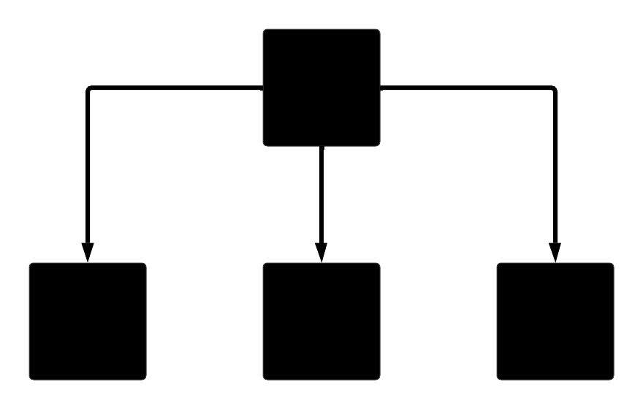
The model
Gradient Boosted Tree Model

Slide 4
How it works
Gradient Boosted Tree Model
Builds decision trees

Slide 5
How it works
Gradient Boosted Tree
Builds decision trees
Learns from mistakes

Slide 6
How it works
Gradient Boosted Tree
Builds decision trees
Learns from mistakes
Evaluates as a whole

Slide 7
How it works
Gradient Boosted Tree
Builds decision trees
Learns from mistakes
Evaluates as a whole
Increases accuracy

Slide 8
Works well for home credit data
Can model non-linear relationships

Slide 9
Works well for home credit data
Model non-linear relationships
Handle large datasets

Slide 10
Works well for home credit data
Model non-linear relationships
Handle large datasets
Computationally efficient (fast)

Slide 11
Works well for home credit data
Model non-linear relationships
Handle large datasets
Computationally efficient (fast)
Less sensitive to outliers

Slide 12
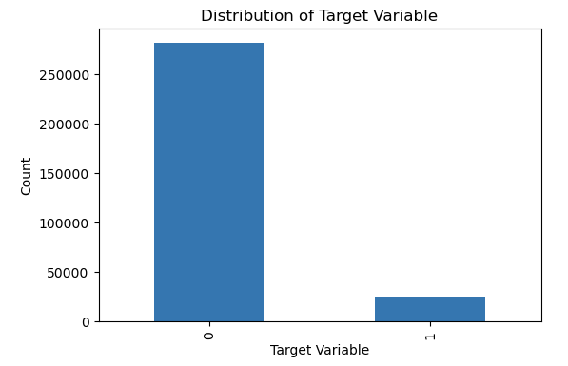
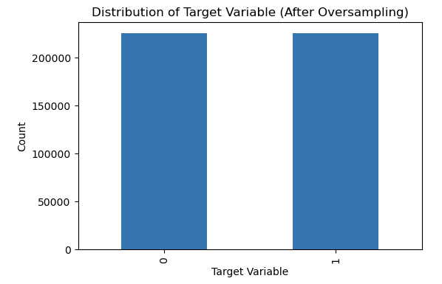
Works well for home credit data
Model non-linear relationships
Handle large datasets
Computationally efficient (fast)
Less sensitive to outliers
Handle data imbalance by oversampling

Slide 13
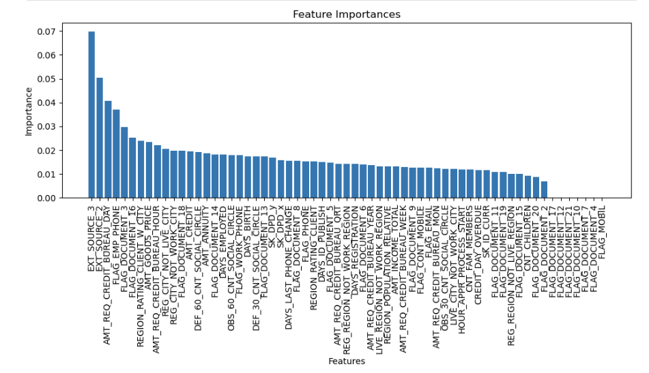
Works well for home credit data
Model non-linear relationships
Handle large datasets
Computationally efficient (fast)
Less sensitive to outliers
Handle data imbalance by oversampling
Able to access important features

Slide 14
Results: Scores
.656
.669
AUC
Kaggle Score
Notes:
Kaggle Score: 0.655604 Accuracy on the Train Set: 0.744094

Slide 15


Results: 10 ATTRIBUTES OF default
EXT_SOURCE_3
EXT_SOURCE_2
AMT_REQ_CREDIT_BUREAU_DAY
FLAG_EMP_PHONE
FLAG_DOCUMENT_3
FLAG_DOCUMENT_16
REGION_RATING_CLIENT_W_CITY
AMT_GOODS_PRICE
AMT_REQ_CREDIT_BUREAU_HOUR
REG_CITY_NOT_LIVE_CITY
Notes:
Kaggle Score: 0.655604 Accuracy on the Train Set: 0.744094

Slide 16

Results: 6 Key ATTRIBUTES OF default
AMT_REQ_CREDIT_BUREAU_DAY
FLAG_EMP_PHONE
REGION_RATING_CLIENT_W_CITY
AMT_GOODS_PRICE
AMT_REQ_CREDIT_BUREAU_HOUR
REG_CITY_NOT_LIVE_CITY

Slide 17

Results: ATTRIBUTES OF default
Many enquiries to Credit Bureau 1 day before application
Client provided work phone
Low Rated Regions
High Price of Goods
Many enquiries to Credit Bureau 1 hour before application
Permanent Address ≠ Contact Address
Notes:
Based on these results, the customer is most likely to default when
A high number of enquiries to Credit Bureau about the client one day before application
Client provided work phone
Suggests that the quality of region is a strong indicator of whether a customer will default. Less rated regions may have more likelihood of default.
Higher price of goods that the loans were given.
Higher number of enquiries to Credit Bureau about the client on hour before
- If the permanent address does not match the contact address then they are more likely to default.

Slide 18
Business value
LIMITATIONS:
Data collection can be streamlined.
Data validation at source is a necessity for the dataset.

Slide 19
Business value
RECOMMENDATIONS: Gathering the details related to the important features derived from the model is crucial for more accurate defaulter identification.
17% increase in correctly predicting default compared to 50/50 guess. 17% increase captures defaulters that would normally receive a loan which translates to savings for Home Credit.

Slide 20
Thank You

