Slide 1

PROJECT ARTEMIS-X
SUSTAINABLE LUNAR SOUTH POLE ARCHITECTURE | LUNAR BASE DESIGN CHALLENGE
● OVERVIEW
ACTIVE
account_circle
Verified Identity
Debjit Dutta
PRIMARY ROLE
AI Project Manager & Concept Lead (Simulated 'Chief Systems Engineer' for the challenge)
SECURITY ACCESS
SYSTEM STATUS
NOMINAL // CONNECTED

Slide 2



PROJECT ARTEMIS-X
SUSTAINABLE LUNAR SOUTH POLE ARCHITECTURE | LUNAR BASE DESIGN CHALLENGE
● PROJECT OBJECTIVE
MANAGEMENT
Orchestrating AI to Build the Future
To demonstrate technical project management, rapid prototyping, and AI orchestration by acting as a director for AI coding assistants, rather than hand-coding a 3D environment from scratch or engineering real-world aerospace hardware. Here is how management shaped this design:
terminal
integration_instructions
bug_report
Prompt Engineering
Translated strict aerospace design constraints into programmatic prompts to guide AI code generation.
Asset Integration
Managed the integration of multiple AI-generated geometries (Starships, Solar Towers, Kevlar Domes) into a cohesive WebGL scene.
Quality Assurance
Acted as the technical reviewer, debugging and refining the AI-generated JavaScript to ensure a performant browser experience.

Slide 3

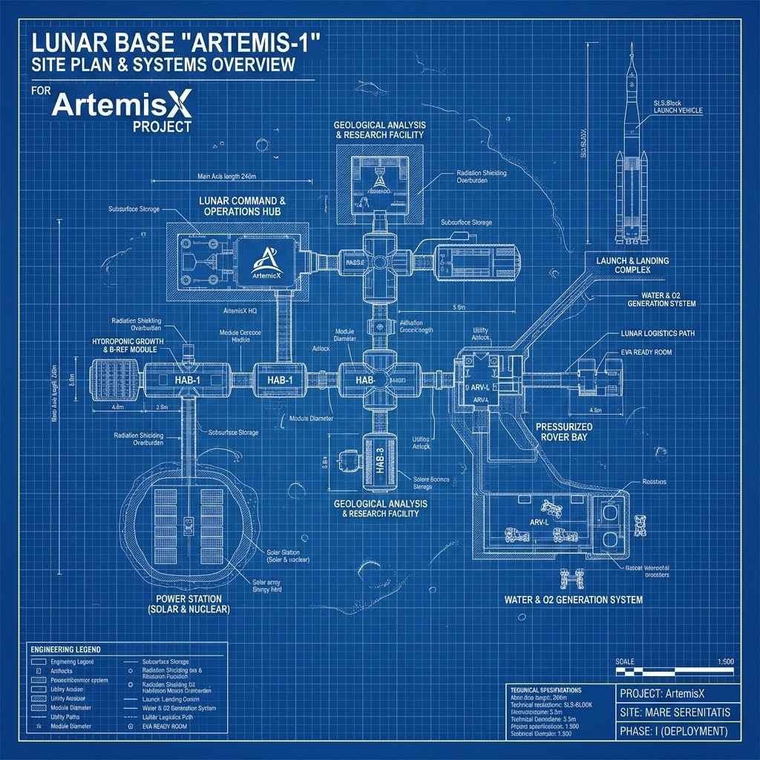
Mission Overview
Strategic Location
Situated at the South Pole's Shackleton Crater, our architecture exploits near-constant solar illumination and proximity to permanently shadowed regions (PSRs) rich in water ice.
Zero-Waste Paradigm
Operating on a strict closed-loop ecosystem, the base utilizes advanced In-Situ Resource Utilization (ISRU) to achieve unprecedented Earth-independence and sustainability.

Slide 4


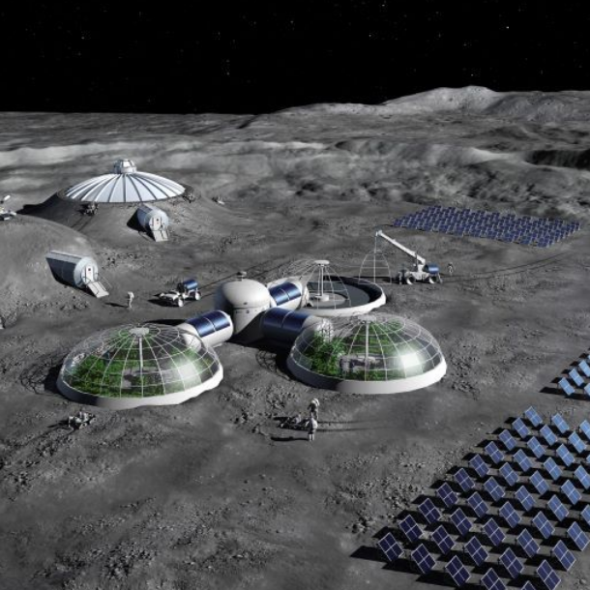



Structural Architecture
●3D SIMULATION
syncROT: 312°
Inflatable Kevlar Habitats
grid_view
Autonomous Shielding: Rovers sinter and pile 2-3 meters of lunar regolith over domes to block Galactic Cosmic Rays and micrometeoroids.
blur_circular
Exoskeleton Ribs: 3D-printed external load-bearing ribs distribute the massive weight of the regolith shielding.
SHIELDING DOME
gps_fixed
Zenith Nodes: Rigid top-mounted caps house optical sensor suites and emergency vertical docking ports.
EXOSKELETON RIBS
sensor_door
Reinforced Airlocks: Interconnecting pressure corridors feature ribbed reinforcement to prevent fatigue and depressurization.
CONNECTING AIRLOCK
3d_rotationDRAG TO ROTATE 3D MODEL

Slide 5


INTERACTIVE 3D SIMULATION
Experience Project Artemis-X in Real-Time
Step inside the digital twin of our proposed lunar South Pole base. This high-fidelity, interactive 3D blueprint allows you to fully inspect the structural integration, solar arrays, and sub-surface architectures.
Key Interactive Features
■ Orbital Rotation: Drag to spin the entire base model and examine the structural distribution.
■ Cross-Section Views: Cut away the 3-meter sintered regolith shields to view interior Kevlar domes.
■ Asset Inspection: Click on individual components like the Zenith Sensor Nodes or vertical solar towers for live telemetry telemetry specifications.
SCAN TO ROTATE MODEL
https://debjit-prime.github.io/ARTEMIS-X/
Compatible with iOS and Android devices. Instantly launch the WebGL interactive experience.

Slide 6






STRUCTURAL INTEGRATIONS
Autonomous Shielding
Exoskeleton Ribs
Zenith Sensor Nodes
The habitat domes feature 3D-printed external structural ribs that evenly distribute the massive, crushing weight of the regolith shielding across the base foundation.
Prior to crew arrival, rovers sinter and pile 2-3 meters of lunar regolith over the inflatable Kevlar domes, providing vital protection against Galactic Cosmic Rays (GCRs).
Each dome is capped with a rigid zenith node housing optical sensors, emergency ventilation valves, and vertical docking ports for rovers and landing modules.

Slide 7

ENERGY & HYDRATION SYSTEMS
1. Power Generation
2. Water Recovery
Vertical Solar Towers: Due to the low polar sun angle, standard flat panels fail. We deploy towering bi-facial arrays that track the sun across the horizon.
Ice Sublimation: Autonomous thermal-mining rovers extract water ice from the crater floor, sublimating it into vapor and leaving toxic lunar dust behind.
Storage & Failsafe: Regenerative Fuel Cells (RFCs) recombine hydrogen and oxygen at night. A 10kW buried Kilopower fission reactor provides a constant emergency baseline load.
Closed-Loop ECLSS: Water is too heavy to import. We recover 98% of all habitat moisture—including sweat and respiration—via catalytic oxidation and distillation.

Slide 8







ISRU & Biosystems Integration
3. Oxygen Prod.
4. Food (Aeroponics)
5. Cyanobacteria
Lunar regolith is ~45% oxygen by weight. Molten Regolith Electrolysis (MRE) heats soil to 1600°C. An electrical current separates pure breathable oxygen from the magma, leaving useful metal alloys behind.
Food is cultivated in vertical aeroponic greenhouses using 95% less water than soil farming. Narrow-band red and blue LEDs supply exact Photosynthetically Active Radiation (PAR) to minimize power draw.
Photobioreactors cultivate Spirulina (microalgae). It rapidly consumes crew CO₂ output and produces a highly dense, easily harvested source of protein and essential vitamins in low-gravity.

Slide 9



Advanced Infrastructure
6. Waste Management
7. Communication Relay
The Sabatier Reaction recovers atmospheric gases, combining Carbon Dioxide and Hydrogen to yield Methane (for lander propellant) and Water:
Primary Uplink: Direct-to-Earth (DTE) Optical (Laser) Communications provide gigabit data rates for real-time telemetry and telemedicine.
Relay Architecture: To prevent blackout periods caused by lunar rotation, a dedicated Lunar Relay Satellite in a Near-Rectilinear Halo Orbit (NRHO) establishes 24/7 telecommunications redundancy.
Solid biological waste is aerobically processed into aeroponic fertilizer, closing the loop.

Slide 10

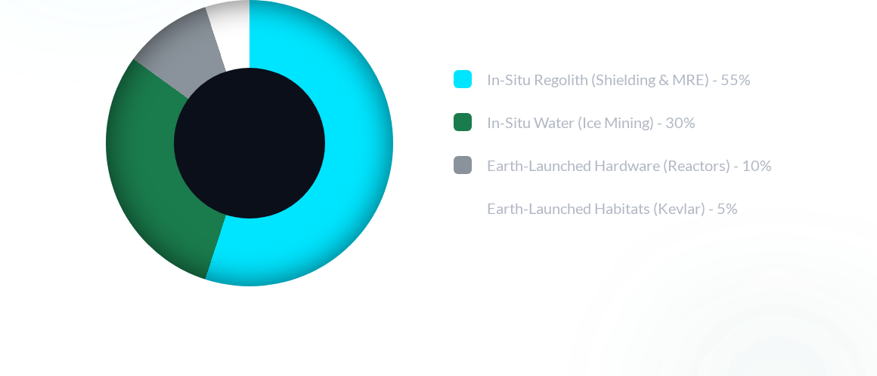
PAYLOAD MASS ALLOCATION
⚡ Telemetry: Active
Target: 85% ISRU
By relying on In-Situ Resource Utilization (ISRU) for 85% of the total base mass, Project Artemis-X drastically reduces Earth-launch payload costs and achieves unprecedented mission sustainability.

Slide 11
Artemis-X Deployment Timeline
PHASE 01 • ACTIVE
Preparation
Autonomous rovers deploy to Shackleton Crater to sinter regolith foundations and establish initial vertical solar array grids.
✓ ROVERS DEPLOYED
PHASE 02 • QUEUED
Construction
Inflatable Kevlar habitats land and pressurize. Rovers bury the modules in 3 meters of regolith shielding.
⚡ READY FOR LANDING
PHASE 03 • PENDING
Integration
ECLSS, Aeroponics, and Molten Regolith Electrolysis systems are brought online and tested autonomously.
○ ECLSS STAGED
PHASE 04 • PENDING
Operations
First crewed landing. Astronauts enter a fully functional, pressurized, and thermally stable biosphere.
○ CREW ASSIGNED

Slide 12
Conclusion
Project Artemis-X proves humanity can establish a permanent foothold through sustainable, closed-loop environmental design.
National Space Day: Lunar Base Design Challenge

Slide 13
Mission Ready.
Establishing a permanent, self-sufficient foothold on the lunar surface.

