Slide 1
Ensemble Learning Techniques for Robust Demand Forecasting in e-commerce

Slide 2
Objective
To develop and evaluate ensemble learning techniques for improving the accuracy and robustness of demand forecasting in e-commerce.
To investigate the performance of different ensemble models in predicting e-commerce demand under varying conditions.
To reduce the mean absolute error (MAE) and mean squared error (MSE) in demand forecasts by leveraging ensemble techniques.
To develop models that maintain high performance despite changes in consumer behavior and market trends.

Slide 3
Problem Definition
Demand forecasting is critical for e-commerce businesses to manage inventory, optimize supply chains, and meet customer demand efficiently.
Seasonal fluctuations, promotional spikes, and changing consumer behaviours make it challenging to forecast accurately.
Current single-model approaches are inadequate for handling the dynamic nature of e-commerce demand, leading to inaccurate forecasts and potential losses in revenue.
There is a need for robust forecasting models that can adapt to rapid changes in demand patterns, leveraging ensemble learning techniques to improve accuracy and reliability

Slide 4
Literature Review
Random Forest and Gradient Boosting techniques have been extensively used for forecasting due to their ability to handle complex datasets. [1]
Studies like Kang et al. (2021) have integrated spatial-temporal models with machine learning for better forecasting accuracy. [2]
Ensemble models such as XGBoost and LightGBM have shown significant improvements in predictive accuracy compared to traditional models. [3]
Stacking regressors have been explored for combining the strengths of multiple models to improve robustness. [4]
Despite advancements, there is limited research on the application of ensemble learning techniques specifically tailored to the volatile nature of e-commerce demand.
This study will explore and compare various ensemble methods to identify the most effective approach for robust demand forecasting in e-commerce.

Slide 5
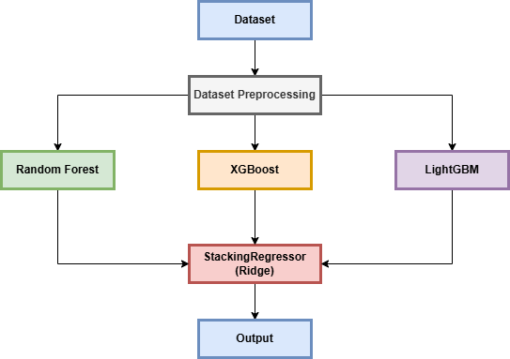
Proposed Methodology
Key Technique
Stacking Ensemble Method
RandomForest, XGBoost, LightGBM as base models
StackingRegressor with Ridge as the meta-model
Process
Data Preprocessing
Model Training with individual ensemble techniques
Combining predictions using StackingRegressor

Slide 6
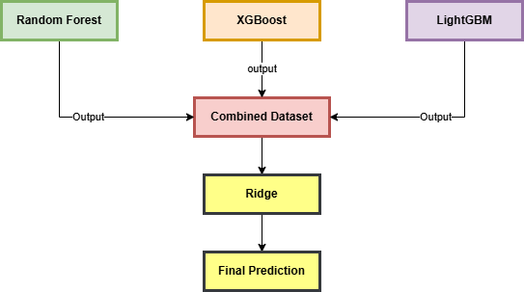
Proposed Methodology
Base Models
Random Forest - Ensemble technique using multiple decision trees. Suitable for handling large datasets with high dimensionality.
XGBoost - Gradient boosting framework that uses decision trees. Known for its efficiency and performance on structured data.
LGBM - Gradient boosting framework focusing on fast training and low memory usage. Handles large datasets efficiently by using leaf-wise growth.

Slide 7
Proposed Methodology
Stacking Regressor
Combines multiple base models to form a meta-model.
Aims to leverage the strengths of each model to improve predictive accuracy.
Ridge Regression
Chosen as the meta-model due to its ability to handle multicollinearity.
Helps in regularizing the stacked predictions to prevent overfitting.
Implementation Steps
Train base models (RandomForest, XGBoost, LightGBM) separately.
Use their predictions as input features for Ridge Regression.
Evaluate the combined model’s performance on test data.
Performance Metrics
Mean Absolute Error
Mean Squared Error

Slide 8
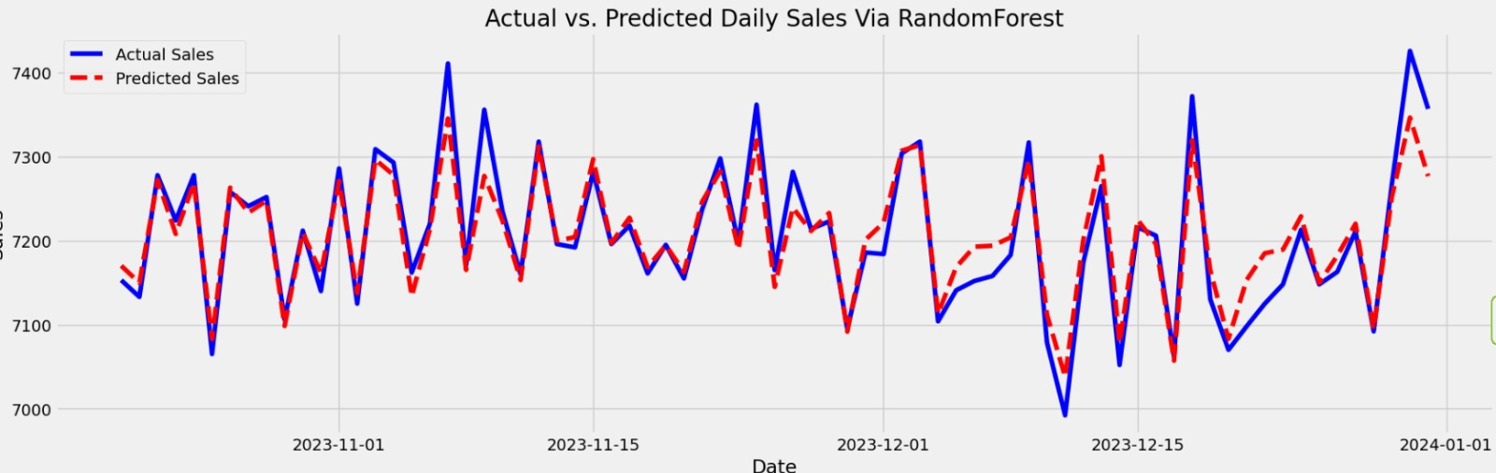
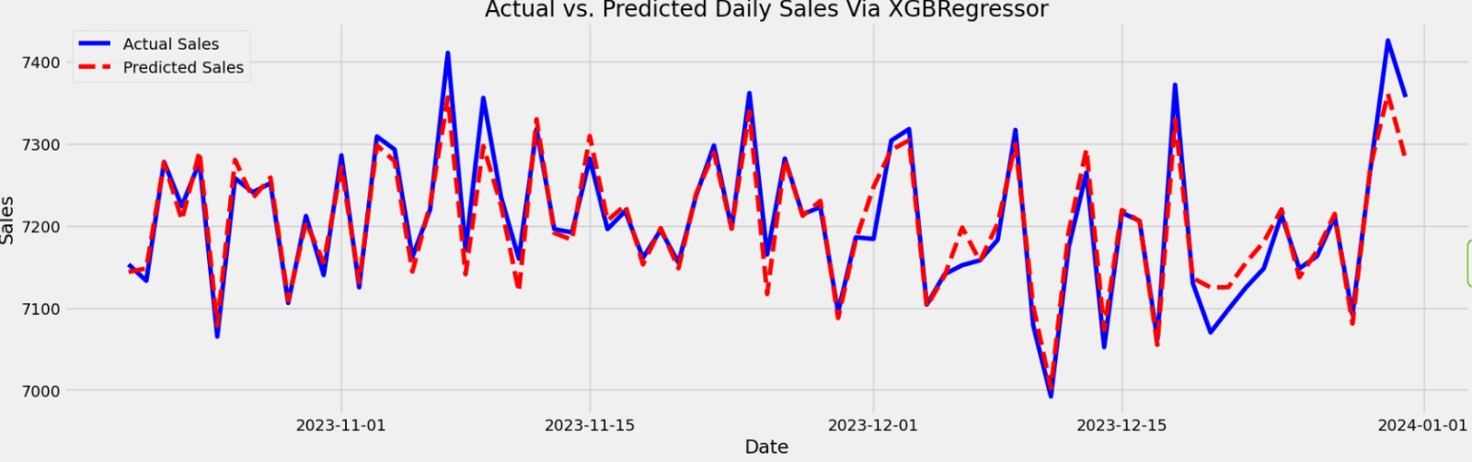
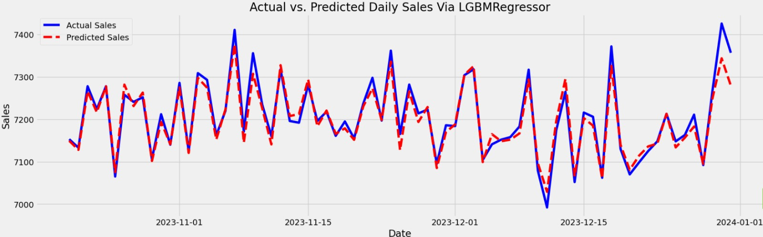
Experimental Details
Random Forest: The Random Forest model delivered a MAE of 20.49 and MSE of 739.32, indicating a moderate error rate in predictions.
XGBoost: The XGBoost model improved accuracy with a MAE of 17.18 and maintained the same MSE of 739.32, suggesting better precision in capturing trends.
LightGBM: The LightGBM model outperformed the others with a MAE of 15.51 and a significantly lower MSE of 467.47, showing superior prediction accuracy and lower variance.

Slide 9
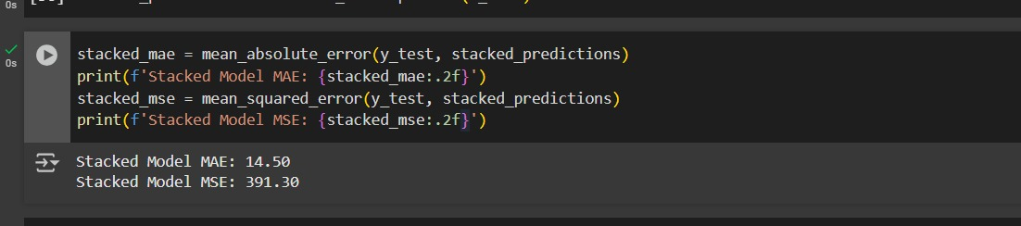
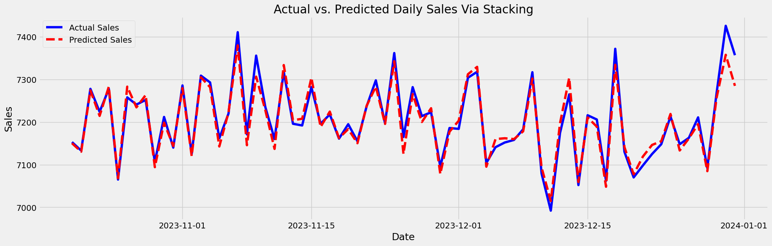
Results and Analysis
Stacked Model Predictions: Made on the test dataset.
Performance Metrics:
MAE: 14.50 (measures prediction error).
MSE: 391.30 (percentage error).
Purpose: Evaluates stacked model accuracy.

Slide 10
Conclusion
The application of ensemble learning techniques has demonstrated significant improvements in the accuracy and robustness of demand forecasting in e-commerce.
The combination of RandomForest, XGBoost, and LightGBM with a StackingRegressor (using Ridge) outperformed traditional single-model approaches.
The ensemble model showed a reduction in forecasting errors (lower MAE and MSE).
This research provides a scalable and efficient framework for e-commerce demand forecasting, leveraging the strengths of multiple ensemble methods.
The proposed methodology offers a promising direction for robust demand forecasting, potentially aiding e-commerce businesses in better decision-making and resource management.

Slide 11
References
S. Punia, K. Nikolopoulos, S. Singh, J. Madaan, and K. Litsiou, “Deep learningwith long short-term memory networks and random forests for demandforecasting in multi-channel retail,” International Journal of ProductionResearch
. Kang, X. Guo, L. Fang, X. Wang, and Z. Fan, “Integration of internet searchdata to predict tourism trends using spatial-temporal xgboost compositemodel,” International Journal of Geographical Information Science
. Xenochristou, C. Hutton, J. Hofman, and Z. Kapelan, “Water demandforecasting accuracy and influencing factors at different spatial scales using agradient boosting machine,” Water Resources Research
. Tsoumakas, “A survey of machine learning techniques for food salesprediction,” Artificial Intelligence Review

Slide 12
THANK YOU

