Slide 1
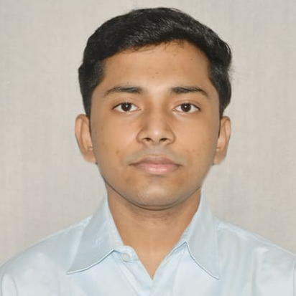

Debjit Chakraborty
Analyst/Software Engineer
iTransform L&D Left Shift Batch
Bachelor of Technology,
Electrical Engineering : 2018-2022
Skills
C# | Basics, OOPS, Exception Handling ,Arrays ,Collection and Generics, Delegates and Events, File Io and Serialization.
.NET Framework | ADO.NET,ASP.NET with MVC5 and WEB API,Entity Framework.
Ado.net | Basics Architecture
Database | SQL
Tools | GIT
UI Technology | HTML5 ,CSS & Angular
Add On Skills | Communication Skills, Team Management.
Mumbai
debjit.chakraborty@capgemini.com
+91 9163242688
A4
Full Stack Developer
Understanding of RDMS concepts using SQL Server.
Practical understanding of C# and SQL concepts using Visual Studio and SQL Server
Hands on experience in developing applications using .NET Framework, ADO.NET Core
Understanding of HTML5 , CSS and Angular Cli
Experience in creating documentation with Swagger and Postman
Completed case study on Online Hotel Management System which is a Web based System to simplify the day to day processes of the hotel. The system will be able to handle many services to take care of all customers in a quick manner. As a solution to the large amount of file handling happening at the hotel, this software will be used to overcome those drawbacks. .
Technologies used:
ANGULAR
ASP.NET CORE
Microsoft SQL Server
Video Link : Click
GitHub Link
https://github.com/sdsameer07

