Slide 1

UNIVERSITY OF KALYANI
DEPARTMENT OF STATISTICS
PROJECT PRESENETATION
Department of Statistics
University of Kalyani
Kalyani, Nadia,741235
27 August,2025

Slide 2
Performance of Distributed Cox Proportional Hazards Modelling for Summary-Level Cancer Data
Presented By: Souradeep Dey
Debjit Saha
Himon Saha
Under the Supervision
of
DR. SUMANTA ADHYA
Assistant Professor, Department of Statistics
West Bengal State University

Slide 3
INTRODUCTION
This study investigates the performance of distributed Cox Proportional Hazards Modelling(CPHM) using summary-level cancer data spanning 2015–2024. The dataset incorporates key risk factors such as genetic predisposition, smoking, and other relevant covariates.
The work addresses a critical challenge in medical research—balancing the need for robust statistical modelling with restrictions on sharing individual-level patient data.
We demonstrate that reliance solely on descriptive statistics can be misleading and insufficient for uncovering the true significance of associations in complex medical datasets.
To overcome data privacy barriers, we apply a recent distributed modelling technique capable of fitting a CPHM using only aggregated summary statistics, without requiring access to primary individual records.
The analysis evaluates model performance, quantifies information loss in comparison to full-data approaches, and highlights the potential of distributed survival models as a privacy-preserving yet statistically rigorous alternative for large-scale epidemiological studies.

Slide 4
DATA COLLECTION
This dataset, sourced from Kaggle, represents global cancer patient data between 2015 and 2024.
It includes simulated information on age, gender, cancer type, genetic risk, environmental exposure (Air pollution), and lifestyle behaviors (Smoking, Alcohol use, Obesity) along with different countries Australia, Brazil, Canada, China, Germany, India, Pakistan, Russia, UK, USA. These features provide a comprehensive basis for analyzing factors influencing cancer diagnosis and survival.
This data contains 33,550 data points. Here we have shown some of the data points.

Slide 5
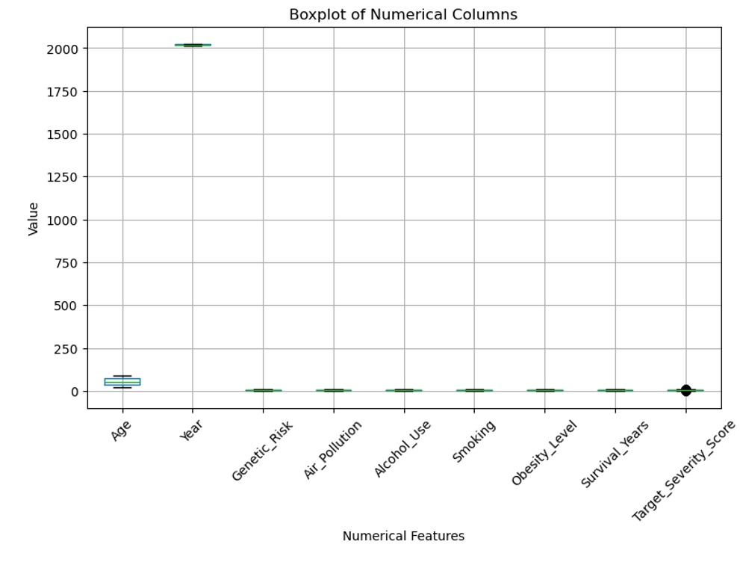
DATA ANALYSIS
1. Data Preprocessing:-
Null value and outlier detection :-
By performing missing value treatment we ensured that there is no missing values in the entire dataset. So the dataset is complete and ready for analysis.
Using the boxplot it was observed that
most columns are tightly distributed
with no major outliers except the
target_severity_score (151 Outliers),
which is 0.30% of the total 50,000 data ,which
is negligible.

Slide 6
2. Generating Event Status:-
Step 1 : Encode the cancer stage:- Stage 0 => 0
Stage I => 1
Stage II => 2
Stage III => 3
Stage IV => 4
Stage V => 5
Step 2 : Process of generating:- Event status will be generated by the conditions i.e.
1 (event occurred → Patient died) (if Stage III or IV and Target_Severity_Score is more than 4)
0 (censored → patient is still alive or lost to follows up) - otherwise
Cancer_Stage Cancer_Stage_Num Target_Severity_Score Event Status
STAGE III 3 3 0 (severity not > 4)
STAGE IV 4 6 1(both conditions hold)
Why we use this logic=>We 're simulating a situation where patients in late-stage cancer (III or IV) and high severity (score > 4) are more likely to have died — which is realistic from a clinical standpoint.
This logic allows us to create a proxy for death events when actual death data is unavailable.

Slide 7
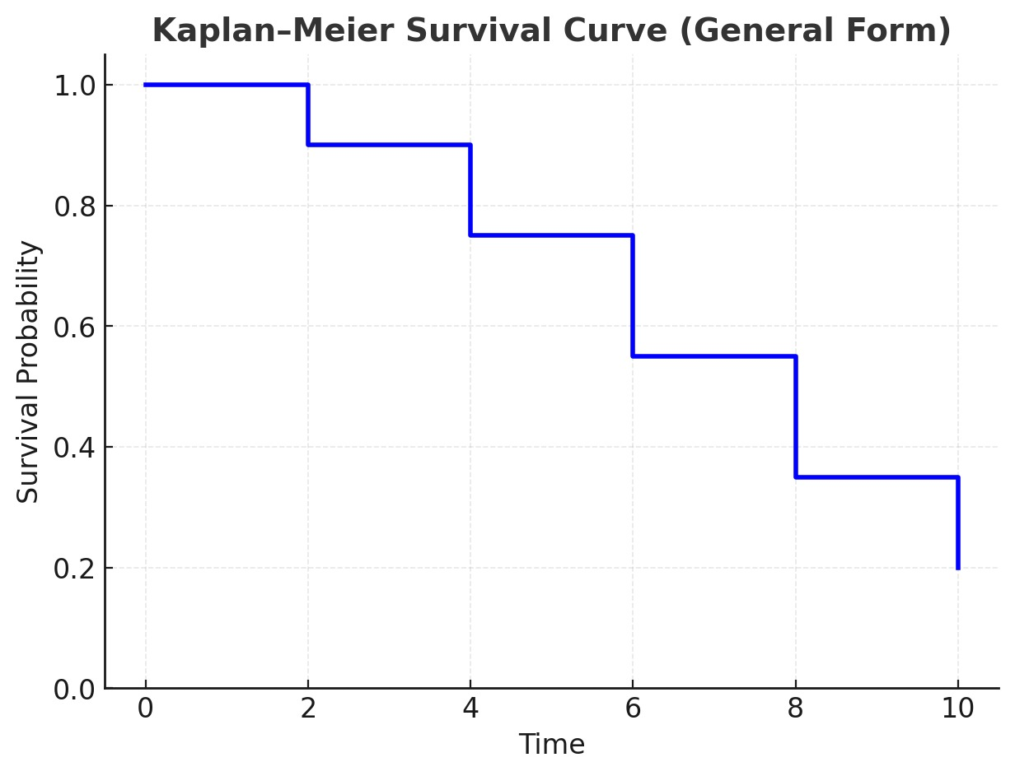
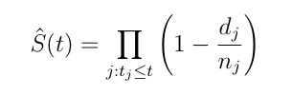

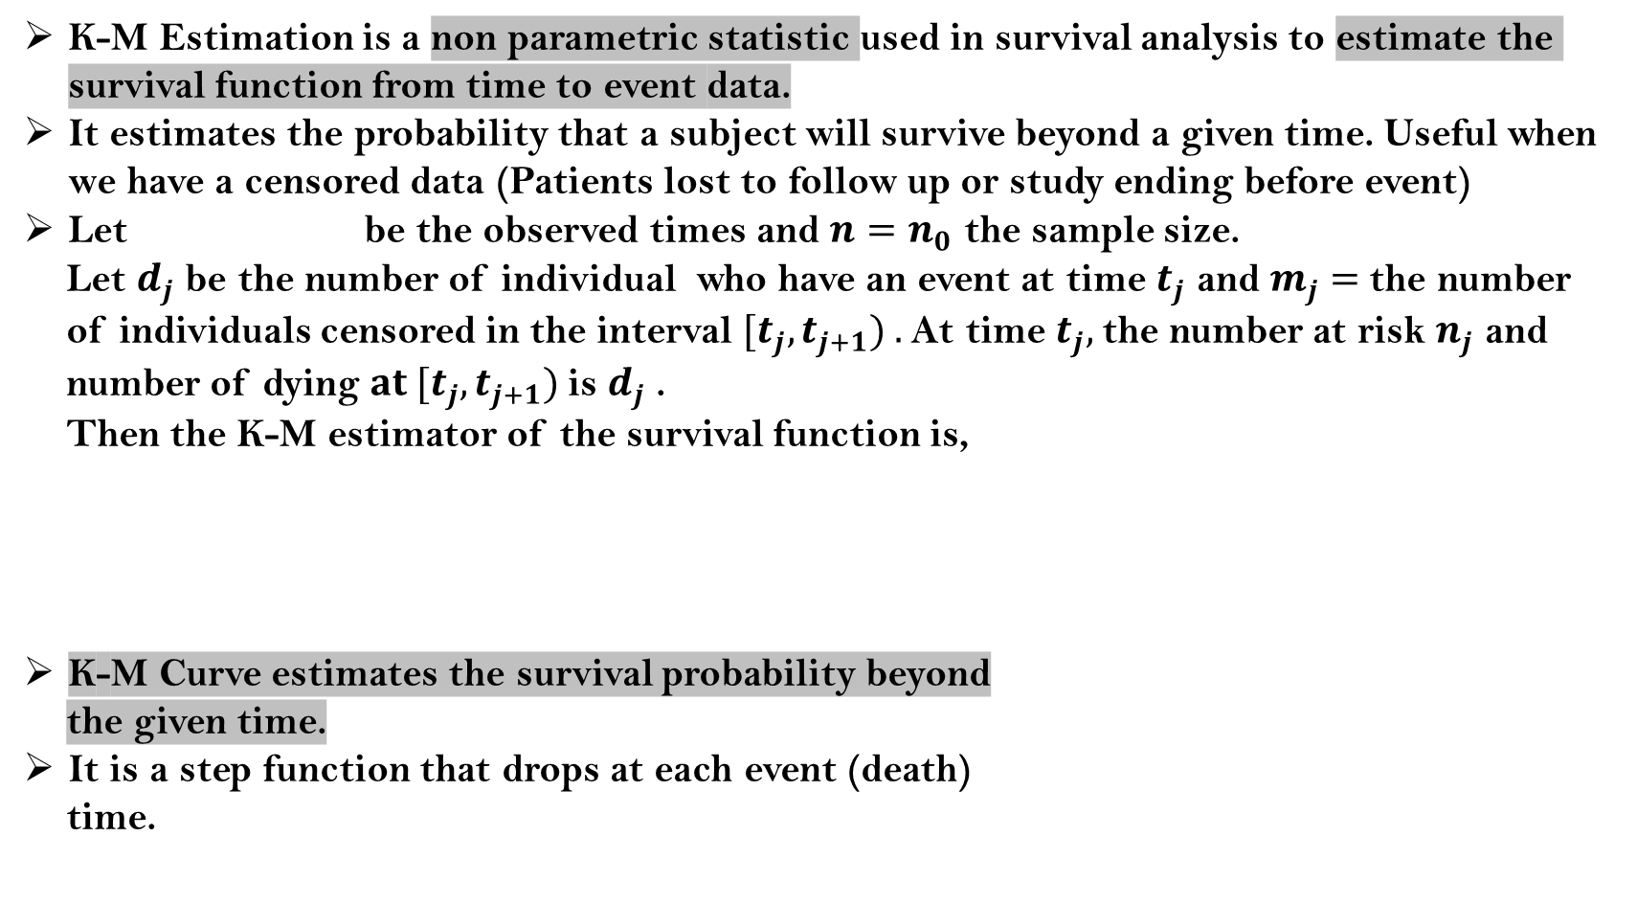
Kaplan-Meier Estimation
K-M Estimation is a non parametric statistic used in survival analysis to estimate the survival function from time to event data.
It estimates the probability that a subject will survive beyond a given time. Useful when we have a censored data (Patients lost to follow up or study ending before event)
Let be the observed times and $n=n_{0}$ the sample size.
Let $d_{j}$ be the number of individual who have an event at time $t_{j}$ and $m_{j}=$the number
of individuals censored in the interval ${[t}_{j},t_{j+1}) .$At time $t_{j},$the number at risk $n_{j}$ and
number of dying $at {[t}_{j},t_{j+1})$is $d_{j}$ .
Then the K-M estimator of the survival function is,
K-M Curve estimates the survival probability beyond
the given time.
It is a step function that drops at each event (death)
time.
$$t_{1}<…..<t_{k}$$

Slide 8

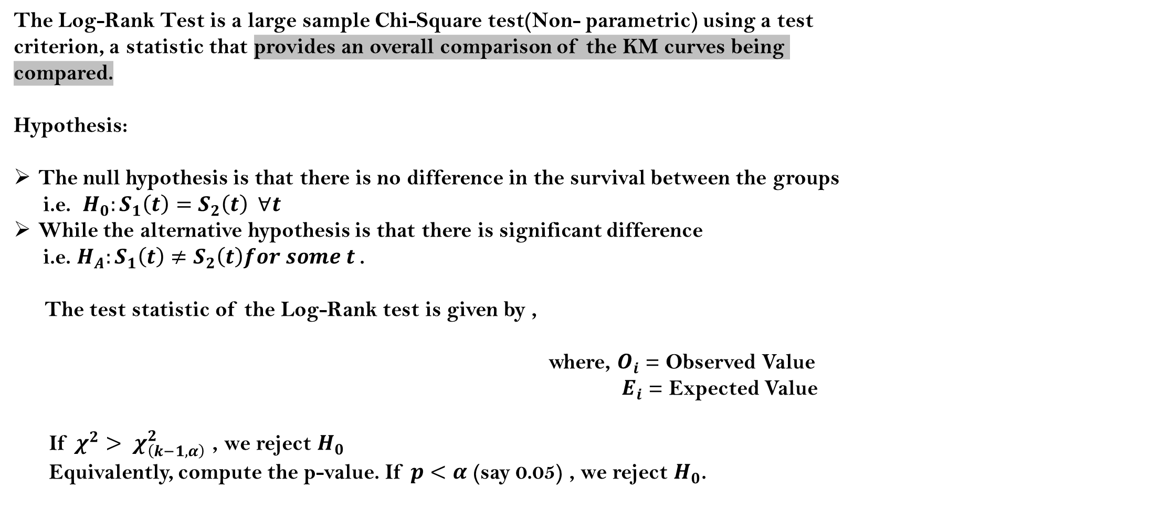
Log-Rank Test
The Log-Rank Test is a large sample Chi-Square test(Non- parametric) using a test criterion, a statistic that provides an overall comparison of the KM curves being compared.
Hypothesis:
The null hypothesis is that there is no difference in the survival between the groups
i.e. $H_{0}:S_{1}\left(t\right)=S_{2}\left(t\right) ∀t$
While the alternative hypothesis is that there is significant difference
i.e. $H_{A}:S_{1}\left(t\right)≠S_{2}\left(t\right)for some t$.
The test statistic of the Log-Rank test is given by ,
where, $O_{i}$ = Observed Value
$E_{i}$ = Expected Value
If $χ^{2}> χ_{\left(k−1,α\right)}^{2}$ , we reject $H_{0}$
Equivalently, compute the p-value. If $p<α$ (say 0.05) , we reject $H_{0}$.

Slide 9
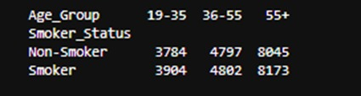
Exploratory Survival Analysis: Log-Rank Tests across Risk Factors
Creating age-bins based on smokers & non-smokers:-
Due to analysis purpose we create 3 age-bins that is 19-35(Young), 36-55(Middle aged) and 55+(Old). For creating the EDA based on survival analysis we are choosing the risk factor “Smoking”(one can use any other risk factors) and as it is a continuous data(lies between 0 to 10), so for converting it to a categorical data we divide it into smoker(>=5.0) and non-smoker(<5.0).
The picture shows a table comparing the counts of smokers and non-smokers across three age groups (19–35, 36–55, and 55+).

Slide 10
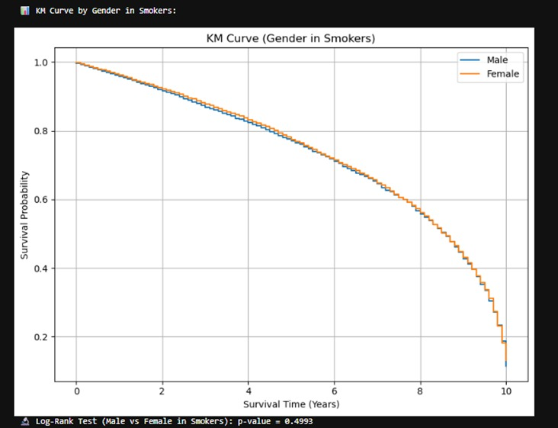
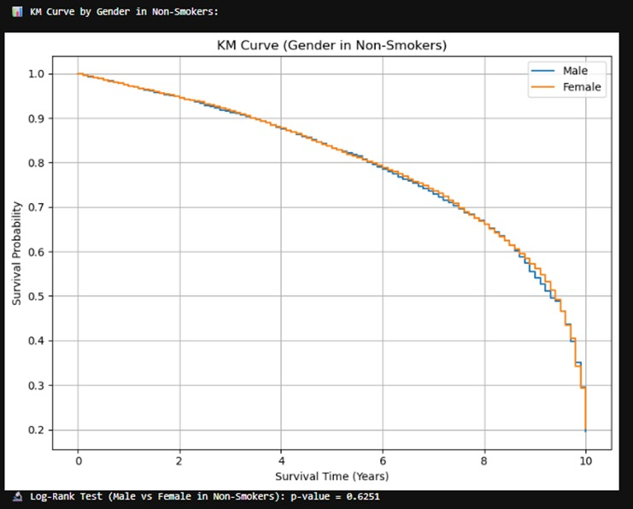
Comparison of Gender vs Smoking Status (Log-Rank Test):-
For Gender vs Smokers Log-Rank Test p-value is 0.4993 so there is no statistically significant difference in survival between male and female smokers in terms of survival.
Visual: - The KM curves for males and females
overlap closely.
For Gender vs Non-Smoker Log-Rank Test p-value is 0.6251, so there is no statistically significant difference in survival between males and females who are non-smokers.
Visual: - The KM curves are very close for
both genders.

Slide 11
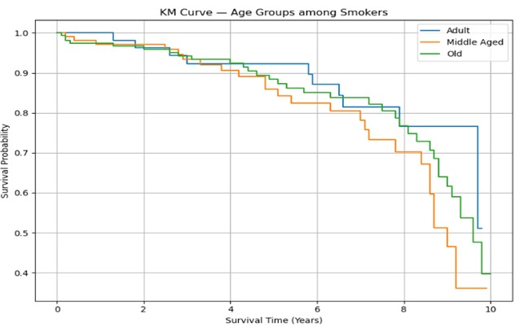
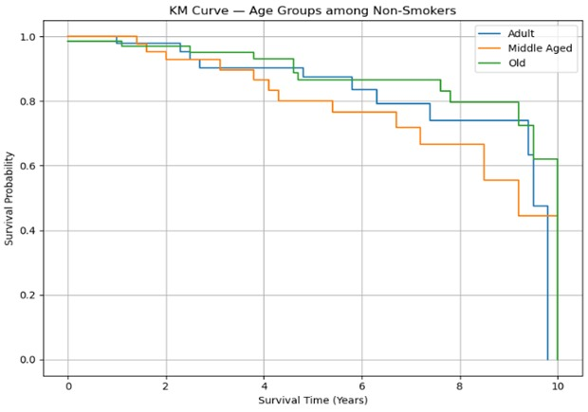
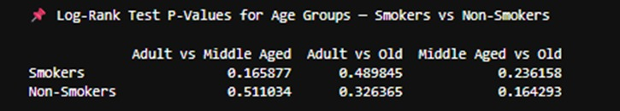
3 different age groups (adult, middle aged, old) vs Smoking (Smokers and Non-Smokers)(Paired Log-Rank Test):-
Interpretation: -
There is no statistically significant difference in survival distributions across age groups within either smokers or non-smokers, as all p-values are > 0.05. Thus, age group alone does not show a significant survival impact when stratified by smoking status.

Slide 12
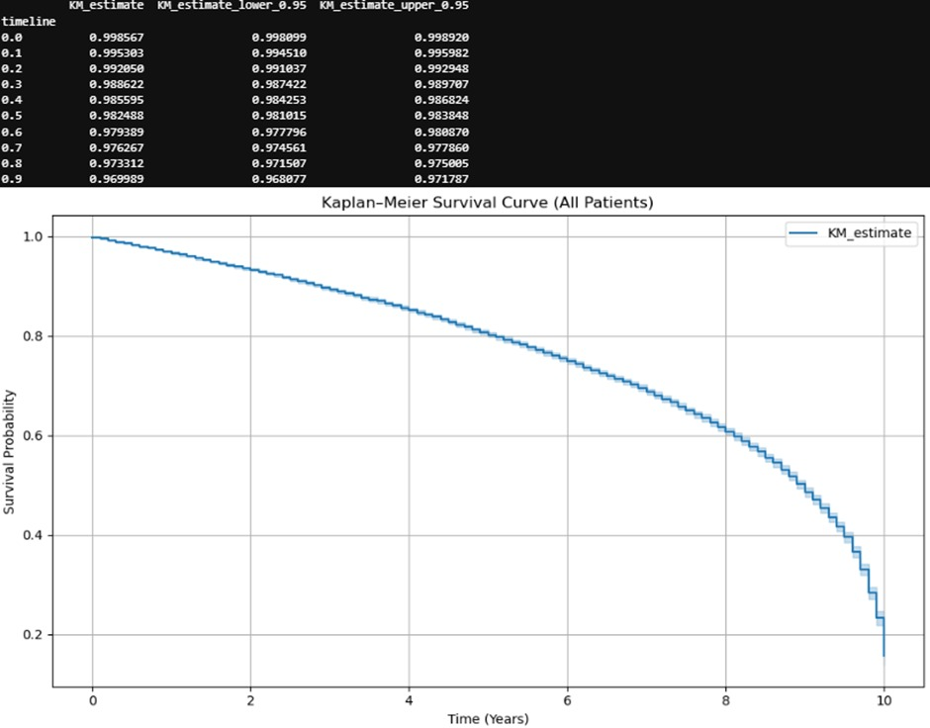
Fitting of K-M Curve for the full dataset:-
Interpretation: -
The overall survival probability steadily declines with time, showing a gradual decrease at first and then a sharper drop after around 7–8 years.
At 10 years, survival probability drops to roughly 20%, meaning only about 1 in 5 patients are expected to survive up to 10 years.
The curve’s smooth and monotonic decrease suggests continuous risk over time rather than abrupt mortality spikes.

Slide 13
Now, Switching to the Regression set up:
KM/log-rank can’t control for multiple variables like gender, smoking, age group, cancer type, etc. ➤ CPHM can estimate the independent effect of each covariate on survival.
Some variables may not appear significant in isolation, but can become significant when adjusted for other variables. ➤ Regression captures these hidden effects.
Interaction or Stratified Analysis Possible: If we suspect interaction between covariates (e.g., smoking may affect survival differently by cancer type), CPHM allows: ➤ Interaction terms ➤ Stratified Cox models.
Summary:
We now switch to the Cox Proportional Hazards regression setup because while KM curves and log-rank tests offer valuable univariate insights, they do not account for potential confounding or interactions across multiple risk factors. Cox regression enables us to estimate the effect of multiple covariates on survival time, adjust for confounders, and quantify hazard ratios, which aligns with the analytical goals of our study.

Slide 14
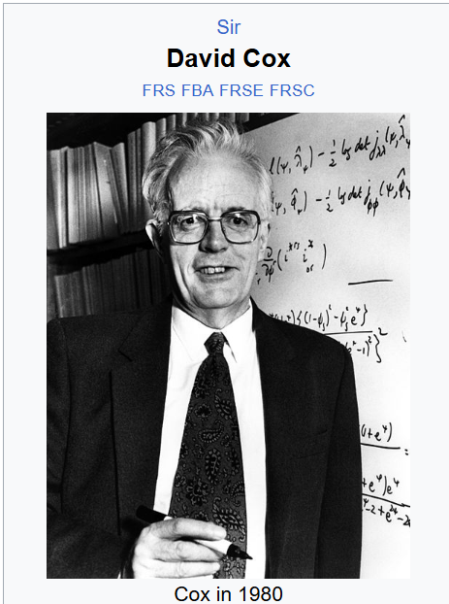



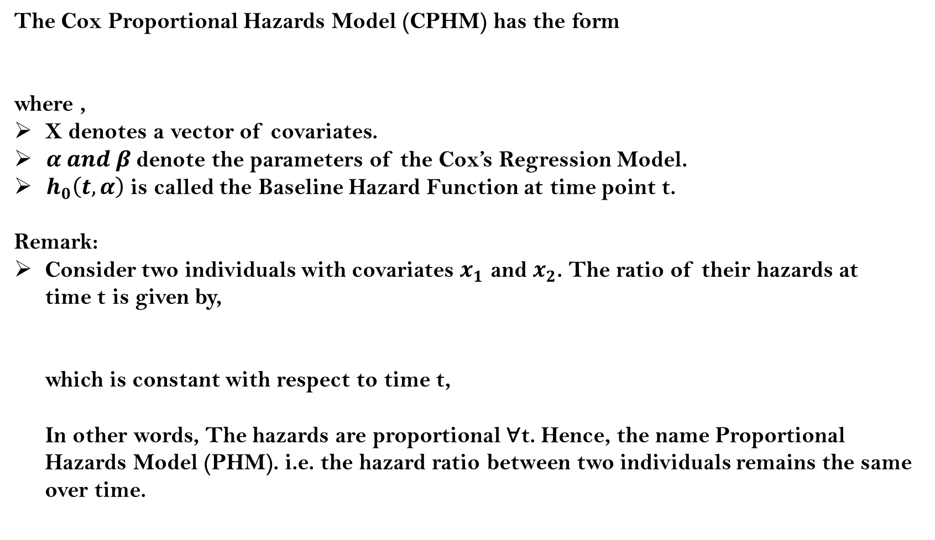
CPHM
The Cox Proportional Hazards Model (CPHM) has the form
where ,
X denotes a vector of covariates.
$α and β$denote the parameters of the Cox’s Regression Model.
$h_{0}\left(t, α\right)$ is called the Baseline Hazard Function at time point t.
Remark:
Consider two individuals with covariates $x_{1}$ and $x_{2}$. The ratio of their hazards at
time t is given by,
which is constant with respect to time t,
In other words, The hazards are proportional ∀t. Hence, the name Proportional
Hazards Model (PHM). i.e. the hazard ratio between two individuals remains the same
over time.

Slide 15
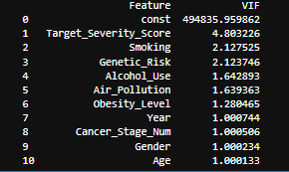

6. Feature Selection :
VIF(Multicollinearity diagnosis):
$VIF_{j}=\frac{1}{1−R_{j}^{2}}$, where,$R_{j}^{2} is the coefficient of determination for jth feature$
Interpretation:- All these features have VIF <= 5 — no multicollinearity risk.
const — automatically handled in regression.

Slide 16
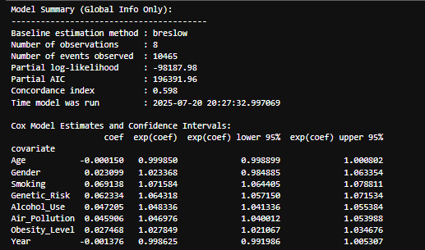
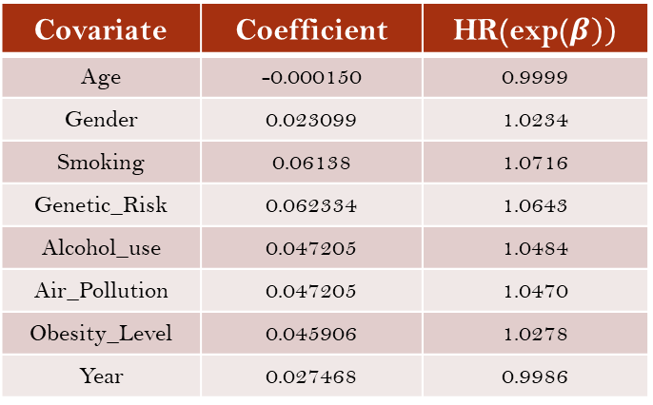
7. Fitting of the model and estimations of model parameter including
their confidence intervals: -
Output
Metric | Value | Interpretation
Baseline Estimation Method | Breslow | (Standard method to handle tied event times)
Number of Observations | 8 | no. of covariates
Number of Events Observed | 10,465 | Total number of actual events (deaths/failures) in the full dataset
Partial Log-likelihood | -98,187.98 | Objective function maximized during model fitting
Partial AIC | 196391.96 | Model selection criterion – lower is better
Concordance Index (C-Index) | 0.598 | Model’s ability to rank individuals by risk – moderate predictive ability
Cox Proportional Hazards model – Global Summary
Covariate | Coefficient | HR(exp($β))$
Age | -0.000150 | 0.9999
Gender | 0.023099 | 1.0234
Smoking | 0.06138 | 1.0716
Genetic_Risk | 0.062334 | 1.0643
Alcohol_use | 0.047205 | 1.0484
Air_Pollution | 0.047205 | 1.0470
Obesity_Level | 0.045906 | 1.0278
Year | 0.027468 | 0.9986
Cox Model Summary of Hazard Ratios and Coefficients (β)

Slide 17

8. Inference based on CPHM: -
Likelihood Ratio Test: -
To check whether the entire set of predictors in our Cox model improves model fit over a baseline/null model.
A large test statistic → large difference between null and full models.
The test statistic is compared to a critical value from the χ² distribution.
Interpretation:- LRT statistic is large, and the corresponding p-value is very small.
Full Cox model is statistically significantly better than the null
model.
The covariates collectively improve model fit and explain survival.

Slide 18
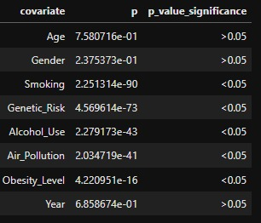
Wald’s Test: - Checking whether there is a significance effects of the covariates on
the survival. These p-values test the null hypothesis that each
individual coefficient (β) is equal to 0.
Interpretation:- Significant variables (<0.05): - Smoking, Genetic_Risk, Alcohol_Use,
Air_Pollution, Obesity_Level .
Not significant variables (>0.05):- Age, Gender, Year.

Slide 19
CONCLUSION
Descriptive statistics and exploratory methods such as Kaplan–Meier curves or univariate log-rank tests provide useful initial insights but may fail to capture the true significance of a risk factor when confounding variables are present. In our biomedical dataset, smoking appeared non-significant in univariate analysis with respect to gender and age-groups.
However, after applying the Cox Proportional Hazards Model (CPHM) with adjustment for multiple covariates, by Wald’s Test based on the CPHM, smoking and the other risk factors were revealed to be statistically significant(<0.05),but in univariate Log-Rank test we see that smoking is not statistically significant.
This demonstrates that regression-based survival models are essential for uncovering the genuine effect of features that may be hidden in simple exploratory analysis.

Slide 20
Distributed Data Network (DDN)
A Distributed Data Network (DDN) is a system for sharing and analyzing data across multiple locations or institutions without moving the raw, individual-level data to a central location. Instead, data stay local (within each organization), and only summary-level results are shared across the network.
Key Features of a Distributed Data Network:
Decentralized Data Storage:
Each site (hospital, clinic, research center) retains control of its own data.
Privacy Protection:
Since individual-level data isn’t shared, DDNs enhance data privacy and security, which is critical in sensitive domains like healthcare and finance.

Slide 21
Distributed Cox Proportional Hazards Regression:
This talks about a new method to analyse medical data from different hospitals or research sites without needing to share individual patient details, which helps protect privacy & reduces technical issues.
What’s the Problem?
1)We now have access to huge amounts of data from many hospitals & clinics(called records or EHRs).
2)To make stronger and more reliable results, researchers want to combine data from multiple places.
3)But sharing individual patient data is hard due to privacy, legal, and technical issues.
What’s the Current Workaround?
1) Instead of sharing raw patient data, share summary-level statistics (like means, totals).
2)These summaries can still be used for analysis without risking patient privacy.
3)This idea is used in DRNs (Distributed Research Networks), where each site keeps its data but takes part in there search together.
What Kind of Data Analysis is Being Done?
1)The focus here is on CPHM (Cox Proportional Hazards Model) for time-to event data (i.e., how long for a patient to be readmitted, die, etc.).
2)But unlike mean or one-shot data, CPHM often needs multiple rounds of calculations (iterations), which slows it down.

Slide 22
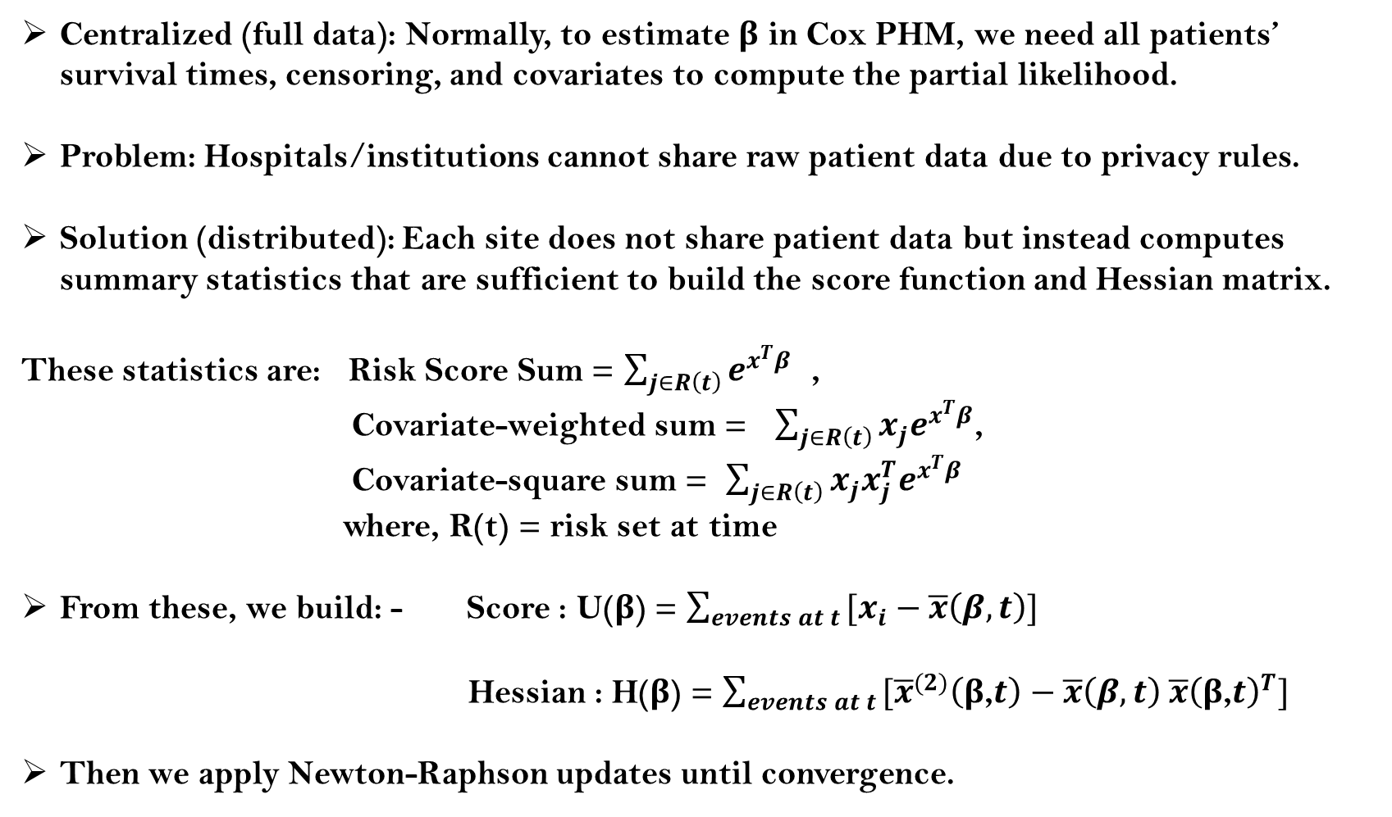
Proposed Method Using Summary Level Information
Centralized (full data): Normally, to estimate β in Cox PHM, we need all patients’ survival times, censoring, and covariates to compute the partial likelihood.
Problem: Hospitals/institutions cannot share raw patient data due to privacy rules.
Solution (distributed): Each site does not share patient data but instead computes summary statistics that are sufficient to build the score function and Hessian matrix.
These statistics are: Risk Score Sum = $\sum_{j∈R\left(t\right)}{e^{x^{T}β}}$ ,
Covariate-weighted sum = $\sum_{j∈R\left(t\right)}{{x_{j}e}^{x^{T}β}}$,
Covariate-square sum = $\sum_{j∈R\left(t\right)}{{x_{j}x_{j}^{T}e}^{x^{T}β}}$
where, R(t) = risk set at time
From these, we build: - Score : U(β) = $\sum_{events at t }{[x_{i}−\overline{x}\left(β,t\right)]}$
Hessian : H(β) = $\sum_{events at t }{[{\overline{x}}^{(2)}\left(\text{β}\text{,}t\right)−\overline{x}\left(β,t\right) \overline{x}{\left(\text{β}\text{,}t\right)}^{T}]}$
Then we apply Newton-Raphson updates until convergence.

Slide 23
Distributed CPHM (Using Summary Level Information)
Country wise division into two sectors for collecting summary level data:-
Countries with moderate to high infrastructure:
Australia, Brazil, Canada, China, Germany
Countries with historically different mortality patterns :
India, Pakistan, Russia, UK, USA
Why this division ?
When working with distributed Cox Proportional Hazards models, we cannot pool individual-level data across centers (due to privacy, security, or legal restrictions). If we had all individual-level data in one place, we’d compute U, H and maximize likelihood directly. But when we split by country or sector, each site computes their own 𝑈, 𝐻 and log-likelihood based on local patients.
These summaries are then added up (because the score equations and log-likelihood are additive across independent datasets.

Slide 24
2) Variable Selection:-
Due to reduce the complexity the of the Hessian Matrix and Score Function, only one most significant covariate, Smoking (p-value = 2.2513e-90).
3) Function to compute the summary statistic (Newton-Raphson Method):
Step 1 : - Standardized the risk factor “Smoking” :-
Numerical Stability especially across sites aggregate gradients and Hessians from different sites.
If the scale of "Smoking" is different across sites (e.g., one site uses 0–1, another uses 0–10), the score function (U) and Hessian (H) will be imbalanced. This can lead to : Overshooting in updates (very large Δβ) poor convergence.
Standardizing ensures uniform scale across all sites → stable and consistent optimization.

Slide 25
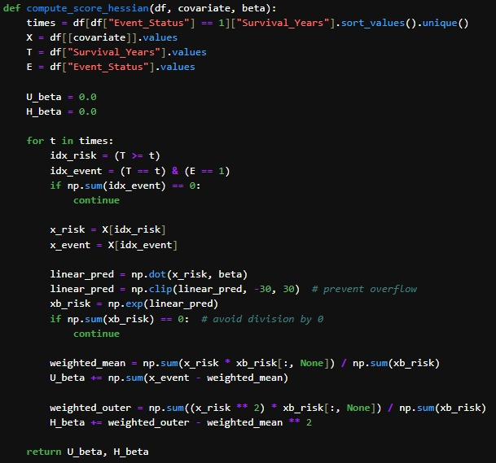
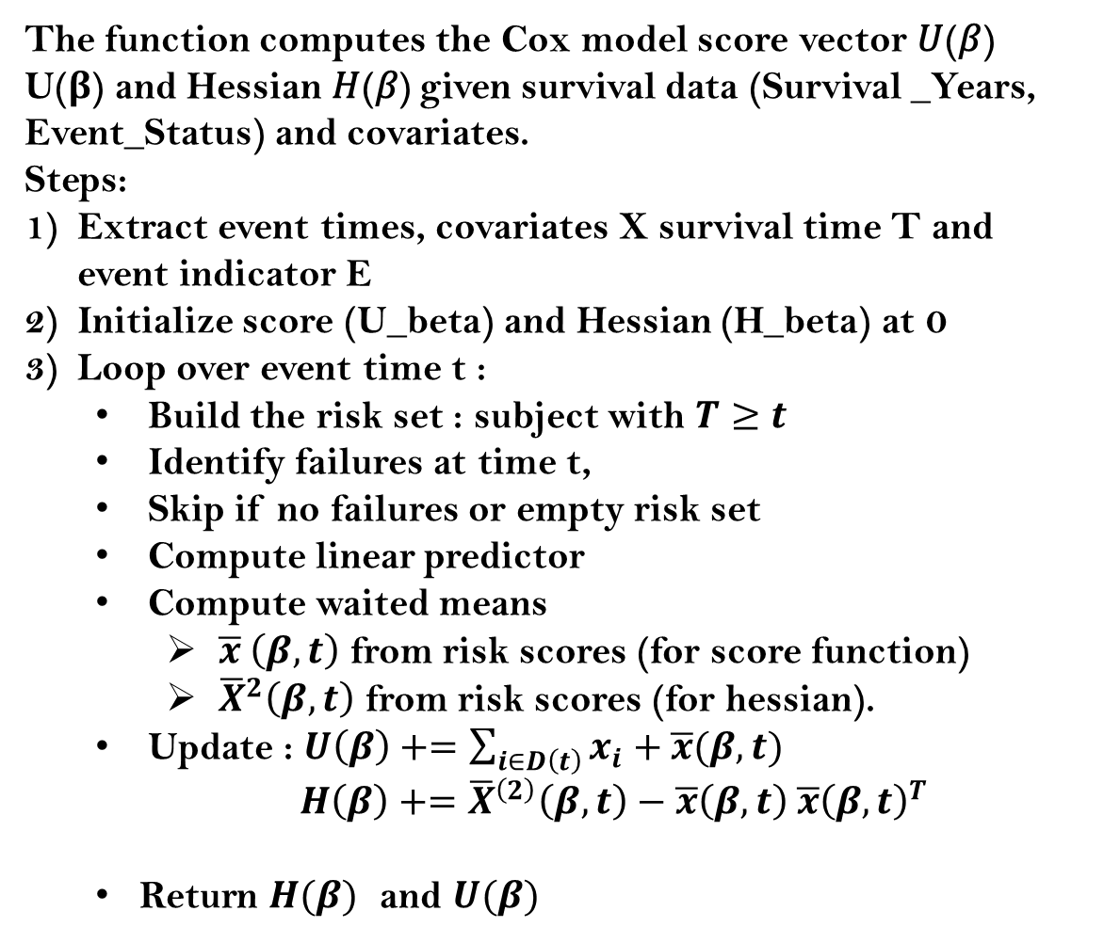
Step 2- Compute Score Function $\left\{U\left(β\right)\right\}$ and Hessian Matrix $\{H(β)\}$ :-
The function computes the Cox model score vector 𝑈(𝛽)
U(β) and Hessian 𝐻(𝛽) given survival data (Survival _Years, Event_Status) and covariates.
Steps:
Extract event times, covariates X survival time T and event indicator E
Initialize score (U_beta) and Hessian (H_beta) at 0
Loop over event time t :
Build the risk set : subject with $T≥t$
Identify failures at time t,
Skip if no failures or empty risk set
Compute linear predictor
Compute waited means
$\overline{x} \left(β,t\right)$ from risk scores (for score function)
${\overline{X}}^{2}\left(β,t\right)$ from risk scores (for hessian).
Update : $U\left(β\right)+=\sum_{i∈D\left(t\right)}{x_{i}+\overline{x}(β,t)}$
$H\left(β\right)+={\overline{X}}^{\left(2\right)}\left(β,t\right)−\overline{x}\left(β,t\right) \overline{x}{\left(β,t\right)}^{T}$
Return $H(β)$ and $U(β)$

Slide 26
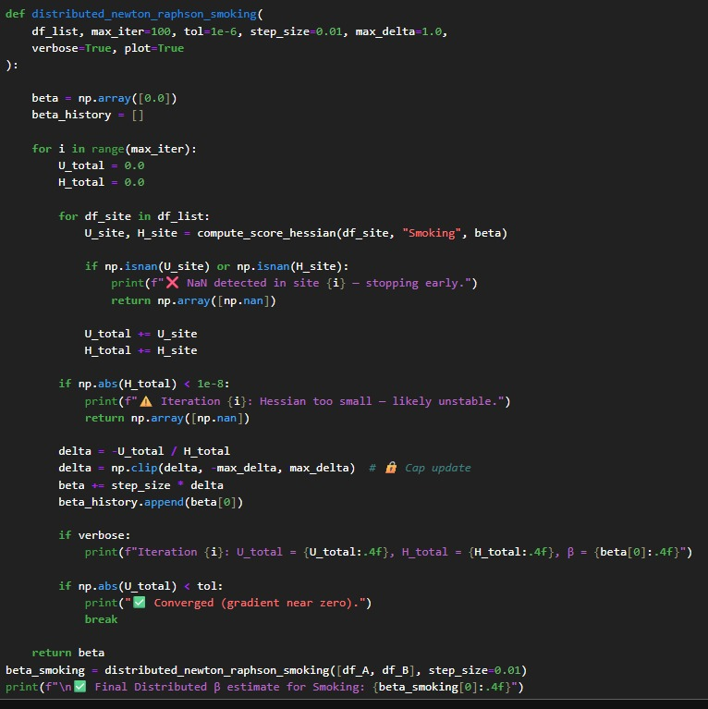
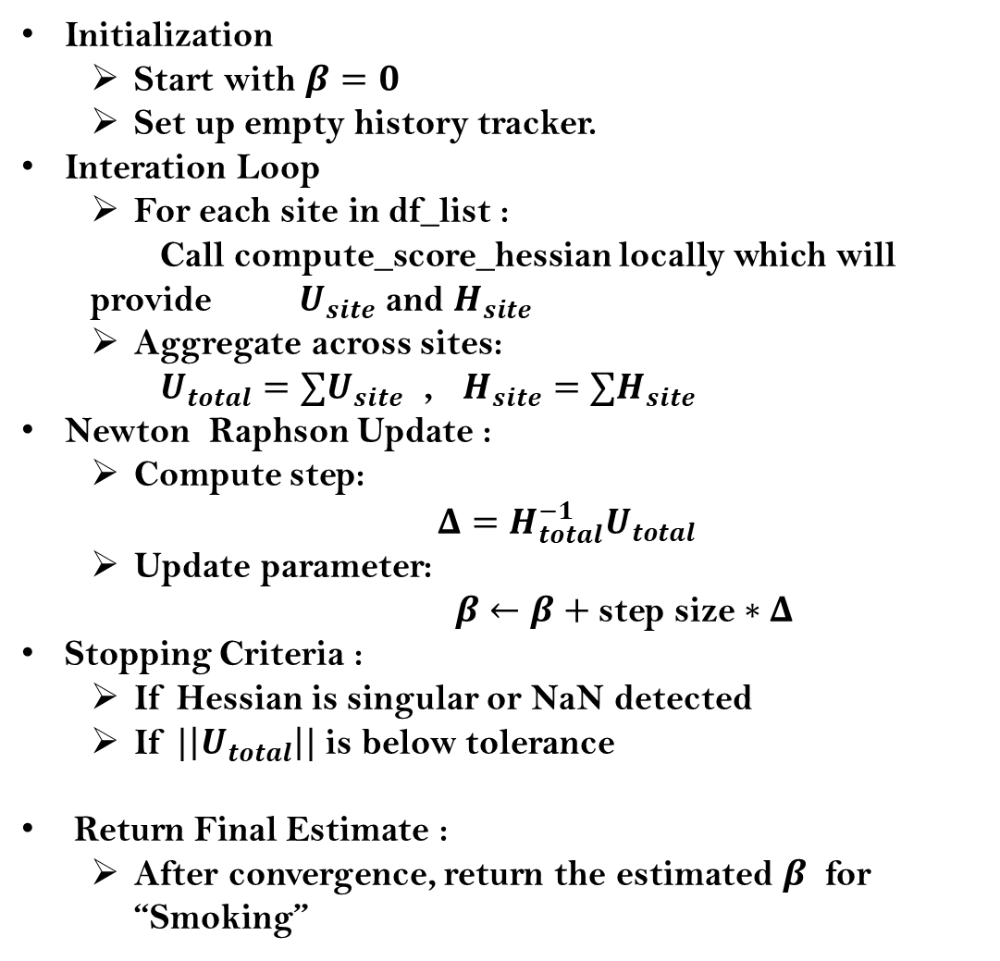
Step 3.Compute β using Newton-Raphson Method :
Initialization
Start with $β=0$
Set up empty history tracker.
Interation Loop
For each site in df_list :
Call compute_score_hessian locally which will provide $U_{site}$ and $H_{site}$
Aggregate across sites:
$U_{total}=∑U_{site}$ , $H_{site}=∑H_{site}$
Newton Raphson Update :
Compute step:
$Δ=H_{total}^{−1}U_{total}$
Update parameter:
$β←β+$ step size$∗Δ$
Stopping Criteria :
If Hessian is singular or NaN detected
If $|\left|U_{total}\right||$ is below tolerance
Return Final Estimate :
After convergence, return the estimated $β$ for “Smoking”

Slide 27
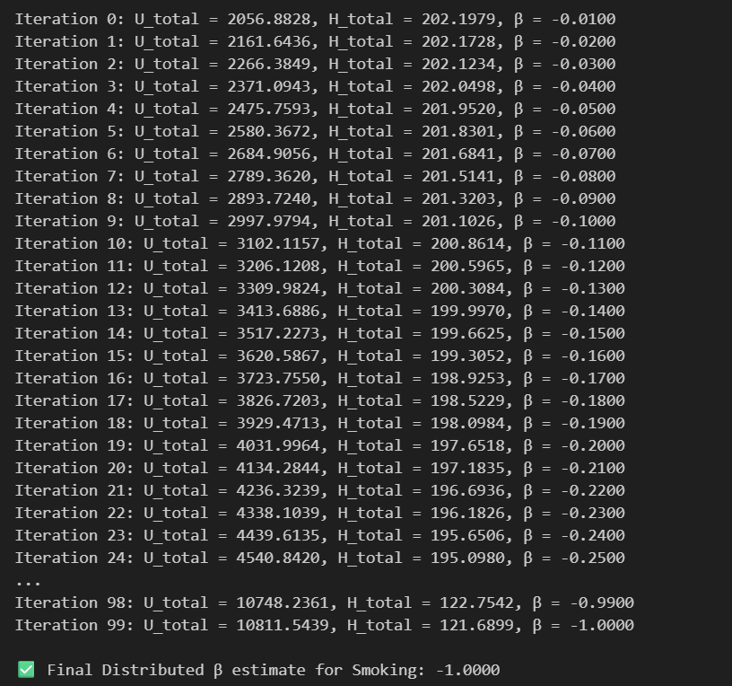
Output of $β$after executing the Newton Raphson Algorithm :
Interpretation : In the distributed Cox PH model using Smoking as a continuous covariate (0–10 scale), we obtained β = –1, corresponding to HR = 0.367.

Slide 28
CONCLUSION
While dealing with the standardized summary outputs where privacy is one of the most important concern in such case one can use the distributed CPHM which was used to compute the model parameter using the aggregative information based on the summary statistics.
Now, in our distributed CPHM, we obtained β = –1, corresponding to HR = 0.367 while the full-data model β ≈ 0.07, corresponding to HR ≈ 1.07. Which is obvious because of information loss and confounding in distributed estimation.
So, our final conclusion is, the algorithm works and is feasible when primary data cannot be shared; with proper adjustment, distributed CPHM can reproduce valid outcomes.

Slide 29
THANK YOU

