Slide 1



Title:
Blinkit Sales Data Analysis Name:
Debjit Sutar
College:
Narula Institute of Technology, Agarpara (6th Semester)

Slide 2
Acknowledgement:
I would like to express my heartfelt gratitude to Mr. Satyaki Das of Classroom Tech for his invaluable guidance, mentorship, and continuous support throughout this internship.
I also extend my sincere thanks to my institution, faculty members, family, and all those who encouraged and supported me during this journey.
Their motivation and guidance played a vital role in the successful completion of this project.

Slide 3
Section Title | Slide No.
Introduction | 1
Acknowledgement | 2
Table of Contents | 3
Objective / Problem Statement | 4
Dataset Overview | 5
Tools Used | 6
Methodology | 7
Question-Wise Visualizations (Q1–Q40) | 8–47
Key Findings | 48
Conclusion | 49
GitHub Repository Link | 50
References | 51
Thank You | 52

Slide 4
Objective: To explore and analyze Blinkit's operational data using Power BI in order to generate meaningful business insights and visual dashboards.
Key Questions Answered:
Which products and categories are top-selling?
What are the peak times for order placement?
How do campaigns impact conversions and revenue?
How efficient is the delivery and logistics chain?
Which regions or customer segments are most active?

Slide 5
Dataset Overview
Dataset Name: Blinkit Sales
Dataset Source: Kaggle
Total Files: 11 CSV/Excel Files
Dataset Name | Rows × Columns | Key Columns for Analysis
blinkit_orders.csv | 5000 × 10 | order_id, customer_id, order_date, store_id
blinkit_order_items.csv | 5000 × 4 | order_id, product_id, quantity, price
blinkit_customers.csv | 2500 × 11 | customer_id, name, email, segment, pincode
blinkit_customer_feedback.csv | 5000 × 8 | feedback_id, customer_id, category, sentiment
blinkit_products.csv | 268 × 10 | product_id, product_name, category_id, price
blinkit_inventory.csv | 75172 × 4 | product_id, stock_level, stock_received_date
blinkit_inventoryNew.csv | 18105 × 4 | product_id, stock_received, damaged_stock
blinkit_delivery_performance.csv | 5000 × 8 | order_id, promised_time, actual_time, distance
blinkit_marketing_performance.csv | 5400 × 11 | campaign_id, campaign_name, spend, revenue_generated
Category_Icons.xlsx | 11 × 2 | category_id, icon_url
Rating_Icon.xlsx | 5 × 3 | rating, emoji

Slide 6
Tools Used:
Power BI:
For importing, cleaning, modeling, and visualizing datasets.
GitHub:
Used for maintaining version control, storing .pbix files, and project documentation.

Slide 7
Methodology:
Data Cleaning (Power Query):
Removed duplicates from blinkit_customers
Handled null values in delivery and feedback tables
Merged stock_1 and stock_2 into inventory_new
Standardized column names and data types.
Visualization Approach:
Created bar, line, pie, funnel, scatter, KPI, matrix charts
Used slicers, filters, and bookmarks for interactivity
Added DAX measures for metrics like ROAS, CLV, Gross Profit

Slide 8

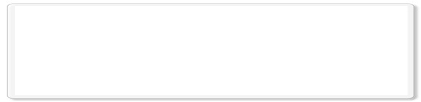


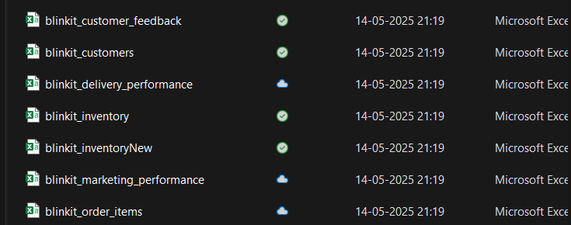
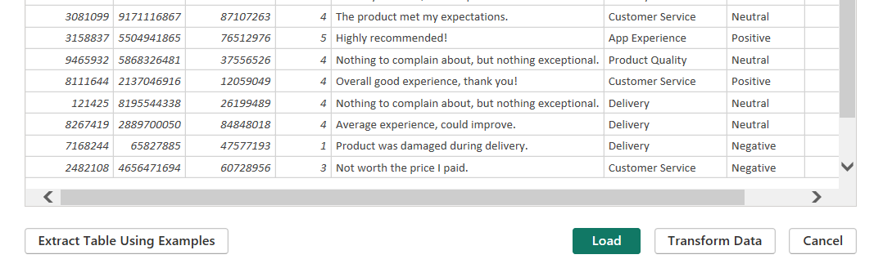
1. How can you import data from all 11 tables into Power BI?
1️⃣ Use Get Data: Go to Home > Get Data, choose your source (Excel, CSV, or SQL), and select all 11 tables from the Navigator window.
2️⃣ Load or Transform: Click Load to import directly, or choose Transform Data to clean and prepare the tables before loading into Power BI.

Slide 9

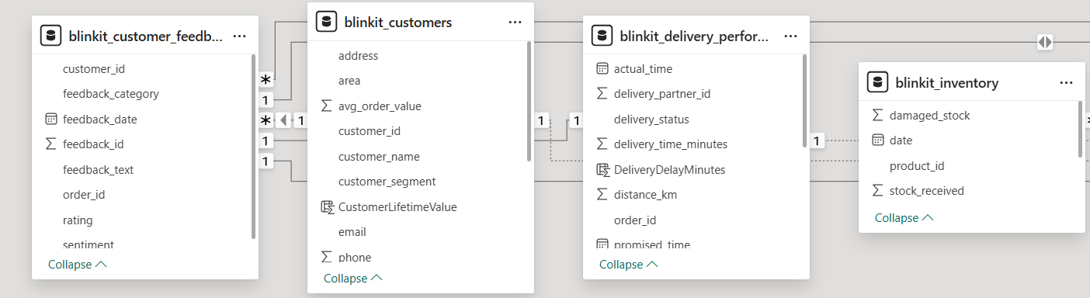
2. How do you create relationships between the tables in Power BI?
1️⃣ Open Model View:
Go to Model View, where all tables are displayed.
2️⃣ Drag and Connect Fields:
Drag a common field (e.g., customer_id, product_id) from one table to its match in another to create a relationship.

Slide 10
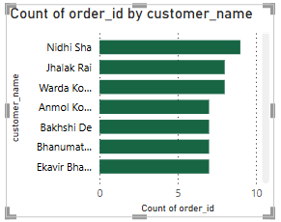
3. Create a bar chart showing the number of orders placed per customer.
1️⃣ Track Monthly Order Volumes: Calculating orders by month reveals overall demand patterns, helping identify trends and seasonal fluctuations.
2️⃣ Spot Sales Peaks and Dips: Monthly analysis highlights peak-performing periods, enabling better planning for inventory, staffing, and marketing strategies.

Slide 11
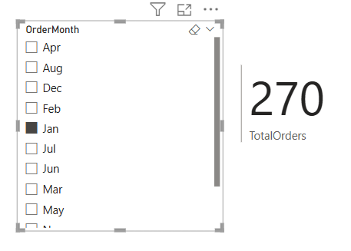
4. How do you calculate the total number of orders placed in a given month?
1️⃣ Monitor Monthly Sales Performance: Calculating total orders per month helps track business growth and detect seasonal trends in customer demand.
2️⃣ Enable Time-Based Filtering: Using date filters or DAX formulas allows dynamic calculation of monthly orders, supporting flexible reporting and analysis.

Slide 12
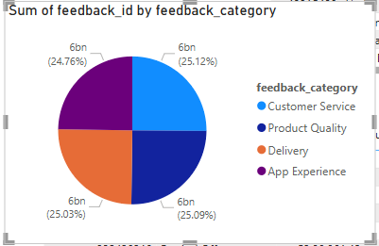
5. Create a pie chart showing the distribution of feedback categories from Table 1.
1️⃣ Visualize Feedback Distribution: A pie chart breaks down feedback into categories (e.g., Positive, Neutral, Negative), offering a clear snapshot of overall customer sentiment.
2️⃣ Identify Areas for Improvement: The distribution helps pinpoint dominant feedback types, guiding focus toward improving customer experience where needed.

Slide 13
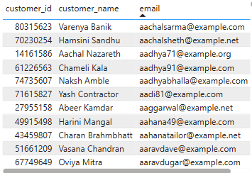
6. Create a table visualization showing customer details (customer_id, name, email) from Table 2.
1️⃣ Display Key Customer Information: A table visualization neatly presents customer IDs, names, and emails, making it easy to reference and manage customer data.
2️⃣ Enable Quick Lookups and Filtering: The structured view allows users to search, sort, or filter specific customers efficiently within Power BI dashboards.

Slide 14
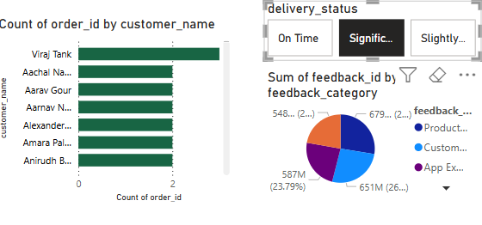
7. How can you filter orders based on delivery status (on-time, delayed) from Table 3?
1️⃣ Use Delivery Status as a Filter:
Apply the delivery_status field from Table 3 as a slicer or visual-level filter to view only on-time or delayed orders.
2️⃣ Enable Focused Analysis:
Filtering by delivery status helps monitor fulfillment performance and identify patterns in delivery delays.

Slide 15
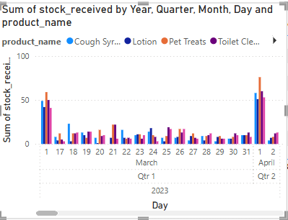
8. Create a column chart showing stock received over time for different products (Table 4 & Table 5).
1️⃣ Track Stock Inflow Trends: A column chart visualizes how stock quantities change over time, making it easy to monitor restocking patterns.
2️⃣ Compare Product Stocking Rates: By combining data from both tables, the chart highlights which products receive stock more frequently or in higher volumes.

Slide 16
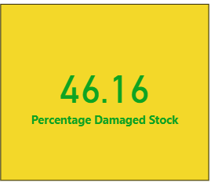
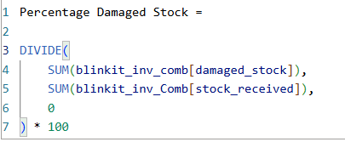
9. How do you calculate the percentage of damaged stock per product?
1️⃣ Apply a DAX Measure for Percentage:
Use a formula like Damaged % = (Damaged Stock / Total Stock Received) × 100 to calculate damage rate per product.
2️⃣ Identify High-Risk Products:
This percentage helps flag products with high damage rates, enabling better quality control and supply chain decisions.

Slide 17
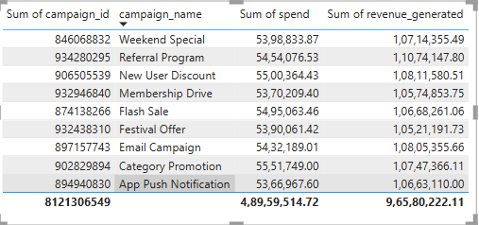
10. Show a table with all campaigns (campaign_id, campaign_name, spend, revenue_generated) from Table 6.
1️⃣ Display Key Campaign Metrics: A table view presents each campaign’s ID, name, spend, and revenue, making it easy to evaluate marketing performance.
2️⃣ Enable ROI Comparison: This structured layout allows quick analysis of campaign effectiveness by comparing spend vs. revenue across campaigns.

Slide 18
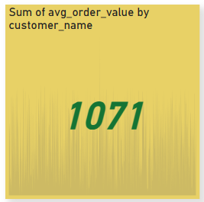
11. Create a KPI visual to display the average order value (avg_order_value) from Table 2.
1️⃣ Highlight Average Customer Spending: A KPI visual shows the average order value at a glance, helping track how much customers typically spend per order.
2️⃣ Monitor Business Health: This metric is key for assessing profitability and can signal changes in customer buying behavior over time.

Slide 19
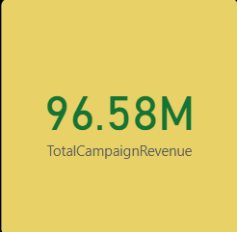
12. How do you calculate the total revenue generated from all campaigns in Table 6?
1️⃣ Use a Simple Aggregation Formula:
Calculate total revenue by summing the revenue_generated column in Table 6 using SUM('Table6'[revenue_generated]).
2️⃣ Track Overall Campaign Impact:
This total helps assess the combined effectiveness of all campaigns in driving revenue.

Slide 20
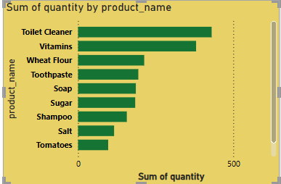
13. Create a stacked bar chart to compare order quantity per product (Table 7).
1️⃣ Compare Product Demand Visually: A stacked bar chart shows how many units of each product were ordered, helping identify top-selling items.
2️⃣ Spot Product-Level Sales Patterns: The visualization highlights which products contribute most to overall order volumes, supporting inventory and marketing decisions.

Slide 21
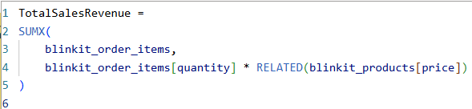
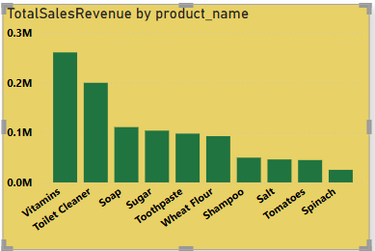
14. How do you calculate the total sales revenue per product?
1️⃣ Calculate Revenue by Linking Tables:
The SUMX function multiplies quantity from blinkit_order_items with price from blinkit_products using the RELATED() function.
2️⃣ Track Product-Wise Sales Performance:
This measure reveals how much revenue each product generates, helping identify best-sellers and optimize pricing strategies.

Slide 22
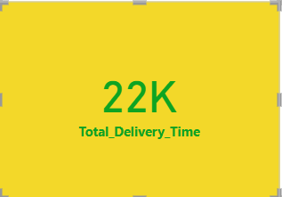
15. Create a measure to calculate the total delivery time (actual_time - promised_time) in Table 3.
1️⃣ Aggregate Delivery Time Efficiently:
The measure Total_Delivery_Time = SUM(blinkit_delivery_performance[delivery_time_minutes]) provides the total time taken across all deliveries in minutes.
2️⃣ Evaluate Logistics Performance:
This total helps assess overall delivery efficiency and spot potential delays in the fulfillment process.

Slide 23
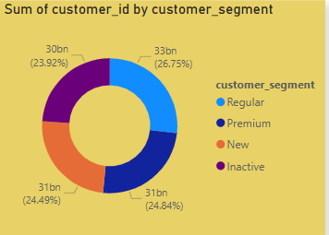
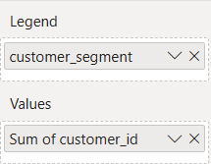
16. How do you visualize customer segments (Table 2) using a pie chart?
1️⃣ Use Segment Field as Legend:
Drag the customer_segment column from Table 2 into the Legend and Values sections of a pie chart to display the distribution.
2️⃣ Highlight Segment Proportions:
The pie chart visually shows how customers are split across different segments (e.g., Regular, Premium), helping target marketing strategies.

Slide 24
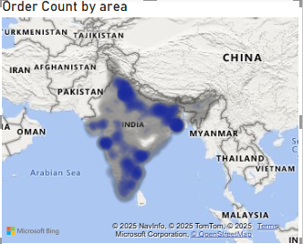
17. Create a heatmap showing the frequency of orders per pincode (Table 2).
1️⃣ Map Order Frequency by Area:
The heatmap uses the area field to show how frequently orders are placed in each location, making demand patterns easy to spot.
2️⃣ Spot High-Performance Zones:
By visualizing order volume by area, you can quickly identify top-performing zones and areas with potential for growth.

Slide 25
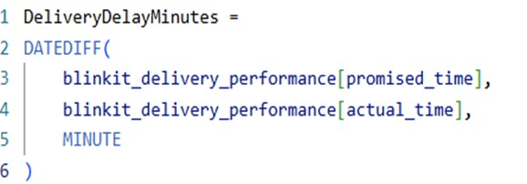
18. How do you create a calculated column for delivery delays (actual_delivery_time - promised_delivery_time)?
1️⃣ Define Delivery Delay per Order: A calculated column helps compute how late each order was delivered by subtracting promised time from actual delivery time.
2️⃣ Enable Delay Pattern Analysis: This allows you to track delays on a per-order basis and identify recurring issues across specific areas, dates, or delivery agents.

Slide 26
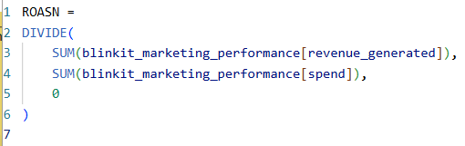
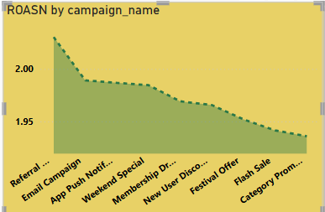
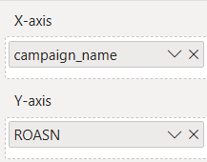
19. Create a measure to calculate the Return on Ad Spend (ROAS) using (revenue_generated / spend) from Table 6.
1️⃣ Use DAX to Calculate ROASN: Create a DAX measure that divides total revenue by total spend to compute ROASN across all campaigns.
2️⃣ Evaluate Marketing Efficiency: ROAS helps assess how effectively each marketing campaign turns ad spend into revenue, supporting budget optimization.

Slide 27
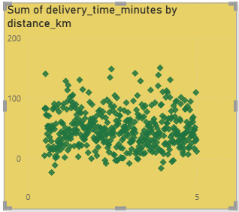
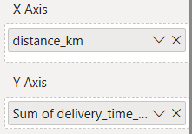
20. Show a scatter plot of distance vs. delivery time to analyze delivery efficiency (Table 3).
1️⃣ Visualize Delivery Patterns:
A scatter plot with distance_km on the X-axis and delivery_time_minutes on the Y-axis helps identify how distance impacts delivery time.
2️⃣ Spot Outliers and Delays:
This chart makes it easy to detect unusual delays for short distances or high efficiency over longer routes, revealing optimization opportunities.

Slide 28
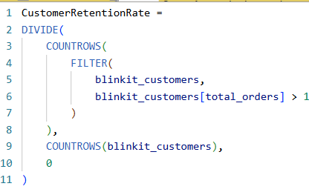
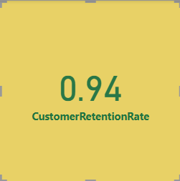
21. Create a measure to calculate customer retention rate using total_orders from Table 2.
1️⃣ Define Retention Logic with DAX: Use a measure to calculate the percentage of customers with more than one order, indicating repeat engagement.
2️⃣ Track Customer Loyalty Trends: Retention rate reveals how effectively customers are returning, helping assess satisfaction and long-term value.

Slide 29
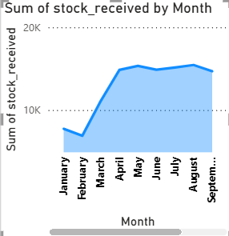
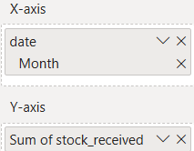
22. How do you create a forecast for future stock levels based on historical stock received data (Table 4 & Table 5)?
1️⃣ Build a Line Chart:
Create a line chart with Date on the X-axis and Stock Received on the Y-axis using the merged stock table.
2️⃣ Enable Forecasting:
In the Analytics pane, add a Forecast line → set the forecast length and confidence interval.
Power BI will project future stock levels based on historical trends.

Slide 30
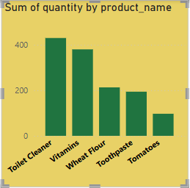
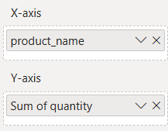
23. Create a report to identify the top 5 best-selling products based on quantity ordered (Table 7).
1️⃣ Rank Products by Quantity Sold: Use a bar chart or table to display products sorted by total quantity ordered, highlighting the top 5 best-sellers.
2️⃣ Focus on High-Demand Items: This report helps identify which products drive the most sales, supporting inventory planning and promotional strategies.

Slide 31
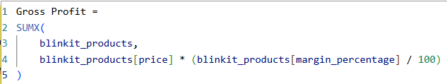
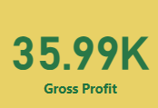
24. Create a measure to calculate gross profit using margin_percentage from Table 9.
1️⃣ Calculate Profit with DAX Logic:
Use a measure that multiplies price by margin_percentage to compute gross profit for each product.
2️⃣ Assess Product Profitability:
This measure highlights which items generate the most profit, guiding pricing and product strategy decisions.

Slide 32
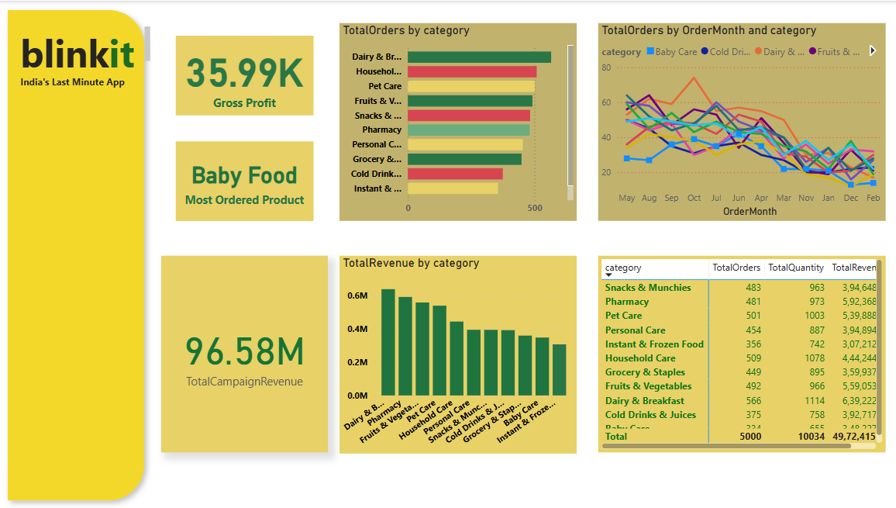
25. How do you build a dashboard to track order trends across different categories (Table 9)?
1️⃣ Combine Multiple Visuals for Insights:
Use bar charts, line charts, KPIs, and tables to display total orders, revenue, and quantity by category, giving a complete view of category-wise performance.
2️⃣ Enable Trend Monitoring Over Time:
Use a line chart with OrderMonth and Category to visualize how order volumes fluctuate monthly across categories, helping spot seasonality and patterns.

Slide 33
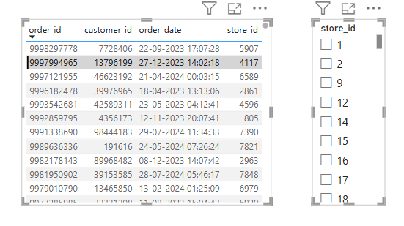
26. Build a time-series analysis of daily order counts using order_date from Table 8.
1️⃣ Highlight Top Performing Stores: Stores 5907, 6589, and 7848 record the highest order volumes, indicating strong customer engagement in these locations.
2️⃣ Showcase Wide Operational Spread: Orders are placed across a diverse range of stores, reflecting Blinkit's extensive geographic footprint and customer reach.

Slide 34
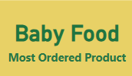
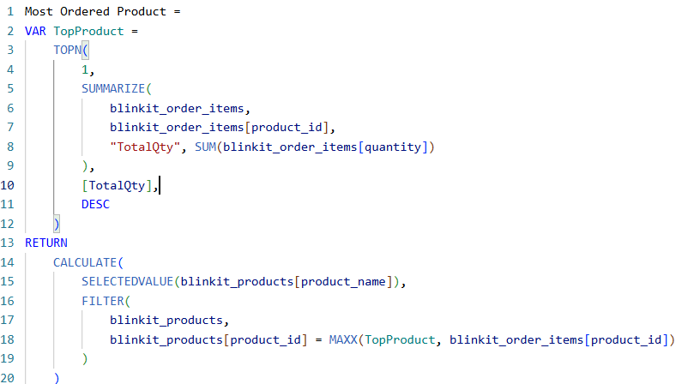
27. How do you use DAX to find the most frequently ordered product?
1️⃣ Use DAX to Identify Top Product: This measure dynamically finds the most frequently ordered product by ranking based on total quantity across all orders.
2️⃣ Display in a Card Visual: The result is shown as a single product name (e.g., "Baby Food") in a card, giving an instant view of top-performing inventory.

Slide 35

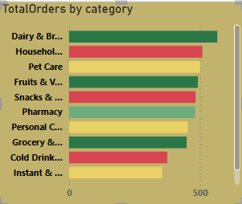
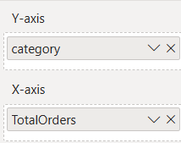
1️⃣ Summarize Data in a Matrix Format:
Use a matrix visual with category in Rows and TotalOrders in Columns, showing total quantity as the Values field.
2️⃣ Enable Detailed Comparison:
The matrix allows easy comparison of how different products perform within each category, supporting better inventory and sales decisions.
28. Create a matrix visualization to show order quantity per product category (Table 9).

Slide 36

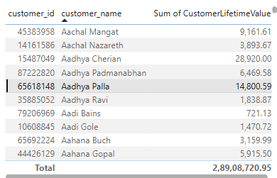
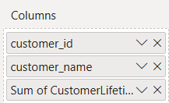
29. How do you calculate customer lifetime value using avg_order_value and total_orders (Table 2)?
1️⃣ Calculate CLV Using Key Metrics:
Multiply avg_order_value by total_orders to compute each customer’s lifetime value, reflecting their overall contribution.
2️⃣ Identify High-Value Customers:
This metric helps segment and prioritize customers based on their long-term revenue potential.

Slide 37
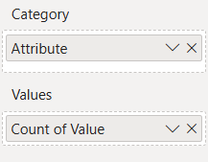
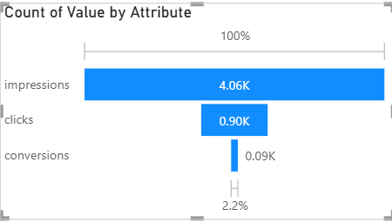
30. How do you create a funnel chart to track the campaign conversion process (Table 6)?
1️⃣ Use Funnel Visual in Power BI:
Select the Funnel chart from the Visualizations pane.
2️⃣ Add Campaign Stages:
Drag fields like Impressions → Clicks → Conversions (in order) to the Values section to visualize how users move through the campaign funnel.

Slide 38
31. Create a dynamic slicer for filtering orders by delivery status (on-time vs delayed).
1️⃣ Use Delivery Status as a Filter:
Apply the delivery_status field from Table 3 as a slicer or visual-level filter to view only on-time or delayed orders.
2️⃣ Enable Focused Analysis:
Filtering by delivery status helps monitor fulfillment performance and identify patterns in delivery delays.

Slide 39

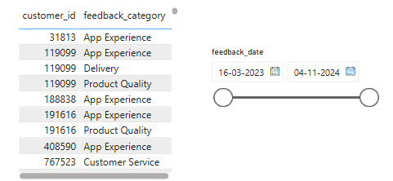
32. Use Power BI parameters to filter data dynamically for a selected date range.
1️⃣ Enable Dynamic Date Filtering with Slicers:
A slicer on feedback_date allows users to interactively filter feedback records within a specific date range.
2️⃣ Analyze Time-Specific Feedback Trends:
This setup helps track how customer feedback categories change over time, supporting timely response and service improvement.

Slide 40
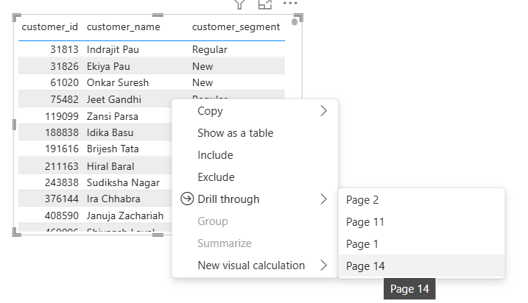
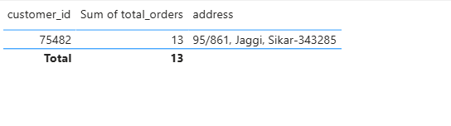
1️⃣ Enable Drill-Through on customer_id or feedback_id:
A dedicated drill-through page is created where customer_id or feedback_id is added to the Drill-through field. This allows users to right-click on summarized visuals and explore detailed feedback records.
2️⃣ Enable Dynamic Date Filtering with Feedback Date Slicer:
A slicer using feedback_date is placed on the drill-through page. This lets users interactively filter and analyze feedback trends across specific time windows for more actionable insights.
33. Create a drill-through report to analyze feedback details (Table 1).

Slide 41
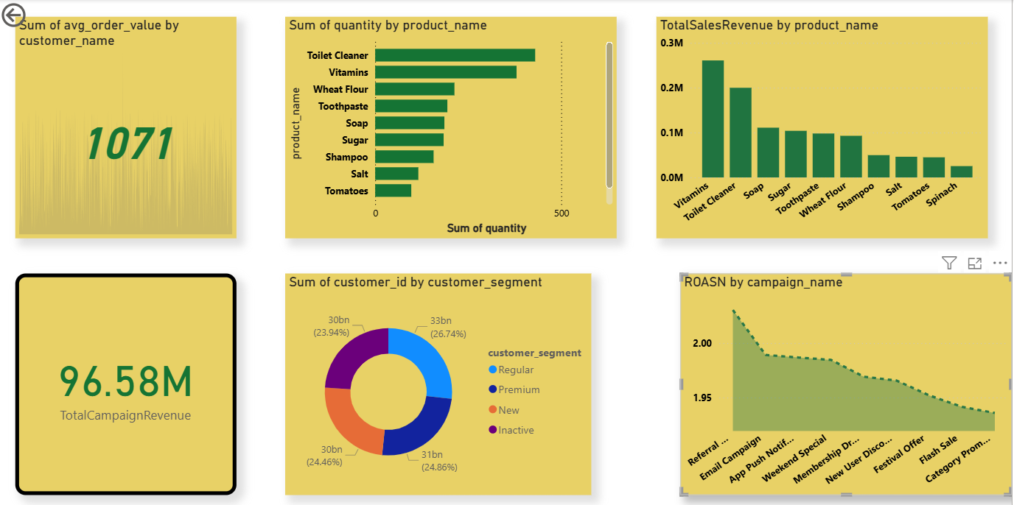


34.How do you set up row-level security to restrict access by customer segment (Table 2)?
1️⃣ Create a Role in Power BI Desktop:
Use Modeling → Manage Roles and apply the filter:
[customer_segment] = "Enterprise"
2️⃣ Assign Users in Power BI Service:
After publishing, go to Dataset → Security and assign users to the EnterpriseAccess role to restrict their view to Enterprise data only.

Slide 42

35. Use Power Query to clean and transform customer data before loading it into Power BI.
1️⃣ Remove Duplicates from blinkit_customers:
In Power Query, select relevant columns in the blinkit_customers table → right-click → choose Remove Duplicates to ensure each customer record is unique.
2️⃣ Load Cleaned Data into Power BI Model:
After transformation, click Close & Apply to load the cleaned blinkit_customers table into the Power BI data model for accurate reporting.

Slide 43




36. How do you merge stock data from Table 4 & Table 5 to create a unified stock report?
1️⃣ Merge Tables in Power Query:
In Power Query, use Append Queries to combine Table 4 and Table 5 into one. Make sure both have matching columns (e.g., product_id, stock_in, date). Rename the result as inventory_new.
2️⃣ Load into Power BI Model:
Click Close & Apply to load inventory_new into Power BI. You can now use it to build unified stock-level visuals and reports.

Slide 44

37. Build a Power BI alert that triggers when stock levels go below the minimum threshold (Table 9).
1️⃣ Create a Measure:
Use the pre-defined measure LowStockCount to calculate products where max_stock_level < min_stock_level.
2️⃣ Set Alert in Power BI Service:
Add the measure to a card visual, publish the report, then go to ... > Manage Alerts on the card to create an alert that triggers when the value crosses a defined limit.

Slide 45
38. Create a report to track customer orders by store_id (Table 8).
1️⃣ Highlight Top Performing Stores: Stores 5907, 6589, and 7848 record the highest order volumes, indicating strong customer engagement in these locations.
2️⃣ Showcase Wide Operational Spread: Orders are placed across a diverse range of stores, reflecting Blinkit's extensive geographic footprint and customer reach.

Slide 46


39. How do you use bookmarks to create different views of the dashboard?
1️⃣ Create Bookmarks in Power BI:
Set up visuals the way you want, then go to View > Bookmarks Pane → click Add to save the current view as a bookmark.
2️⃣ Link with Buttons:
Insert a button or shape, then assign the bookmark to it via Action > Type: Bookmark.
Now, clicking the button switches the view as shown in your image.

Slide 47

1️⃣ Use Area or Pincode Field in Map Visual:
Drag the area or pincode column from Table 2 into the Map visual’s Location field, and use order_id in the Values field set to Count.
2️⃣ Visualize Order Density Geographically:
The map now displays bubble sizes or heat points representing the number of orders per area, helping identify high-demand locations.
40. Build a map visualization showing order density per area (Table 2).

Slide 48
Key Findings:
Top Customers:
Customers like Viraj Tank and Aachal Nazarreth placed the most orders.
Feedback Focus:
Most feedback relates to Product Quality and App Experience.
Stock Trends:
Cough Syrup and Pet Treats had steady stock received in March.
Campaign ROI:
Weekend Special and Referral Program earned the highest revenue.
Delivery Status:
Mix of on-time and delayed deliveries shows scope for improvement.

Slide 49
Conclusion:
Gained hands-on experience with Power BI dashboards, DAX, and data modeling
Learned to clean, transform, and visualize real-world datasets
Analysis supports better inventory planning, marketing strategy, and customer retention efforts

Slide 50
GitHub Repository Link:
https://github.com/Debjitsutar/blinkit-powerbi-project
🔍 This repository contains the complete Power BI project, including datasets, .pbix file, visualizations, and report documentation.

Slide 51
References:
Kaggle – Blinkit Sales Dataset Source of raw data for customer, orders, products, inventory, delivery, and marketing performance.
Power BI Documentation – https://learn.microsoft.com/en-us/power-bi/ For DAX functions, data modeling, and visualization best practices.
Microsoft Power Query Docs – https://learn.microsoft.com/en-us/power-query/ used for data cleaning, merging, and transformation workflows.
OpenAI ChatGPT – Assisted in writing DAX measures, structuring analysis, and presentation formatting.
GitHub – Version control and storage of project files and .pbix report.
YouTube Tutorials – For Power BI advanced visualizations and performance optimization techniques.

Slide 52
Thank You
Debjit Sutar 📧 debjitsutar65@gmail.com 🔗 linkedin.com/in/debjit-sutar-65a97a31b
🙏 Special thanks to Classroom Tech for their constant guidance and support throughout the internship journey. This experience helped me apply classroom knowledge to real-world data using Power BI. Grateful for the opportunity to learn, build, and grow professionally.

