Slide 1

DISEASE PREDICTION SYSTEM USING MACHINE LEARNING
PRESENTATION ON
UNIVERSITY OF ENGINEERING AND MANAGEMENT
DEPARTMENT OF COMPUTER SCIENCE
PAPER NAME : PROJECT - II
PAPER CODE : PROJCS801
By
GROUP No. 80

Slide 2
GROUP No. 80
GUIDE DETAILS Prof. (Dr.) SUKALYAN GOSWAMI Prof. BIPASHA MUKHOPADHYAY
MEMBER DETAILS
NAME SOUMISHILA DE DEBMALYA PAL SUBHAM BAGCHI TANMOY SINGHA MAHAPATRA UDISHA MANDAL VASHISTHA N PRADHAN
ENROLLMENT No. 12018009019182
12018009019078
12018009019264
12018009019513
12018009019108
12018009019462

Slide 3
CONTENTS
INTRODUCTION
MOTIVATION
MACHINE LEARNING
TECHNOLOGIES
ALGORITHMS
ARCHITECTURE OF THE APPLICATION
RESULTS
ADVANTAGES & DISADVANTAGES
FUTURE SCOPE
CONCLUSION

Slide 4
INTRODUCTION
The “Disease Prediction System” is a system based on Machine Learning, which attempts to predict the disease based on the information of symptoms provided by the user.
It is a system which provides the tips and tricks to maintain the health system of the user at his fingertips by – 1. Providing for the early diagnosis of probable health hazards 2. Easing the access to diagnosis system from any corner of the World.

Slide 5
MOTIVATION
Our goal in developing this system is :-
To integrate in health sector the advancements in the field of Computer Science and Automation to ease and develop user experience.
Easing the access to basic yet trustworthy and safe diagnostic facilities for the common people.
Help reduce the direct workload on medical staffs, specially after we experienced Covid-19 pandemic.

Slide 6
MACHINE LEARNING
Machine Learning (ML) is basically that field of computer science with the help of which computer systems can provide sense to data in much the same way as human beings do.
It is a type of artificial intelligence that extract patterns out of raw data by using an algorithm or method.
The key focus of ML is to allow computer systems to learn from experience without being explicitly programmed or human intervention.

Slide 7
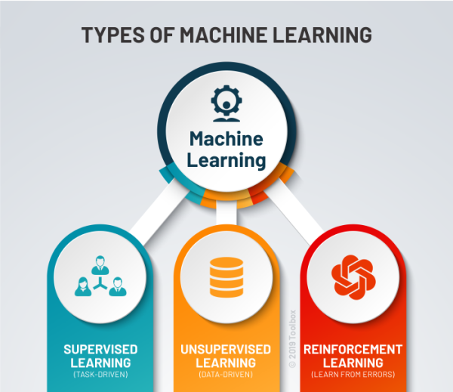

Slide 8
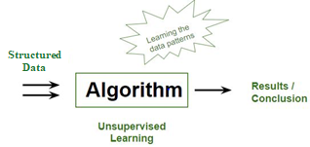
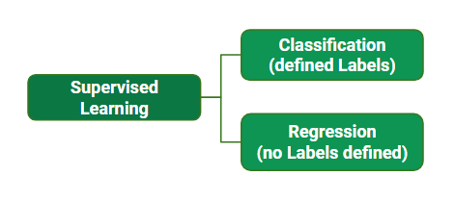
SUPERVISED LEARNING
Machine Learning technique in which machines are trained using well "labelled" training data, and on basis of that data, machines predict the output.
The labelled data means some input data is already tagged with the correct output.

Slide 9
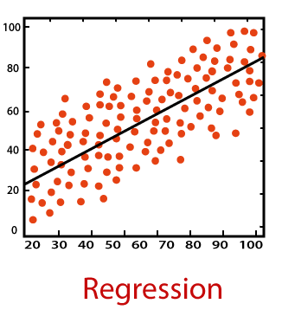
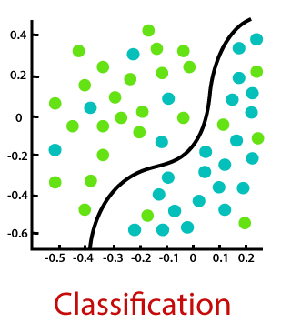
SUPERVISED LEARNING
REGRESSION
CLASSIFICATION
The process of finding the correlations between dependent and independent variables.
Maps the input variable to the continuous output variable.
Eg. : 1. prediction of Market Trends, 2. prediction of House prices, etc.
The process of identifying the category of new observations on the basis of training data.
Maps the input variable to the discrete output categories.
Eg. : 1. Email Spam Detector, 2. Disease Prediction System, etc.

Slide 10
ALGORITHMS
Naïve Bayes Classification
Decision Tree Classification
Random Forest Classification
Support Vector Machines (SVM)

Slide 11
TECHNOLOGIES USED
FRONTEND TECHNOLOGIES HyperText Markup Language (HTML) Cascading Style Sheets (CSS) JavaScript
BACKEND TECHNOLOGIES Python (Framework - FLASK)
MACHINE LEARNING TECHNOLOGIES
Python (Libraries – NUMPY, PANDAS, SCIKIT LEARN)

Slide 12



HTML HyperText Markup Language
CSS Cascading Style Sheets
JS JavaScript

Slide 13

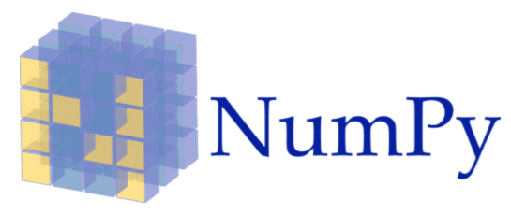




PYTHON
NUMPY
PANDAS
MATPLOTLIB
SCIKIT LEARN
FLASK

Slide 14
ARCHITECTURE OF THE APPLICATION

Slide 15
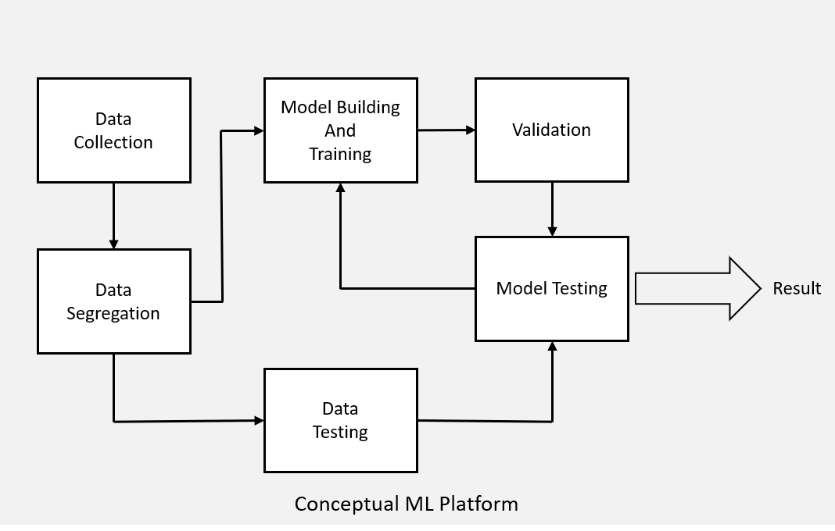
ARCHITECTURE OF THE ML MODEL

Slide 16
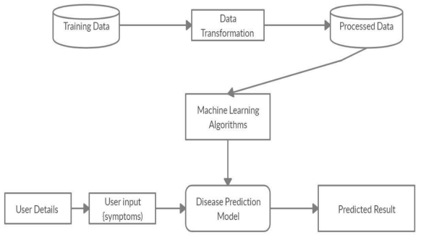
SYSTEM ARCHITECTURE

Slide 17
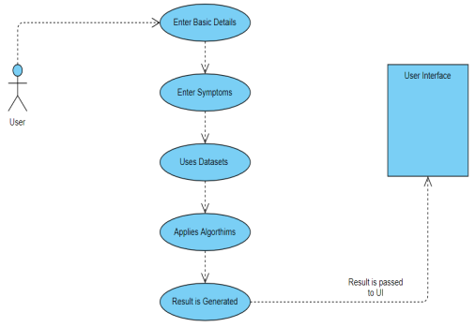
SYSTEM ARCHITECTURE

Slide 18
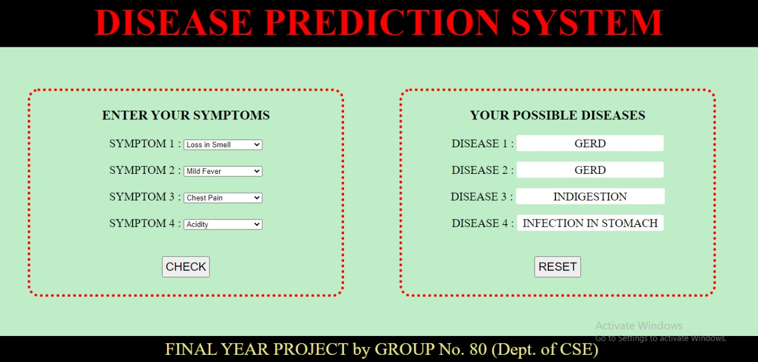
RESULTS

Slide 19
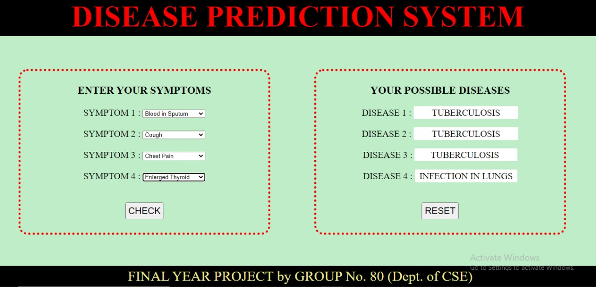
RESULTS

Slide 20
ADVANTAGES
Helps patient to get a preliminary idea about their health condition at their convenience without involving medical help
Cost effective for patients.
Reduces workload on the medical system.
Clinics can then take appropriate measures to avoid or minimize the risk and in turn, improve quality of care and avoid potential hospital admissions.
Disease prediction has the potential to benefit stakeholders such as the government and health insurance companies. It can identify patients at risk of disease or health conditions.

Slide 21
DISADVANTAGES
A computerized system alone does not ensure accuracy. It is highly dependent on the user’s correct interpretation of symptoms.
The warehouse data is only as good as the data entry that created it.
Ignorance and misinterpretation of results from the system in case of serious disorder requiring professional medical intervention can be extremely hazardous to the patient’s life.

Slide 22
FUTURE SCOPE
More diseases and symptoms can be updated further to make the system more advanced and universal.
Feature of providing an option to contact doctors and health bodies in the close the proximity of the user. Also, in case of serious ailment that would require immediate medical attention, the system could itself inform the nearby health bodies for help providing the user’s details and location

Slide 23
CONCLUSION
We conclude by saying that this project “Disease Prediction System” using Machine Learning is very useful in everyone’s day to day life and it is mainly of more importance for the healthcare sector, because they are the one that daily uses these systems to predict the diseases of the patients based on their general information for faster and efficient disposal of cases.
The system is to provide prediction for the various and generally occurring diseases – those, when unchecked and sometimes ignored, can turn into fatal disease and cause a lot of problems to the patient.

Slide 24

THANK YOU

