Slide 1
HOTEL MANAGEMENT SYSTEM
DEBMALYA PAL

Slide 2
Technologies used
Back end
Core java
Spring boot
Spring data jpa
Spring security
JUNIT
SWAGGER
FRONT end
REACT JS
HTML
CSS
Bootstrap
IDE & TOOLS
Eclipse (Backend)
VS CODE (Front end)
POSTMAN (API TESTING)

Slide 3
5 Microservices
Auth Microservice
Hotel microservice
Booking microservice
Employee microservice
Front end ui

Slide 4
Auth microservice
Deals with signup, sign in (for ADMIN and CUSTOMER)
Has database that stores all the details of the Users.
Entities -> User Payloads -> LoginRequest, LoginResponse, Customer / CurrentUser
Primarily runs on port 9000

Slide 5
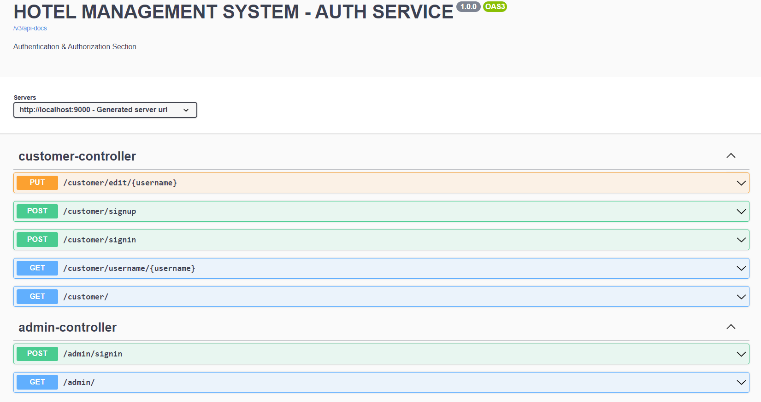

Slide 6
Hotel microservice
Deals with Tariff – type, price and rooms of each category
Has database that stores all the details of the tariffs and rooms.
Entities -> Tariff, Room
Primarily runs on port 8080

Slide 7
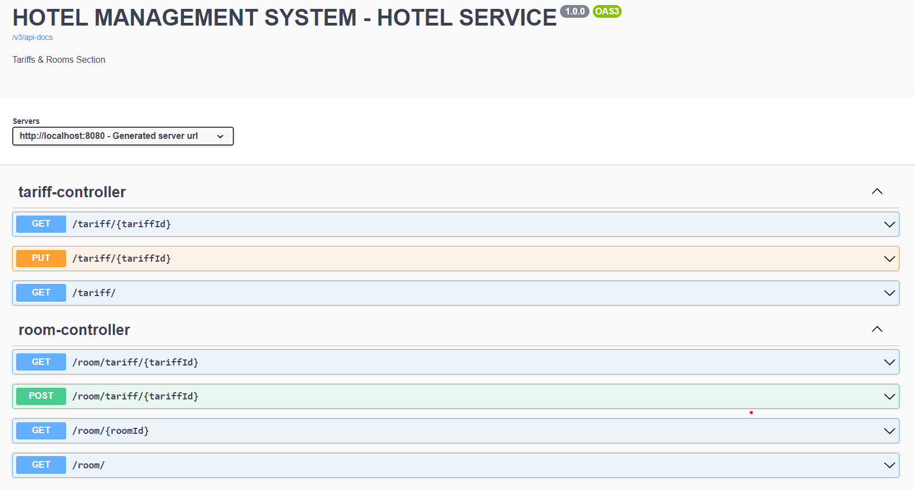

Slide 8
booking microservice
Deals with Bookings of rooms made by customers
Has database that stores all the details of the Bookings.
Communicates with AUTH and HOTEL Microservice
Entities -> Booking Payloads -> MasterBookingDetails Tariff, Room ( Tariff Microservice) Customer / CurrentUser (Auth Microservice)
Primarily runs on port 9010

Slide 9
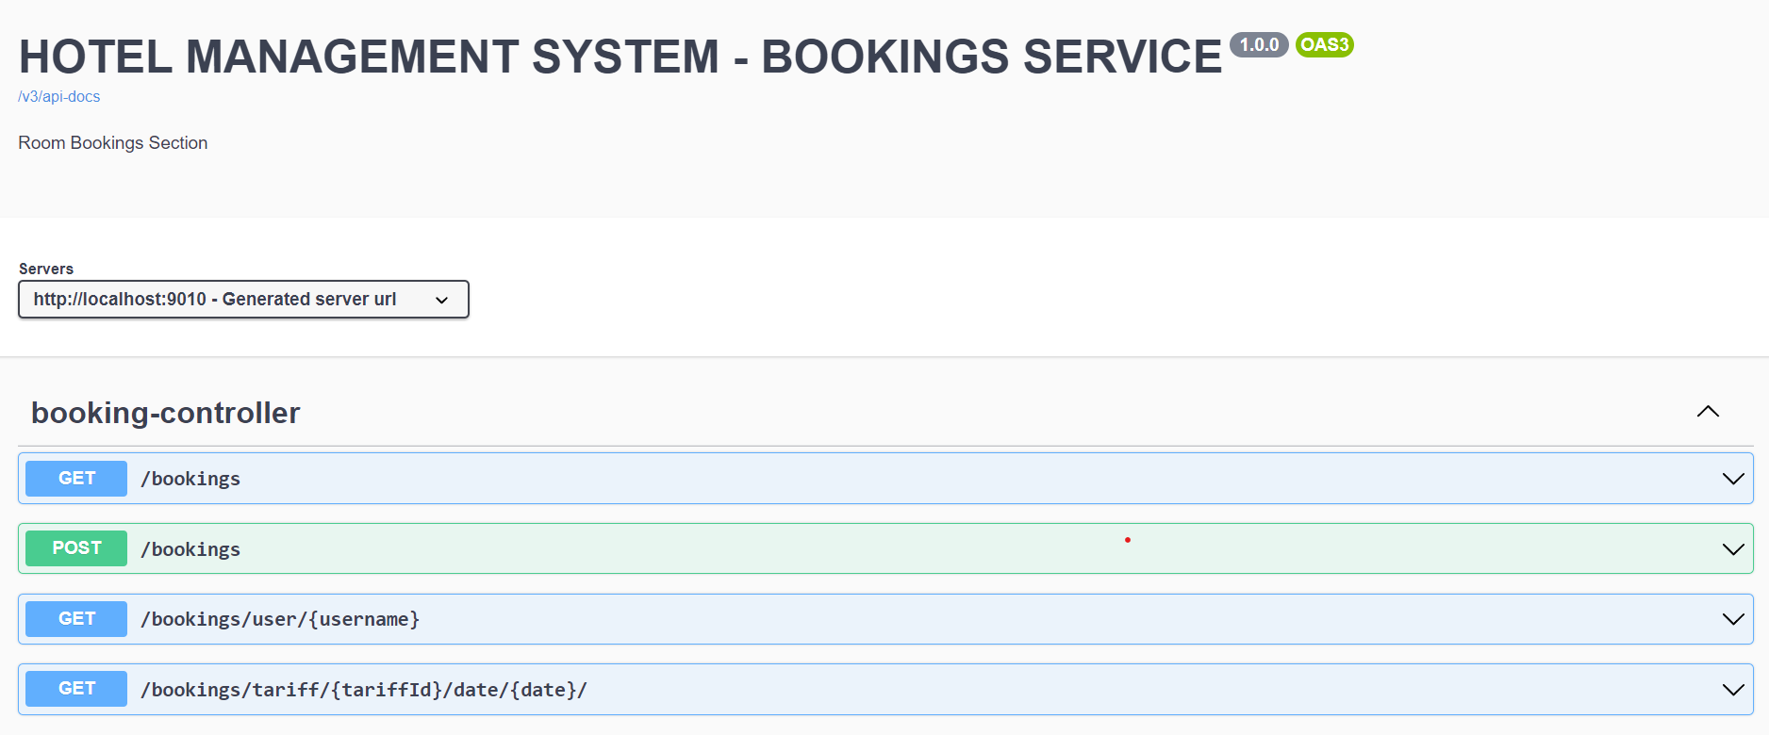

Slide 10
Employee microservice
Deals with internal section of hotel – department and its employees and their details.
Has database that stores all the details of departments and employees.
Entities -> Department, Employee
Primarily runs on port 8090

Slide 11
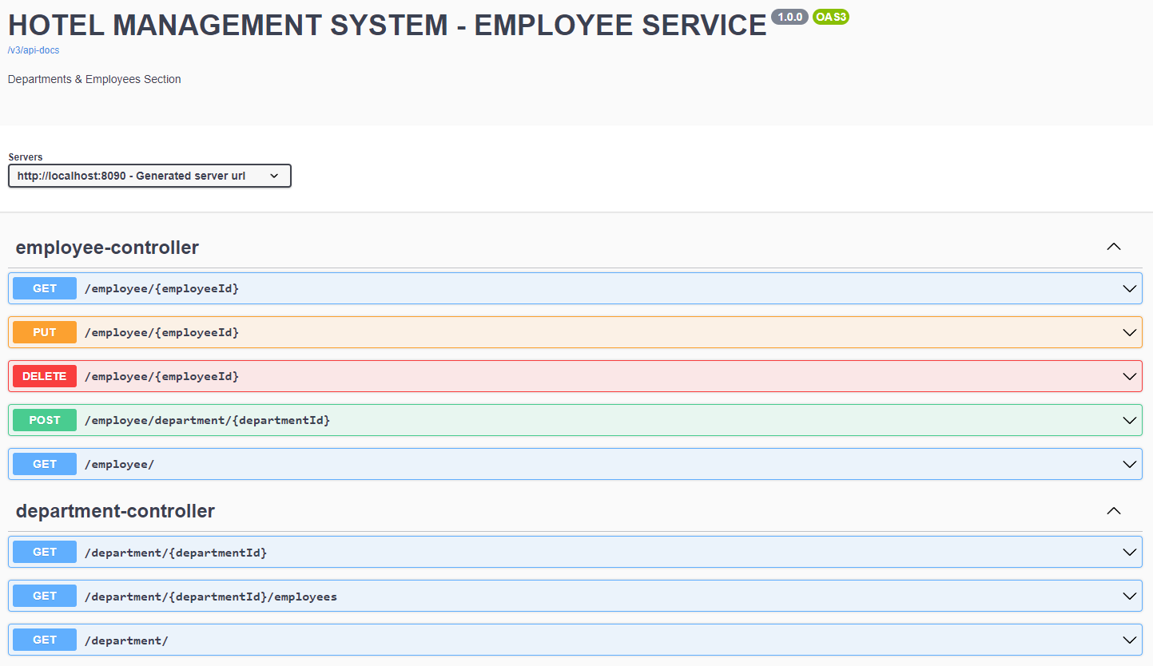

Slide 12
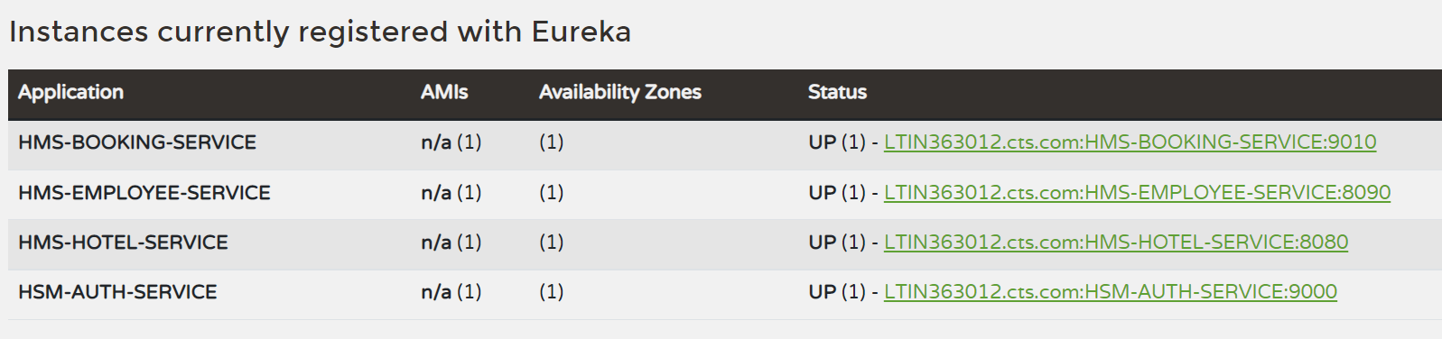

Slide 13
Front end - ui
Created using React JS
Provides an UI based interface for --- 1. Admins -> A. Sign In B. View, Edit Tariff C. View, Add Rooms under Tariff D. View, Add, Delete Employees under Departments E. View Bookings 2. Customers -> A. Sign up & Sign In B. View Tariff C. Check availability for room and book room D. View their own bookings E. Edit personal data
Communicates with backend microservices using HTTP requests (Axios library)
Primarily runs on port 3000

Slide 14
WORKING SCREENSHOTS

Slide 15
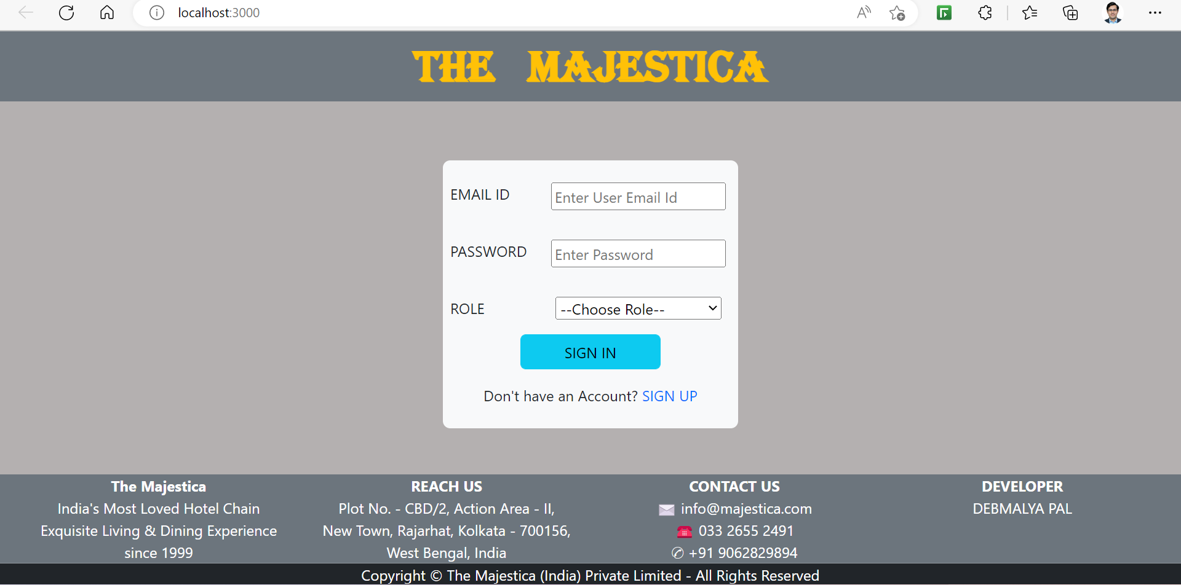
SIGN IN PAGE (LaNDing page)

Slide 16
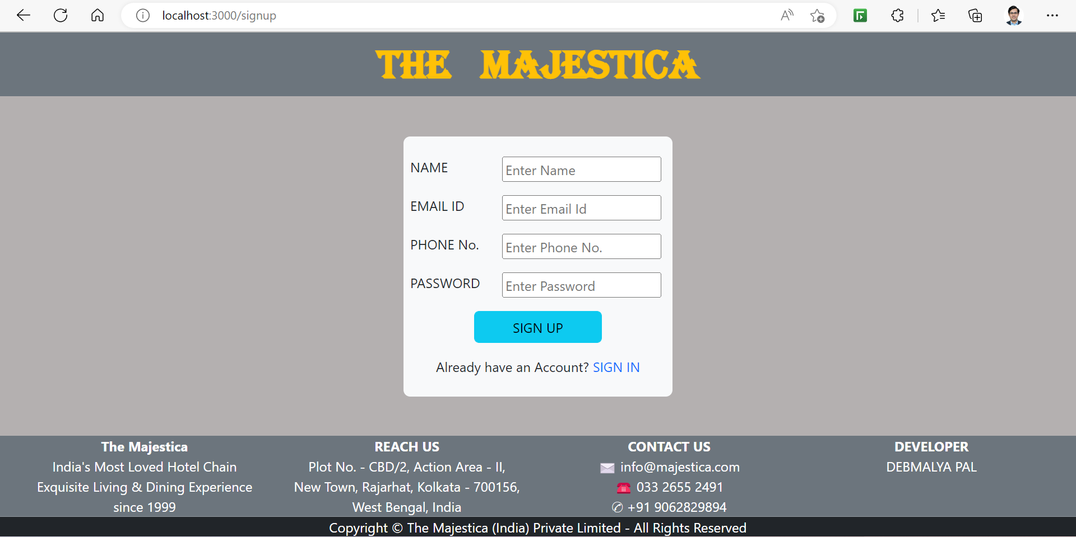
SIGN UP PAGE

Slide 17
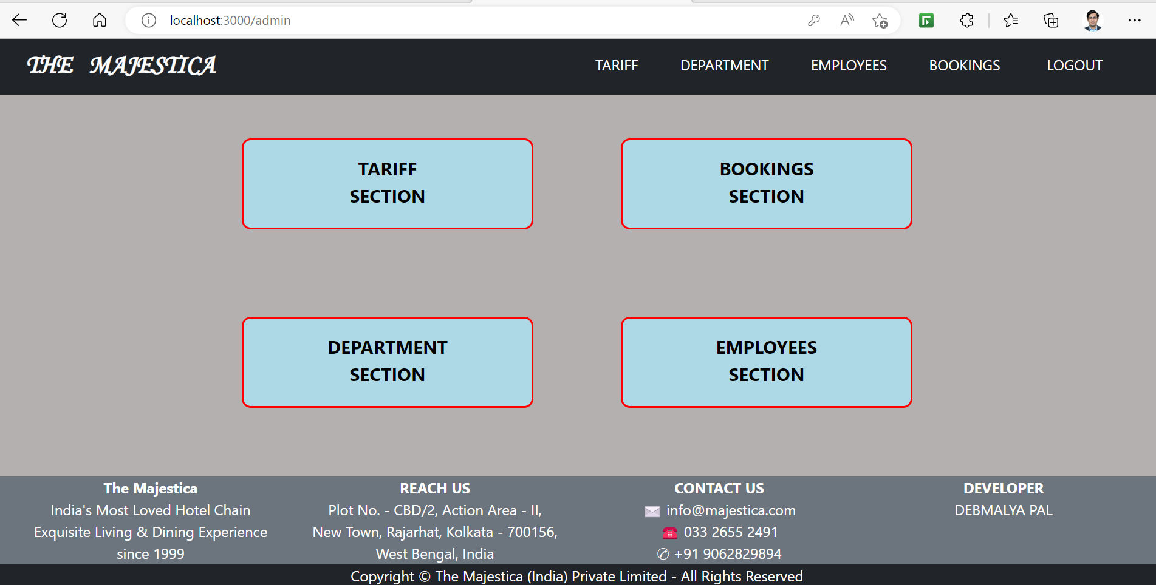
LOGGED IN ADMIN’s HOME PAGE

Slide 18
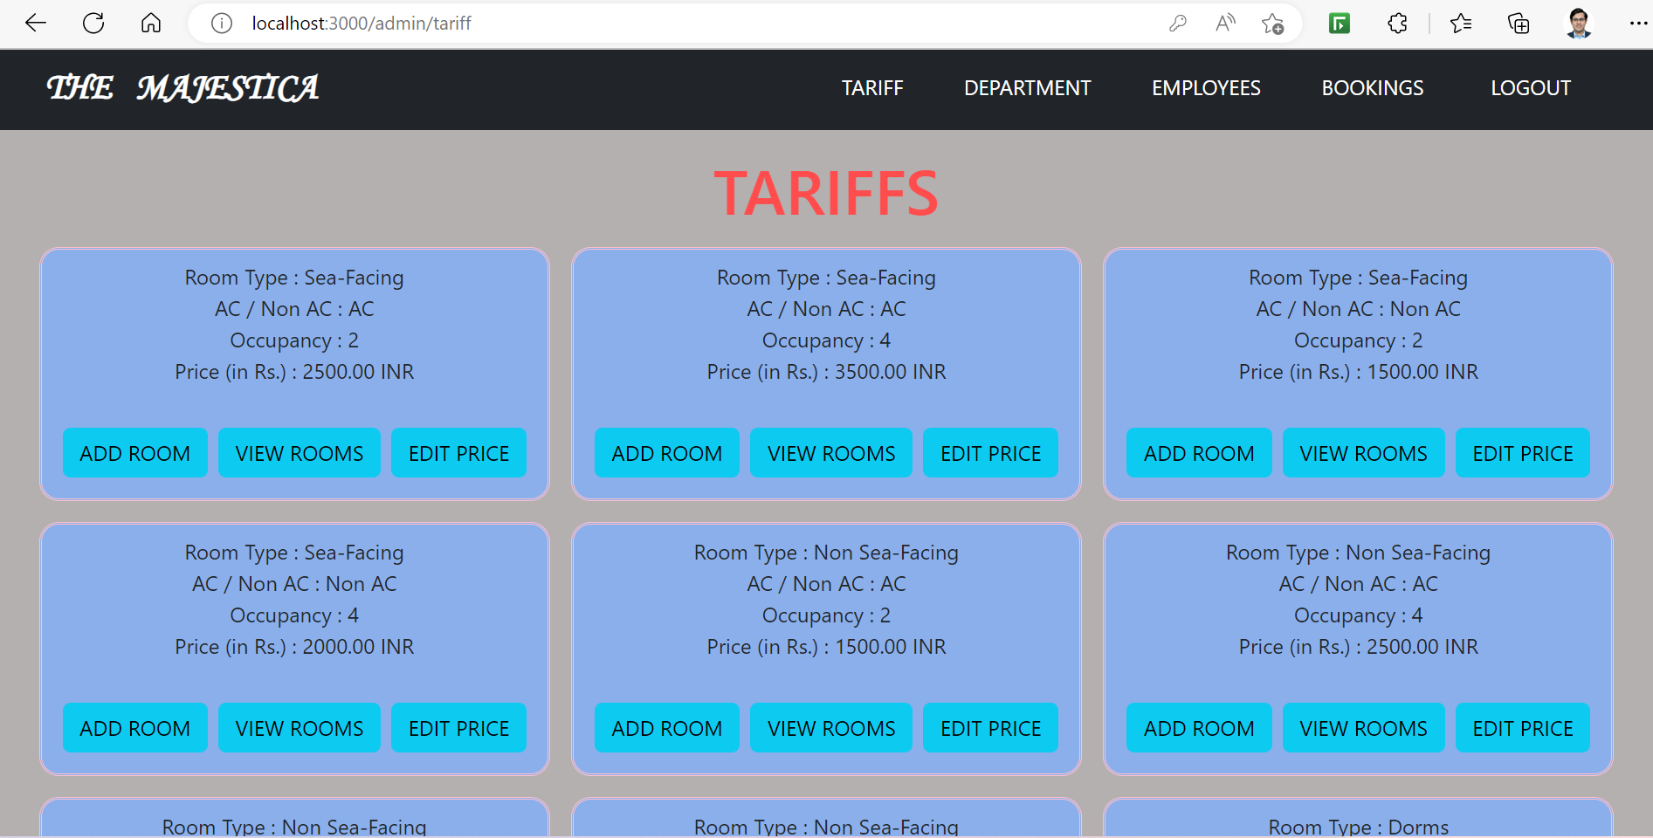
ADMIN’s tariff PAGE

Slide 19
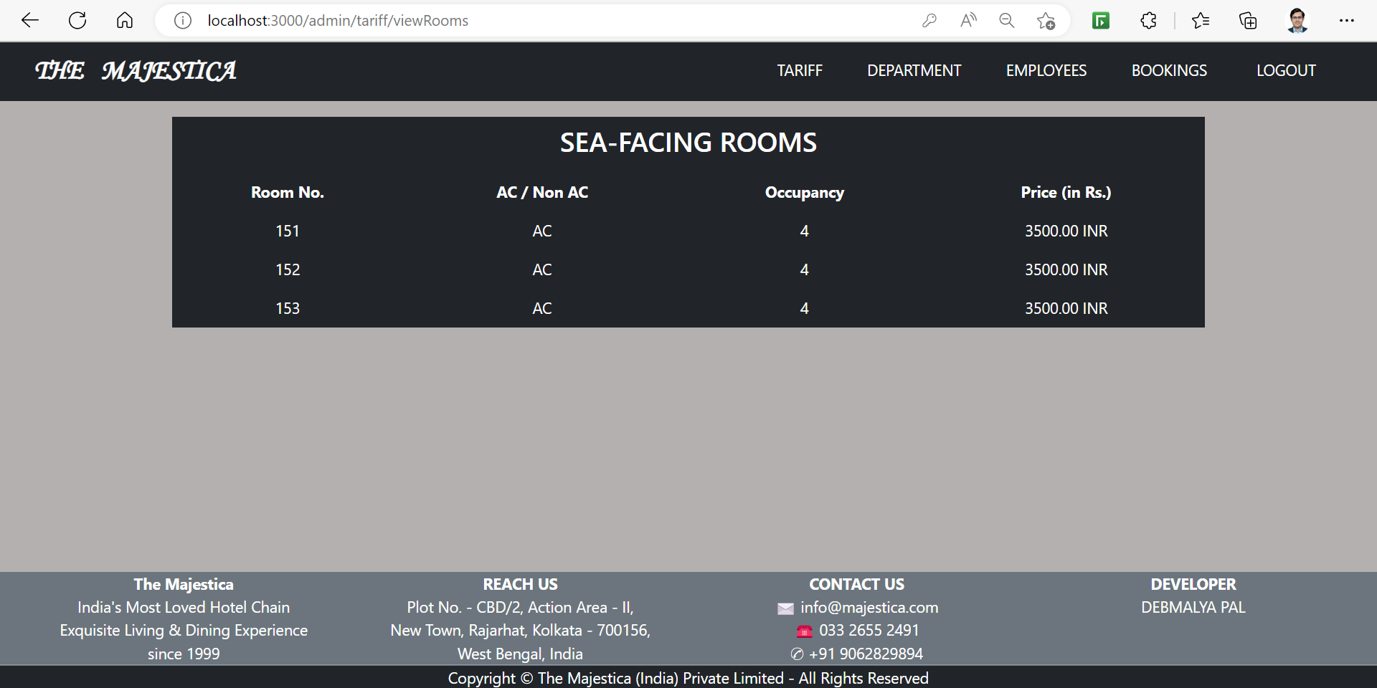
ADMIN’s TARIFF PAGE – VIEW ROOMS

Slide 20
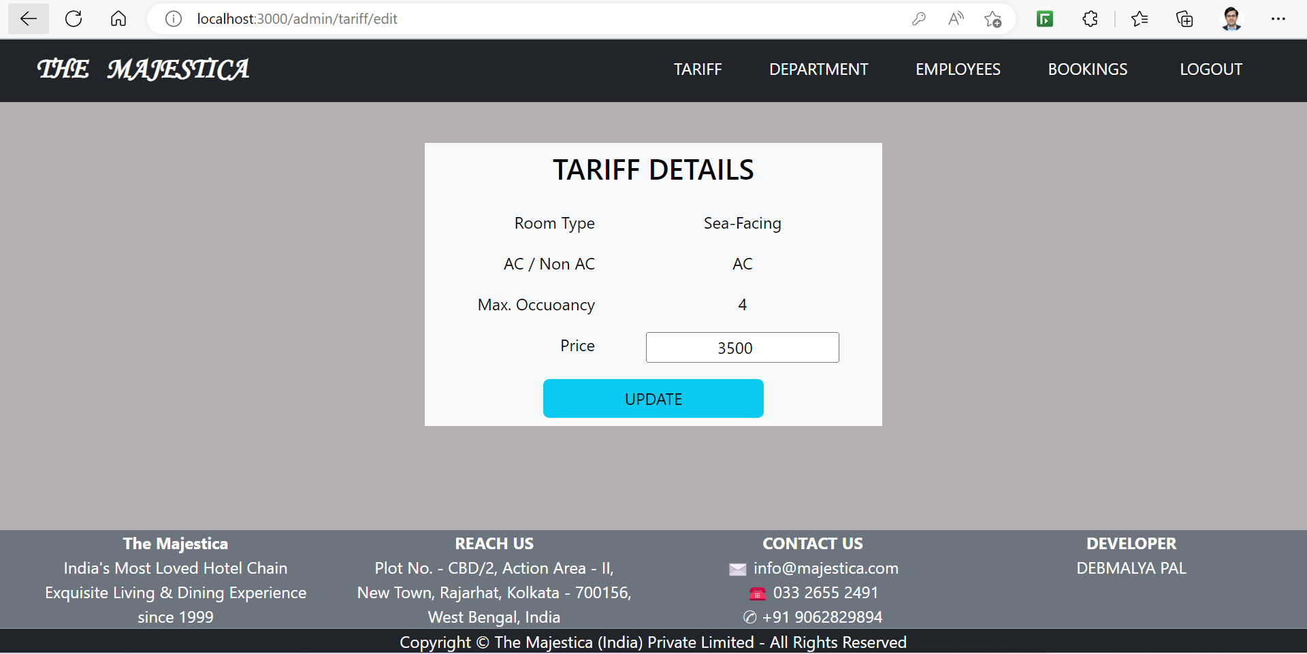
ADMIN’s TARIFF PAGE – EDIT price

Slide 21
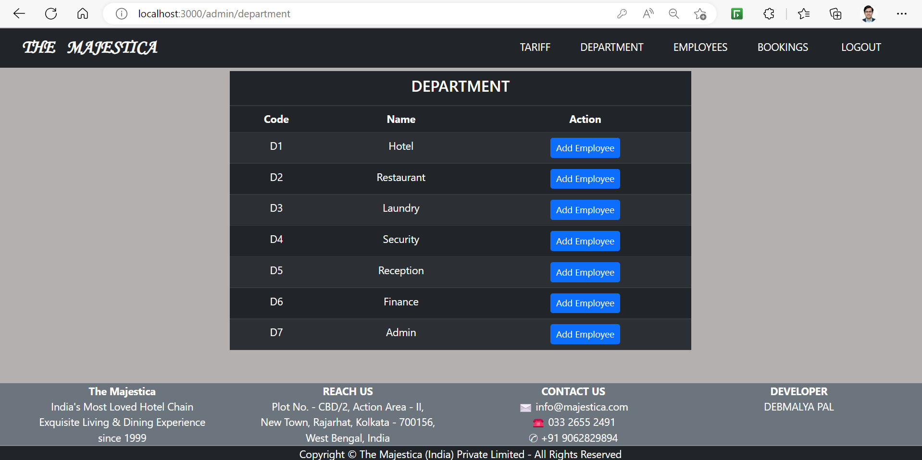
Admin’s department PAGE

Slide 22
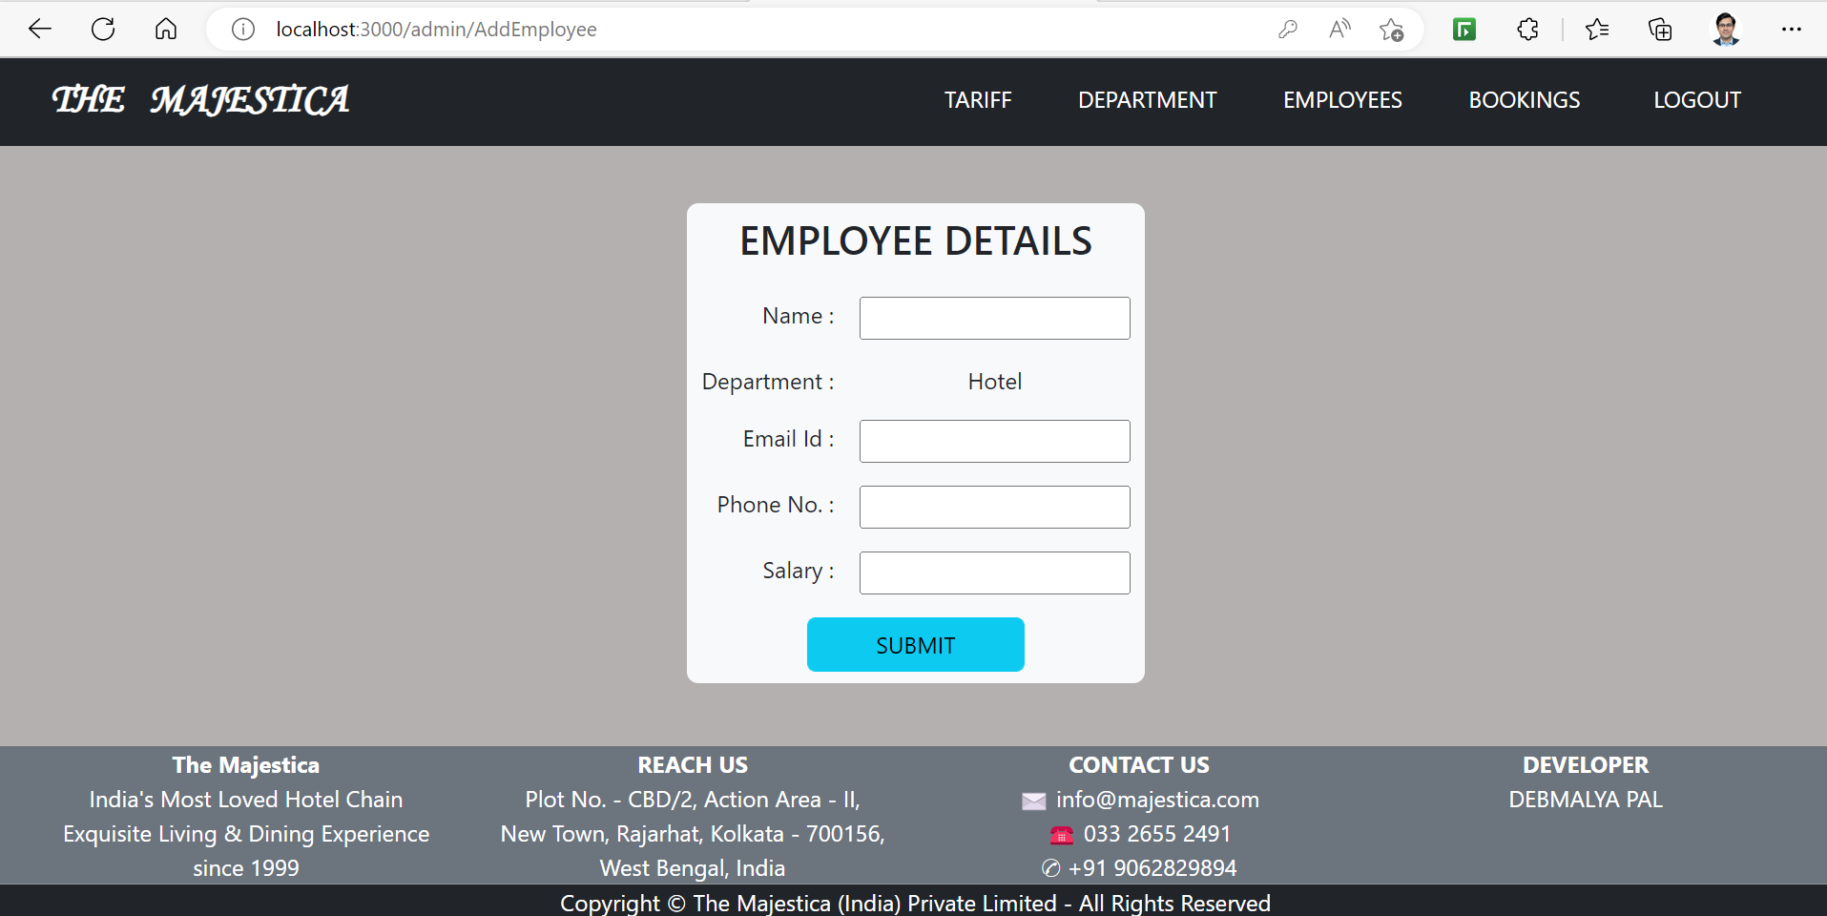
Admin’s department PAGE – add employee

Slide 23
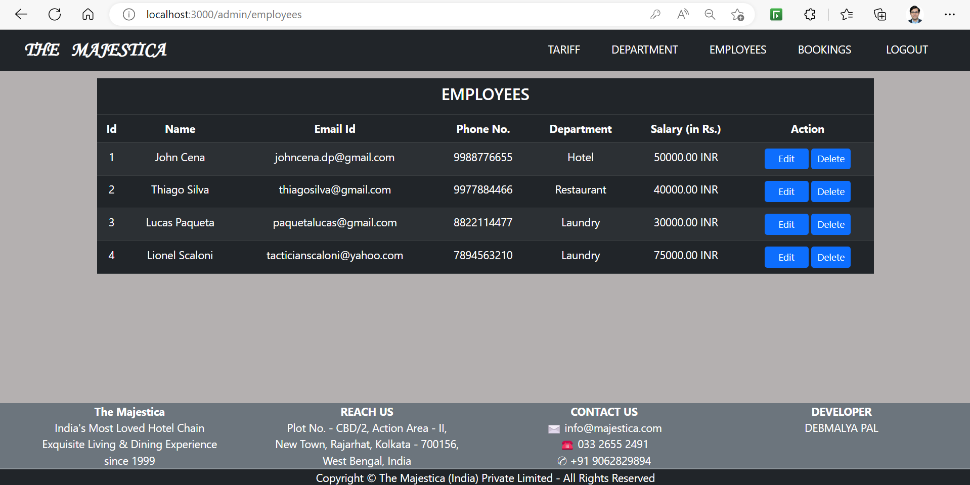
ADMIN’s EMPLOYEE PAGE

Slide 24
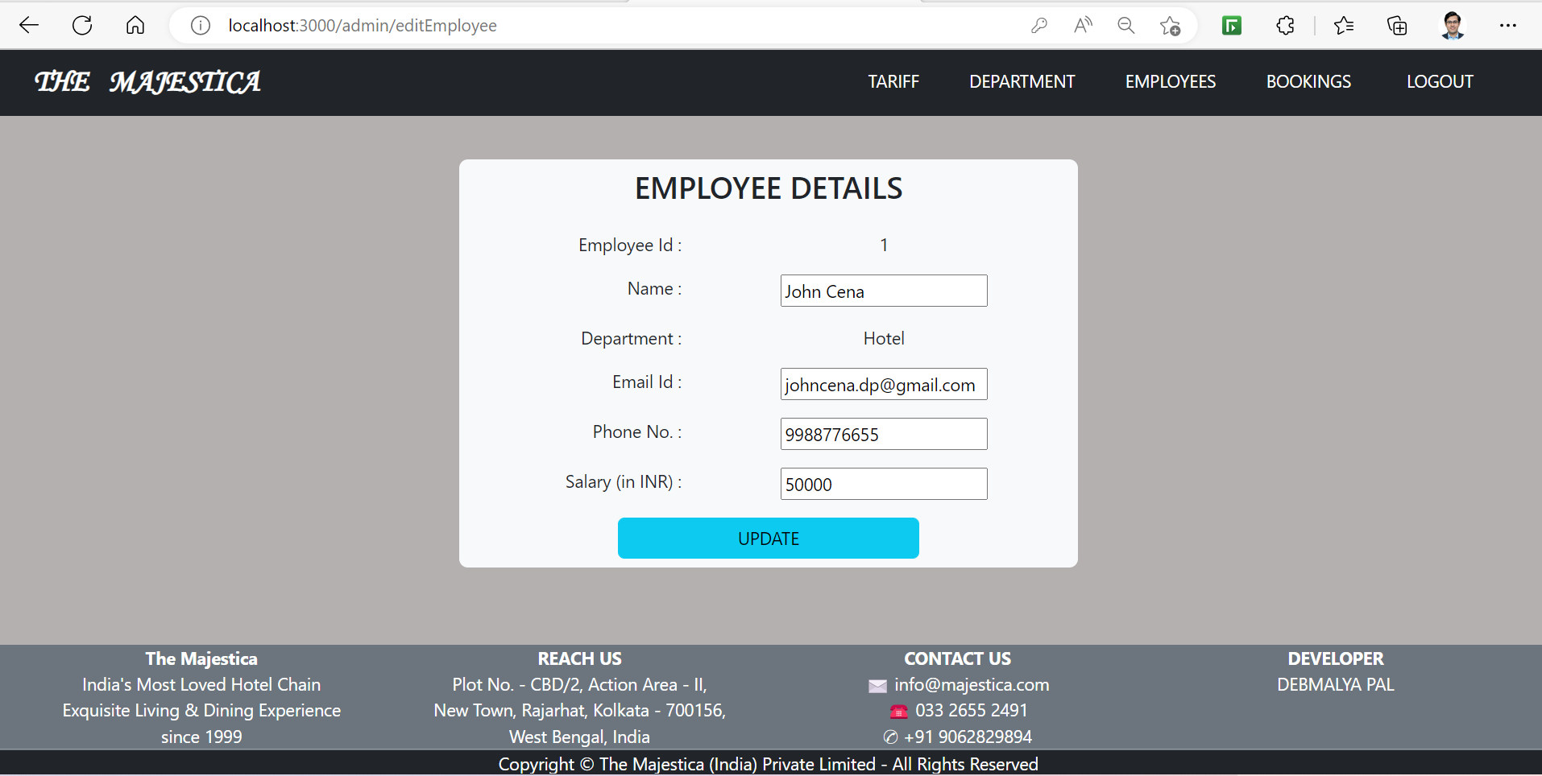
ADMIN’s EMPLOYEE PAGE – EDIT EMPLOYEE

Slide 25
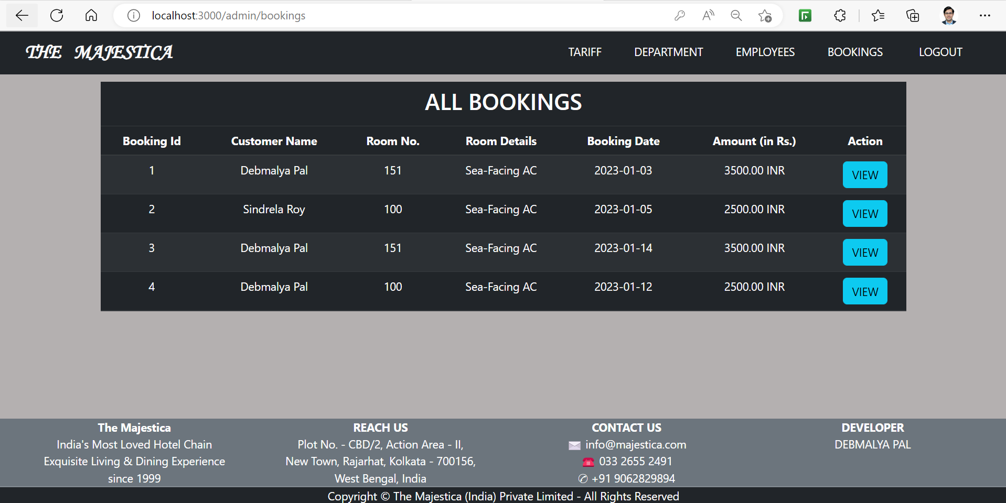
ADMIN’s bOOKINGS PAGE

Slide 26
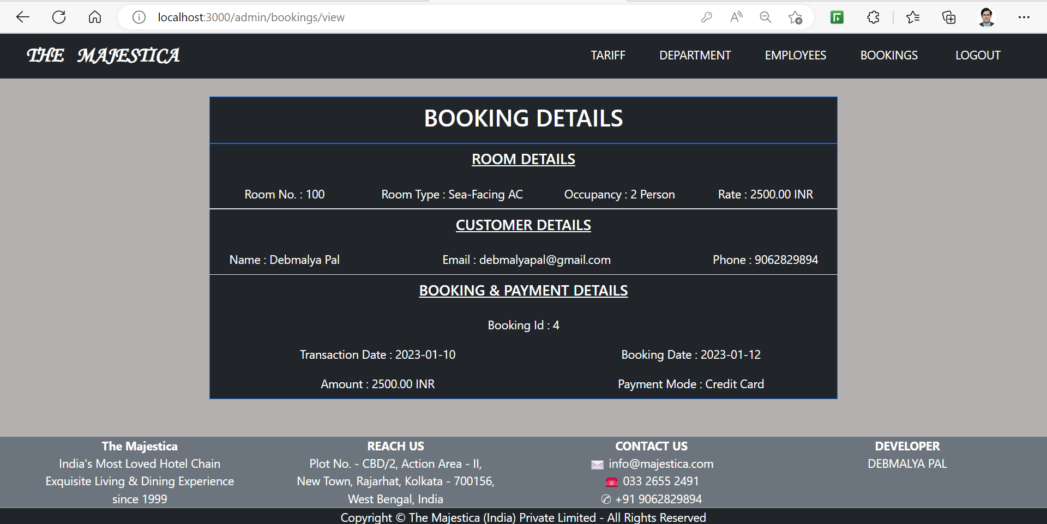
ADMIN’s view bOOKING PAGE

Slide 27
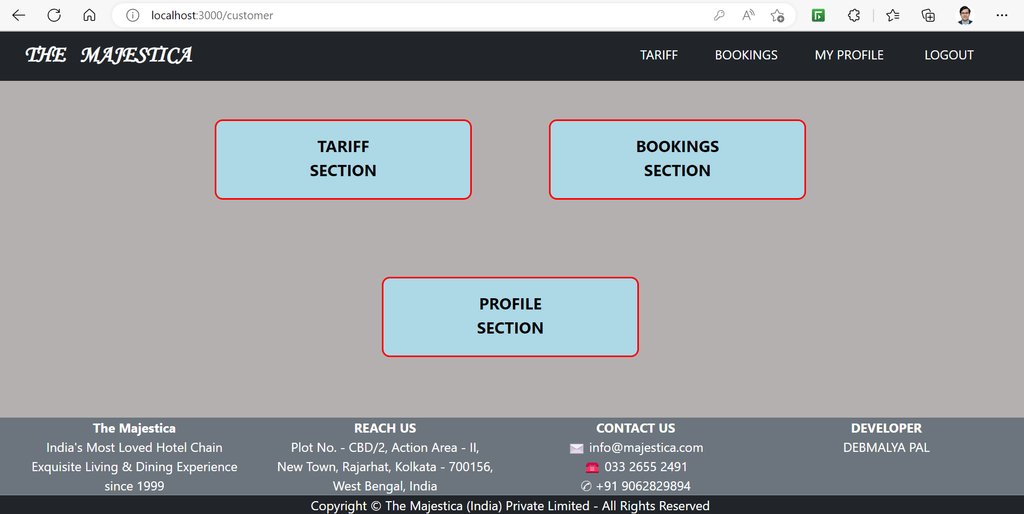
LOGGED IN CUSTOMER’S HOME PAGE

Slide 28
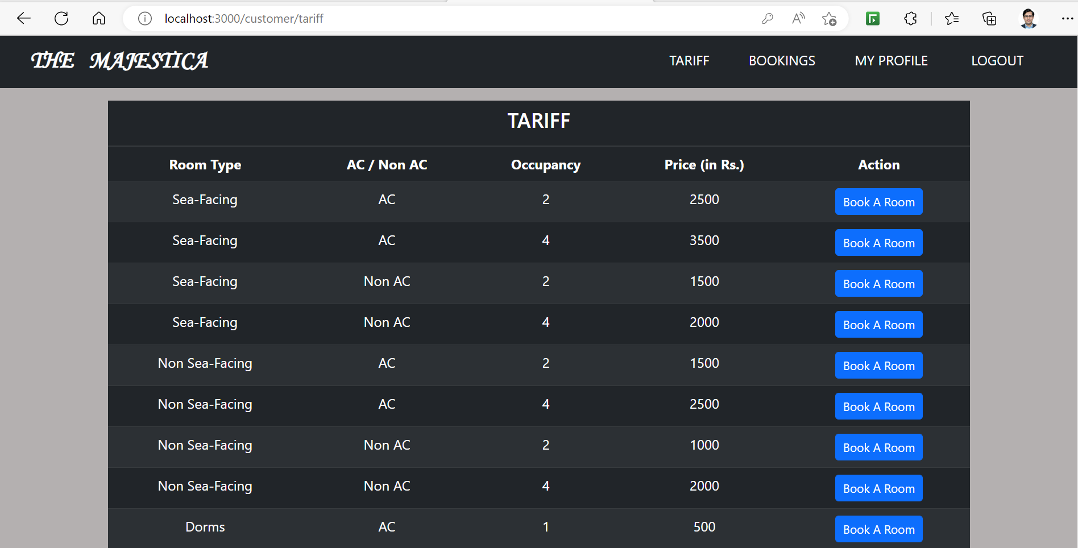
CUSTOMER’S tariff PAGE

Slide 29
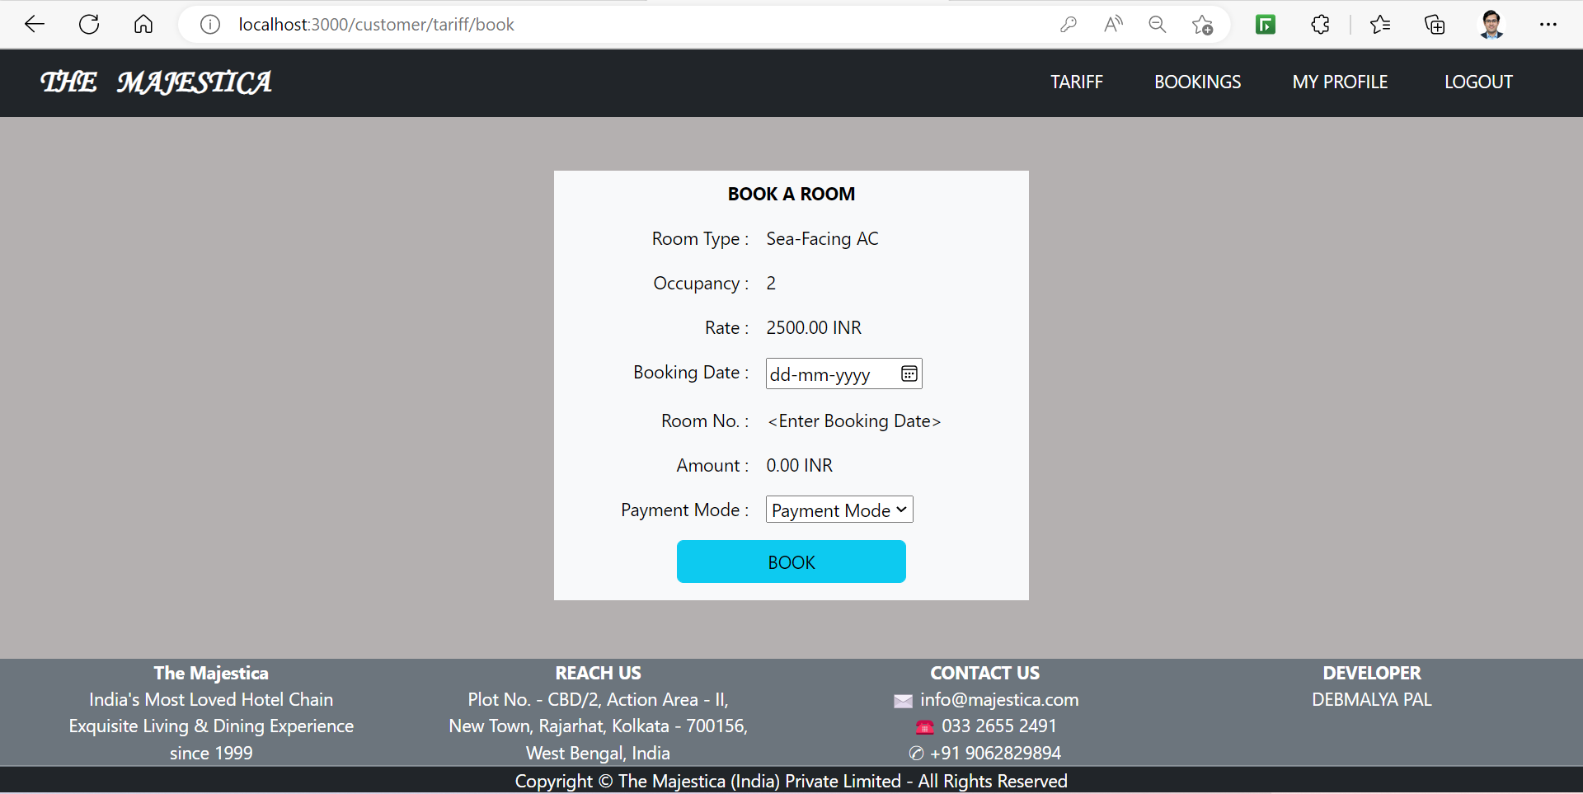
CUSTOMER’S ROOM BOOKING PAGE

Slide 30
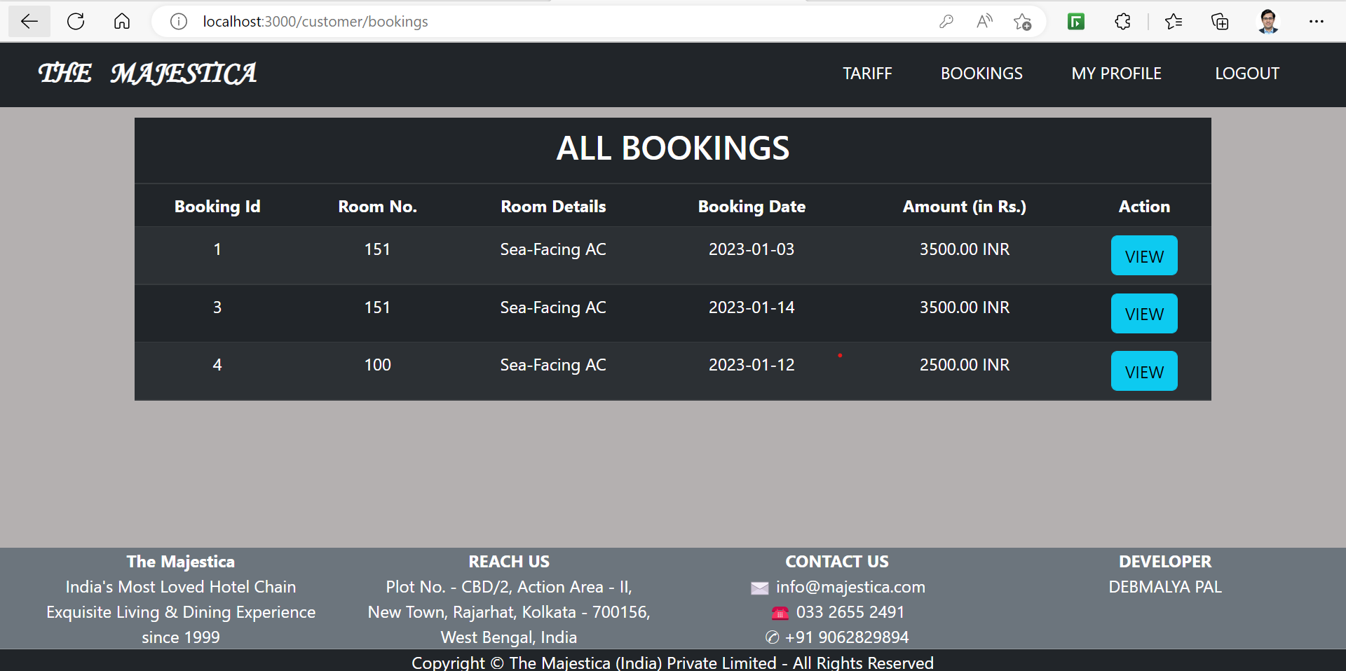
CUSTOMER’S BOOKINGs PAGE

Slide 31
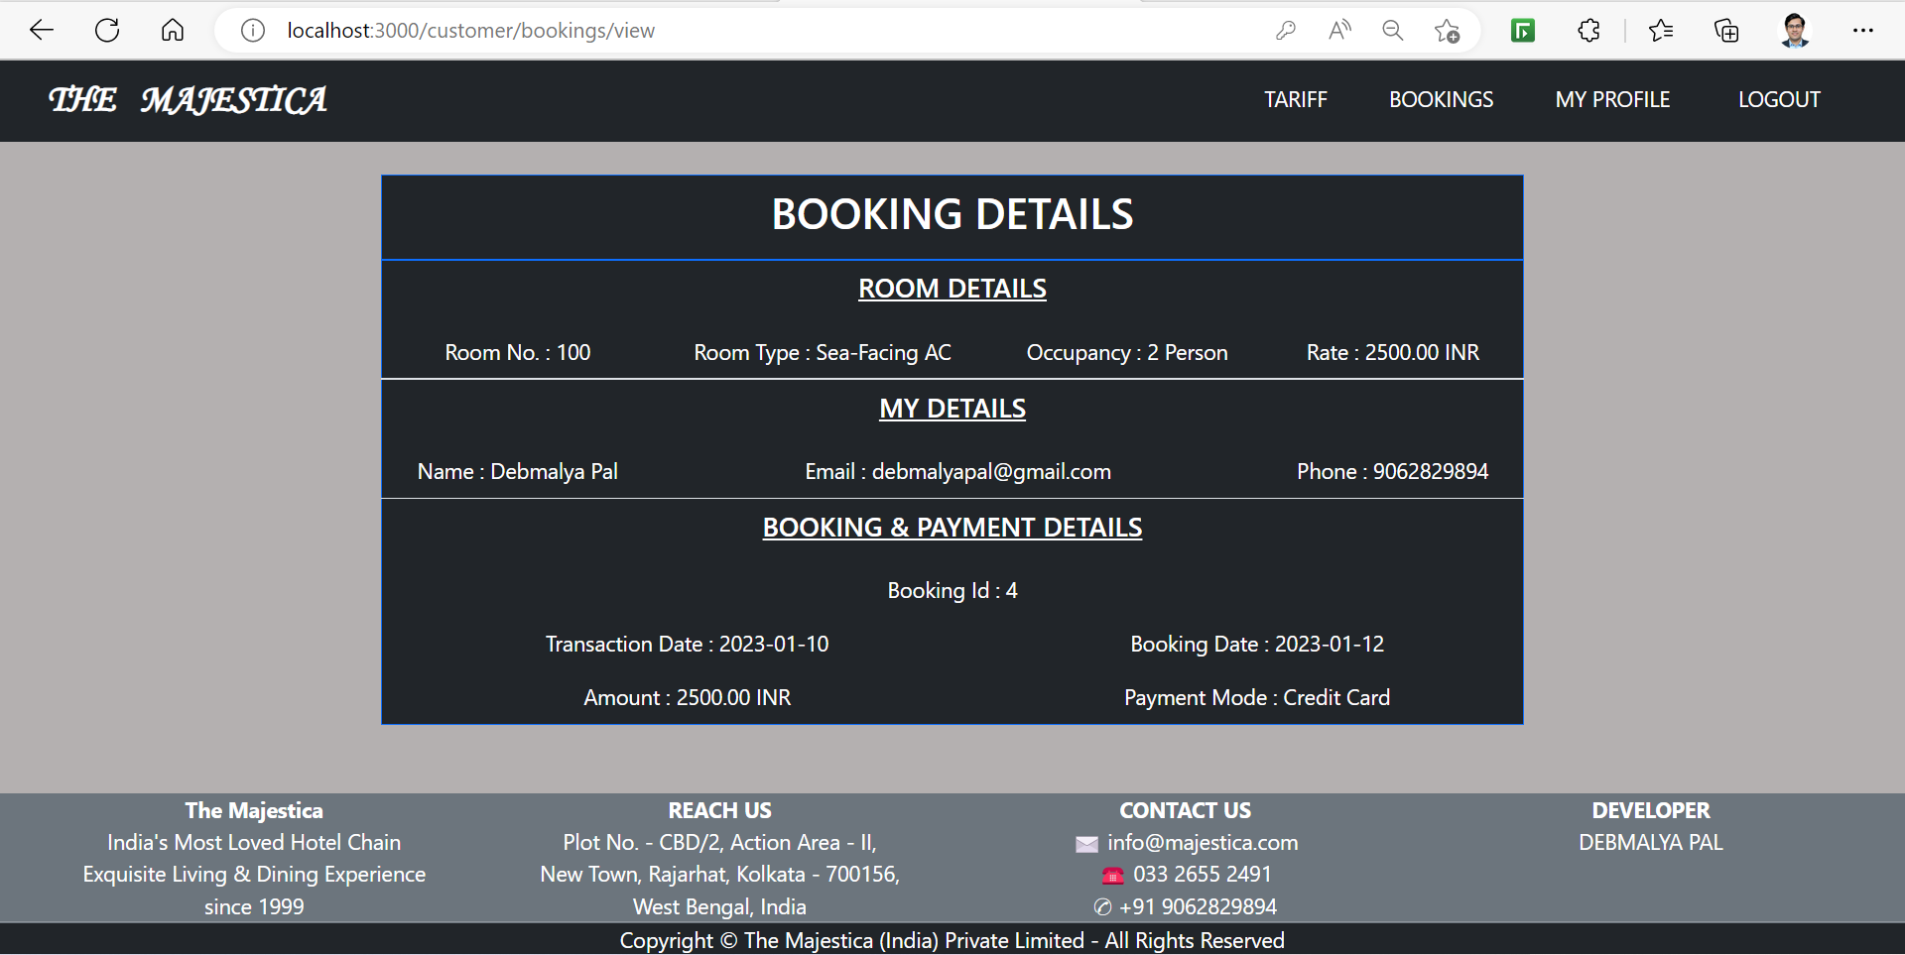
CUSTOMER’S view BOOKING PAGE

Slide 32
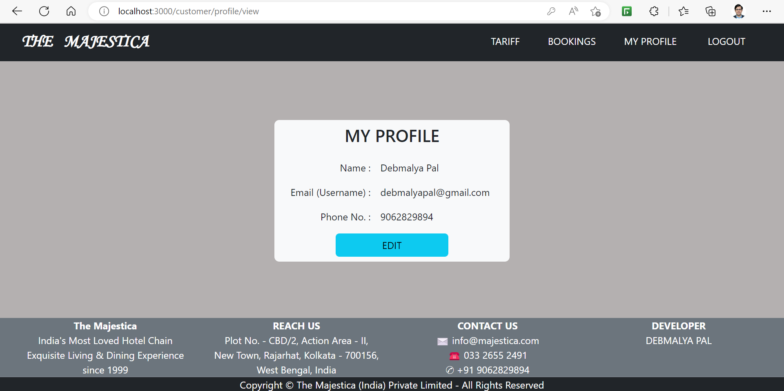
CUSTOMER’S PROFILE PAGE

Slide 33
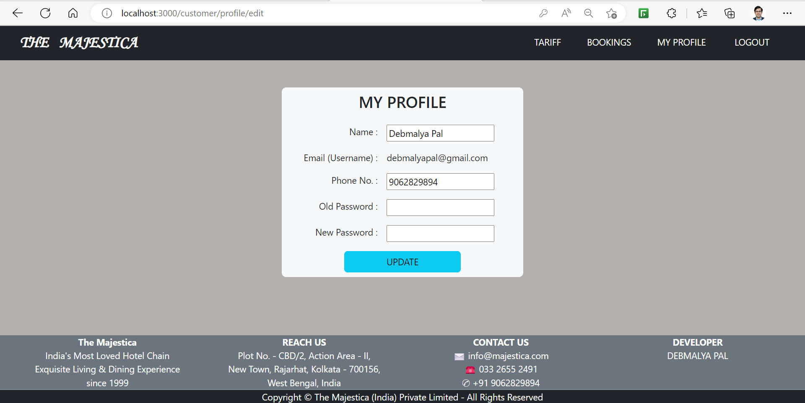
CUSTOMER’S edit profile PAGE

Slide 34
THANK YOU

