Slide 1
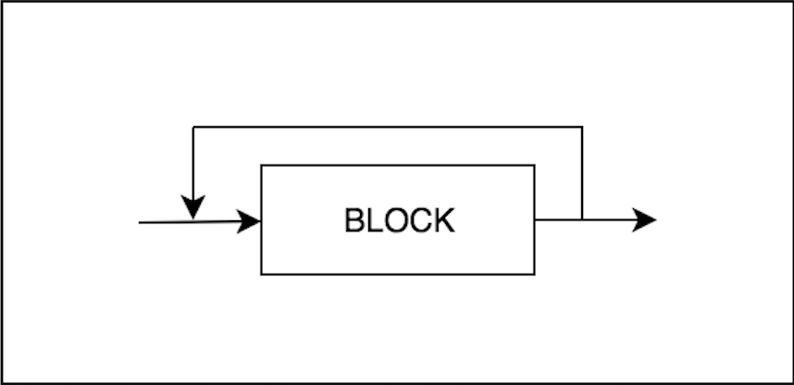
Program
1
1
1
2

Slide 2
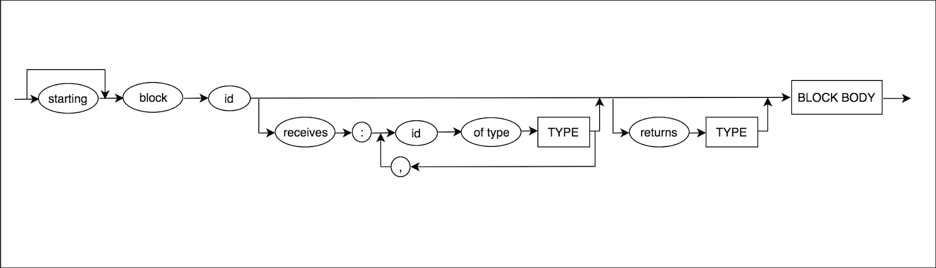
Block
1
5
1
1
1
1
2
6
1
1
3
4

Slide 3
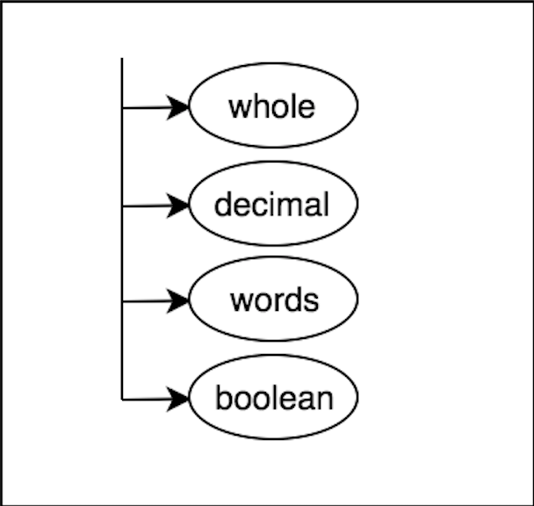
Type
No tiene nada

Slide 4
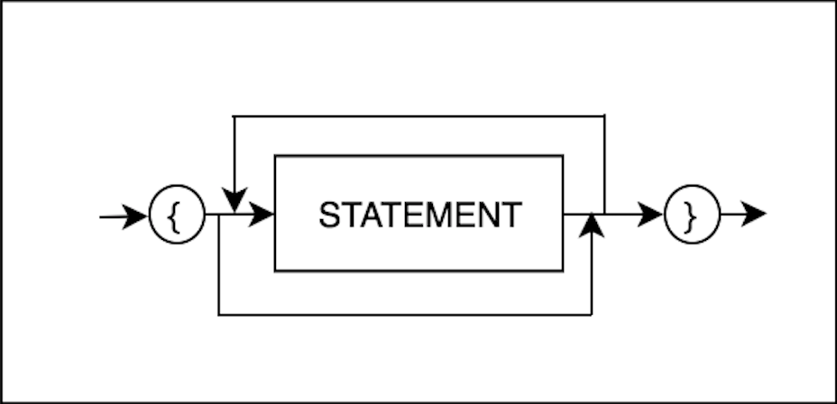
Body

Slide 5
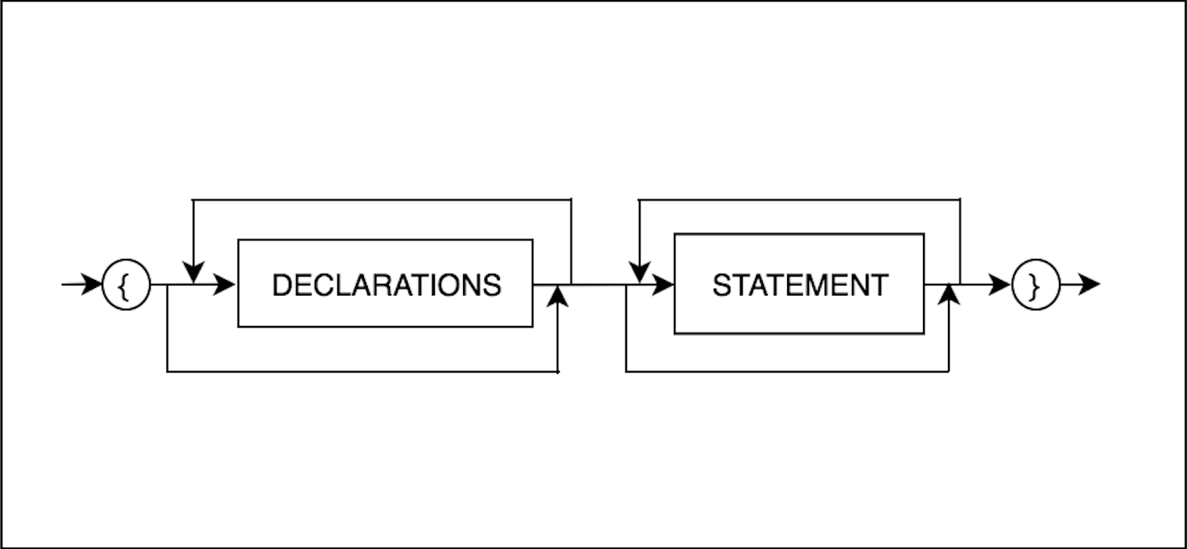
Block Body
1
1

Slide 6
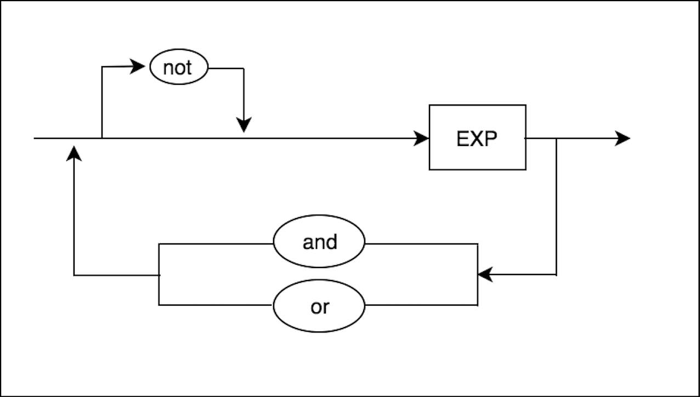
Expression
1
1
1
2
1
3
1
4

Slide 7
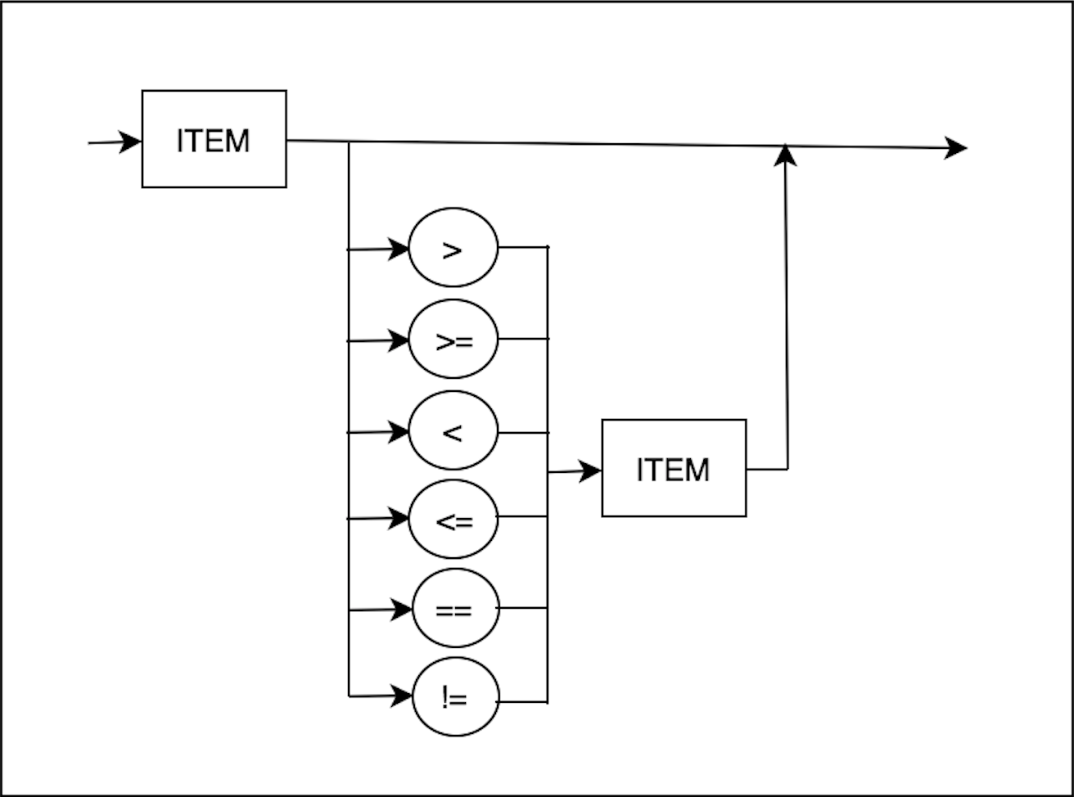
EXP
1
1
1
2

Slide 8
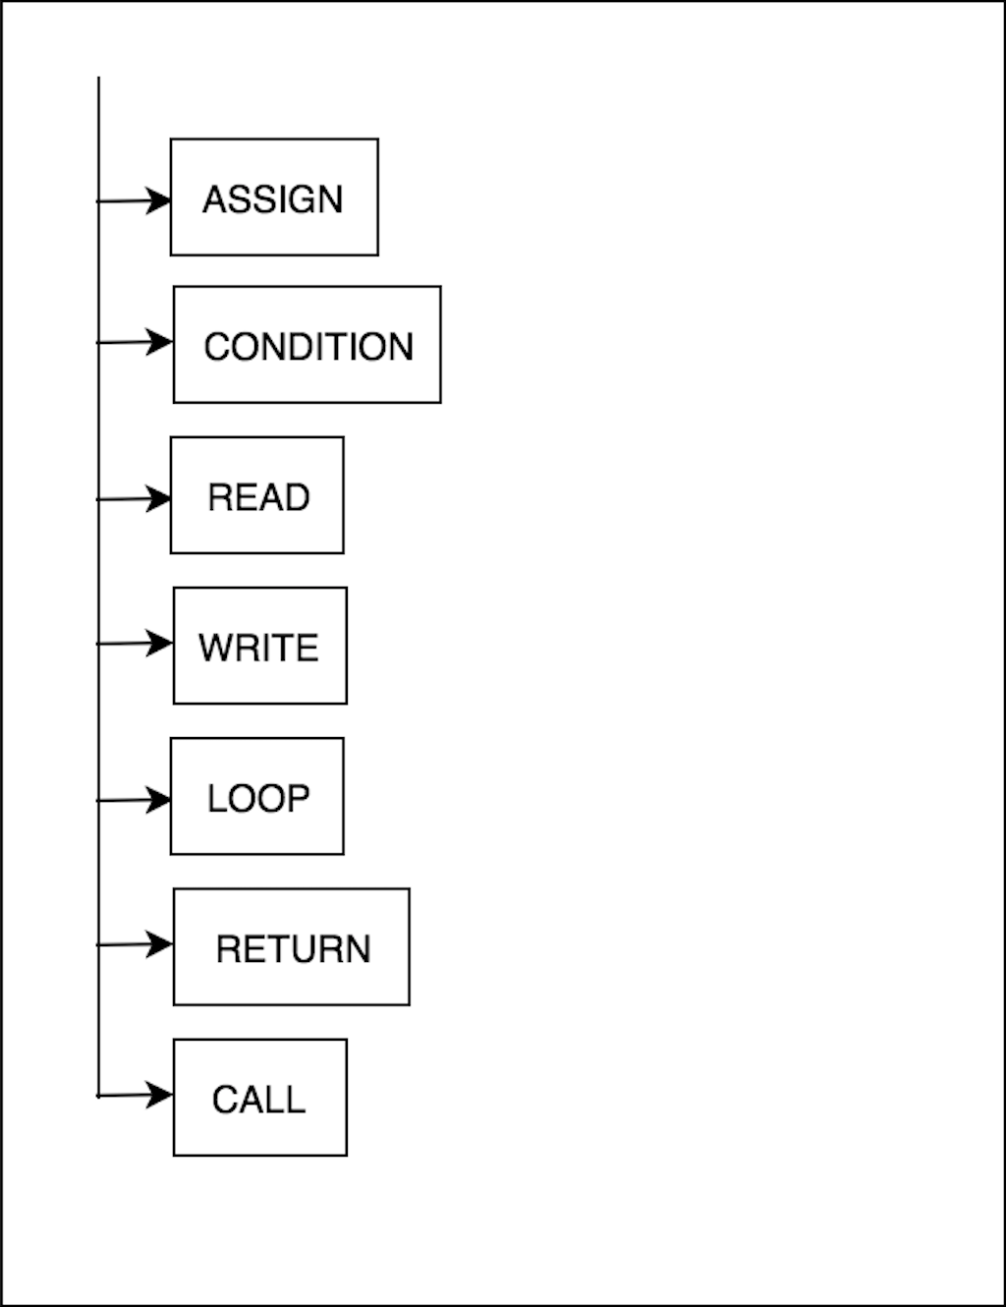
1
1
Statement

Slide 9
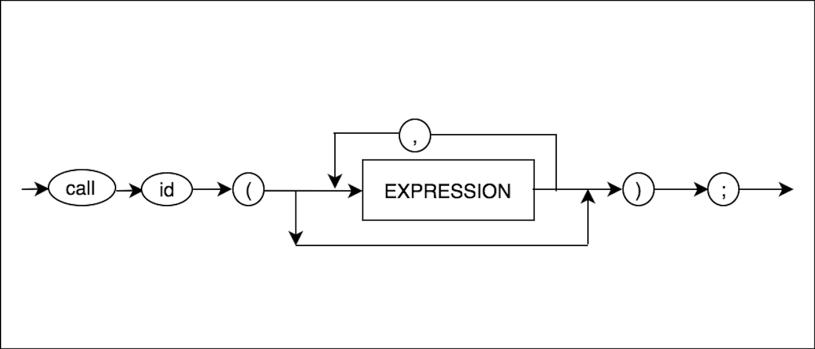
Call
1
1

Slide 10
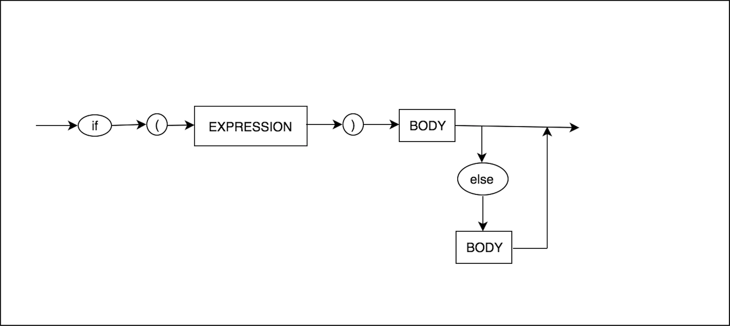
Condition
1
1
1
3
1
2

Slide 11
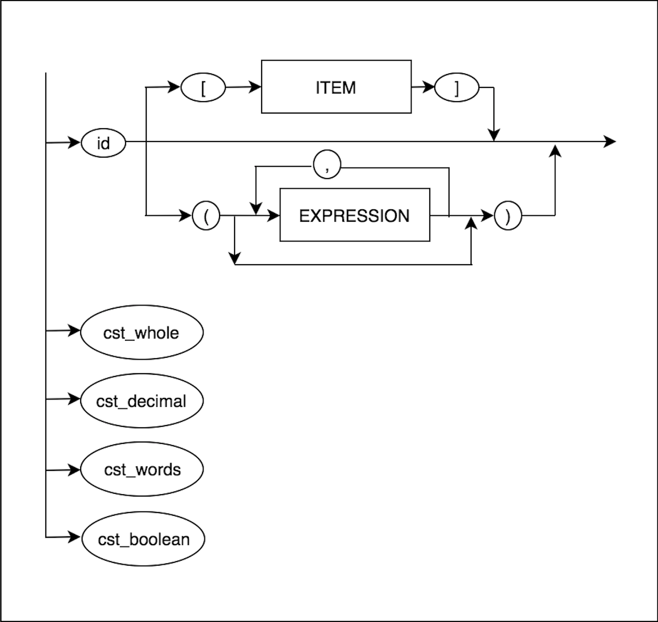

1
1
7
8
1
Constant
1, 6
1
1
9
12
1
1
11
10
1
1, 2
1
1, 3
1
1, 4
1
1, 5

Slide 12
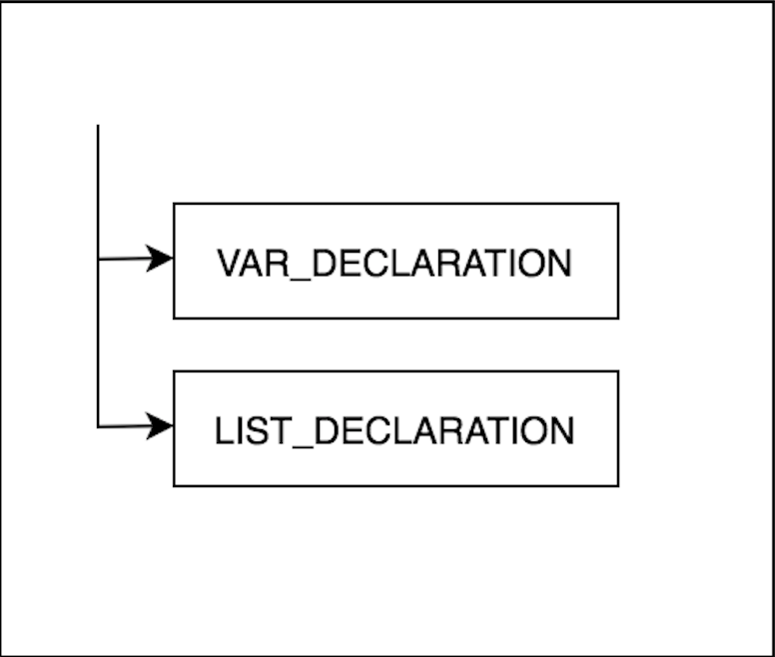
Declarations

Slide 13
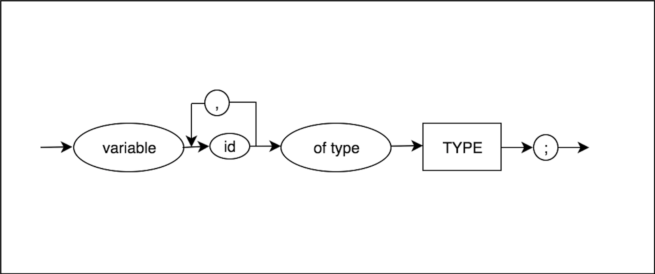
Var Declarations
1
1
1
1
2
3

Slide 14
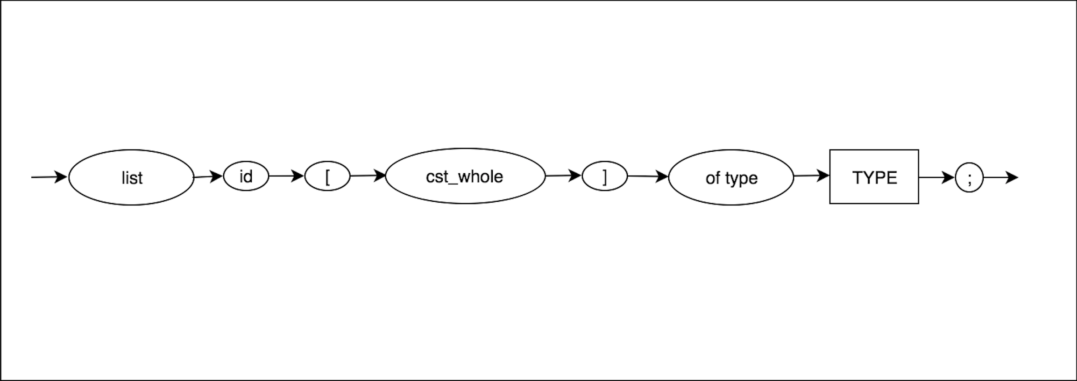
List Declarations
1
1
1
2
1
1
3
4

Slide 15
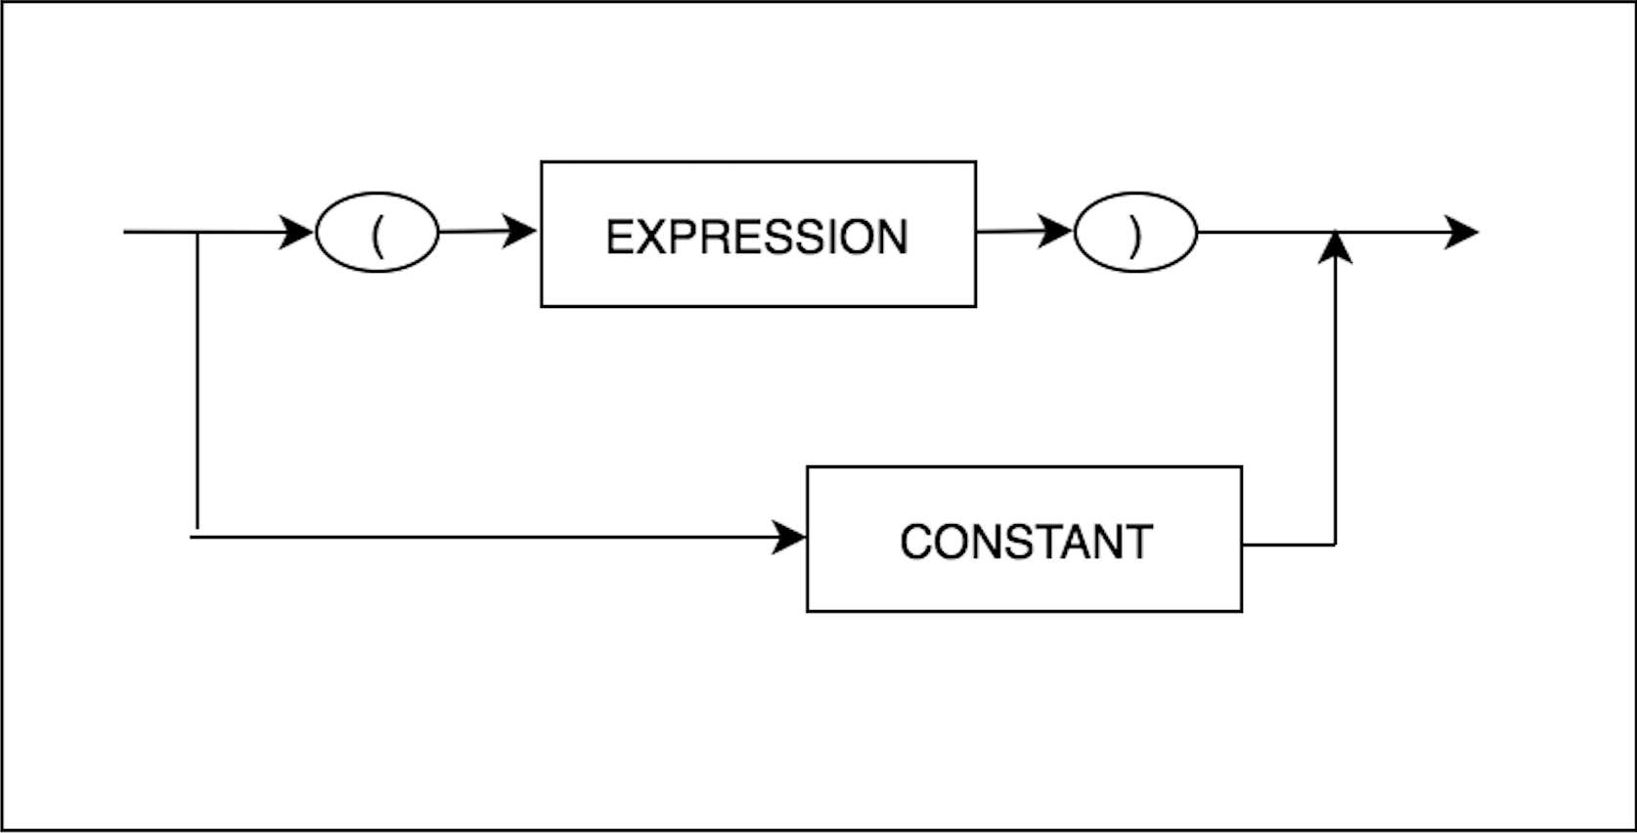
Factor
1
1
1
2

Slide 16
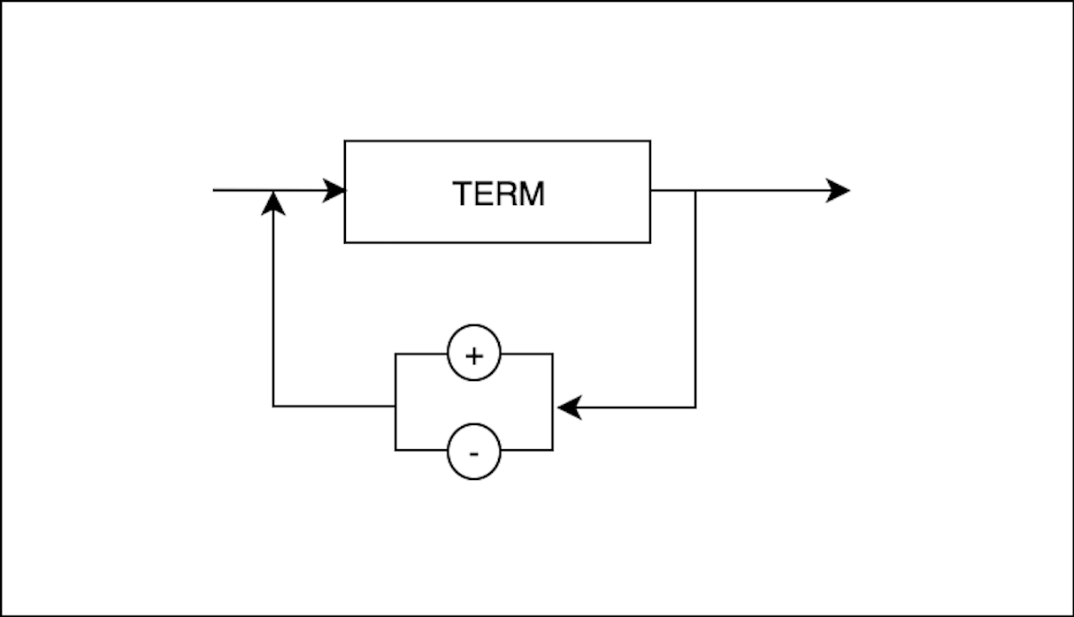
Item
1
1

Slide 17
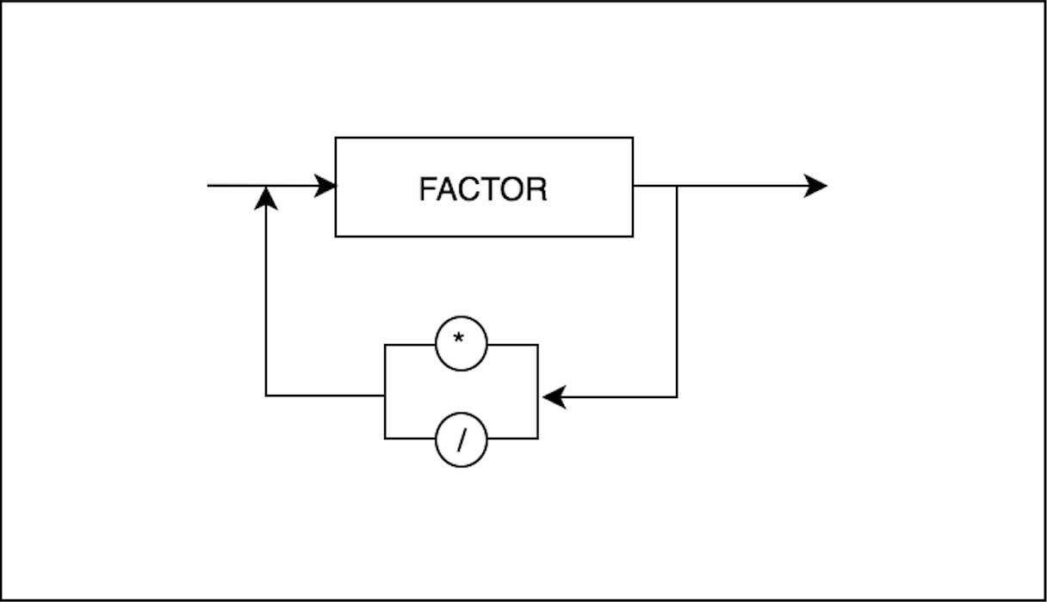
Term
1
1

Slide 18
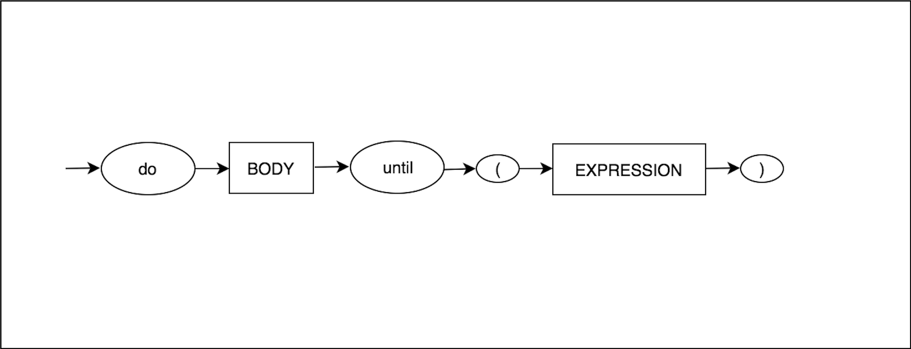
1
Loop
1

Slide 19
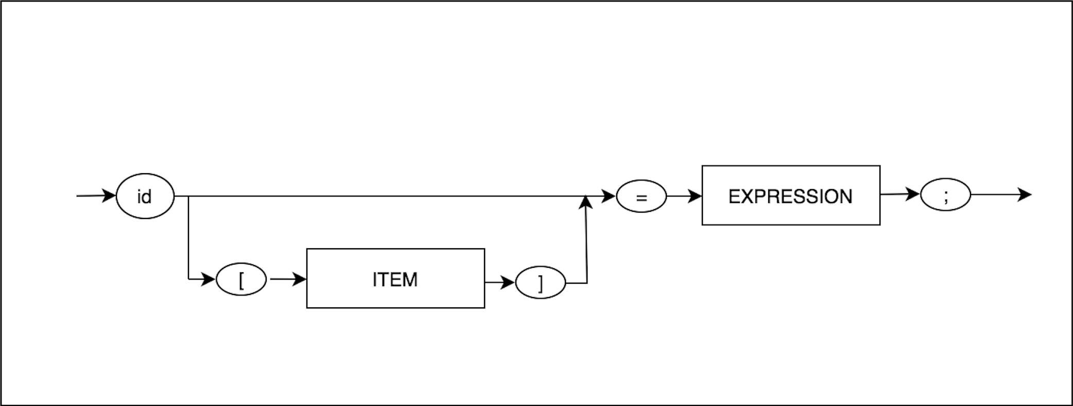
Assign
1
1

Slide 20
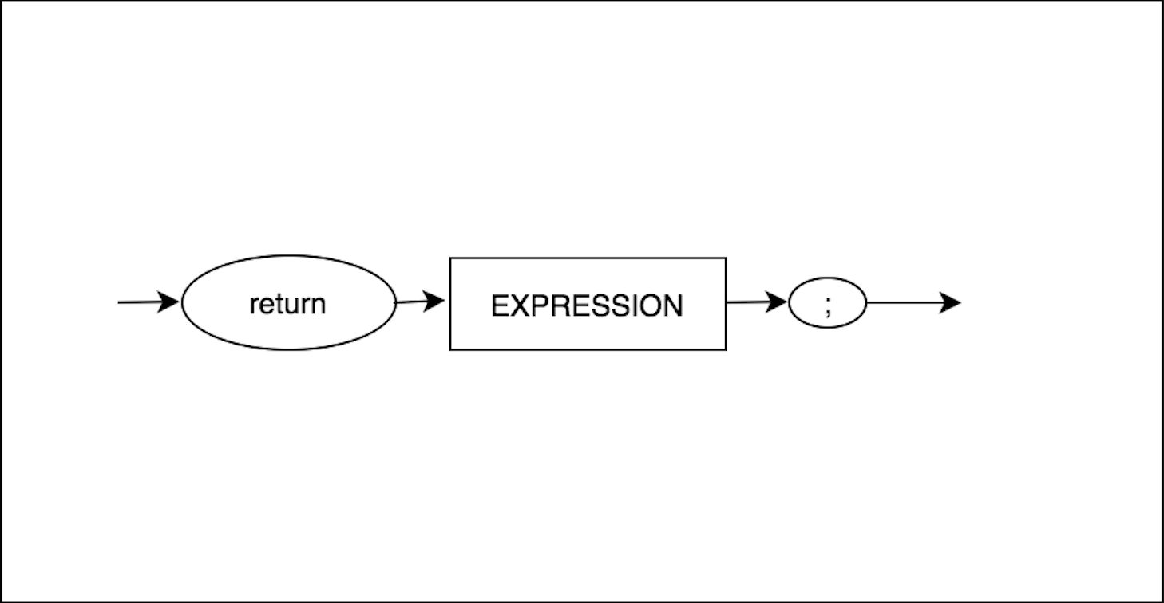
Return
1
1

Slide 21
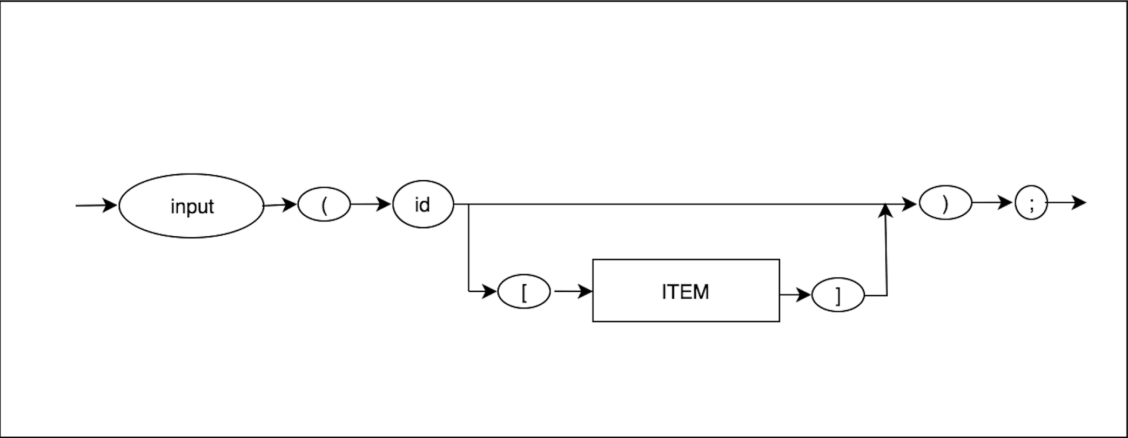
Read
1
1

Slide 22
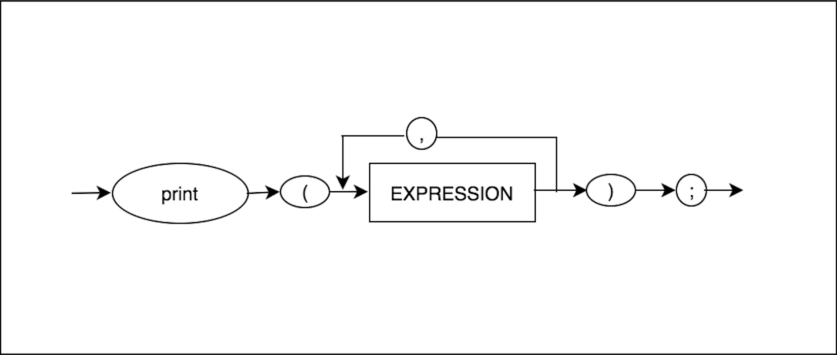
Write
1
1

