Slide 1

"QLoRA-Enhanced Domain-Specific Modeling for Hardware Trojan Detection"
PHASE 2 ISA2 PRESENTATION
DEBOPAM SINHA
PES1PG24EC006

Slide 2
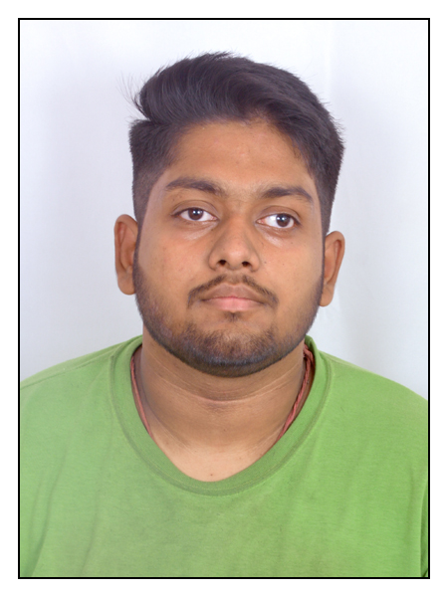
SL.NO | NAME | SNR | PHOTO
1
DEBOPAM SINHA
PES1PG24EC006
GUIDE –
Dr. Nirmala Devi M
Professor (Department of Electronics and Communication Engineering )

Slide 3
Introduction
The Global Risk: Outsourcing chip fabrication minimizes costs but allows untrusted third parties to plant Hardware Trojans (HTs) in RTL netlists.
Detection Challenges: HTs are stealthy and remain dormant until triggered by rare conditions, making standard testing insufficient.
The "Localization Gap": Current LLM verification (e.g., PEARL) relies on human-readable names like trigger or malicious_payload.
Vulnerability: Simple renaming attacks (e.g., Node_001) cause a steep drop-off in detection accuracy for generic LLMs

Slide 4
Proposed RCSL Framework
Core Objective: Eliminate semantic reliance by forcing the model to learn Boolean netlist topology.
Architecture: Leverages an 8-Billion parameter LLM (Hermes-3-Llama-3.1-8B).
Innovation: Using QLoRA Domain Adaptation to map hardware behavior directly into the model weights.
Approach: Replaces semantic inference with topological mapping

Slide 5
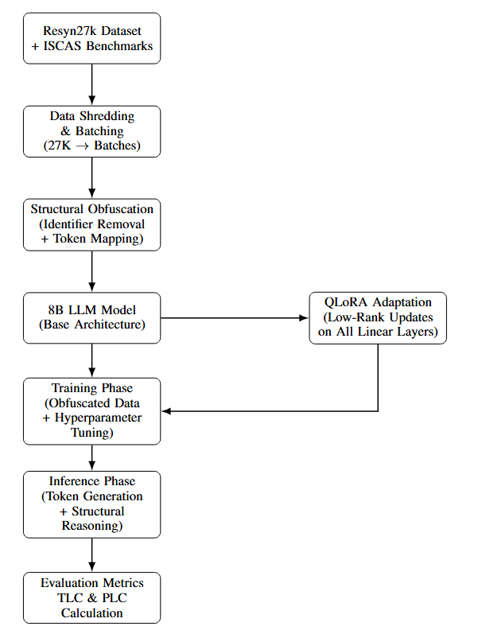
Methodology Flow

Slide 6
Data Pipeline and Automated Obfuscation
Data Preparation: Utilized the Resyn27k dataset (27,000 Verilog instances).
Shredding: Chunked data into 27 batches of 1,000 samples to manage memory limitations.
Automated Obfuscator:
Uses a two-pass regular expression extraction to find all wire, reg, input, and output identifiers.
Maps all human-readable names to structural tokens (e.g., clk → Node_01).
Example: assign trigger = (count == 8'hFF) becomes assign Node_007 = (Node_006 == 8'hFF).

Slide 7
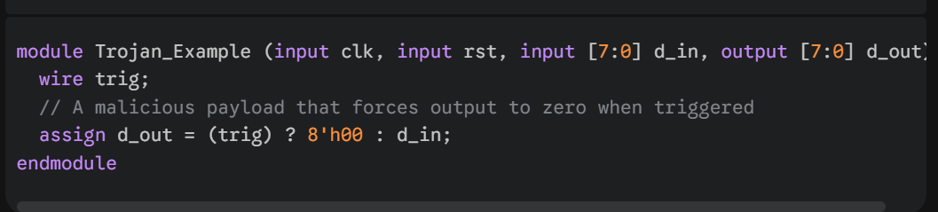
How the Model "Sees" Hardware Logic
1. The Original Code (The "general" View): In a standard Verilog file, we might see something like this:

Slide 8
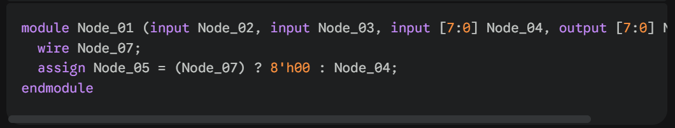
2. The Obfuscated Code (The "RCSL" View): This is what my training data actually looks like :

Slide 9

Technical Implementation -QLoRA Adaptation
Weight Injection: Updates the model via the rule
Target Layers: Targeted all linear projection layers (q, k, v, o, gate, up, down).
MLP Fine-Tuning: Specifically targeting MLP parts (up_proj, gate_proj) enables the model to process complex cycle branching logic like Verilog FSMs.
Quantization: Used 4-bit NormalFloat (NF4) to maintain hardware stability on consumer-grade GPUs.
Parameters - Rank(32) , Alpha (64) , Max sequence length (128) , gradient accumulation (16).

Slide 10
Training Execution
Iterative Tuning: Moved from basic configurations to an "Optimal condition".
Constraints: Implemented a 45% VRAM limit to prevent system crashes.
Convergence Indicators:
Loss Plateauing: Cross-Entropy Loss of 0.1240 after Batch 18.
Syntax Integrity: Peaked at 98.60% syntax pass rate, signaling the model understood Verilog structure.

Slide 11
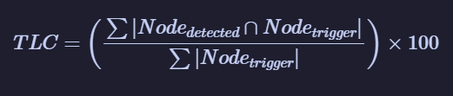
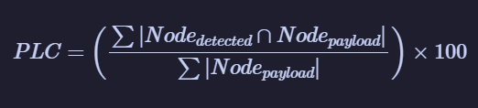
Security Metrics — TLC and PLC Framework
Trigger Line Coverage (TLC): This metric represents the model's precision in identifying the activation logic (the "trigger") of the Trojan..
Payload Line Coverage (PLC): This metric measures the success rate in identifying the nodes where the malicious logic compromises the circuit's intended functionality (the "payload").

Slide 12
Results (Resyn27k dataset) -
Trial and Error during Training
Trial | Rank (r) | Alpha (α) | Seq. Length | Grad. Accum. | Batch Loss | Structural Accuracy | Syntax Integrity | Technical Observation
1 | 8 | 16 | 512 | 4 | 0.9773 | 12.40% | NA | Critical OOM error.
2 | 16 | 32 | 512 | 8 | 0.7842 | 34.20% | NA | VRAM spiked.
3 | 32 | 64 | 384 | 8 | 0.5211 | 61.80% | 86.40% | Structural learning improved
4 | 32 | 64 | 256 | 16 | 0.3104 | 88.50% | 92.10% | Ongoing Stable progression
5 | 32 | 128 | 128 | 16 | 0.1855 | 94.20% | 71.40% | Structural accuracy improving but sudden drop in Syntax integrity
Final | 32 | 64 | 128 | 16 | 0.1240 | 97.42% | 98.60% | Maximum structural depth within VRAM safety limit.

Slide 13
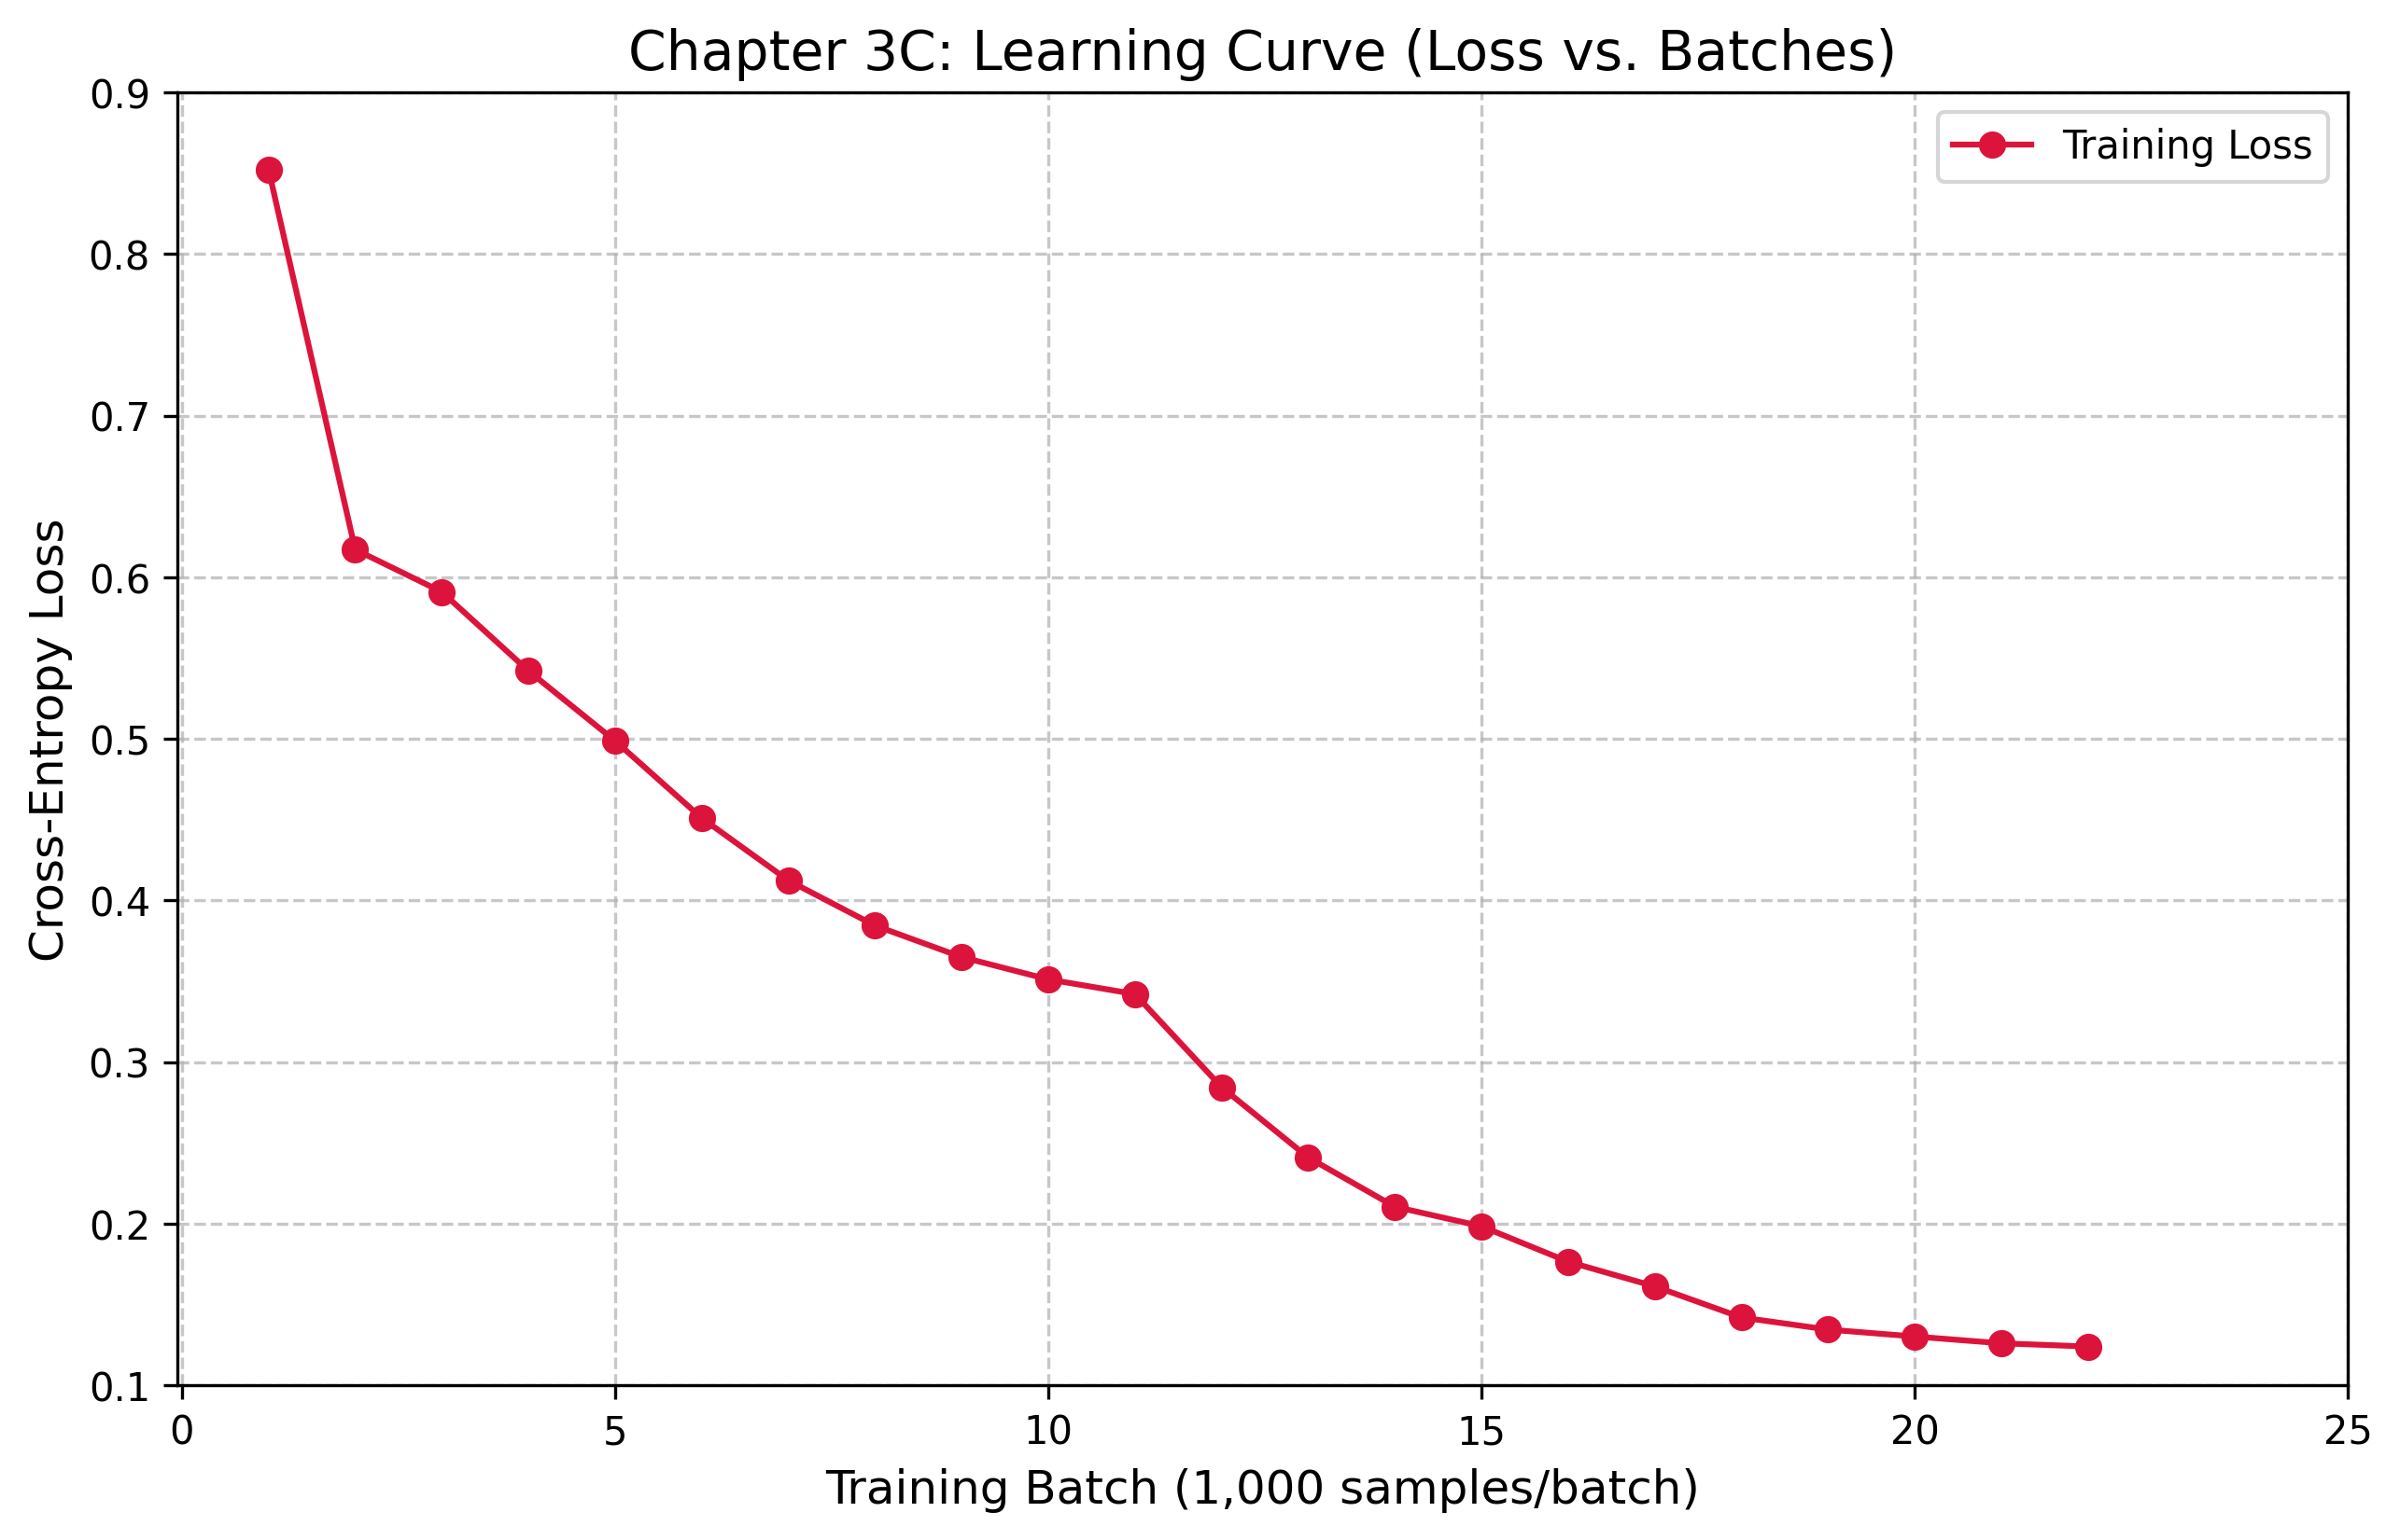
Results (Resyn27k dataset) -
Batch-wise Training Progression
Table showing batch-wise training
Batch | Cross-Entropy Loss
B01 | 0.8524
B02 | 0.6172
B03 | 0.5910
B04 | 0.5421
B05 | 0.4988
B06 | 0.4510
B07 | 0.4124
B08 | 0.3845
B09 | 0.3650
B10 | 0.3512
B11 | 0.3421
B12 | 0.2845
B13 | 0.2410
B14 | 0.2105
B15 | 0.1984
B16 | 0.1765
B17 | 0.1612
B18 | 0.1420
B19 | 0.1345
B20 | 0.1302
B21 | 0.1260
B22 | 0.1240

Slide 14
Results (Resyn27k dataset)-
Verification (batch 23 , batch 24)
Testing (batch 25 , batch 26 , batch 27)
Metric | Trial 1 | Final Optimized
Structural Accuracy | 12.40% | 97.42 %
Syntax Integrity | 78.40% | 98.60 %
Performance Metric | RCSL (Structural-Traceability)
Detection Accuracy | 97.42%
Precision | 96.85%
Recall (TPR) | 98.10%
F1-Score | 97.47%

Slide 15
Results (Resyn27k dataset)-
Trial and Error for TLC and PLC -
Trial | Parameter Change | Resulting TLC (batch 25) | Resulting PLC(batch 25) | Technical Observation
Trial 1 | max_new_tokens=64, r=8 | 84.12% | 81.30% | TLC and PLC very less .
Trial 2 | max_new_tokens=128, r=16 | 91.45% | 88.60% | TLC and PLC improving .
Trial 3 | max_new_tokens=256, r=32 | 96.06% | 95.45% | The model successfully traced trigger condition and payload condition.

Slide 16
Results (Resyn27k dataset)-
TLC and PLC -
Metric | Batch 25 | Batch 26 | Batch 27 | Aggregated Total
Trigger Line Coverage (TLC) | 96.06% | 95.91% | 96.22% | 96.06%
Payload Line Coverage (PLC) | 95.45% | 94.66% | 95.21% | 95.11%
False Positive Rate (FPR) | 0.85% | 0.71% | 0.70% | 0.75%

Slide 17
References
Kundu, R. K., Khalil, K., Garcia, E., Grassia, E., Calyam, P., Hoque, K. A. (2025).PEARL: An Adaptive and Explainable Hardware Trojan Detection Using OpenSource and Enterprise Large Language Models. IEEE Access, 13, 133755–133772.
Saha, D., Yahyaei, K., Saha, S. K., Tehranipoor, M., Farahmandi, F. (2024). Empowering Hardware Security with LLM: The Development of a Vulnerable HardwareDatabase. In Proceedings of the IEEE International Symposium on Hardware Oriented Security and Trust (HOST), 233–243.
Faruque, M. O., Jamieson, P., Patooghy, A., Badawy, A.-H. A. (2026). TrojanWhisper: Evaluating Pre-Trained LLMs to Detect and Localize Hardware Trojans. IEEEAccess, 14, 30965–30983.
Hayashi, V.T., Ruggiero, W.V., "Hardware Trojan Detection in Open-Source Hardware Designs Using Machine Learning," IEEE Access, vol. 13, pp. 53200-53217, 2025.
G.-W. Wan, S.-Z. Wong, D. Liu, and X. Wang, ‘‘Assessment of pre-trained large language models for hardware trojan detection in RTL designs,’’ in Proc. IEEE LLM Aided Design Workshop (LAD), Jun. 2024, p. 1.
https://github.com/hkust-zhiyao/RTL-Coder

Slide 18
THANK YOU

