Slide 1
Stock market data analysis using Twitter data
Final Project
Course: Big data for official statistics
-------------------------
Debodeep Banerjee
Matricola - 1901253

Slide 2
Topics to Discuss ---------------------------------------------
A. The Dataset
1. Motivation and source
2. Brief description
3. Challenges and preprocessing
B. Exploratory Data Analysis
1. Simple and exponential moving average
2. Daily return
3. Stationarity check
C. News polarity
1. Methodology
2. Polarity construction
D. Forecasting

Slide 3
A. Dataset -------------------------------------------------------
The dataset has been collected from: investpy module: it retrieves data from investing.com
The data is collected from January 2015 to May 2021
The data consists of ‘high’, ‘low’, ’open’, ‘close’ value of ONGC
Textual data is collected from twitter.
Instead of using twitter API, the data has been collected with twint.

Slide 4
Dataset: Challenges and preprocessing -------------------------------------------------------------
The stock market data needed no pre-processing.
Tweets were in multiple languages and pre-processing was needed. Only English language was taken into account.
All the stop words, punctuations were removed.

Slide 5
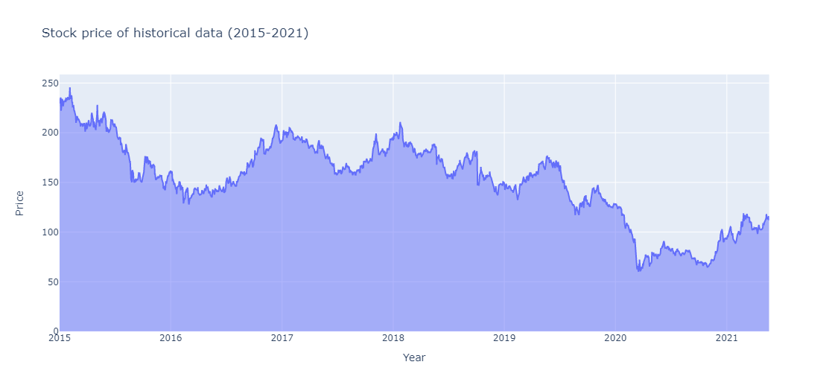
B. Exploratory Data Analysis -------------------------------------------
Key thoughts:
------------------
Intuitively- no seasonality
Huge fall in 2020-21:
perhaps due to covid?

Slide 6
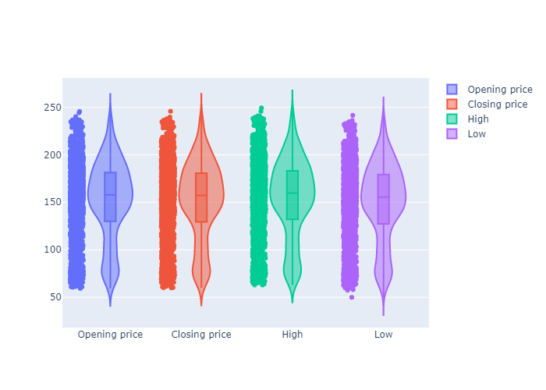
B. Exploratory Data Analysis(contd.) ------------------------------------------------
Key insights:
Almost same shapes
The shapes are not symmetric
‘Low’ values have one outlier

Slide 7
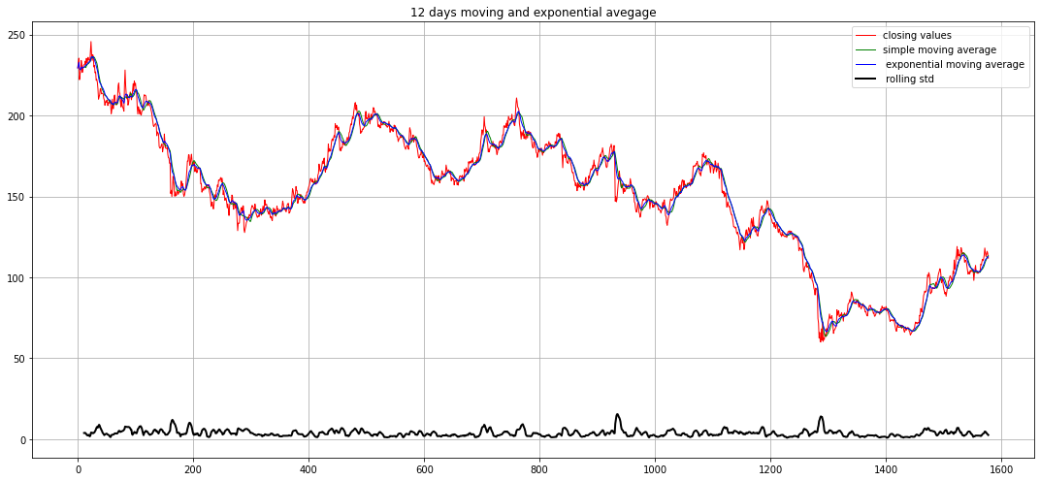
B. Exploratory Data Analysis(contd.) ------------------------------------------------
Observation: 12 days MA
Rolling mean and exponential moving average are close to the data points.

Slide 8
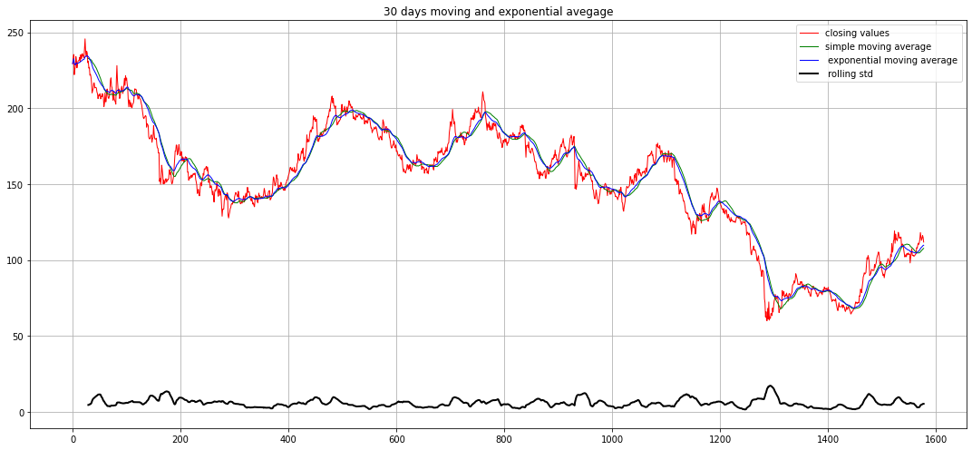
B. Exploratory Data Analysis(contd) -----------------------------------------------
Observation: 30 days MA
Rolling mean and exponential moving average are close to the data points not like before

Slide 9
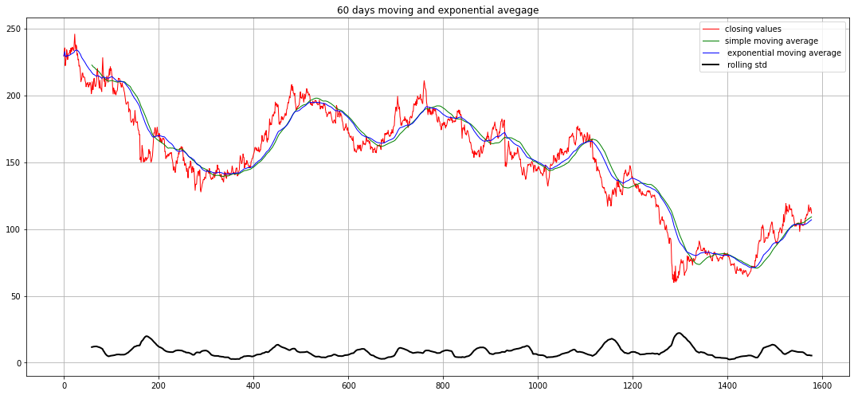
B. Exploratory Data Analysis(contd) -----------------------------------------------
Observation: 60 days MA
Rolling mean and exponential moving average are more far away from the data points.

Slide 10
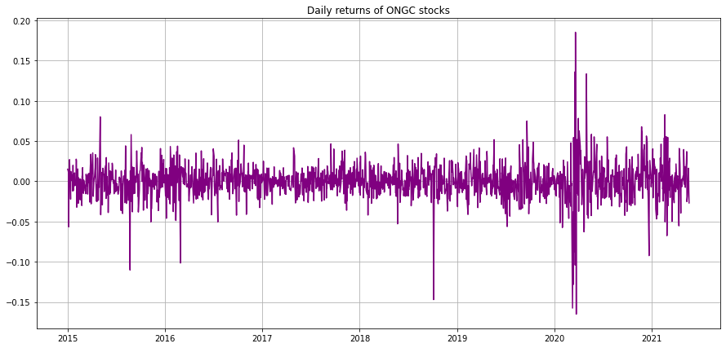

B. Exploratory Data Analysis(contd.) -----------------------------------------------
Formula:
Daily return= $\frac{P_{1}}{P_{0}}$ - 1
P0: initial value
P1: next day vale
Observation: Daily return
Havoc volatility in 2020-21. Same drop in late 2018

Slide 11
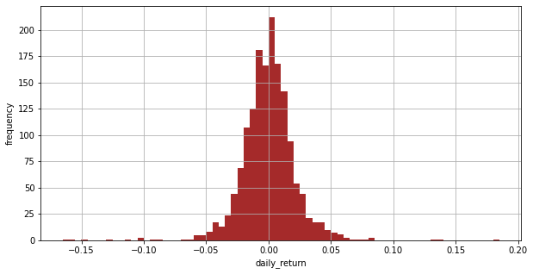
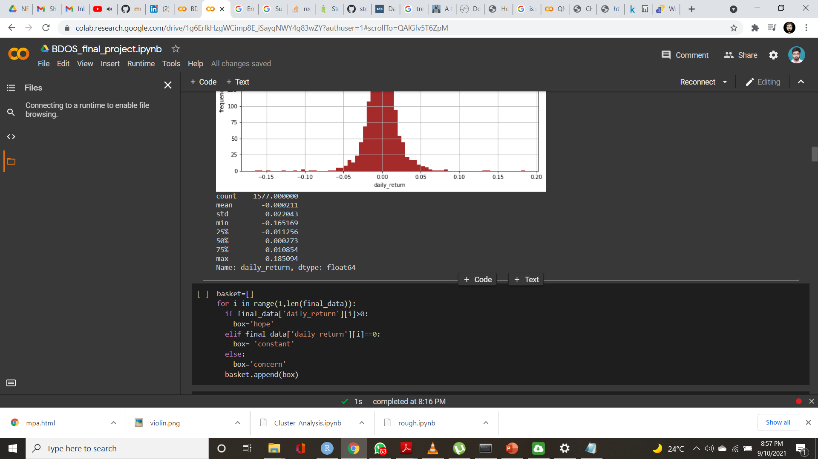
B. Exploratory Data Analysis(contd.) -----------------------------------------------
Daily Return:
Key observation: The daily return has been centered around the origin.

Slide 12
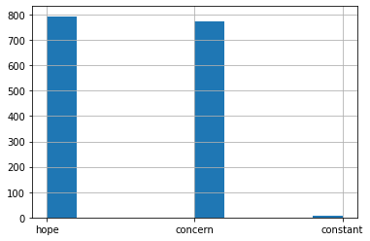
B. Exploratory Data Analysis(contd) -----------------------------------------------
Logic:
If(df_return)>0:
Happy
Elif(df_return)==0
Constant
Else:
Concern
------------------------------------------
Result:
Happy: 49.8%
Concern: 50.1%
Constant: 0.1%

Slide 13
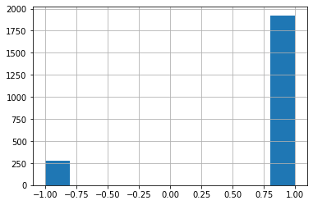
C. News polarity -----------------------------
For the news polarity check, after retreating the tweets, the data needed to be cleaned. For that purpose, all the stop words those are included in the nltk library are removed. Apart from that, any links, special characters, emoticons are removed. Only tweets with English language are kept for further analysis.
After cleaning the data, vader library was used for the sentiment analysis. We used the compound score to judge the sentiment of the tweets. Finally, if the score is less than 0, we assign -1 and if the score is more than 0, we assign +1.

Slide 14
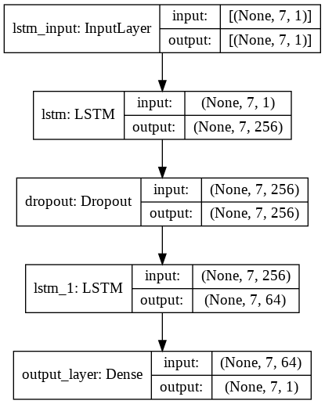
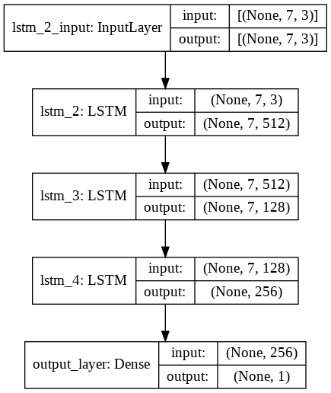
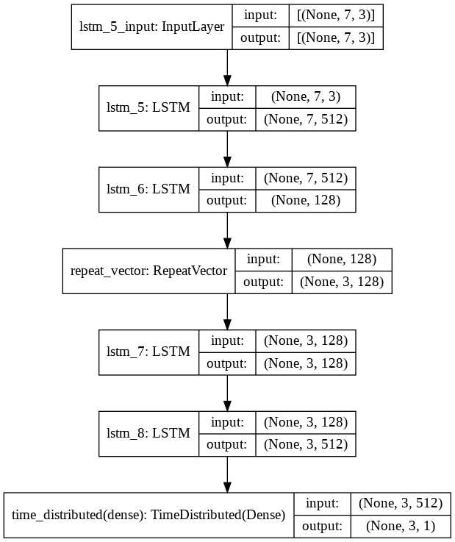
Forecasting: Model Architecture
-----------------------------------------
Simple LSTM Multivariate LSTM LSTM Autoencoder

Slide 15
Forecasting
-----------------------------------------
Key insights:
3 separate LSTM are exploited.
AE model used for news data.
We see that the LSTM model with news polarity has out perfumed all other model variations.
Model Name | Metrics (RMSE)
Simple LSTM | 19.178
Multivariate LSTM | 3.012
LSTM Auto Encoder | 3.390

Slide 16
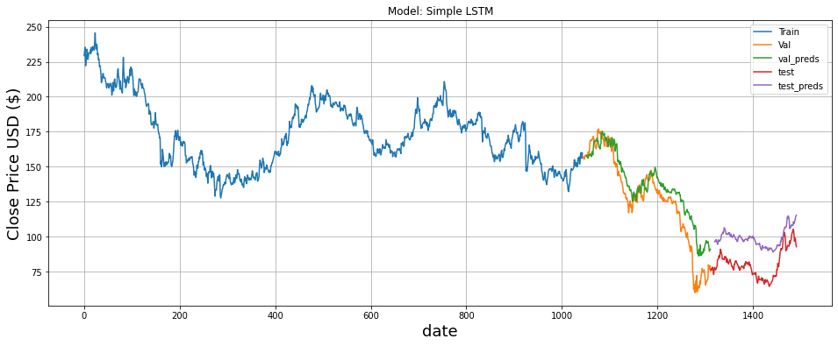
Forecasting(LSTM)
-----------------------------------------

Slide 17
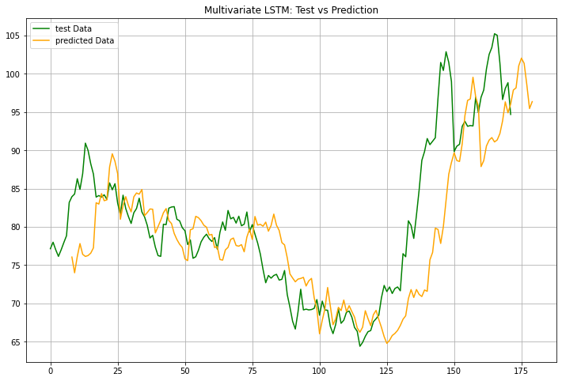
Forecasting(LSTM)
-----------------------------------------
Test vs Prediction: Zoomed in

Slide 18

Forecasting(Multivariate LSTM)
-----------------------------------------

Slide 19
Forecasting(Multivariate LSTM)
-----------------------------------------
Test vs Prediction: Zoomed in

Slide 20
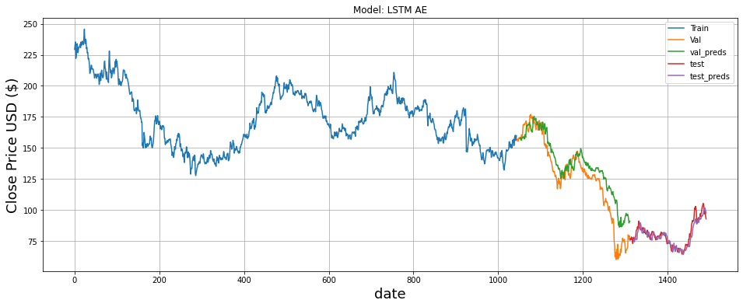
Forecasting
-----------------------------------------

Slide 21
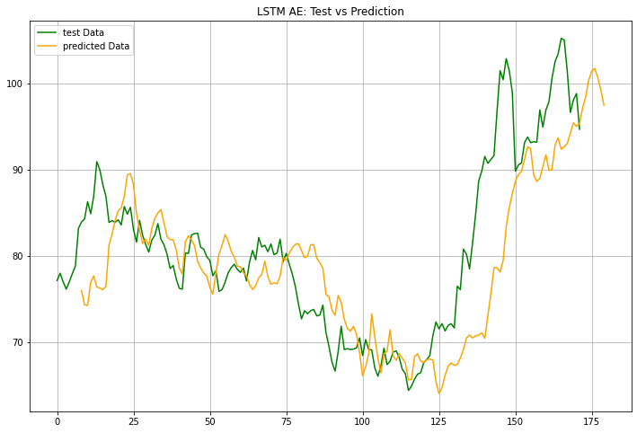
Forecasting
-----------------------------------------
Test vs Prediction: Zoomed in

Slide 22
Conclusion and future works ---------------------------------------------
The news polarity LSTM model works best, marginally though.
More data?
Over all the models performed well.
Along with twitter, news headlines can be collected.
Model robustness: Does the model work well for different train and test data

Slide 23
Thank you

