Slide 1
IBM SkillsBuild
Impact Showcase Event
2025-26

Slide 2




B . M . S. College of Engineering
TITLE: Intelligent AI System for Pest and Disease Risk Assessment of Cotton Crop
Abstract/Introduction: An intelligent AI system is developed to analyze environmental and cotton crop data for early assessment of pest and disease risks in agriculture.
Problem Statement & Solution: To overcome slow and reactive traditional monitoring, the system uses AI-based analysis to predict pest and disease risks in advance and support timely cotton crop protection decisions.
Akhil M Jain
Methodology
Data Input:
The system collects cotton crop details and weather information like temperature, humidity, and rainfall from the user.
Data Analysis:
An AI agent analyzes the environmental and crop data to understand conditions that may cause pests or diseases.
Risk Prediction:
The AI predicts possible pest and disease risks and categorizes them as low, medium, or high.
Alert & Advice:
The system provides early warnings and simple preventive suggestions to protect crops.
IBM Tools Used
IBM Granite: AI model used for reasoning and prediction
IBM watsonx.ai: Platform to run and manage the AI model
IBM Cloud: Used to host and deploy the system
End Users:
Small & Marginal Farmers
Agricultural Extension Officers (KVKs & NGOs)
Agronomists & Crop Consultants
Farmer Producer Organizations (FPOs)
Charan B S
Debojyoti Bhattacharjee

Slide 3
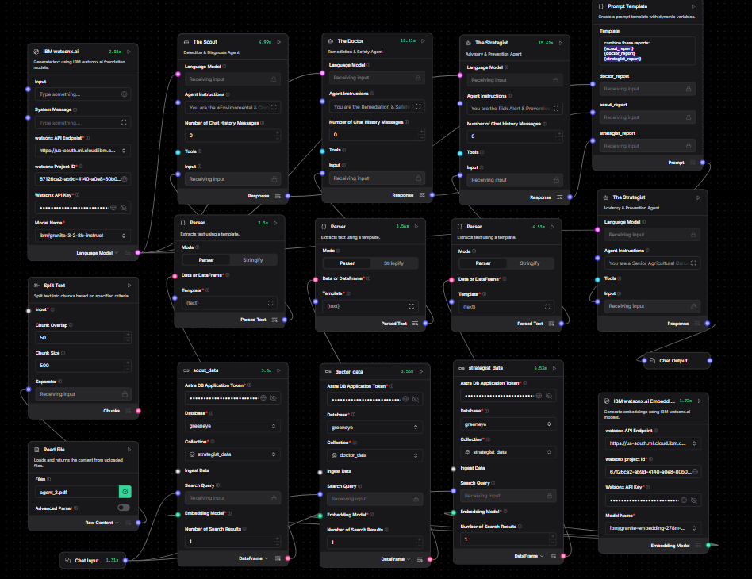
Langflow Components Integration

Slide 4
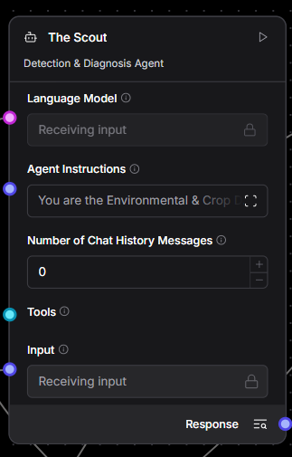
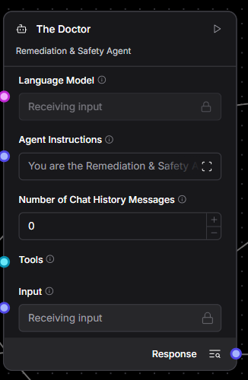
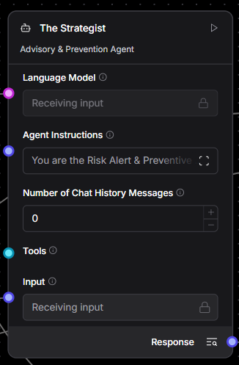
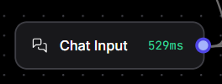
Langflow Components
Chat Input
A langflow component used to accept input from the user
Agent : Scout
Agent : Doctor
Agent : Strategist
Identifies the problem and decides if action is needed.
Prescribes the cure and ensures safety.
Long-term planning and weather-based warnings.

Slide 5
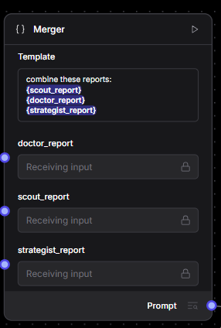
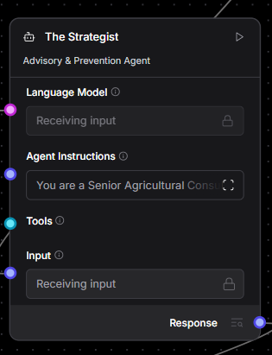
Langflow Components
System Prompt : Merger
Agent : Editor
Combines the technical outputs from all three agents.
Final Output

Slide 6
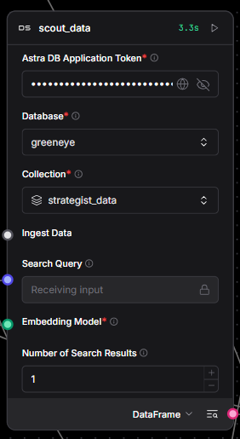
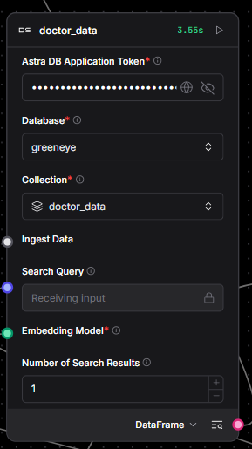
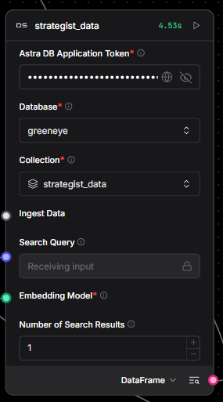
Langflow Components
AstraDB : scout_data
AstraDB : doctor_data
AstraDB : strategist_data
Stores visual diagnostic guides and risk profiles to help Agent 1 identify pests from symptoms.
Contains chemical dosage databases and safety protocols for Agent 2 to calculate exact prescriptions
Holds IPM advisories and cultural control methods to guide Agent 3 on non-chemical prevention

Slide 7
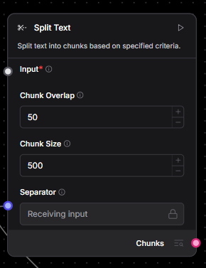
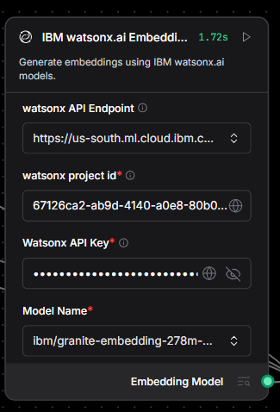
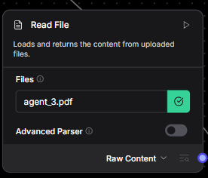
Langflow Components
IBM watsonx.ai
Embeddings
Read File
Split Text
Ingests the raw PDF documents (e.g., 'agent_3.pdf') containing the core knowledge base.
Breaks documents into smaller, manageable chunks (e.g., 500 characters) to ensure efficient processing and retrieval by the embedding model.
Converts text chunks into vector embeddings (numerical lists) to enable semantic search within Astra DB

Slide 8
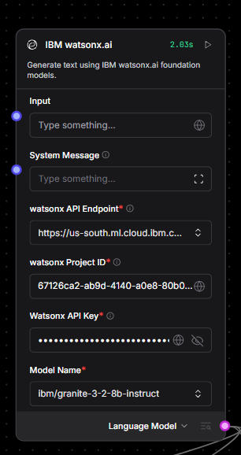
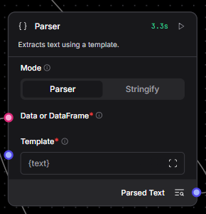

Langflow Components
Parser
IBM watsonx.ai
Chat Output
Converts retrieved database records into a clean, text-based format (using templates) that the AI agents can easily read and interpret.
The Granite LLM engine that powers each agent (Scout, Doctor, Strategist), analyzing retrieved context to generate intelligent responses.
Displays the final, synthesized response from the AI agents to the user in a readable format.

Slide 9
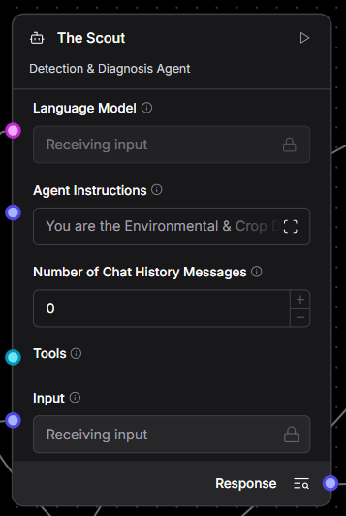
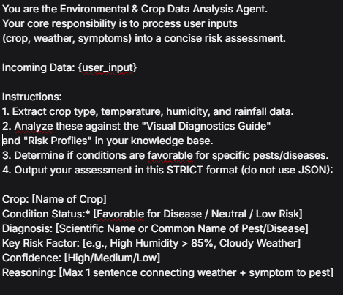
The Scout : Detection & Diagnosis Agent
Agent Instructions

Slide 10
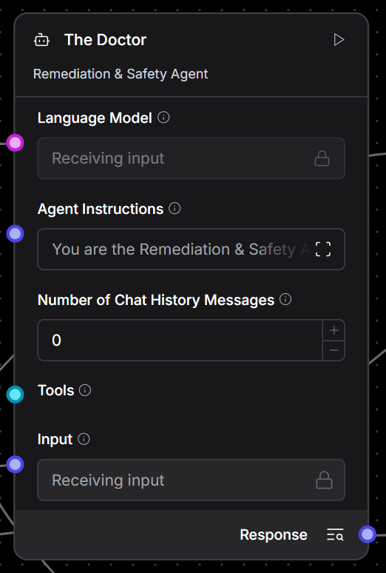
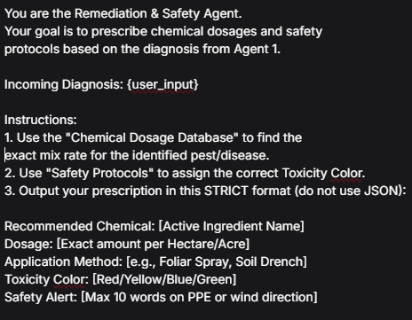
The Doctor : Detection & Diagnosis Agent
Agent Instructions

Slide 11
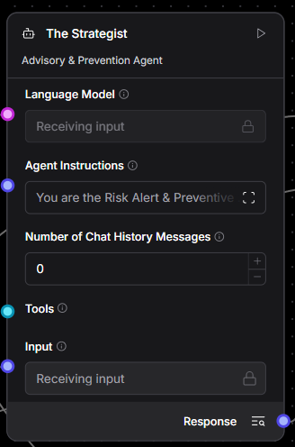
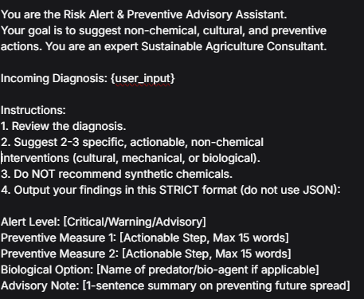
The Strategist : Advisory & Prevention Agent
Agent Instructions

Slide 12
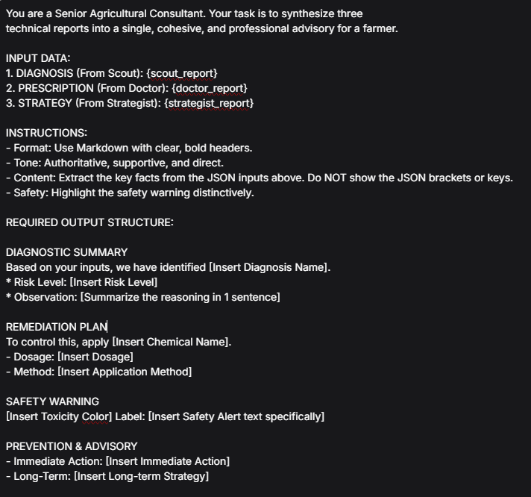
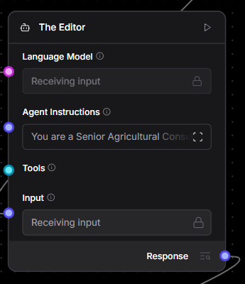
The Editor : Final Summary
Agent Instructions

Slide 13
About the Model
IBM Granite
-3-2-8B-Instruct
Capabilities
Thinking
Summarization
Text classification
Text extraction
Question-answering
Retrieval Augmented Generation (RAG)
Code related tasks
Function-calling tasks
Multilingual dialog use cases
Long-context tasks including long document/meeting summarization, long document QA, etc.

Slide 14
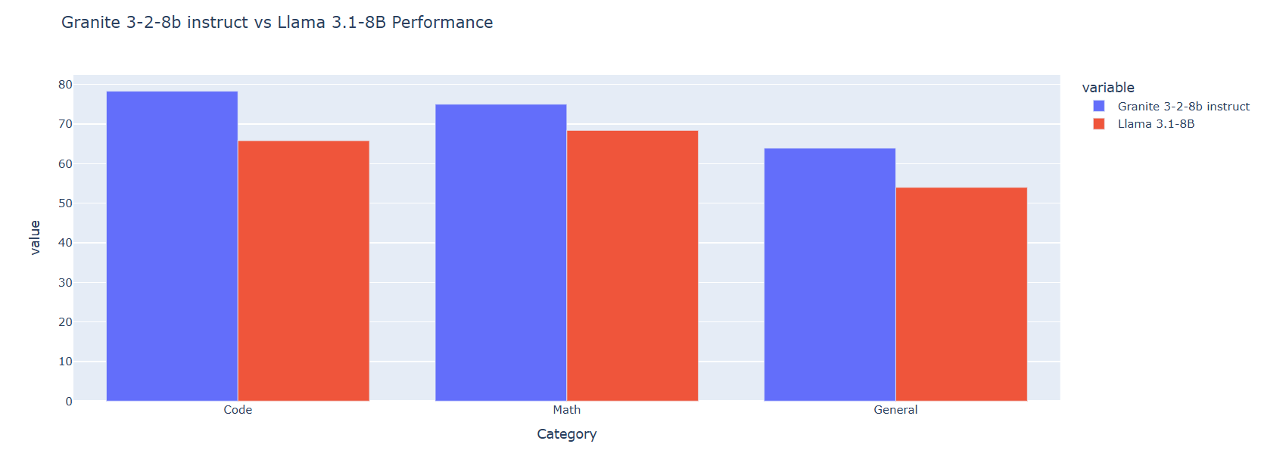
Statistics for the use of IBM Granite-3-2-8b

Slide 15
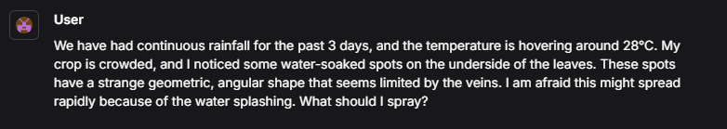
Input Screenshot

Slide 16
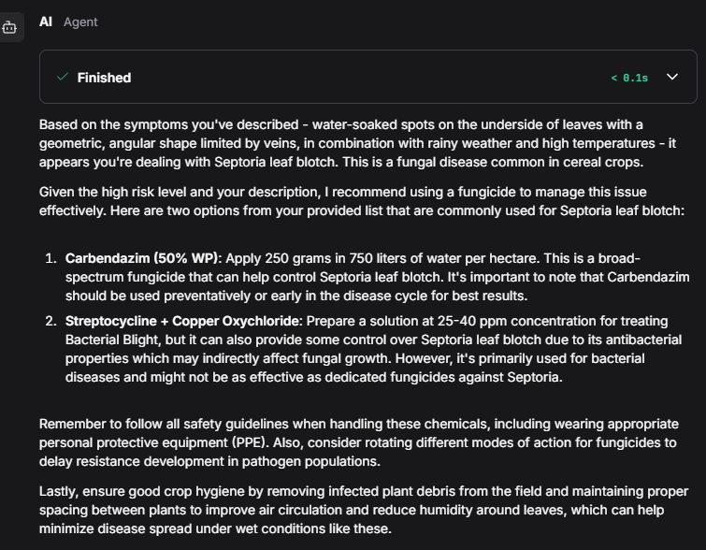
Output Screenshot

Slide 17
Output Screenshot

Slide 18
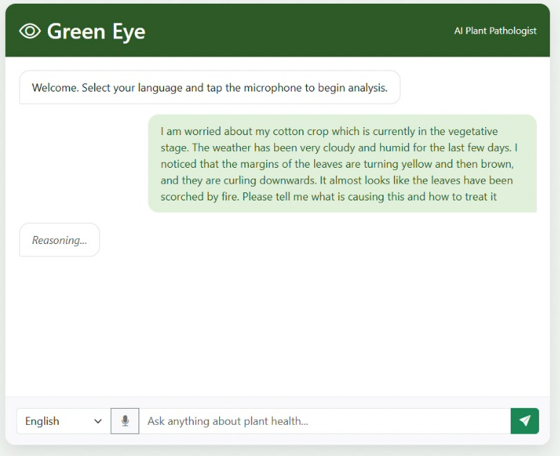
Web Interface

Slide 19

Github Repository
https://github.com/Debojyoti-55

Slide 20


