Slide 1
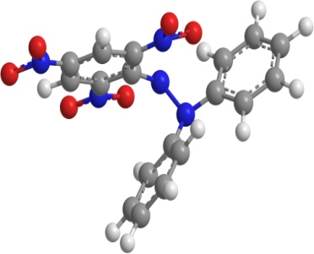
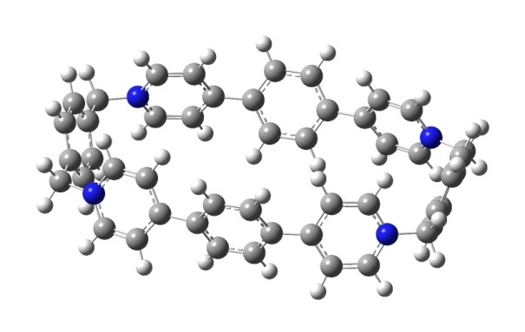
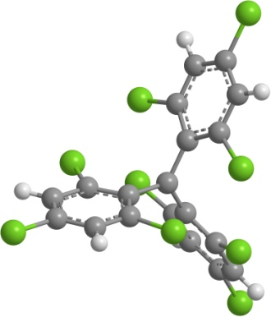
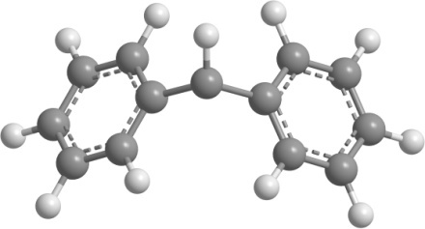
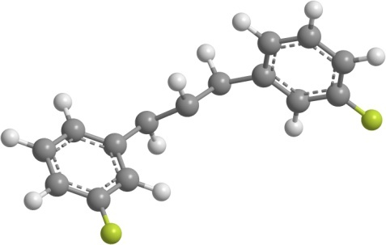
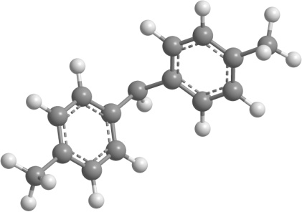
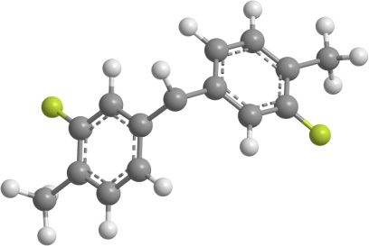
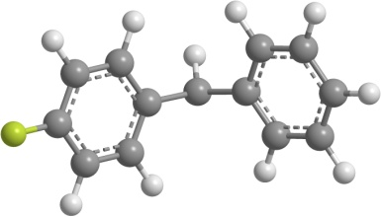
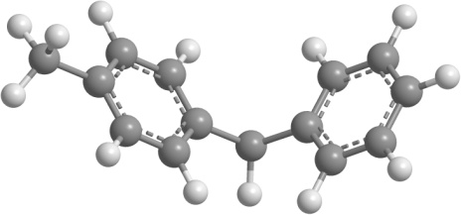
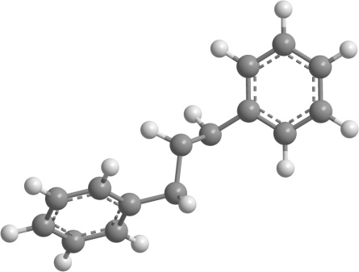
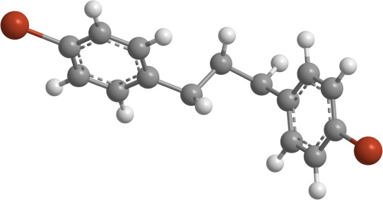
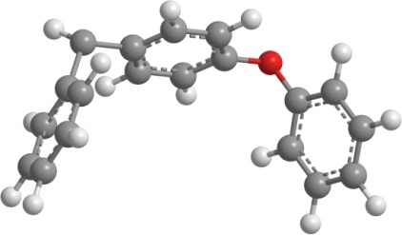
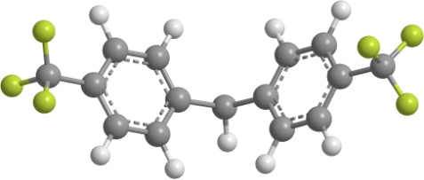
22-diphenyl-1-246-trinitrophenyl_hydrazin-1-yl
ExBox4+
tris-246-trichlorophenyl_methyl
diphenylmethylium
bis(3-fluoro-4-methylphenyl)methylium
(4-fluorophenyl)(phenyl)methylium
phenyl(p-tolyl)methylium
1,3-bis(3-fluorophenyl)propan-2-ylium
di-p-tolylmethylium
(4-phenoxyphenyl)(phenyl)methylium
bis(4-(trifluoromethyl)phenyl)methylium
2(E)-1,3-bis(4-bromophenyl)allylium
(E)-1,3-diphenylallylium

Slide 2
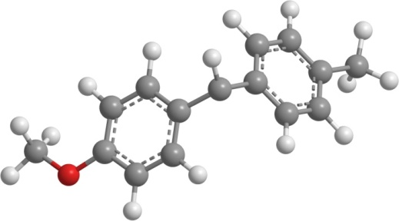
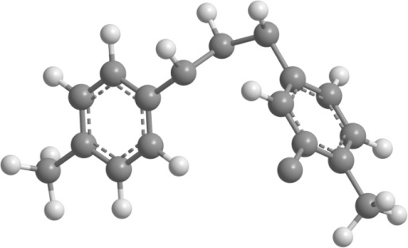
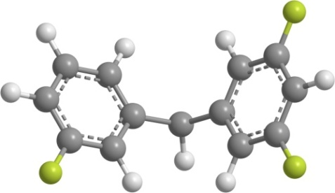
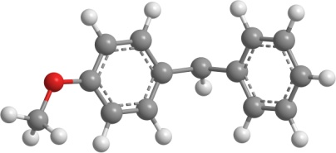
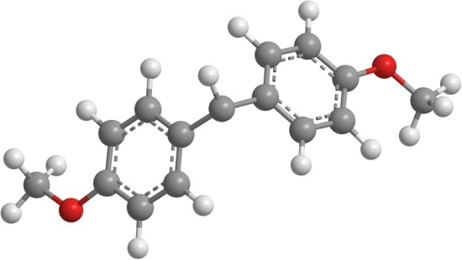

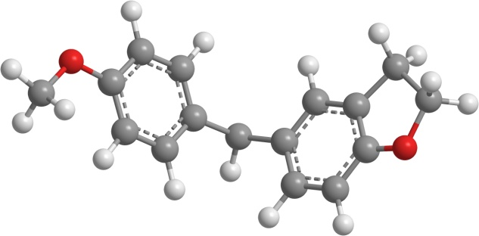
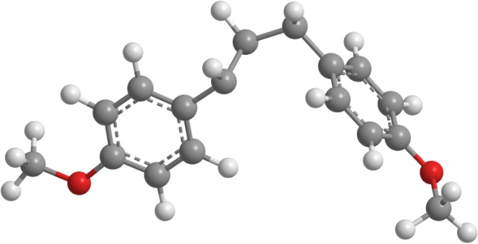
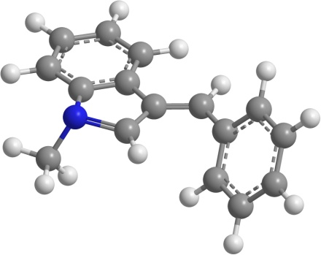
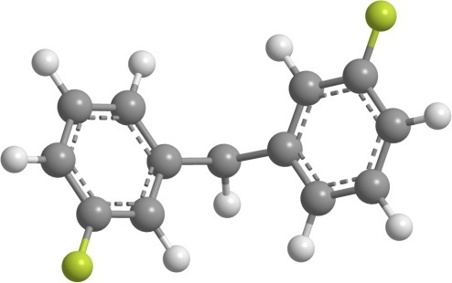
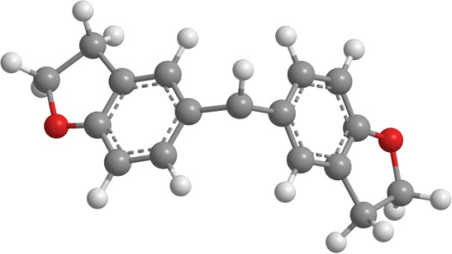
(4-methoxyphenyl)(phenyl)methylium
(4-methoxyphenyl)(p-tolyl)methylium
(3,5-difluorophenyl)(3-fluorophenyl)methylium
(E)-1,3-di-p-tolylallylium
bis(4-methoxyphenyl)methylium
bis(4-methoxyphenyl)methylium
(2,3-dihydrobenzofuran-5-yl)(4-methoxyphenyl)methylium
bis(2,3-dihydrobenzofuran-5-yl)methylium
(E)-1,3-bis(4-methoxyphenyl)allylium
(Z)-3-benzylidene-1-methyl-3H-indol-1-ium
bis(3-fluorophenyl)methylium

Slide 3
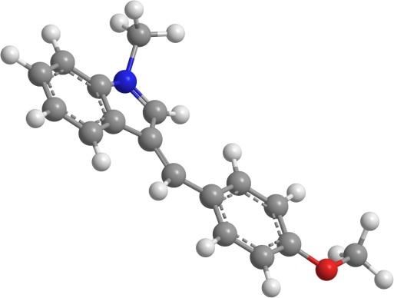
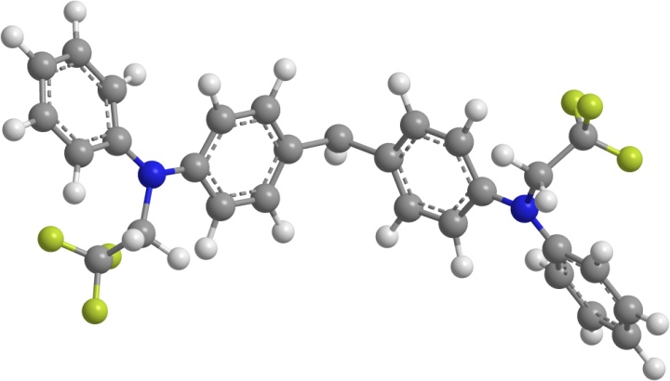
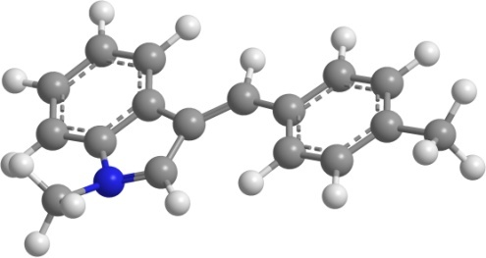
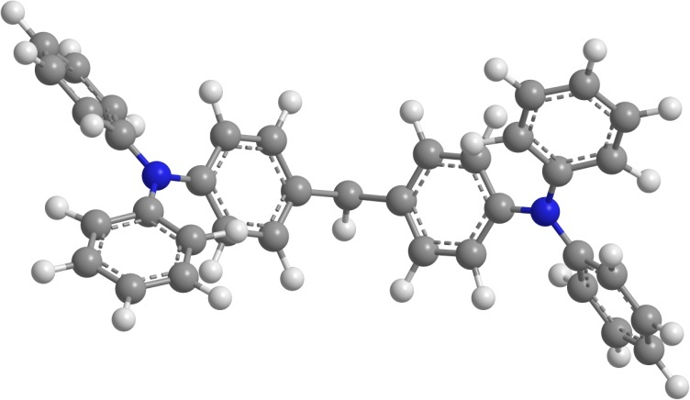
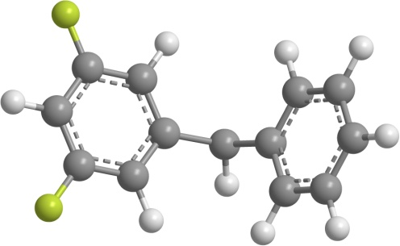
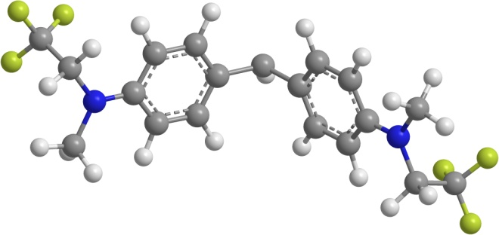
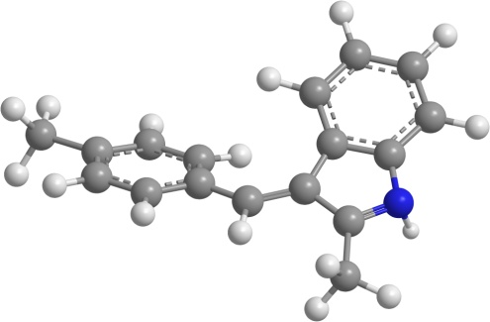
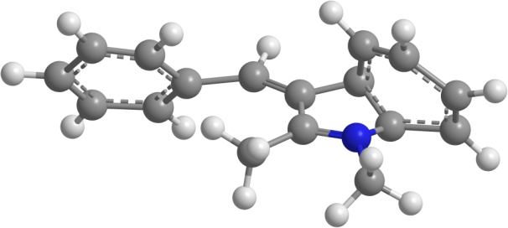
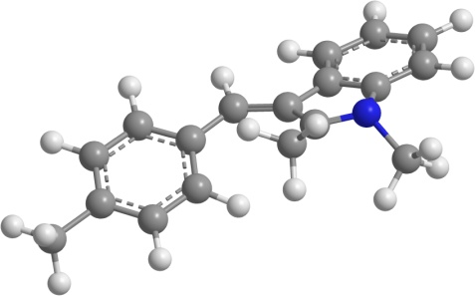
(Z)-1-methyl-3-(4-methylbenzylidene)-3H-indol-1-ium
(Z)-3-(4-methoxybenzylidene)-1-methyl-3H-indol-1-ium
bis(4-(phenyl(2,2,2-trifluoroethyl)amino)phenyl)methylium
bis(4-(methyl(2,2,2-trifluoroethyl)amino)phenyl)methylium
(3,5-difluorophenyl)(phenyl)methylium
bis(4-(diphenylamino)phenyl)methylium
(E)-3-benzylidene-1,2-dimethyl-3H-indol-1-ium
(E)-1,2-dimethyl-3-(4-methylbenzylidene)-3H-indol-1-ium
(E)-2-methyl-3-(4-methylbenzylidene)-3H-indol-1-ium

Slide 4
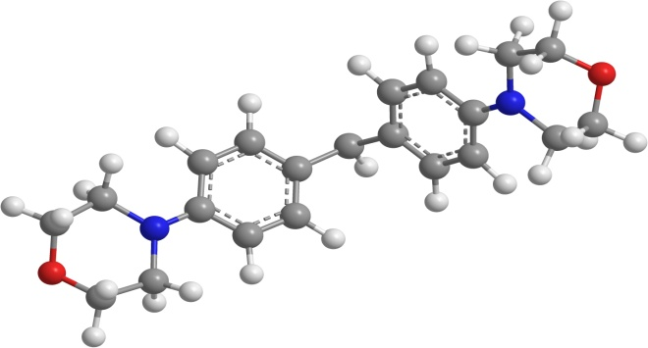
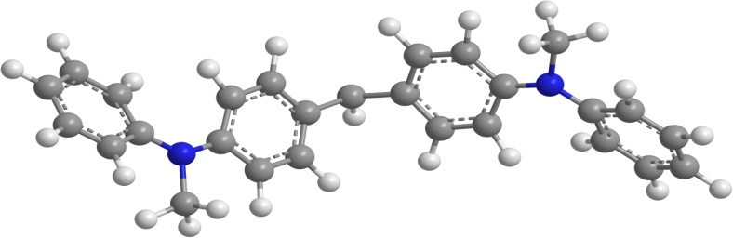
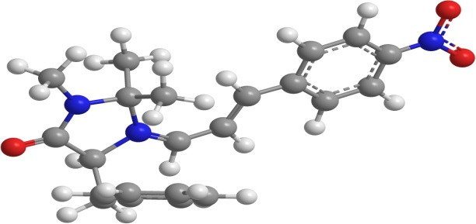
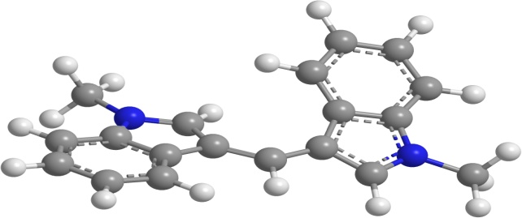
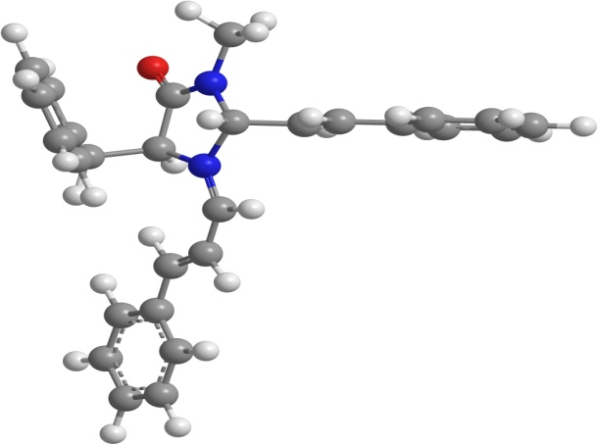
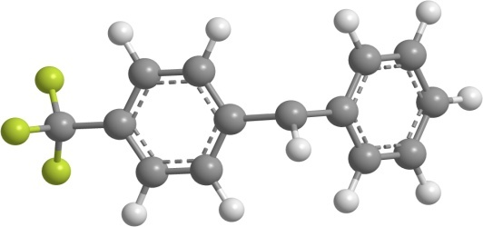
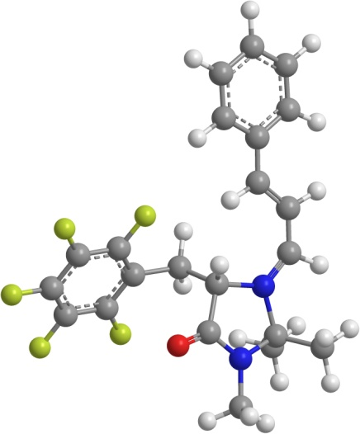
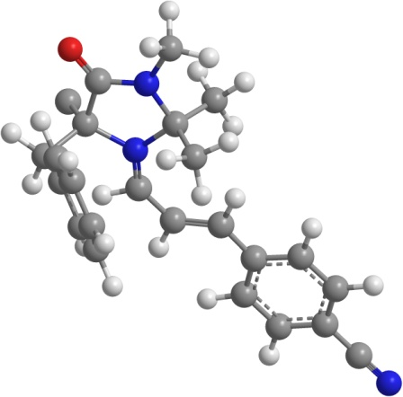
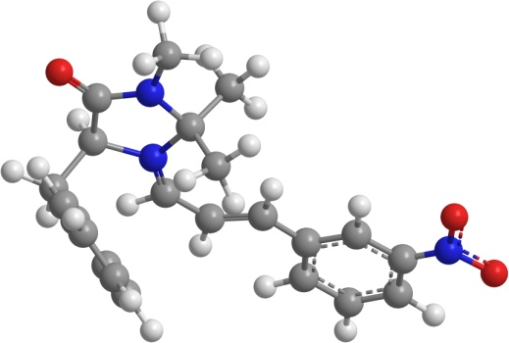
bis(4-(methyl(phenyl)amino)phenyl)methylium
bis(4-morpholinophenyl)methylium
(E)-5-benzyl-2,2,3-trimethyl-1-((E)-3-(4-nitrophenyl)allylidene)-4-oxoimidazolidin-1-ium
(Z)-1-methyl-3-((1-methyl-1H-indol-3-yl)methylene)-3H-indol-1-ium
phenyl(4-(trifluoromethyl)phenyl)methylium
(E)-5-benzyl-3-methyl-4-oxo-1-((E)-3-phenylallylidene)-2-((E)-styryl)imidazolidin-1-ium
(E)-2,2,3-trimethyl-4-oxo-5-((perfluorophenyl)methyl)-1-((E)-3-phenylallylidene)imidazolidin-1-ium
(E)-5-benzyl-1-((E)-3-(4-cyanophenyl)allylidene)-2,2,3-trimethyl-4-oxoimidazolidin-1-ium
(E)-5-benzyl-2,2,3-trimethyl-1-((E)-3-(3-nitrophenyl)allylidene)-4-oxoimidazolidin-1-ium

Slide 5
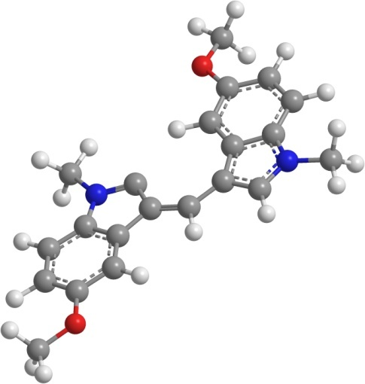
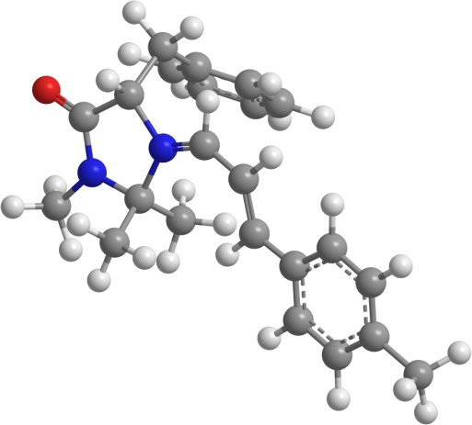
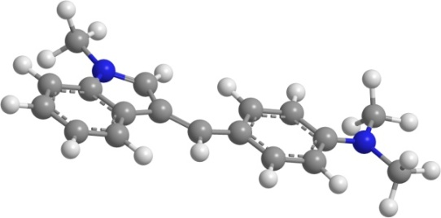
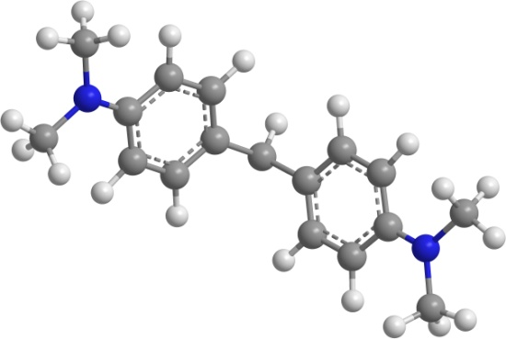
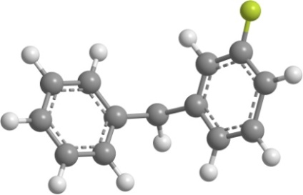
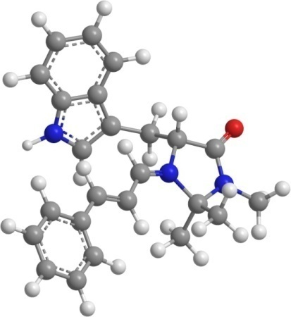
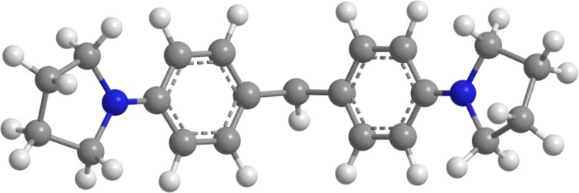
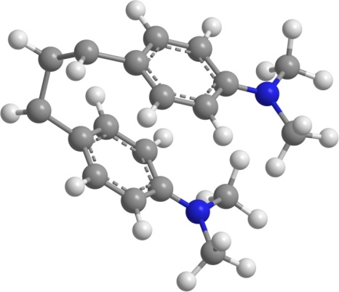
(Z)-3-(4-(dimethylamino)benzylidene)-1-methyl-3H-indol-1-ium
bis(4-(dimethylamino)phenyl)methylium
(Z)-5-methoxy-3-((5-methoxy-1-methyl-1H-indol-3-yl)methylene)-1-methyl-3H-indol-1-ium
(E)-5-benzyl-2,2,3-trimethyl-4-oxo-1-((E)-3-(p-tolyl)allylidene)imidazolidin-1-ium
(3-fluorophenyl)(phenyl)methylium
bis(4-(pyrrolidin-1-yl)phenyl)methylium
(E)-5-((1H-indol-3-yl)methyl)-2,2,3-trimethyl-4-oxo-1-((E)-3-phenylallylidene)imidazolidin-1-ium
(E)-1,3-bis(4-(dimethylamino)phenyl)allylium

Slide 6
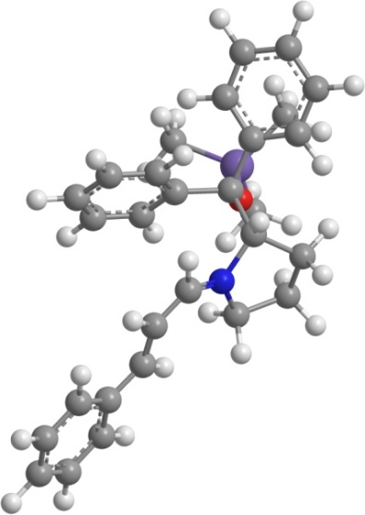







bis(1-methyl-1,2,3,4-tetrahydroquinolin-6-yl)methylium
(Z)-1-methyl-3-((2,3,6,7-tetrahydro-1H,5H-pyrido[3,2,1-ij]quinolin-9-yl)methylene)-3H-indol-1-ium
(E)-5-benzyl-1-((E)-3-(4-methoxyphenyl)allylidene)-2,2,3-trimethyl-4-oxoimidazolidin-1-ium
(E)-2-(diphenyl((trimethyl-l4-sulfanyl)oxy)methyl)-1-((E)-3-phenylallylidene)pyrrolidin-1-ium
(E)-4-(3-phenylallylidene)morpholin-4-ium
bis(1-methylindolin-5-yl)methylium
(E)-1,3-bis(3,5-difluorophenyl)allylium
(E)-N-benzyl-1-phenyl-N-(3-phenylallylidene)methanaminium

Slide 7







(E)-N-methyl-N-(3-phenylallylidene)methanaminium
bis(2,3,6,7-tetrahydro-1H,5H-pyrido[3,2,1-ij]quinolin-9-yl)methylium
(E)-1-(3-phenylallylidene)pyrrolidin-1-ium
(E)-1,3-bis(2,3,6,7-tetrahydro-1H,5H-pyrido[3,2,1-ij]quinolin-9-yl)allylium
(E)-1-(3-phenylallylidene)pyrrolidin-1-ium
bis(4-chlorophenyl)methylium
(E)-3-((1,2-dimethyl-1H-indol-3-yl)methylene)-1,2-dimethyl-3H-indol-1-ium

