Slide 1
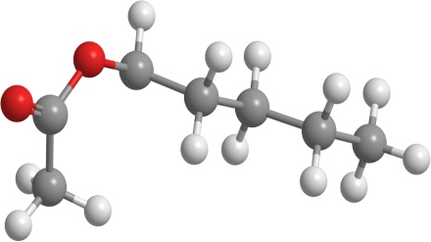
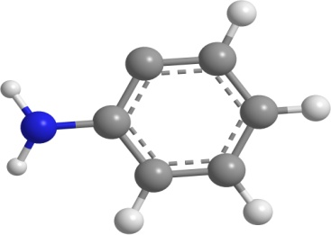
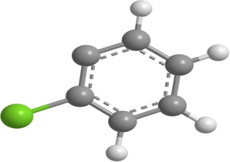
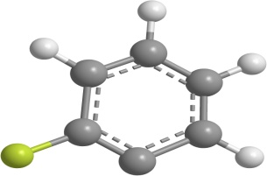
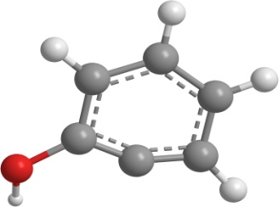
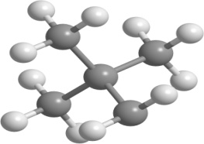
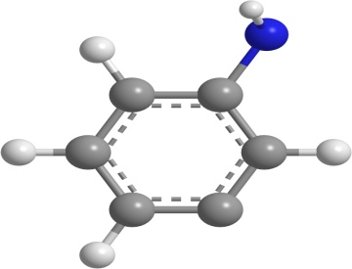
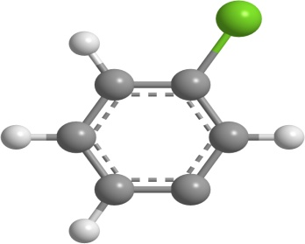
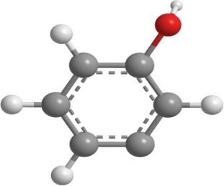
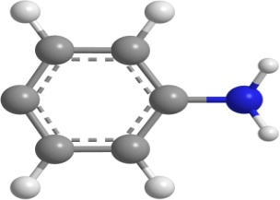
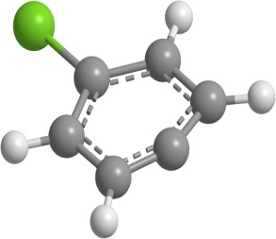
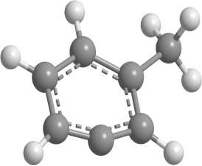
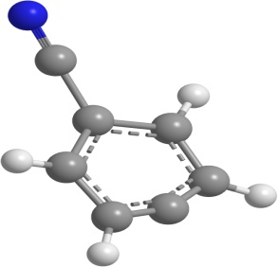
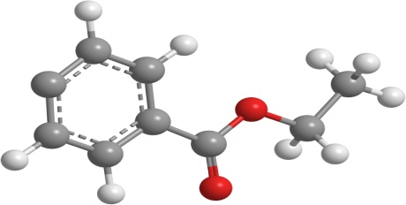
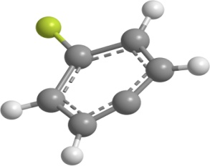
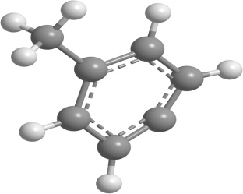
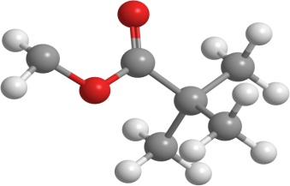
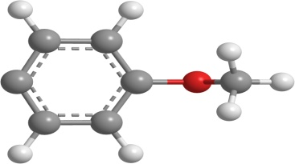
22-dimethylpropyl
1-acetyloxypentyl
2-aminophenyl
2-chlorophenyl
2-fluorophenyl
2-hydroxyphenyl
3-aminophenyl
3-chlorophenyl
4-aminophenyl
4-chlorophenyl
3-hydroxyphenyl
3-methylphenyl
methyl_pivalate_radical
4-cyanophenyl
4-ethoxycarbonylphenyl
4-fluorophenyl
4-methoxyphenyl
4-methylphenyl

Slide 2
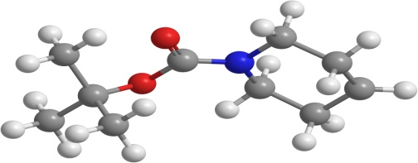
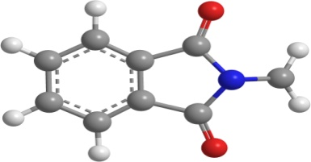
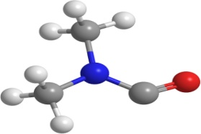
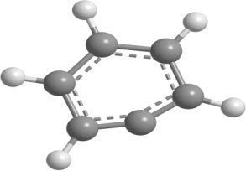
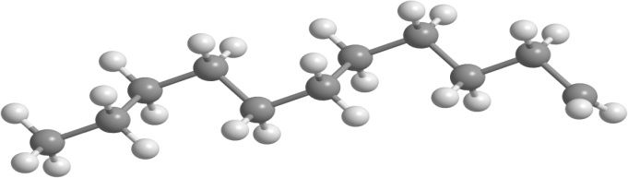
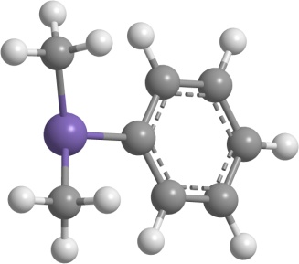
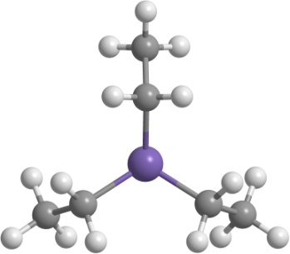
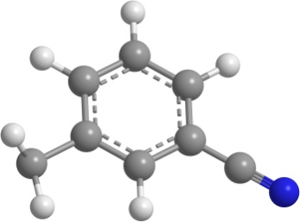
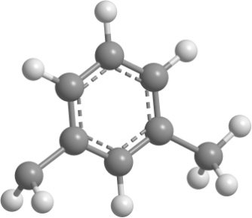
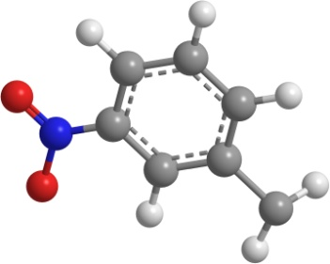
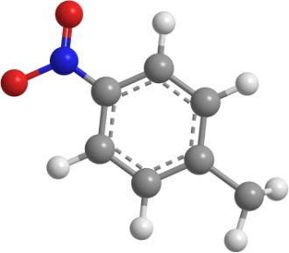
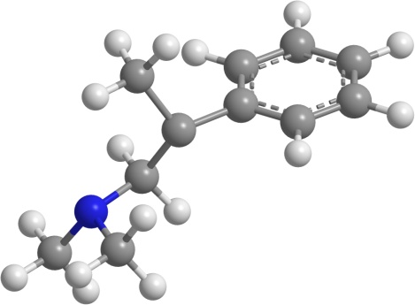
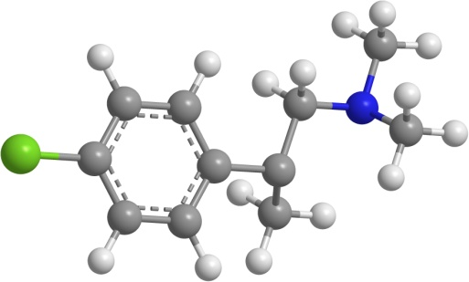
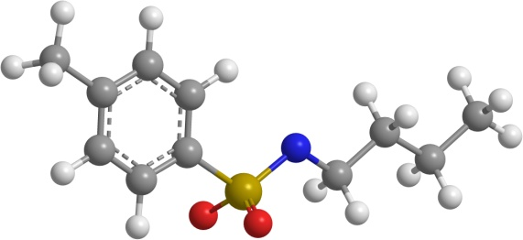
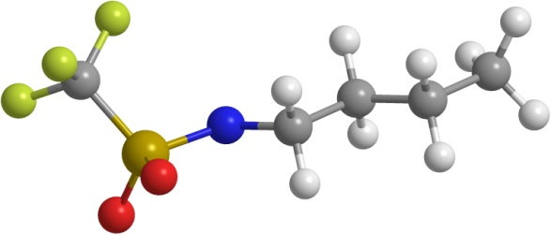
phenyl
undecyl
N-boc-piperidin-4-yl
N-methylphthalimide_radical
NN-dimethylcarbamoyl
3-methylphenyl_methyl
3-nitrophenyl_methyl
4-nitrophenyl_methyl
dimethyl_phenyl_silyl
triethyl_silyl
3-cyanophenyl_methyl
Nbutyltrifluoromethanesulfonamido
Nbutyl_4methylbenzenesulfonamido
1-_dimethylamino_-2-phenylpropan-2-yl
1-_dimethylamino_-2-_4-chlorophenyl_propan-2-yl

Slide 3
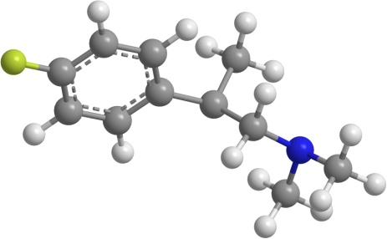
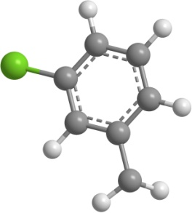
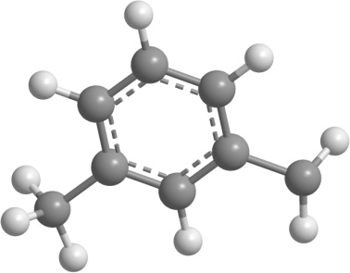
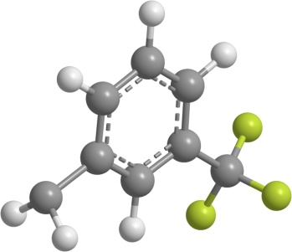
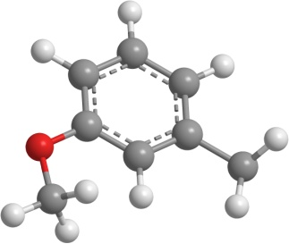
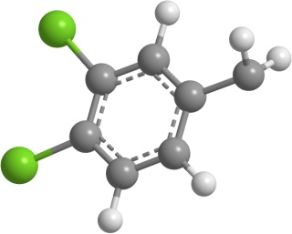
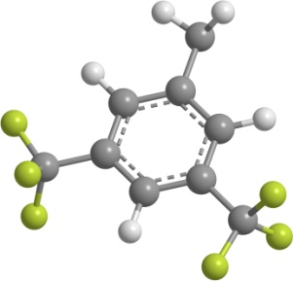
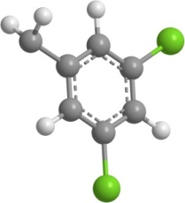
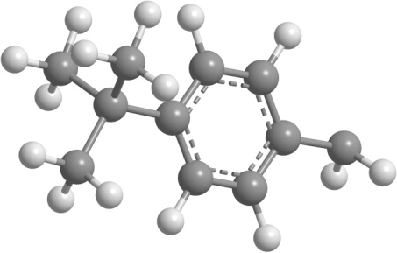
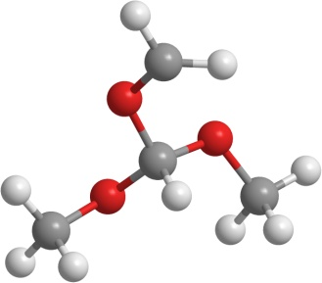
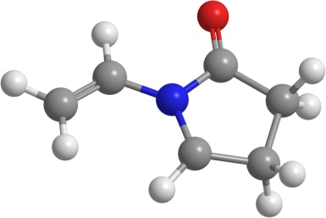
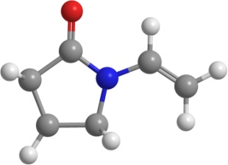
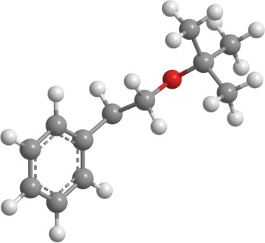
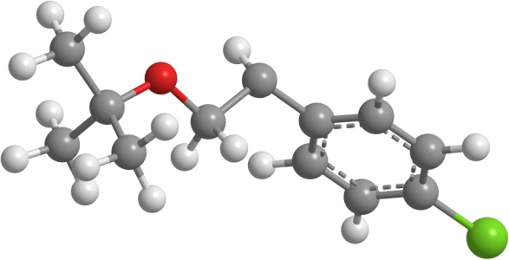
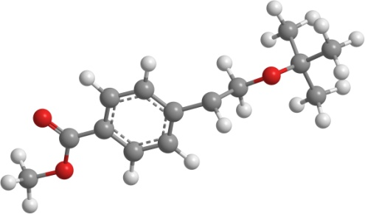
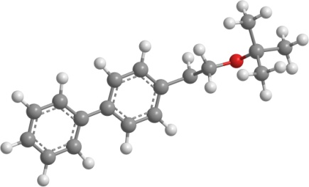
1-_dimethylamino_-2-_4-fluorophenyl_propan-2-yl
3-chlorophenyl_methyl
3-methylphenyl_methyl
3-methoxyphenyl_methyl
3-trifluoromethyl_phenyl_methyl
34-dichlorophenyl_methyl
1-ethenyl_5-oxopyrrolidin-2-yl
1-ethenyl_5-oxopyrrolidin-3-yl
dimethoxymethoxy_methyl
35-dichlorophenyl_methyl
4-tert-butylphenyl_methyl
35-bis_trifluoromethyl_phenyl_methyl
2-_tert-butoxy_-1-phenylethyl
2-_tert-butoxy_-1-_4-chlorophenyl_ethyl
1-_1_1biphenyl_-4-yl_-2-_tert-butoxy_ethyl
2-_tert-butoxy_-1-4-_methoxycarbonyl_phenyl_ethyl

Slide 4
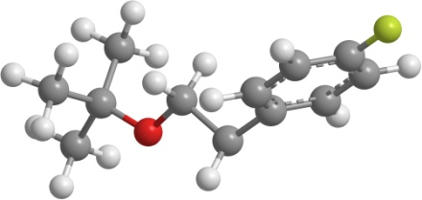














2-_tert-butoxy_-1-_4-fluorophenyl_propan-2-yl
2-_tert-butoxy_-1-_4-nitrophenyl_ethyl
1-_acetoxy_pentyl
2-_tert-butoxy_-1-_4-methoxyphenyl_ethyl
1-_acetyloxy_-2-methylpropyl
1-_acetyloxy_-2-phenylethyl
1-_sodiooxy_pentyl
1-_acetyloxy_-2-_4-fluorophenyl_ethyl
11-difluoropropan-1-yl
1122-tetrafluoropropan-1-yl
2-chloroethyl_oxidanyl
2-fluoroethyl_oxidanyl
2-chloro-2-methylpropan-1-yl
2-methoxyethyl_oxidanyl
2-oxo-2-phenylethyl_oxidanyl

Slide 5















22-dichloropropan-1-yl
22-difluoropropan-1-yl
26-dichloroheptan-4-yl
3-chloropropan-1-yl
246-trimethylphenyl_methyl_sulfanyl
4-acetylphenyl_oxidanyl
4-methylphenyl_oxidanyl
4-cyanophenyl_oxidanyl
4-formylphenyl_oxidanyl
4-formyl-2-methoxyphenyl_oxidanyl
4-tert-butylphenyl_sulfanyl
4-_methoxycarbonyl_phenyl_oxidanyl
6-sulfanylhexyl_sulfanyl
4-_methoxycarbonyl_phenyl_methyl
heptadecafluorooctyl

Slide 6






nonyl
pentyl
hexan-2-yl
hexylsulfanyl
undecyl
phenylmethanesulfonyl

