Slide 1


Global Cybersecurity Threat Analysis Dashboard
Power BI Capstone Project
Debopam Rath

Slide 2

Project Proposal & Dataset Description
The objective of this project is to analyze global cybersecurity threats, financial damages, cyber risk patterns, and defense effectiveness using an interactive Power BI dashboard.
Project Objectives:
• Analyze global cyber attack trends from 2015–2024
• Identify high-risk countries and industries
• Measure financial and operational impact of cyber attacks
• Evaluate effectiveness of cybersecurity defense mechanisms
• Develop advanced analytical insights using feature engineering
Dataset Description:
The dataset contains information regarding attack types, industries, financial losses, affected users, attack sources, vulnerability types, defense mechanisms, and resolution times.
Feature Engineering:
Severity Level, Cyber Risk Score, Resolution Speed, Defense Effectiveness, User Impact Category and Attack Impact Score.

Slide 3
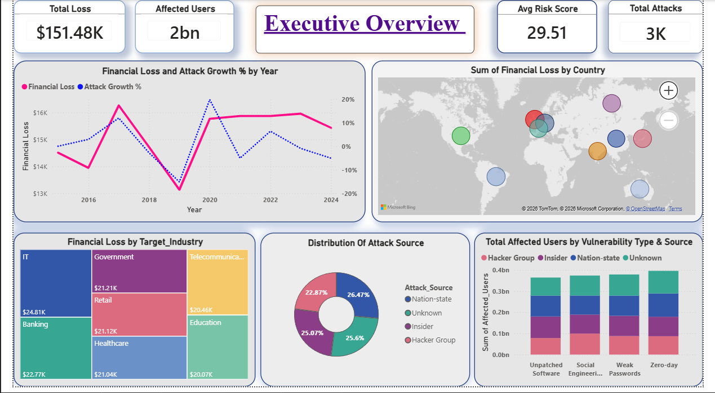
Dashboards:

Slide 4
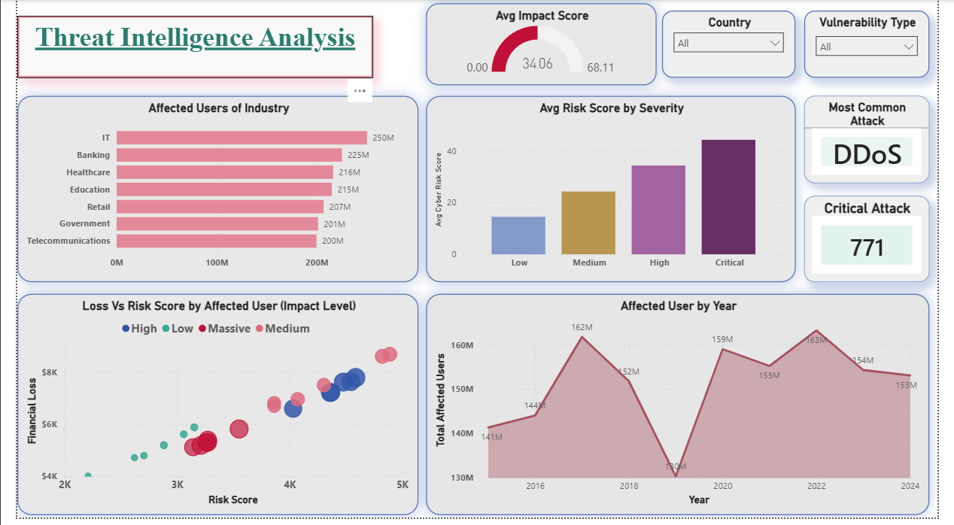

Slide 5
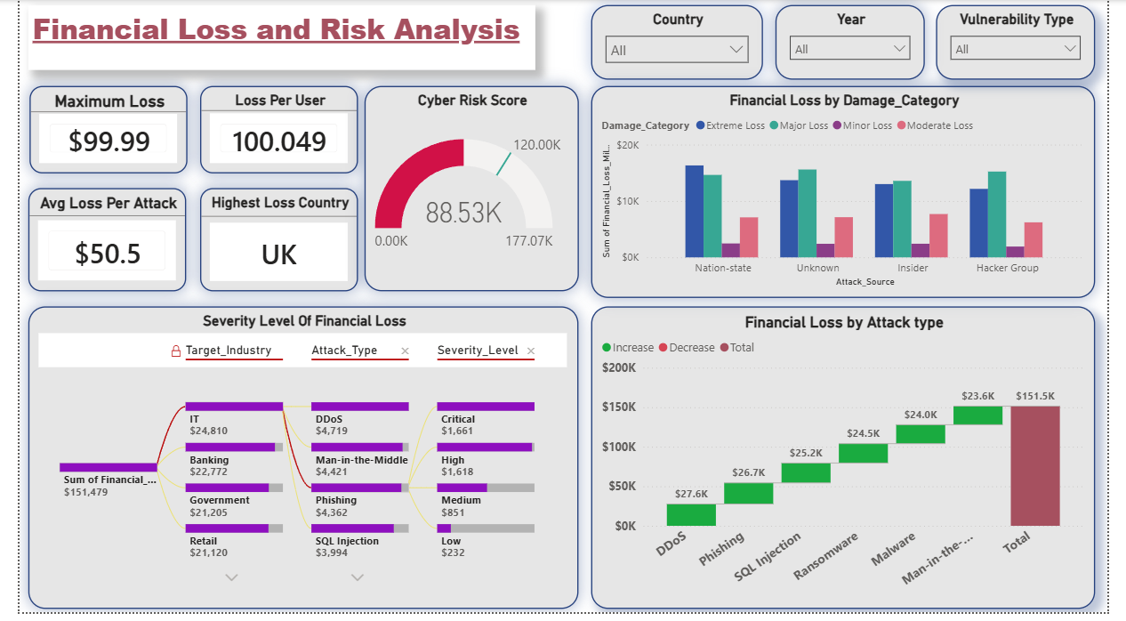

Slide 6
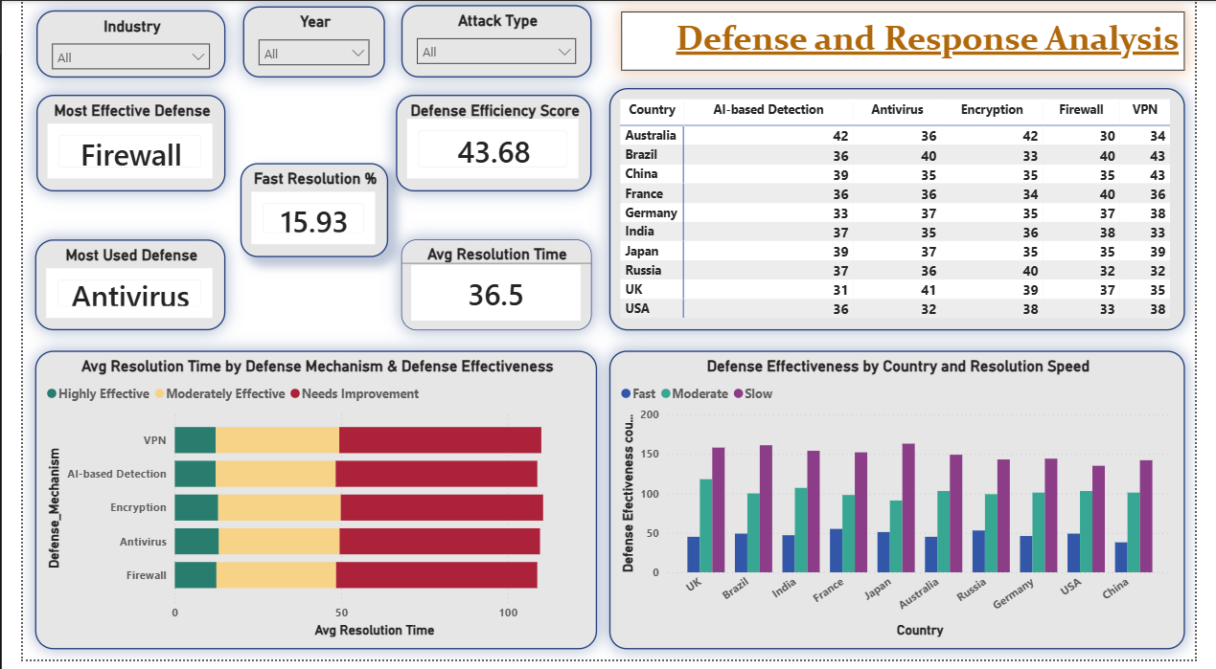

Slide 7
Key nsights:
1. The trend analysis shows a continuous rise in cyber attack growth and financial losses after 2019.
2. DDoS attacks occur most frequently, making them the dominant global cyber threat across industries and countries.
3. IT and Banking sectors experience maximum financial damage due to high-value digital assets and large user bases.
4. The scatter plot analysis clearly demonstrates that incidents with higher cyber risk scores generate significantly greater financial losses and user impact.
5. Antivirus is the most commonly used defense mechanism.
6. Firewall demonstrates the highest operational effectiveness
7. Social Engineering and Unpatched Software are major vulnerabilities.
8. UK records the highest overall financial loss.
9. Antivirus is the most commonly used defense mechanism.
10. Firewall demonstrates the highest operational effectiveness

Slide 8
THANK YOU

