Slide 1
🦷 NurseFlow
Confident training for new dental assistants
✅ Step-by-step guides
✅ Procedure checklists
✅ Progress tracking for managers
→ Reduces training time by up to 40%
→ Improves clinic flow & staff confidence

Slide 2
Training is Stressful and Inconsistent
What dental assistants experience:
Little or no structured training
Pressure to “just pick it up” on the job
Fear of slowing down the dentist or asking too many questions
Constant mental checklist: “Am I doing this right?”
🔄 What clinics deal with:
Senior staff spend time repeating instructions
Mistakes during procedures (missing tools, setup delays)
New hires take weeks to ramp up
No easy way to track progress

Slide 3
The Opportunity:
Consistent, standardized training with clear, easy-to-follow guides
Measurable progress — track how new hires are doing in real-time
Faster onboarding for new dental assistants (reduce ramp-up time by 30–40%)
For new hires: Less stress, more confidence
For clinics: Reduced training time, fewer
mistakes, smoother operations

Slide 4
The Solution – “How NurseFlow Works”

Slide 5

NurseFlow Homepage Preview
A clean, efficient UI that streamlines onboarding, enhances user engagement, and accelerates training for new dental assistants.

Slide 6
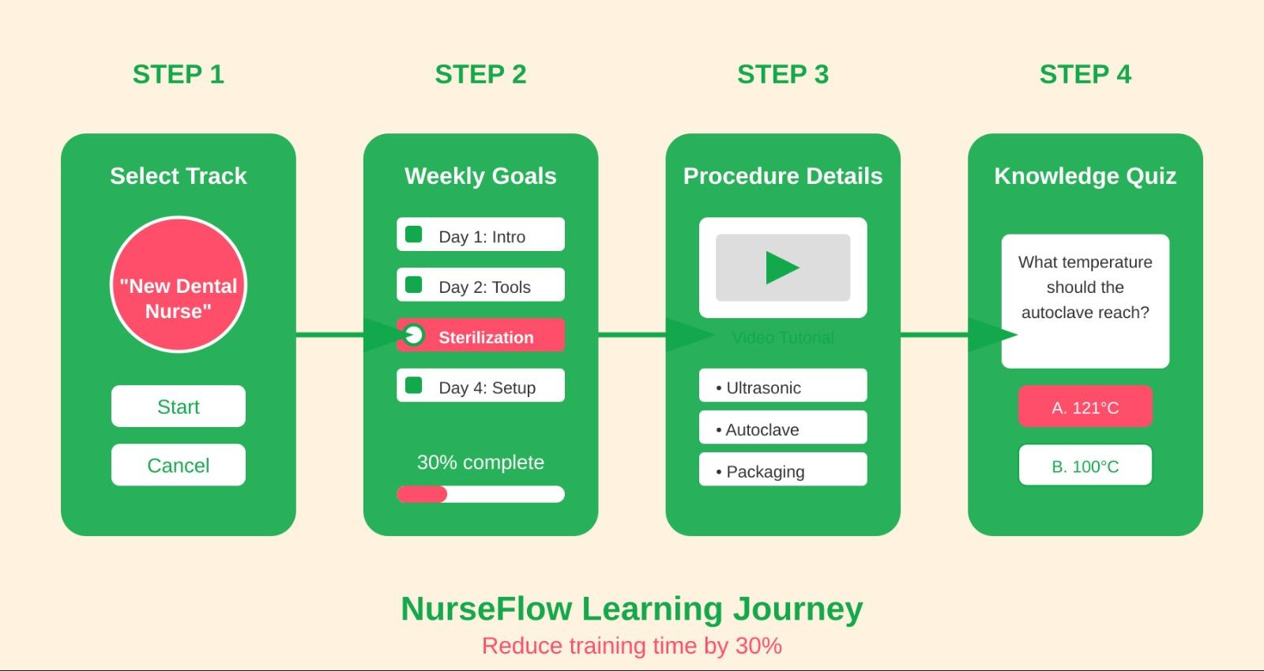
How It Works (Basic Flow)
New hire opens app → selects "New Dental Nurse" track
Views weekly goals checklist (e.g., “Learn sterilization routine” by Day 3)
Taps into a procedure → sees:
Step-by-step images/video
Supplies list
Tips ("What the dentist expects")
Takes a short quiz to reinforce memory
Clinic manager can track progress if needed

Slide 7
How I’d Build It – MVP Tech Stack
As a junior developer, I’d focus on simplicity, scalability, and fast deployment:
🖥️ Frontend: React for flexibility and scalability, or basic HTML/CSS/JS for quick prototyping.
📄 Data Handling: Use JSON files or Firebase to manage procedure guides and track user progress.
💾 Storage: Start with LocalStorage for offline support in the MVP, then scale to cloud sync for team visibility.
🚀 Hosting & Deployment: Deploy on Netlify or Vercel for fast, reliable hosting with easy CI/CD integration.

