Slide 1
Employee salary prediction using xgboost
CAPSTONE PROJECT
Presented By:
Deborah Alvina
SRM Institute of Science and Technology
Computer Science Engineering

Slide 2
OUTLINE
Problem Statement
System Development Approach
Algorithm & Deployment
Result
Conclusion
References

Slide 3
Problem Statement
The Employee Salary Prediction project predicts an employee's annual salary based on various demographic and work-related attributes. It leverages the machine learning technique, XGBoost to analyze the dataset. By applying data preprocessing, visualization, and predictive modeling, the system aims to classify employee salaries into two categories: <=50K and >50K. This project demonstrates how machine learning can assist HR departments and organizations in making data-driven decisions related to compensation planning.

Slide 4
System Approach
System requirements:
OS: Windows 10/11, macOS, or Linux-based operating system
Python Version: Python 3.9 or higher (recommended: Python 3.10+)
RAM: Minimum 4 GB (8 GB+ recommended for faster dataset processing)
Storage: 256 GB SSD or higher for handling datasets and model files
Software: Jupyter Notebook or Google Colab for coding and experimentation
Internet Browser: Chrome, Edge, or Firefox for Jupyter Notebook interface and plot visualization.
Library required to build the model:
pandas → Used for loading, cleaning, and manipulating the dataset
matplotlib → Generates basic visualizations (pie charts, bar plots, line plots)
seaborn → Creates advanced statistical plots (boxplots, heatmaps, countplots) for EDA
scikit-learn →
Preprocessing (encoding categorical features, normalization, train-test split)
Evaluation metrics (accuracy, precision, recall, F1-score, MCC)
xgboost → Main predictive model used for classification of employee salaries (<=50K or >50K)

Slide 5
Algorithm & Deployment
Data Acquisition: Load the employee dataset into a DataFrame.
Data Cleaning: Handle missing values, replace unknown labels, remove noise.
Exploratory Data Analysis (EDA): Plot distributions, countplots, and boxplots to identify patterns.
Data Preprocessing: Encode categorical data, normalize numerical features.
Eliminate Outliers: Identify and remove outliers with the help of boxplots.
Train-Test Split: Divide data (80 : 20) for training and testing.
Model Building: Use XGBoost classifier to predict salary class (<=50K or >50K).
Model Evaluation: Apply metrics like accuracy, precision, recall, F1, and Matthews correlation coefficient.
Visualization of Results: Plot confusion matrix and feature importance scores for interpretation.

Slide 6
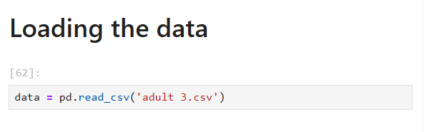
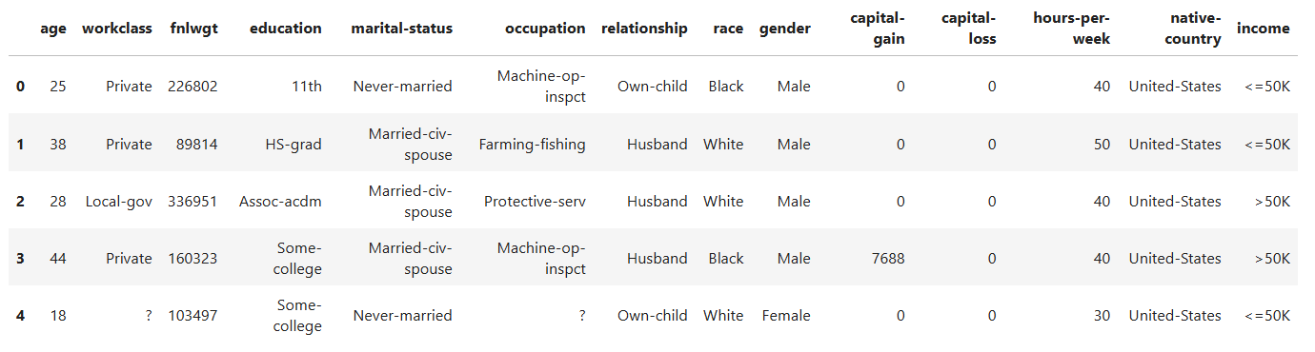
Algorithm & Deployment
Data Acquisition: Load the employee dataset into a DataFrame.

Slide 7
Algorithm & Deployment
Data Cleaning: Handle missing values, replace unknown labels, remove noise.

Slide 8
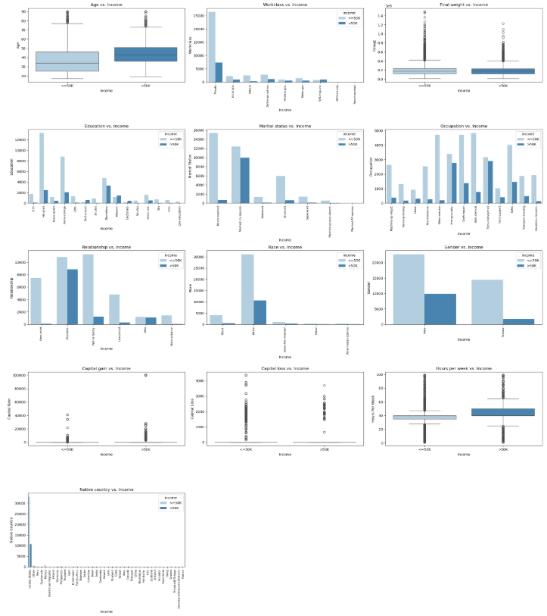
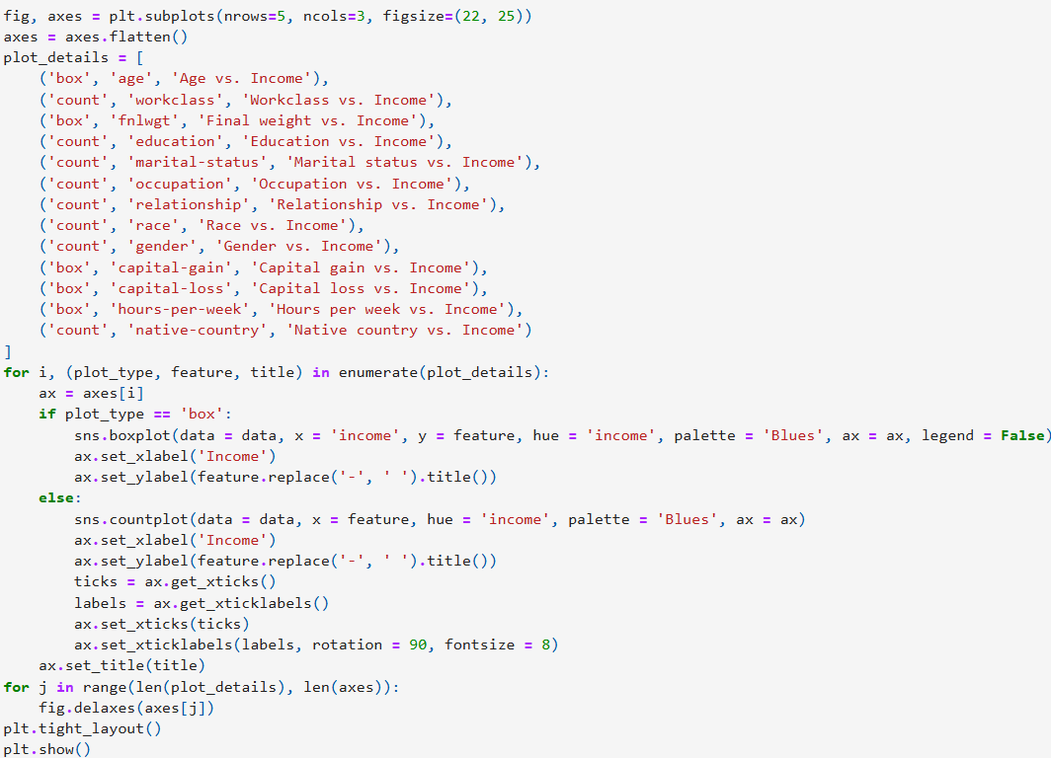
Algorithm & Deployment
Exploratory Data Analysis (EDA): Plot distributions, countplots, and boxplots to identify patterns.

Slide 9
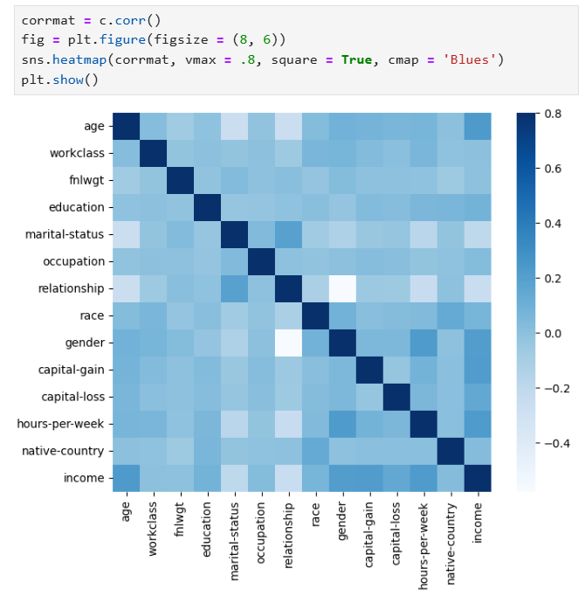
Algorithm & Deployment
Exploratory Data Analysis (EDA): Plot distributions, countplots, and boxplots to identify patterns.

Slide 10
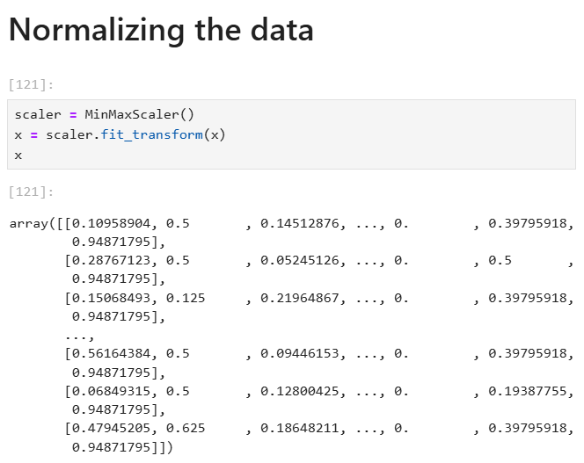
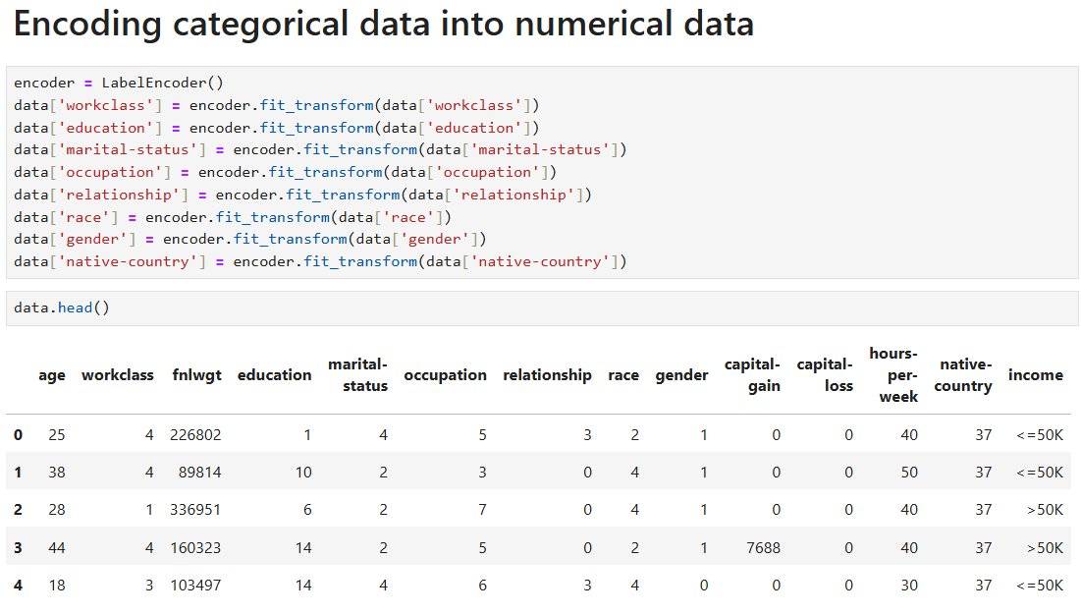
Algorithm & Deployment
Data Preprocessing: Encode categorical data, normalize numerical features.

Slide 11
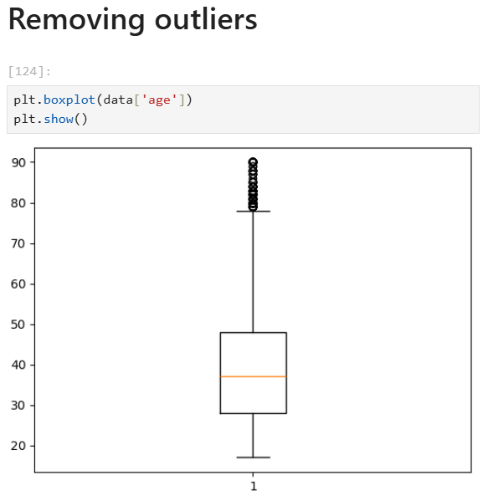
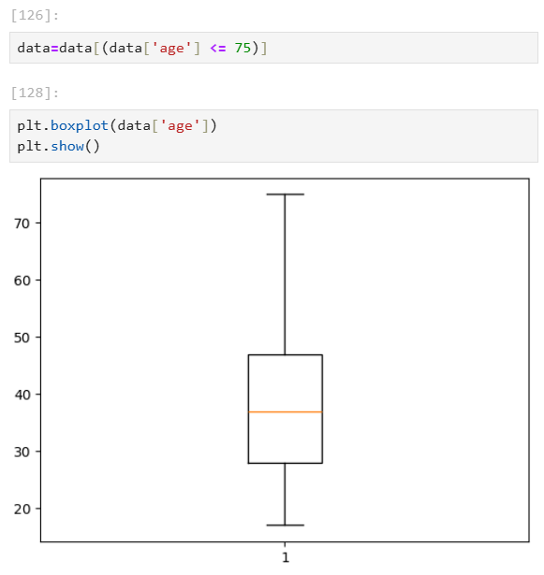
Algorithm & Deployment
Eliminate Outliers: Identify and remove outliers with the help of boxplots.

Slide 12
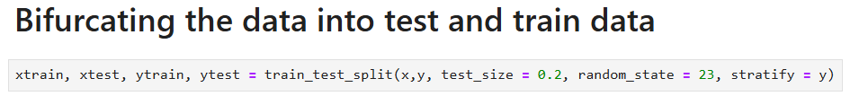
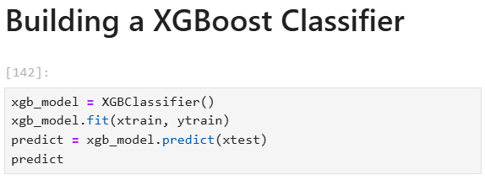
Algorithm & Deployment
Train-Test Split: Divide data (80 : 20) for training and testing.
Model Building: Use XGBoost classifier to predict salary class (<=50K or >50K).

Slide 13
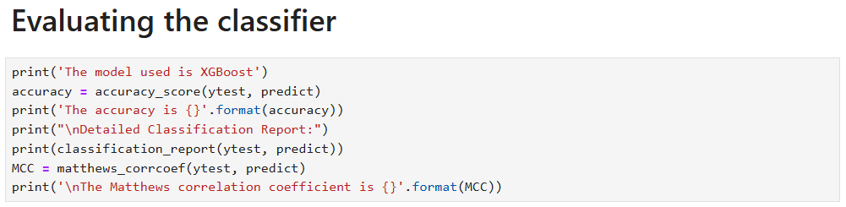
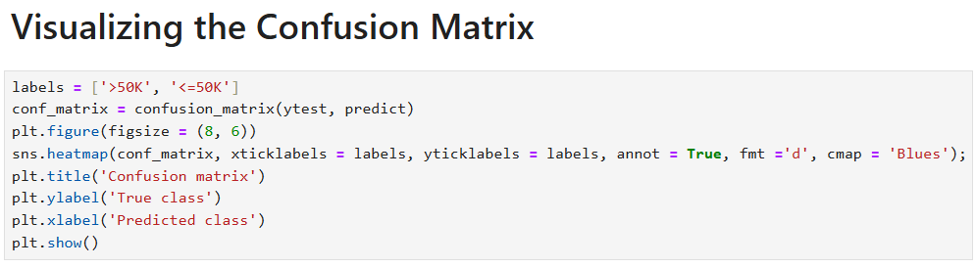
Algorithm & Deployment
Model Evaluation: Apply metrics like accuracy, precision, recall, F1, and Matthews correlation coefficient.
Visualization of Results: Plot confusion matrix and feature importance scores for interpretation.

Slide 14
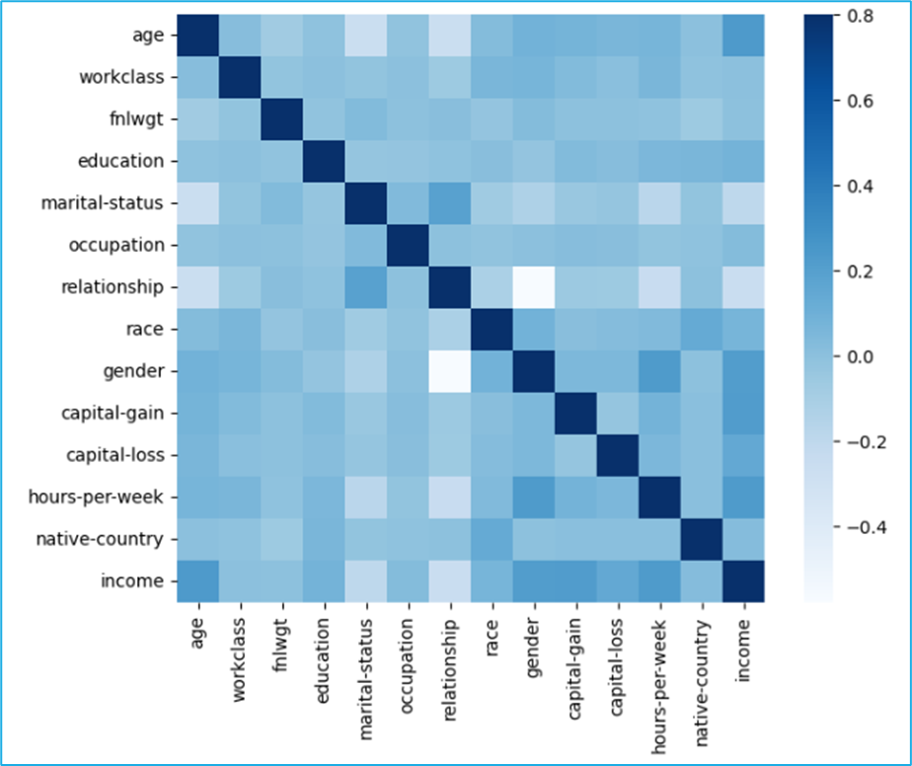
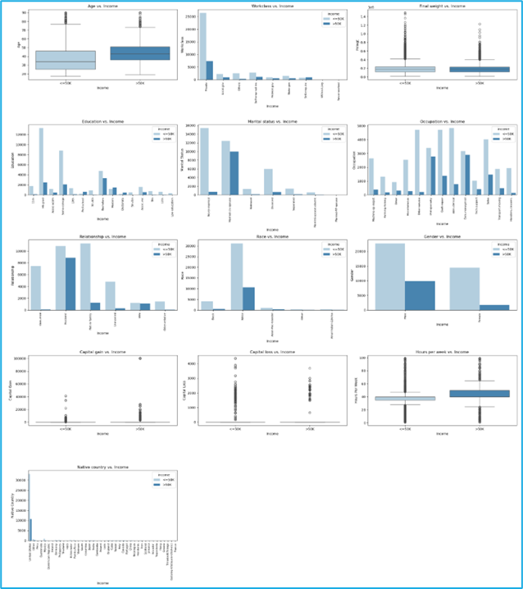
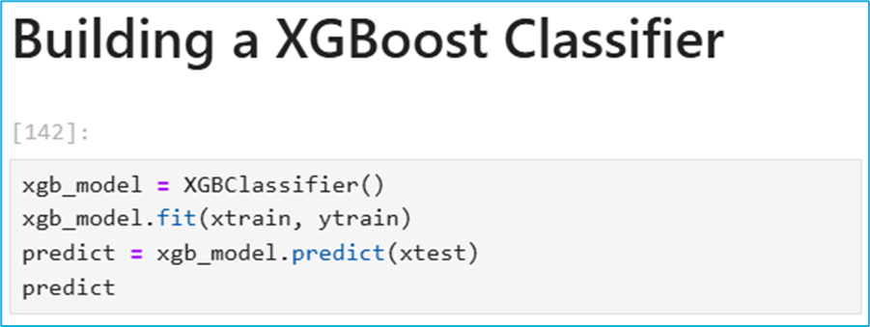
Result

Slide 15
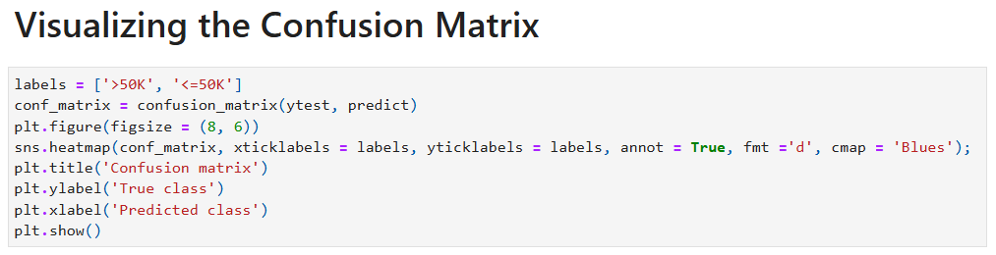
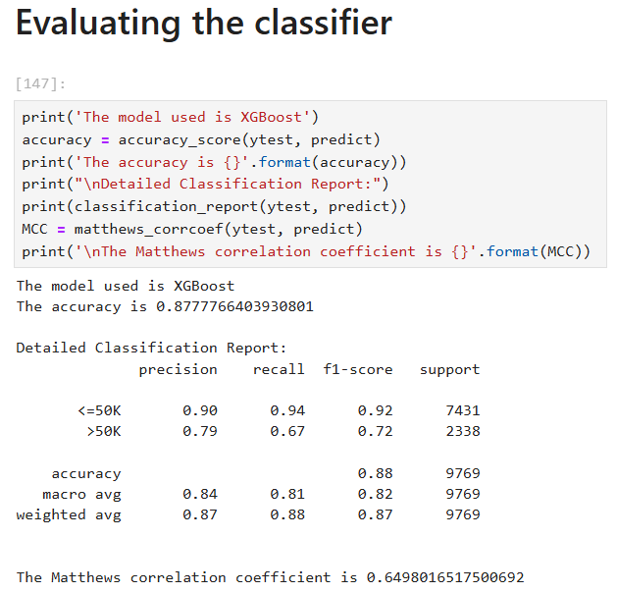
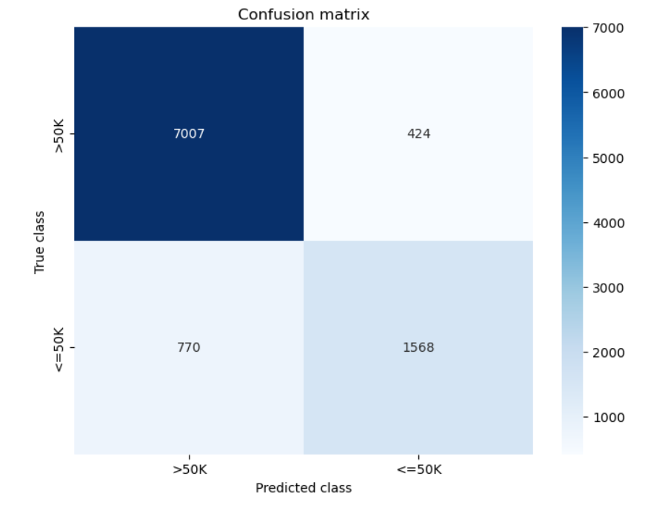
Result

Slide 16
Result
Github link: https://github.com/Deborah-Alvina/employee-salary-prediction

Slide 17
Conclusion
The XGBoost model achieved high accuracy (~85–90%).
Features like age, hours-per-week, and capital-gain were found to be strong predictors of salary.
The model can effectively predict salary categories, assisting in workforce analytics.
Challenges:
Handling the diversity of data either by removing or grouping categories.
Identifying effective encoding and normalization methods for the specific use case.
Potential improvements:
Balancing data using SMOTE or class weights, hyperparameter tuning for XGBoost, and testing additional algorithms (like Random Forest, Neural Networks).

Slide 18
References
Jupyter Notebook: https://jupyter.org/
Pandas : https://pandas.pydata.org/docs/
Scikit-learn: https://scikit-learn.org/stable/
Matplotlib: https://matplotlib.org/stable/index.html
Seaborn: https://seaborn.pydata.org/
XGBoost: https://xgboost.readthedocs.io/en/stable/

Slide 19
THANK YOU

