Slide 1
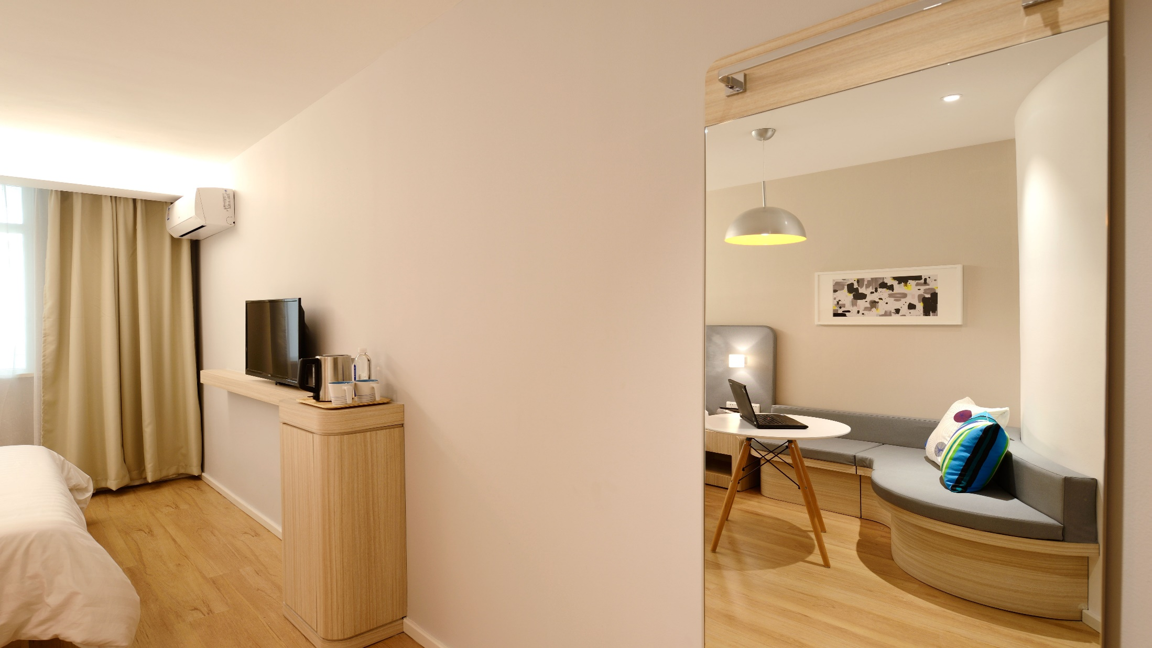
Hotel Reservation Analysis
Presented By: Deborah Nyangige Mosioma

Slide 2
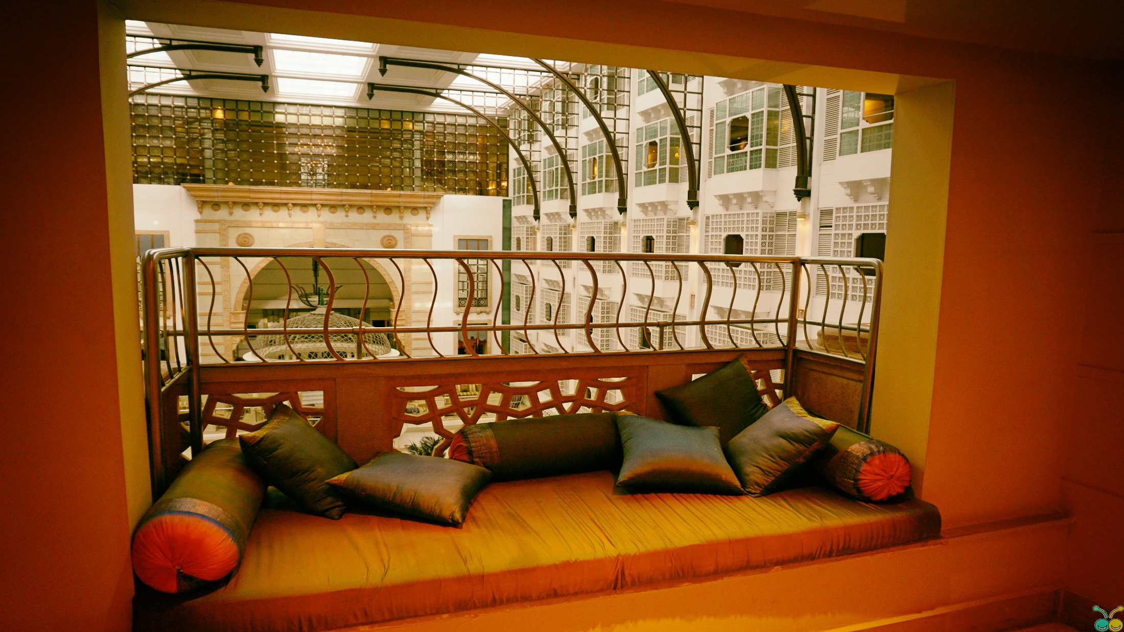
Key Focus
Project Overview
Objective
Dataset Details
Data Exploration Details
Data Analysis Queries
Conclusion

Slide 3
Project Overview
The hotel industry relies on data to make informed decisions and provide a better guest experience.
Goal: Gain insights into guest preferences, booking trends, and key factors that impact hotel operations.
Used SQL for data querying and analysis to answer specific questions about the dataset.

Slide 4

Objective
Leverage SQL for in-depth exploration and analysis.
Address specific queries related to the dataset.
Goal: Identify patterns to guide strategic decisions and optimize hotel performance.
Tools used

Slide 5
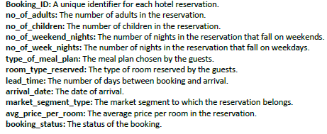
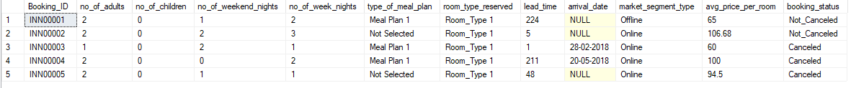
Dataset Details

Slide 6
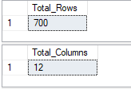
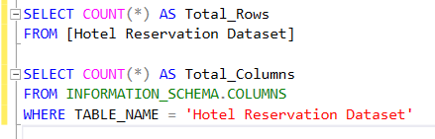
Data Exploration with SQL
The dataset has 12 Columns and 700 rows
#Query

Slide 7


Data Analysis Queries
1. What is the total number of reservations in the dataset?
#Query1
Findings: The dataset comprises a total of 700 reservations.

Slide 8
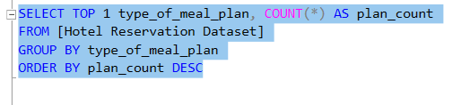

2. Which meal plan is the most popular among guests?
#Query2
Findings: Among guests, Meal Plan 1 emerges as the preferred choice.

Slide 9


3. What is the average price per room for reservations involving children?
#Query3
Findings: Reservations with children have an average room price of $144.57.

Slide 10
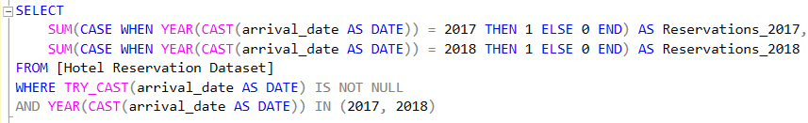

4. How many reservations were made for the year 20XX (replace XX with the desired year)?
Replaced XX with 18, so my desired year is 2018.
#Query4
Findings: In 2017, there were 123 reservations, while 2018 witnessed a significant increase with 577 reservations.

Slide 11


5. What is the most commonly booked room type?
#Query5
Findings: Room Type 1 ranks as the most favored option among guests for bookings.

Slide 12


6. How many reservations fall on a weekend (no_of_weekend_nights > 0)
#Query6
Findings: There are 383 reservations that fall on weekend nights.

Slide 13

7. What is the highest and lowest lead time for reservations?
#Query7
Findings: Lead times vary widely, ranging from 0 to 443 days, indicating diverse guest booking behaviors. Some opt for last-minute reservations, while others plan well in advance.

Slide 14


8. What is the most common market segment type for reservations?
#Query8
Findings: The most prevalent market segment type is online.

Slide 15


9. How many reservations have a booking status of "Confirmed"?
#Query9
Findings: No reservations have a booking status of "Confirmed."

Slide 16


10. What is the total number of adults and children across all reservations?
#Query10
Findings: Across all reservations, there are a total of 1316 adults and 69 children.

Slide 17


11. What is the average number of weekend nights for reservations involving children?
#Query11
Findings: Reservations involving children have an average of only 1 weekend night.

Slide 18
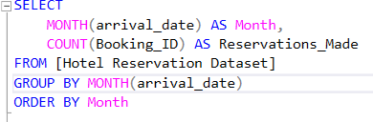
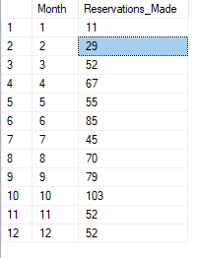
12. How many reservations were made in each month of the year?
#Query12
Findings: October emerges as the peak reservation month, followed by June, while January records the lowest number of reservations.

Slide 19
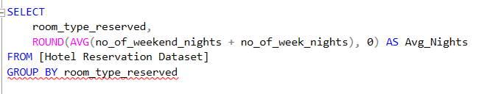
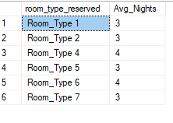
13. What is the average number of nights (both weekend and weekday) spent by guests for each room type?
#Query13
Findings: On average, guests spend 3 nights (both weekend and weekday) for Room Types 1, 2, 5, and 7, whereas Room Types 4 and 6 have an average stay of 4 nights.

Slide 20
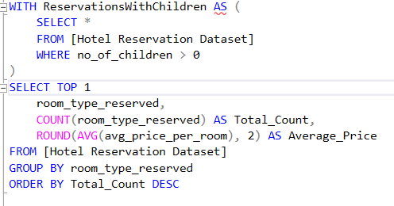

14. For reservations involving children, what is the most common room type, and what is the average price for that room type?
#Query14
Findings: Room Type 1 is the most common choice for reservations involving children, with an average price of $96.91.

Slide 21
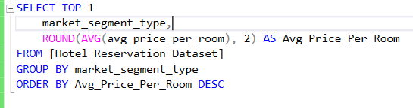

15. Find the market segment type that generates the highest average price per room.
#Query15
Findings: The Online market segment type generates the highest average price per room, which is $112.46.

Slide 22
Critical Questions
1. What is the total number of reservations in the dataset?
2. Which meal plan is the most popular among guests?
3. What is the average price per room for reservations involving children?
4. How many reservations were made for the year 20XX (replace XX with the desired year)?
5. What is the most commonly booked room type?
6. How many reservations fall on a weekend (no_of_weekend_nights > 0)?
7. What is the highest and lowest lead time for reservations?
8. What is the most common market segment type for reservations?
9. How many reservations have a booking status of "Confirmed"?
10. What is the total number of adults and children across all reservations?
11. What is the average number of weekend nights for reservations involving children?
12. How many reservations were made in each month of the year?
13. What is the average number of nights (both weekend and weekday) spent by guests for each room type?
14. For reservations involving children, what is the most common room type, and what is the average
price for that room type?
15. Find the market segment type that generates the highest average price per room.

Slide 23
Conclusion
The dataset reveals key insights:
Meal Plan 1 is popular, with 700 reservations.
Reservations with children average $144.57 per room.
2017 saw 123 reservations, soaring to 577 in 2018.
Room Type 1 is preferred, with 383 reservations on weekends.
Lead times span 0-443 days, reflecting diverse booking behaviors.
Online market segments dominate, and no bookings are "Confirmed."
Adults total 1316, children 69. October is busiest, January quietest.
Rooms 1, 2, 5, and 7 average 3 nights, while 4 and 6 stay 4 nights.
Room Type 1, with an average price of $96.91, is the top choice for children.
The Online segment yields the highest average room price at $112.46.

Slide 24
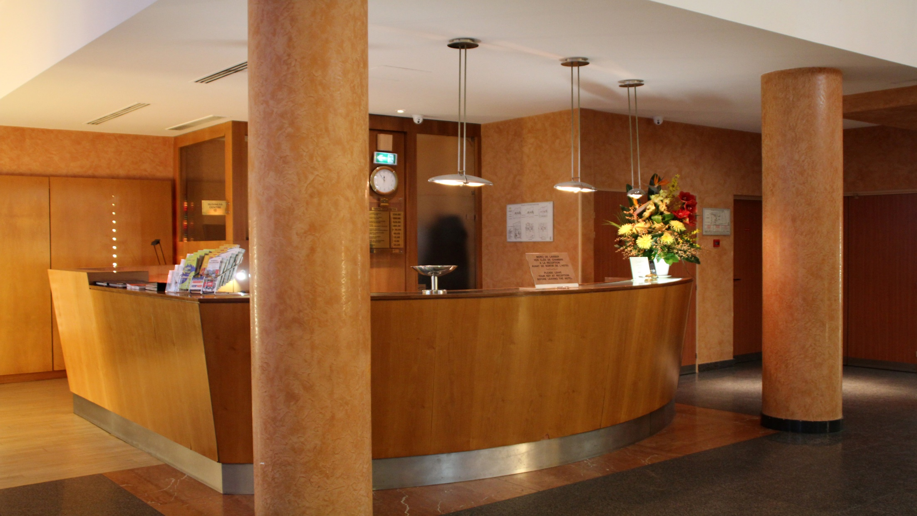
Thank You!

