Slide 1
Angular LOB Applications Hands-On
Deborah Kurata & Jerry Kurata
Consultants
http://blogs.msmvps.com/deborahk
deborahk@insteptech.com
jerryk@insteptech.com
Notes:
In this session, you’ll learn the basics of building an Angular application. Your journey begins with a short overview of what Angular is and why it is a great choice for building full-featured Web applications.
We will then walk step by step through the process of building a sample application including a view, model, module, and controller. Along the way you’ll learn the Angular terminology, best practices, and some useful tips and techniques.

Slide 2
Deborah Kurata
Independent Consultant | Developer | Mentor
Web (Angular), .NET
Pluralsight Author
AngularJS Line of Business Applications
Angular Front to Back with Web API
Object-Oriented Programming Fundamentals in C#
Microsoft MVP

Slide 3
Jerry Kurata
Independent Consultant | Developer | Mentor
Web (Angular), .NET
Pluralsight Author
AngularJS Line of Business Applications
Angular Front to Back with Web API
Object-Oriented Programming Fundamentals in C#
Microsoft MVP

Slide 4
Session Materials & Sample Code
https://github.com/DeborahK/SDD2015

Slide 5
Rate Yourself on Angular
New to Angular - no proficiency
Just starting out - limited proficiency
Doing it, not fully understanding it - working proficiency
Been there, done that, can help others - full proficiency

Slide 6

Overview - Part 1
Introduction to Angular
Angular and HTML: Building a View
Data Binding
Angular Code: Building the Module & Controller
Bootstrap: Styling the View

Slide 7
Overview - Part 2
Introduction to SPA
Rule-Based Navigation / Routing
Routing Frameworks (ngRoute/ngNewRouter)
JavaScript Promises
Accessing Data by Calling an HTTP Service
Reusable Code: Building a Service

Slide 8
Part I

Slide 9

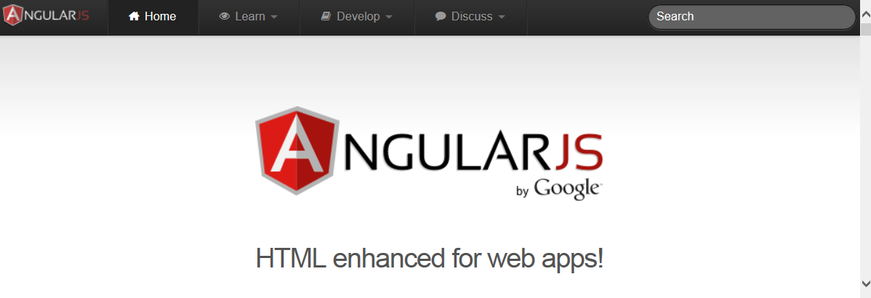
A client-side JavaScript framework for building interactive Web applications
Brings simple/clean back to complex Web apps
Originally developed by Google
Now open source: https://angularjs.org/

Slide 10



Web Server
Web Browser
URL Request (www.mysite.com)
HTML
HTML
Response (Page and Assets)
Java-Script
Java-Script
Notes:
So, how does it work.
There are no "Angular" files per se.
Index.html by convention is the startup page.
It contains link and script tags with the paths to the required assets (HTML templates, JavaScript files, CSS files, etc)

Slide 11
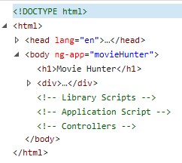
DOM
Document Object Model
Tree structure that defines all of the loaded elements in an HTML document

Slide 12
DEMO: Angular Apps
Notes:
Be sure to show:
Resizing
Filtering
Use F12 tools to show the communication with the server.
Use F12 tools to show the DOM
Leave up the browser to show the visual while going through the code.

Slide 13
Why Angular?
Expressive HTML
Powerful Data Binding
Modularity
Rule-based Navigation
Easily Call HTTP Service
Testable
It's Popular

Slide 14
Movie List View
Expressive HTML
<div ng-controller="MovieListCtrl">
<div>{{title}}</div>
<div>Filter by:</div><input type="text" ng-model="listFilter" />
<div ng-show="listFilter">
<h3>Movies filtered by: {{listFilter}}</h3>
</div>
<table ng-if="movies.length">
<thead>
<tr>
<td><button type="button"
ng-click="toggleImage()">
{{showImage ? "Hide" : "Show"}} Poster
</button></td>
<td>Title</td> <td>Director</td> <td>Release Date</td> <td>Rating</td>
</tr>
</thead>
<tbody>
<tr ng-repeat="movie in movies | filter : {title:listFilter} | orderBy : 'title'">
<td><img ng-show="showImage"
ng-src="{{movie.imageurl}}" title="{{movie.title}}"></td>
<td>{{ movie.title}}</td>
<td>{{ movie.director }}</td>
<td>{{ movie.releaseDate | date }}</td>
<td>{{ movie.mpaa | uppercase}}</td>
</tr>
</tbody>
</table>
</div>

Slide 15
Directives
Expressive HTML
Extend HTML
Apply special behavior to attributes or elements in the HTML
Are simple to define in the HTML
Prefixed with "ng-"
Provide an extensive set of features and capabilities

Slide 16
Directives
<body ng-app="movieHunter">
<table ng-if="movies.length">
<tr ng-repeat="movie in movies | orderBy:'title' ">
<img ng-show="showImage"
ng-src="" />
<button type="button"
ng-click="toggleImage()">Poster
</button>

Slide 17
One Way Data Binding
Powerful Data Binding
View is a projection of the model
When the model changes, the view reflects the change
Binding Expression
{{movie.title}}

Slide 18
One Way Data Binding
<tr ng-repeat="movie in movies | orderBy:'title' ">
<td>
<img ng-show="showImage"
ng-src="{{movie.imageurl}}" />
</td>
<td>
<a>{{movie.title}}</a>
</td>
<td>{{movie.director}}</td>
<td>{{movie.date | date}}</td>
<td>{{movie.mpaa | uppercase}}</td>
</tr>

Slide 19
Two Way Data Binding
Powerful Data Binding
Data in the model and the view are synchronized
Changes to the model are reflected in the view
Changes in the view are reflected in the model
Define using a directive: ng-model
ng-model="listFilter"

Slide 20
Two Way Data Binding
<div>
<div>Filter by:</div>
<div>
<input type="text" ng-model="listFilter" />
</div>
</div>
<div ng-show="listFilter">
<h3>Movies filtered by: {{listFilter}}</h3>
</div>
<tr ng-repeat="movie in movies | orderBy:'title'
| filter : {title : listFilter}">

Slide 21
Directives and Binding
Expressive HTML
Directives
ng-app
ng-if
ng-repeat
ng-show/ng-hide
ng-model
Data Binding
One way binding
{{movie.title}}
Two way binding
ng-model="listFilter"
Powerful Data Binding

Slide 22
Angular Code
Modularity
Write using
JavaScript
TypeScript
Divided into
Modules
Controllers
Services
Notes:
TypeScript
Class-based object-oriented
Strongly typed

Slide 23
Module
Defines an Angular component
Tracks the application code
Tracks all of the dependencies for the application
Keeps the application modularized

Slide 24
Angular Module Method
Setter Method
angular.module("movieHunter", ["ngRoute",
"common.services"]);
Getter Method
angular.module("movieHunter");

Slide 25
Angular Main Module
var app = angular.module("movieHunter",
[]);

Slide 26
Angular Main Module
function () {
var app = angular.module("movieHunter",
[]);
}

Slide 27
Angular Main Module - IIFE
(function () {
var app = angular.module("movieHunter",
[]);
}());

Slide 28
The IIFE JavaScript Pattern
Immediately-Invoked Function Expression
JavaScript var declarations have global scope
JavaScript variables and functions defined within a function have local scope
(function () {
// Code here
}());

Slide 29
Module
Modularity
One "main" module for the application
Any number of additional modules
Group related functionality
Define reusable common code

Slide 30
Controller
Defines the Model
Movies
Implements Methods
Hide/Show Images

Slide 31
View, Controller, and $scope
Angular Application (movieHunter)
movieListView
MovieListCtrl
<div ng-controller=
"MovieListCtrl">
$scope
Directives & Bindings
Model
</div>
Methods

Slide 32
Angular Controller
(function () {
"use strict";
angular
.module("movieHunter")
.controller("MovieListCtrl",
["$scope",
MovieListCtrl]);
function MovieListCtrl($scope) {
$scope.movies = [];
$scope.title = "Search by Movie Title";
$scope.showImage = false;
$scope.toggleImage = function () {
$scope.showImage = !$scope.showImage;
};
}());

Slide 33
Angular "Controller As" Syntax
(function () {
"use strict";
angular
.module("movieHunter")
.controller("MovieListCtrl",
["$scope",
MovieListCtrl]);
function MovieListCtrl($scope) {
$scope.movies = [];
$scope.title = "Search by Movie Title";
$scope.showImage = false;
$scope.toggleImage = function () {
$scope.showImage = !$scope.showImage;
};
}());

Slide 34
Angular "Controller As" Syntax
(function () {
"use strict";
angular
.module("movieHunter")
.controller("MovieListCtrl",
[MovieListCtrl]);
function MovieListCtrl() {
$scope.movies = [];
$scope.title = "Search by Movie Title";
$scope.showImage = false;
$scope.toggleImage = function () {
$scope.showImage = !$scope.showImage;
};
}());

Slide 35
Angular "Controller As" Syntax
(function () {
"use strict";
angular
.module("movieHunter")
.controller("MovieListCtrl",
[MovieListCtrl]);
function MovieListCtrl() {
var vm = this;
$scope.movies = [];
$scope.title = "Search by Movie Title";
$scope.showImage = false;
$scope.toggleImage = function () {
$scope.showImage = !$scope.showImage;
};
}());

Slide 36
Angular "Controller As" Syntax
(function () {
"use strict";
angular
.module("movieHunter")
.controller("MovieListCtrl",
[MovieListCtrl]);
function MovieListCtrl() {
var vm = this;
vm.movies = [];
vm.title = "Search by Movie Title";
vm.showImage = false;
vm.toggleImage = function () {
vm.showImage = !vm.showImage;
};
}());

Slide 37
View "Controller As" Syntax
<div ng-controller="MovieListCtrl">
<div>{{title}}</div>
<div>Filter by:</div><input type="text" ng-model="listFilter" />
<div ng-show="listFilter">
<h3>Movies filtered by: {{listFilter}}</h3>
</div>
<table ng-if="movies.length">
<thead>
<tr>
<td><button type="button"
ng-click="toggleImage()">
{{showImage ? "Hide" : "Show"}} Poster
</button></td>
<td>Title</td> <td>Director</td> <td>Release Date</td> <td>Rating</td>
</tr>
</thead>
<tbody>
<tr ng-repeat="movie in movies | filter : {title:listFilter} | orderBy : 'title'">
<td><img ng-show="showImage"
ng-src="{{movie.imageurl}}" title="{{movie.title}}"></td>
<td>{{ movie.title}}</td>
<td>{{ movie.director }}</td>
<td>{{ movie.releaseDate | date }}</td>
<td>{{ movie.mpaa | uppercase}}</td>
</tr>
</tbody>
</table>
</div>

Slide 38
View "Controller As" Syntax
<div ng-controller="MovieListCtrl as vm">
<div>{{title}}</div>
<div>Filter by:</div><input type="text" ng-model="listFilter" />
<div ng-show="listFilter">
<h3>Movies filtered by: {{listFilter}}</h3>
</div>
<table ng-if="movies.length">
<thead>
<tr>
<td><button type="button"
ng-click="toggleImage()">
{{showImage ? "Hide" : "Show"}} Poster
</button></td>
<td>Title</td> <td>Director</td> <td>Release Date</td> <td>Rating</td>
</tr>
</thead>
<tbody>
<tr ng-repeat="movie in movies | filter : {title:listFilter} | orderBy : 'title'">
<td><img ng-show="showImage"
ng-src="{{movie.imageurl}}" title="{{movie.title}}"></td>
<td>{{ movie.title}}</td>
<td>{{ movie.director }}</td>
<td>{{ movie.releaseDate | date }}</td>
<td>{{ movie.mpaa | uppercase}}</td>
</tr>
</tbody>
</table>
</div>
Notes:
ALIAS

Slide 39
View "Controller As" Syntax
<div ng-controller="MovieListCtrl as vm">
<div>{{vm.title}}</div>
<div>Filter by:</div><input type="text" ng-model="listFilter" />
<div ng-show="listFilter">
<h3>Movies filtered by: {{listFilter}}</h3>
</div>
<table ng-if="vm.movies.length">
<thead>
<tr>
<td><button type="button"
ng-click="vm.toggleImage()">
{{vm.showImage ? "Hide" : "Show"}} Poster
</button></td>
<td>Title</td> <td>Director</td> <td>Release Date</td> <td>Rating</td>
</tr>
</thead>
<tbody>
<tr ng-repeat="movie in vm.movies | filter : {title:listFilter} | orderBy : 'title'">
<td><img ng-show="vm.showImage"
ng-src="{{movie.imageurl}}" title="{{movie.title}}"></td>
<td>{{ movie.title}}</td>
<td>{{ movie.director }}</td>
<td>{{ movie.releaseDate | date }}</td>
<td>{{ movie.mpaa | uppercase}}</td>
</tr>
</tbody>
</table>
</div>

Slide 40
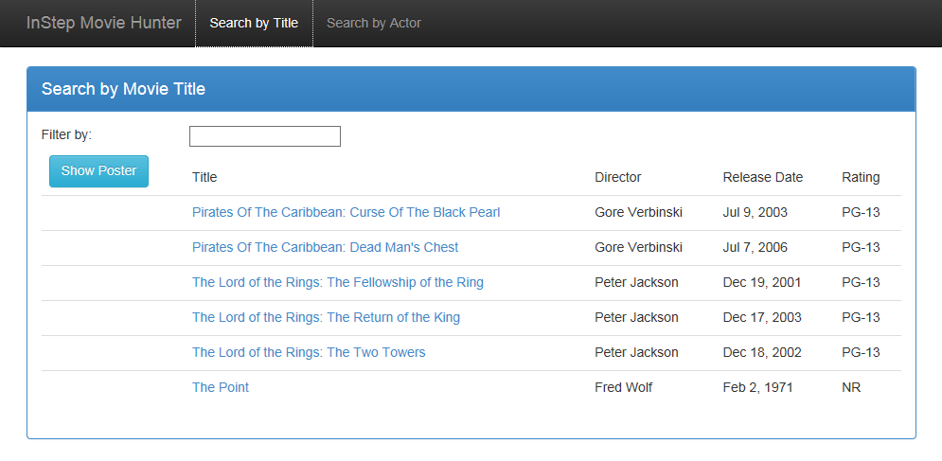
Sample Application

Slide 41
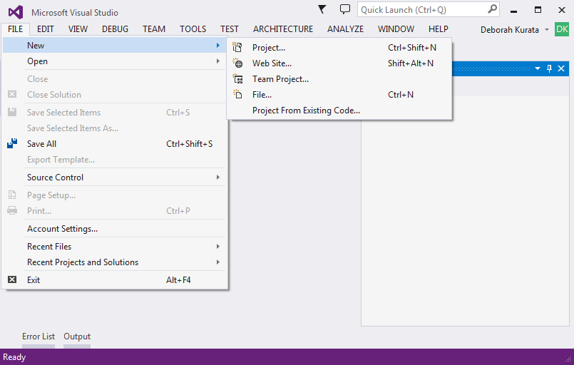
Creating an Angular Project

Slide 42
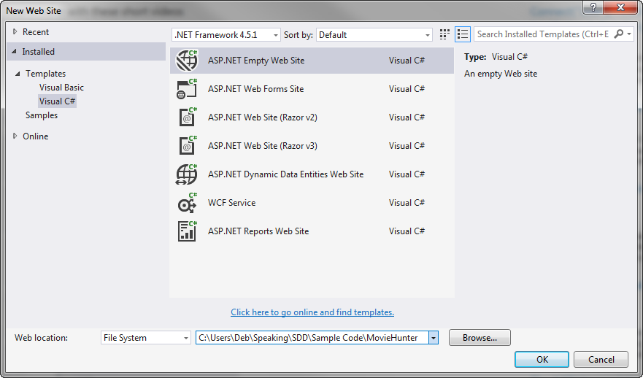
Selecting a Template

Slide 43
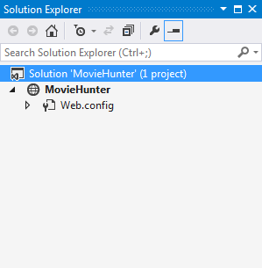
Generated Solution

Slide 44
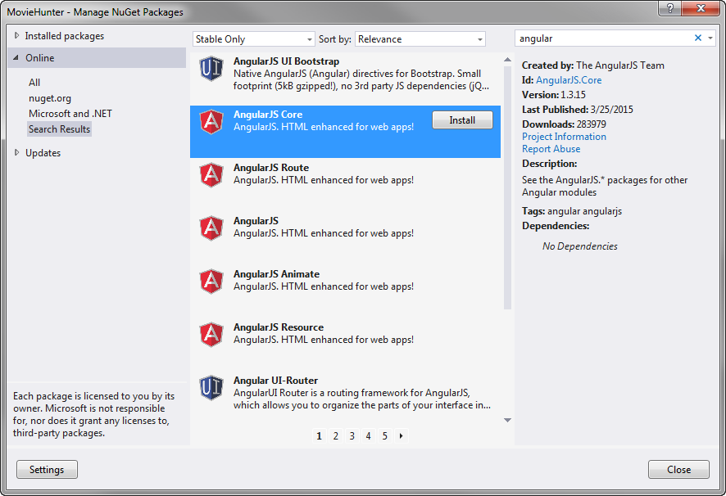
NuGet Package Manager

Slide 45
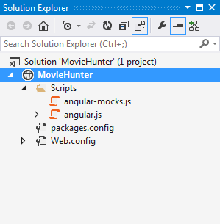
Solution Explorer

Slide 46
app.js (movieHunter)
index.html
movieListView.html
<head>
<link …/>
</head>
<body ng-app=
"movieHunter">
<div ng-controller=
"MovieListCtrl as vm">
...
</div>
movieListCtrl.js (MovieListCtrl)
[menu code here]
<ng-include=
"'movieListView.html'">
Model
<script …/>
</body>
Methods

Slide 47
DEMO: Angular Code So Far

Slide 48
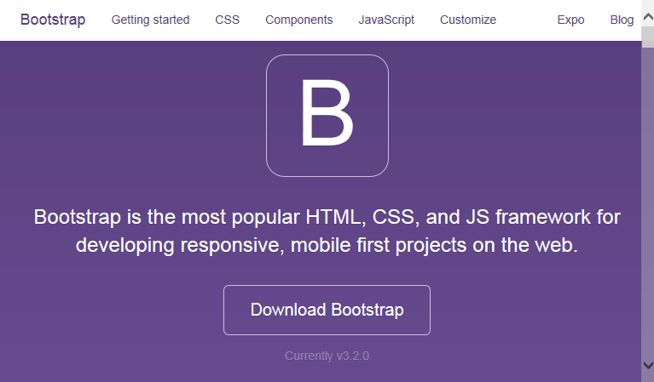
Bootstrap
Framework for prettifying Web pages
Developed by Twitter
http://getbootstrap.com/
Large third party community
Notes:
Responsive
Browser Differences

Slide 49
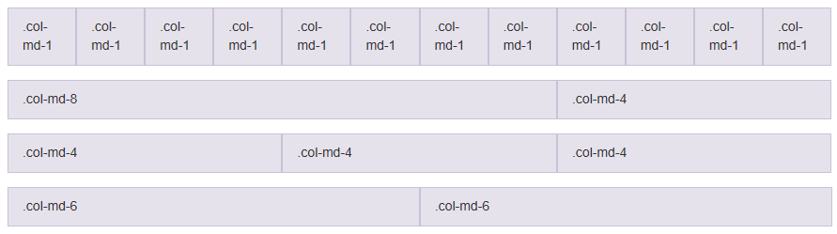
Bootstrap Grid System
Notes:
Responsive
Browser Differences

Slide 50
DEMO: Bootstrap

Slide 51
Take Away
Expressive HTML
Powerful Data Binding
Modularity
Easily Call HTTP Service
Rule-based Navigation

Slide 52
Thank You!
@deborahkurata
deborahk@insteptech.com
http://blogs.msmvps.com/deborahk
https://github.com/DeborahK/SDD2015

