Slide 1
Building An Angular Web APP From the Ground Up - Part 2
Deborah Kurata
Consultant
http://blogs.msmvps.com/deborahk
deborahk@insteptech.com
Notes:
In the second part of this session, you’ll learn additional techniques for building an Angular application including navigation using routing, accessing data from an http service, and building custom services.
We will walk step by step through the details of each of these techniques. Along the way you’ll learn the Angular terminology, best practices, and tips and techniques.

Slide 2
Deborah Kurata
Independent Consultant | Developer | Mentor
Web (Angular), .NET
Pluralsight Author
AngularJS Line of Business Applications
Angular Front to Back with Web API
Object-Oriented Programming Fundamentals in C#
Microsoft MVP

Slide 3
Session Materials & Sample Code
https://github.com/DeborahK/SDD2015

Slide 4
Why Angular?
Expressive HTML
Powerful Data Binding
Modularity
Rule-based Navigation
Easily Call HTTP Service
Testable
It's Popular

Slide 5

Overview - Part 2
Introduction to SPA
Rule-Based Navigation / Routing
Routing Frameworks (ngRoute/ngNewRouter)
JavaScript Promise
Accessing Data by Calling an HTTP service
Reusable Code: Building a Service

Slide 6
DEMO: Angular Apps
Notes:
productManagement
Point out the child container for the tabs.
And that this does *not* have a back-end service!
Completed Movie Hunter
Point out that this has simple navigation
And this *is* using a back-end service (ASP.NET Web API)
Movie Hunter where we are now

Slide 7
ROUTING: Rule-based Navigation

Slide 8
Rate Yourself on Routing
New to Angular - no proficiency
Just starting out - limited proficiency
Doing it, not fully understanding it - working proficiency
Been there, done that, can help others - full proficiency

Slide 9
app.js (movieHunter)
index.html
movieListView.html
<head>
<link …/>
</head>
<body ng-app=
"movieHunter">
<div ng-controller=
"MovieListCtrl as vm">
...
</div>
movieListCtrl.js (MovieListCtrl)
[menu code here]
<ng-include=
"'movieListView.html'">
Model
<script …/>
</body>
Methods

Slide 10
SPA
Single Page Application
Only one page?
Only one full HTML page
All other pages are HTML Fragments called templates
And are displayed within the one HTML page
Goals:
Enhance user experience
Reduce round tripping

Slide 11

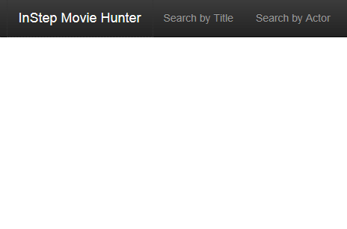
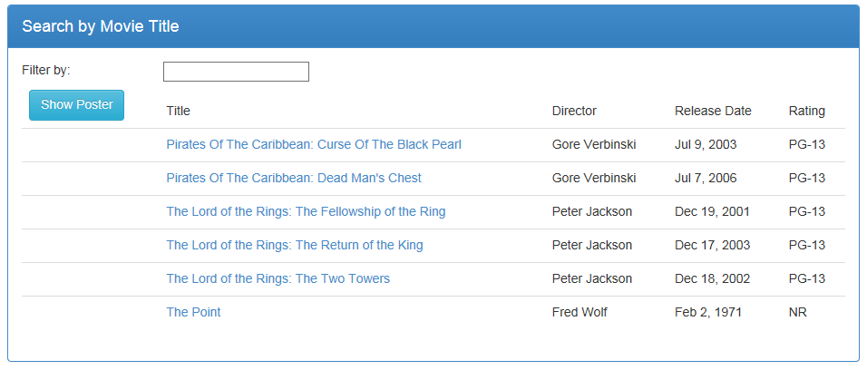
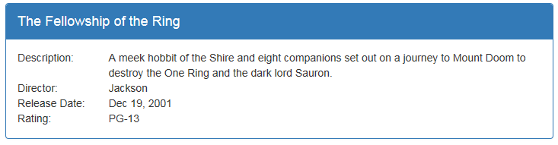
Multiple Views
Notes:
Most Web applications are more than one page.
- Define each view in its own html file.
Define the header, menu, footer in the index.html.
Define the ng-view directive in the location in the HTML where the views should appear.

Slide 12
Routing
Rule-based Navigation
Technique for navigating between views
Each route represents a specific view
Activating a route navigates to that view
Routes defined by rules

Slide 13
Site Map
Welcome Page
Movie Detail
Movie List
Menu
Movie Edit
Notes:
An easy way to picture the routing is to look at a site map.

Slide 14
Routes
Welcome Page
/showDetail/3
Movie Detail
/
/searchByTitle
Movie List
/editMovie/3
Menu
Movie Edit
/editMovie/0
Notes:
Each view in the map can then be associated with a named route.

Slide 15
Routing URL Fragments
<mysite>/index.html#/searchByTitle
<mysite>/index.html#/
<mysite>/index.html#/showDetail/3
Notes:
Define the ng-view directive in the location in the HTML where the views should appear.
ng-viewport in the new Angular router.

Slide 16
Routing Frameworks
ngRoute
UI Router
ngNewRouter
Notes:
ngRoute
Is the original routing framework provided by Angular.
It provides for simple, straight-forward routes.
UI Router
Is a third-party routing package.
It has more advanced features than ngRoute including
Nested views, as we saw with the tab pages in the Product Management application we looked at.
ngNewRouter
Is the new router that is coming out in Angular 1.4
And is expected to be the router for Angular 2.0.
It provides the ease of use of ngRoute
With many of the more advanced features from UI Router.
Though the syntax will be slightly different, the concepts are the same for each of the three frameworks

Slide 17
ngRoute
Available from
https://angularjs.org/
angular-route.js
Based on
URL fragment identifiers
Each route has
URL fragment identifier
View template
Optional Controller
Angular Web Site
http://mysite/index.html#/searchByTitle

Slide 18
UI Router
Available from
https://github.com/angular-ui/ui-router
angular-ui-router.js
Based on
Application States
Each state has
Optional URL fragment identifier
View template
Optional Controller
Third-party Angular UI Library

Slide 19
ngNewRouter
Available from
https://github.com/angular/router
Router.es5.js
Based on
URL fragment identifiers
Each route has
URL fragment identifier (path)
Component
Angular 1.4
http://mysite/index.html#/searchByTitle

Slide 20
ngRoute
https://docs.angularjs.org/api/ngRoute
Notes:
We'll first look at the Angular module: ngRoute.

Slide 21
ngRoute: index.html
<div class="container">
<div ng-view></div>
</div>
Notes:
- By convention, the "single page" of the application is defined in index.html.
- In the index.html file, define the header, menu bar, and footer.
- And use the ng-view directive to identify where the HTML templates for the views should appear.
ng-view includes the rendered template of the current route into the main layout.
Every time the route changes, the included view changes with it according to the route configuration.

Slide 22
Routes
Welcome Page
/showDetail/3
Movie Detail
/
/searchByTitle
Movie List
Menu

Slide 23
ngRoute: app.js
var app = angular.module("movieHunter", ["ngRoute"]);
app.config(['$routeProvider',
function ($routeProvider) {
$routeProvider
.when("/", {
templateUrl: "app/welcomeView.html"
})
.when("/searchByTitle", {
templateUrl: "app/movies/movieListView.html",
controller: "MovieListCtrl as vm"
})
.when("/showDetail/:movieId", {
templateUrl: "app/movies/movieDetailView.html",
controller: "MovieDetailCtrl as vm"
})
.otherwise("/");
}]);
Notes:
$routeProvider is the provider for the $route service.
Providers create and provide instances of services and expose configuration APIs.
Providers can only be injected into config functions.
Everyone know what "controller as" means?
NOTE: Now that the controller is defined here, the view does NOT need the ng-controller directive.

Slide 24
Navigation
Anchor tags
Link to the appropriate route
<a ng-href="#searchByTitle">
$location service
$location.path("/searchByTitle");
Notes:
To navigate to a view, activate its route.

Slide 25
ngRoute: index.html
<div class="navbar-collapse collapse">
<ul class="nav navbar-nav">
<li>
<a ng-href="#searchByTitle">Search by Title</a>
</li>
</ul>
</div>

Slide 26
ngRoute: movieDetailView.html
<div class="panel-footer">
<a class="btn btn-default"
ng-href="#searchByTitle"
style="width:80px">
<i class="glyphicon glyphicon-chevron-left"></i>
Back
</a>
</div>

Slide 27
DEMO: Navigation & Routing
Notes:
Show the app.js file.
Show the index.html file
Show the movieDetailView.html file.

Slide 28
ngNewRouter
https://github.com/angular/router
https://angular.io/
Notes:
Now let's take a quick look at ngNewRouter
- This is the router coming out in Angular 1.4 and used in Angular 2.0

Slide 29
ngNewRouter: index.html
<div class="container">
<div ng-viewport></div>
</div>
Notes:
ng-viewport directive instead of ng-view
Defines where the content is displayed

Slide 30
ngNewRouter : app.js
var app = angular.module("movieHunter", ["ngNewRouter"]);
app.controller('AppController', ['$router', AppController]);
function AppController ($router) {
$router.Config([
{ path: '/', component: 'welcome' },
{ path: '/searchByTitle', component: 'movieList' },
{ path: '/showDetail/:movieId', component: 'movieDetail' }
]);
}
Notes:
Things to notice here:
Dependency on ngNewRouter
We define a controller instead of using the .config.
The router config takes an array of pairings (path and component)
The paths map to routable components
The route is a named component with an aliased function
NOTE: The new router enforces the "controller as" syntax!

Slide 31
Routable Component in 1.4+
components/
welcome/ welcome.html
movieList/ movieList.html movieList.js
movieDetail/ movieDetail.html movieDetail.js
Defined by the directory structure
Or configure with
$componentLoader
Notes:
Or configure in the $componentLoader service
Best practice: Define each component in a separate module.
Once the Angular team implements lazy loading, it will be possible to delay loading of the module until it is requested

Slide 32
ngNewRouter: movieDetailView.html
<div class="panel-footer">
<a class="btn btn-default"
ng-link="movieList"
style="width:80px">
<i class="glyphicon glyphicon-chevron-left"></i>
Back
</a>
</div>
Notes:
ng-link directive navigates to the route component.
Link to the *component* not the path.
Notice the difference in syntax for the link to movieEdit.
This uses a function expression.
The movieId is passed as an argument.

Slide 33
Advanced Features
Multiple viewports
Sibling Components
Child Views
Tab-based UI
Lifecycle Hooks
canActivate | activate
canDeactivate | deactivate
Notes:
Multiple viewports allows us to display multiple views within the index.html file.
Examples:
Separating application header from the menu
Child views allow defining a viewport within a view.
Building a tab-based UI
Lifecycle hooks provide hook functions for these lifecycle events
Ensuring a user is authorized for the view
Retrieving data needed by the view
Ensuring the user has saved
Clean up

Slide 34
Routing
Rule-based Navigation
SPA: Single Page Application
Use routing to display the views
Routing provides rule-based navigation
Define the routes using .config
Navigate to a route using <a>
Consider using the new 1.4 router

Slide 35
DATA ACCESS: Calling an HTTP Service

Slide 36
Rate Yourself on Data Access
New to Angular - no proficiency
Just starting out - limited proficiency
Doing it, not fully understanding it - working proficiency
Been there, done that, can help others - full proficiency

Slide 37
HTTP Service
Easily Call HTTP Service
What is an HTTP service?
Why call one from our Angular app?

Slide 38



Web Server
Web Browser
URL Request (www.mysite.com)
HTML
HTML
Response (Page and Assets)
Java-Script
Java-Script
HTTP Service
DB

Slide 39
Web Server
Web Browser
HTML
URL Request (www.mysite.com)
HTML
Response (Page and Assets)
Java-Script
Java-Script
(http://mysite/api/movies)
HTTP Service
Response
DB
Data

Slide 40
JavaScript Promise
Launch an asynchronous operation
Up to 3 Callback Functions
Async Operation
Return immediately
As the operation progresses …
When the operation is complete
If the operation is successful …
If the operation fails …

Slide 41
Calling HTTP Service
$http
$resource
$httpBackend
Notes:
$httpBackend
Angular's fake HTTP backend implementation
Mocks calls to the HTTP service
Returns static data to the application

Slide 42
$http
$http.get("/api/movies/")
.success(function(response) {
vm.movies = response.data;
});
Built into Angular Core
Facilitates communication with a back-end service get, post, put, delete, …
Asynchronous
Notes:
When the request is complete:
The callback function is executed
The response object is passed in
Define the callback functions
Success
Error

Slide 43
REST
REpresentational State Transfer
Requests and responses involve the transfer of resources
Resources are identified with a URL
/api/movies/
Requests utilize a standard set of HTTP verbs
GET | POST | PUT | DELETE
And much more!

Slide 44
$resource
function movieResource($resource) {
return $resource("/api/movies/:movieId")
}
Separate Angular component: angular-resource ngResource
Abstraction on top of $http for calling RESTful services
Requires less code
Notes:
When the request is complete:
The callback function is executed
The response object is passed in

Slide 45
Reusable Data Access Service
Angular module
(common.services)
Angular module
(movieHunter)
Custom Angular service
(movieResource)
View
(movieList View)
Angular controller
(movieListCtrl)
HTTP Service
Built in $resource service
Model
Methods
Notes:
Let's zoom in on the movieResource service

Slide 46
Built-In $resource Methods
Angular module (common.services)
movieResource service
$resource service
Query
Get
Save
HTTP Service
GET Request
api/movies
GET Request
api/movies/5
POST Request
api/movies

Slide 47
$resource Methods
Method Name | URL | Description
query | /api/movies | Retrieves all of the movies
get | /api/movies/5 | Retrieves the specified movie
save | /api/movies | Saves modifications to the movies
movieResource.query(function (data) {
vm.movies = data;
});

Slide 48
DEMO: Retrieving Data

Slide 49
DEMO: Saving Data
Notes:
Index.html
Add menu option
Add edit control script
App.js
Add route
movieEditView.html
New page
movieEdtCtrl.js
Assocaited controller
movieListView.html & movieDetailView.html
Added Edit button

Slide 50
HTTP Service
Easily Call HTTP Service
Easily call an HTTP service using $resource
Steps:
Create a new common module
Add a movieResource service
Inject the service into a controller
Call the $resource methods
query, get, save

Slide 51
Take Away
Expressive HTML
Powerful Data Binding
Modularity
Rule-based Navigation
Easily Call HTTP Service
Testable
It's Popular

Slide 52
Thank You!
@deborahkurata
deborahk@insteptech.com
http://blogs.msmvps.com/deborahk
https://github.com/DeborahK/SDD2015

