Slide 1

Note: The data and information in this document is reflective of a hypothetical situation and client. This document is to be used for KPMG Virtual Internship purposes only.
Sprocket Central Pty Ltd
Data analytics approach
[Division Name] - [Engagement Manager], [Senior Consultant], [Junior Consultant]

Slide 2
Note: The data and information in this document is reflective of a hypothetical situation and client. This document is to be used for KPMG Virtual Internship purposes only.
Agenda
Introduction
Data Exploration
Model Development
Interpretation

Slide 3
Note: The data and information in this document is reflective of a hypothetical situation and client. This document is to be used for KPMG Virtual Internship purposes only.
Introduction
We identify potential high-value customers by a 3 step process of analyzing customer data, developing a representative model and interpreting the results for suitable action.
The existing and new customer data supplied by Sprocket Central will form the basis of the dataset and will be augmented by transaction and address data from other sources.
This merged dataset will then be prepared for the next stages by data cleaning: handling inconsistencies, outliers, etc.

Slide 4
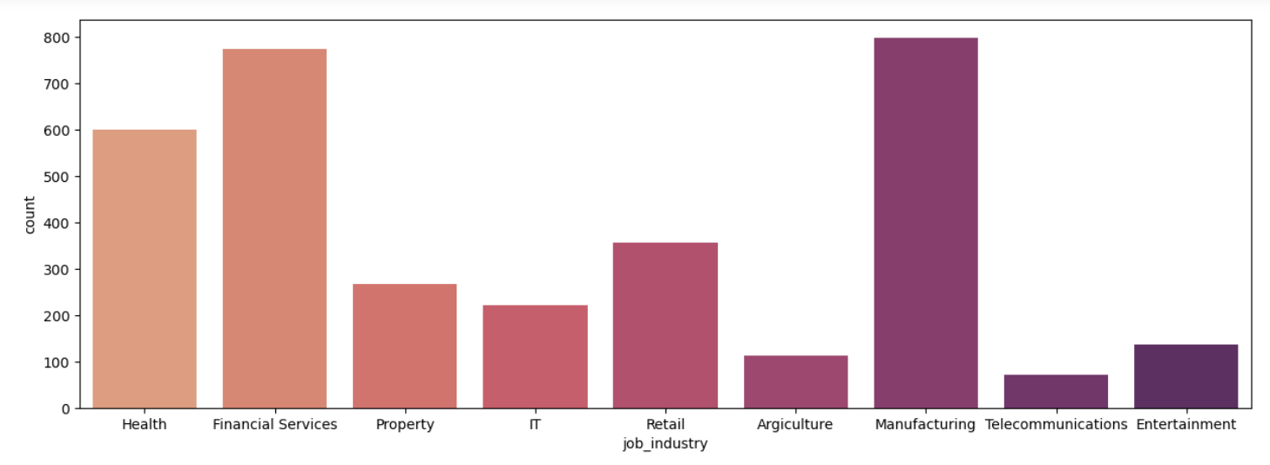
Note: The data and information in this document is reflective of a hypothetical situation and client. This document is to be used for KPMG Virtual Internship purposes only.
Data Exploration
We use charts and graphs to visualize the data and discover any hidden trends or interesting patterns that can give us insights regarding the dataset.
This involves the following components:
Understanding data distributions
Data transformation
Feature engineering
Distribution of customers across industries

Slide 5
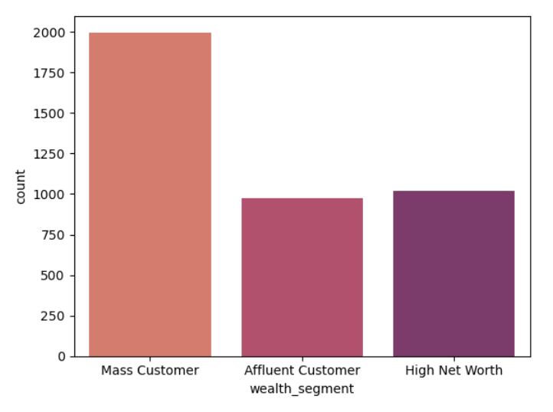
Note: The data and information in this document is reflective of a hypothetical situation and client. This document is to be used for KPMG Virtual Internship purposes only.
Model Development
Understanding Data distributions
Bar charts, histograms, etc. are used to plot the distribution of data points for various features and their interrelations.
This gives us insight into whether data is skewed towards certain values or if one feature affects another.
Distribution across wealth segments

Slide 6
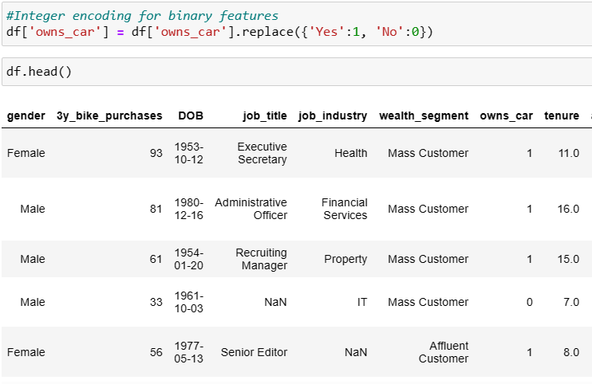
Note: The data and information in this document is reflective of a hypothetical situation and client. This document is to be used for KPMG Virtual Internship purposes only.
Model Development
Data transformation
Data in the columns are converted into suitable forms for modelling later, such as one-hot encoding categorical variables and converting text to numerical form where possible (1 and 0 instead of Yes and No).
Modifying owns_car column

Slide 7
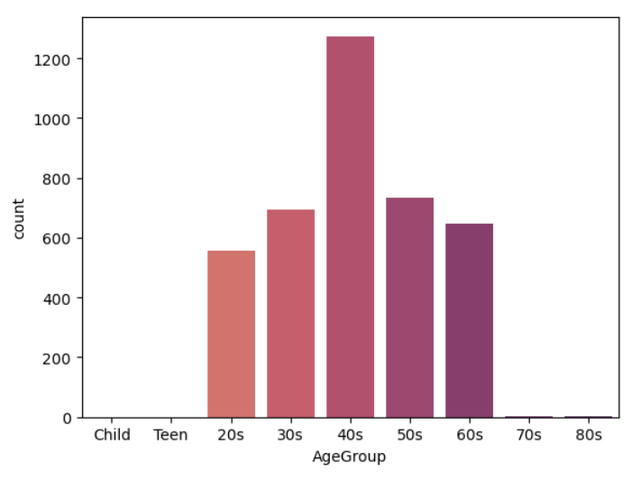
Note: The data and information in this document is reflective of a hypothetical situation and client. This document is to be used for KPMG Virtual Internship purposes only.
Model Development
Feature engineering
Transformed data is then used to create new features that can be more useful for modelling, such as calculating Age from DOB column, and Age Group from Age column.
Distribution across newly created Age Group column

Slide 8
Note: The data and information in this document is reflective of a hypothetical situation and client. This document is to be used for KPMG Virtual Internship purposes only.
Interpretation
We analyze the results from the model to identify the set of traits and favorable factors that characterize (potential) high-value customers of the set of new customers
The results are then interpreted and the sum total of knowledge gained will be condensed in a report form.
The report can then assist the marketing team in making data-driven decisions on which customers to market towards for maximum profit.

Slide 9
Note: The data and information in this document is reflective of a hypothetical situation and client. This document is to be used for KPMG Virtual Internship purposes only.
Appendix

Slide 10
Note: The data and information in this document is reflective of a hypothetical situation and client. This document is to be used for KPMG Virtual Internship purposes only.
Appendix

