Slide 1
SVH DATAFEST 2026 · PATIENT JOURNEY ANALYSIS
They Asked
For Help.
7.6M
Total patient encounters
1,048
Did Anyone
Listen?
Depression-flagged patients
86%
Never got mental health care
ASA DataFest 2026 · Mental Health Patient Journey · Stormont Vail Health, Kansas

Slide 2
ABOUT THE DATA
4 years of real patient data from Stormont Vail Health, Kansas
7.6M
947K
7 files
11
Patient encounters
2022 – 2025
Unique patients
in the system
Linked data files
covering care
SDOH survey
domains tracked
How the 7 files connect
patients.csv
encounters.csv
departments.csv
encounters.csv
947K rows
7.6M rows · hub file
11.6K rows
7.6M rows · central hub
diagnosis.csv
providers.csv
1.5M rows
299K rows
social_det.csv
tigercensus.csv
3.9M rows · SDOH
2.5K rows · KS geo
Our focus: social_determinants → depression screening → behavioral health visits

Slide 3
THE TOOL WE USED
The Edinburgh Depression Scale — a real medical tool
What is it?
How we classified 1,048 patients
A 10-question survey given to patients during their visit. Each question asks how the patient has been feeling — for example, have they felt sad, unable to sleep, or lost their enjoyment in things. Each answer is scored 0 to 3. Total score = 0 to 30. Score 10 or above = clinical threshold for depression. This is the globally accepted standard — used by doctors worldwide, including SVH.
Score 0–9
14,494 rows
No depression
Score 10–13
619 patients
Mild depression
Score 14–19
328 patients
Moderate depression
Score 20–30
101 patients
Severe depression
Total positive screens (score 10+): 1,048 unique patients · From 15,542 total Edinburgh screenings in the social_determinants file

Slide 4
THE FINDING
86%
1,048
patients clinically flagged
0.4%
got care within 30 days
of clinically flagged
patients NEVER received
behavioral health care
1.4%
got care within 90 days
417 days
median wait — over a year
Source: Edinburgh Depression Scale scores in social_determinants.csv · Behavioral health visits matched via encounters.csv + departments.csv

Slide 5
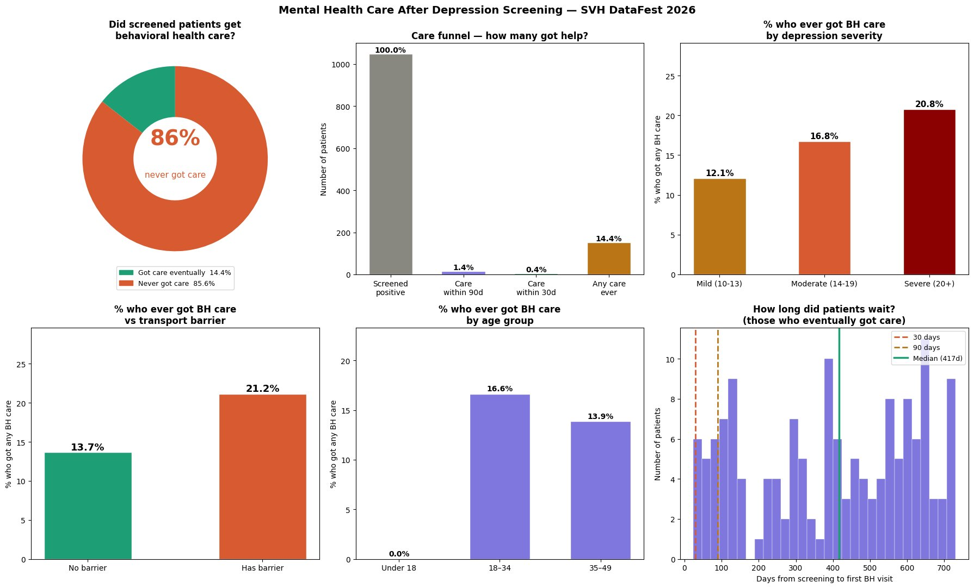
DATA VISUALIZATIONS
Six charts — one complete picture

Slide 6
FINDING 1 — THE OVERALL PICTURE
Getting screened does not mean getting help

Slide 7
FINDING 2 — WHO GETS LEFT BEHIND
The gap is not random — the same people are always missed

Slide 8
THE HUMAN COST
Four groups the data told us about
0%
417d
Children under 18
Over a year to wait
85 children were clinically flagged for depression. Not a single one received behavioral health follow-up. Zero.
Among the 14.4% who did eventually get care, the median wait was 417 days. That is not a gap — that is a system failure.
20.8%
21.2%
Even severe cases missed
Transport barrier patients
Patients scoring 20+ on the Edinburgh Scale — clinically severe depression — less than 1 in 5 ever reached behavioral health.
Patients flagging transport issues had slightly higher contact (21.2%) but still only 1 in 5 got care. Distance is a real barrier.

Slide 9
HOW WE DID IT
Four steps from raw data to insight
01
Find the depression screening data
Searched social_determinants.csv (3.9M rows) for Domain = 'Depression'. Found 15,542 Edinburgh Depression Scale scores. Filtered to score ≥ 10 (clinical threshold) → 1,048 unique patients.
02
Find behavioral health visits
Identified psychiatry departments from departments.csv. Matched F-code mental health diagnoses from diagnosis.csv. Found 119,000+ behavioral health encounters across all 4 years.
03
Match screening to follow-up care
For each flagged patient, checked if they had a behavioral health visit AFTER their screening date. Measured the gap in days. Classified as 30-day, 90-day, or never.
04
Compare groups
Split patients by age, severity score, and transport barrier (from SDOH survey). Identified which groups were most likely to fall through the cracks.

Slide 10
OUR RECOMMENDATION
The screening works.
The referral pathway is broken.
01
Automate the follow-up appointment
Every patient scoring 10+ on the Edinburgh Scale should leave with a psychiatry appointment already booked — not a referral slip, a real scheduled appointment. Before they walk out the door.
02
Prioritize children and severe cases immediately
Under-18 patients and scores of 20+ should trigger a same-week urgent referral. Zero exceptions. The data shows these are the groups most likely to be completely missed.
03
Close the loop — measure what happens next
Track referral completion rates monthly, broken down by age, severity, and transport barrier. SVH already collects this data. Use it to measure whether the fix is working.
SVH already knows who needs help. The data is there. The tool is there. Now make the next step automatic.

