Slide 1
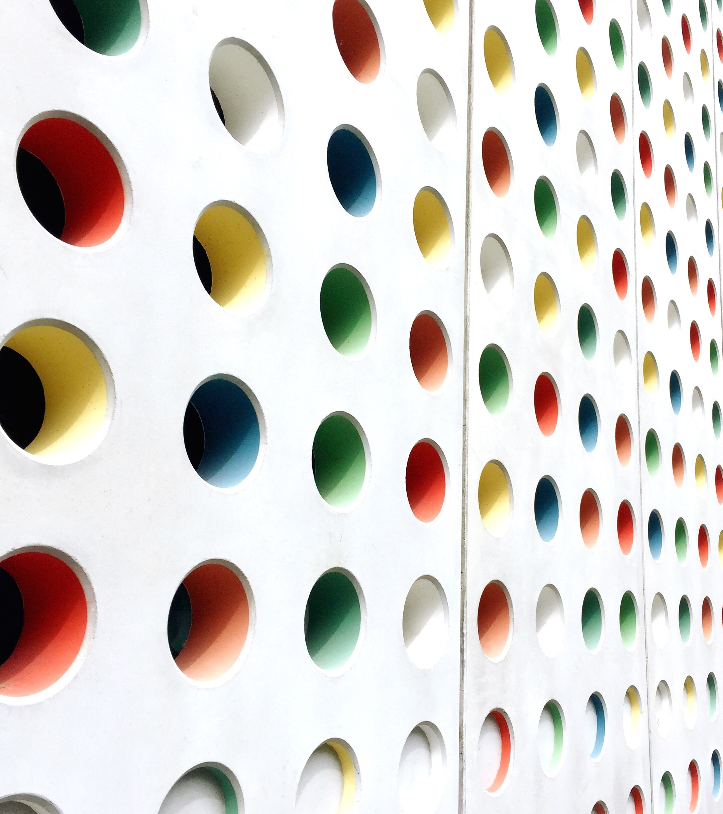
RFID-based Hospital Monitoring System
Presented by:
Debottam Kar
Soumodeep Karmakar
Aritra Mazumdar
Tanmoy Das
Sarthak Biswas

Slide 2
Application
Users: Patients, staff, divices
RFID tags: Bracelets/badges for patients, staff and hospital assets
RFID readers: Hospital corridors, wards
Application

Slide 3
Class Diagram (Structural Diagram)

Slide 4
Relationships
Association(One to One):
Users
(Patient,Staff,Device)
RFIDTag

Slide 5
Relationships
Composition:
Hospital
Monitoringsystem

Slide 6
Relationships
Aggregation:
Users
(Patient,Staff,Device)
Monitoringsystem

Slide 7
1……1
©️RFIDTag
+ tagID + tagType + issueDate + status
+ getTagDetails() + activateTag() + updateTagType()
©️Patient
+ RFIDtag + patientID + name + age + medicalRecord + location
+ getPatientInfo() + updateLocation() + linkRFIDTag() + getMedicalRecord()
©️Hospital
+ hospitalName + address + monitoringSystem
+ addPatient() + addStaff() + addDevice() + getHospitalReport()
©️Monitoringsystem
+ patients + staff + devices
+ trackEntity() + registerPatient() + registerStaff() + registerDevice() + generatePatientReport() + generateStaffReport() + generateDeviceReport()
1……1
1……1
©️Staff
+ RFIDtag + staffID + name + role + department
+ getStaffInfo() + updateRole() + updateDepartment() + linkRFIDTag()
©️Devices
+ RFIDtag + deviceID + deviceType + status + location + lastMaintenanceDate
+ getDeviceStatus() + updateStatus() + updateLocation() + scheduleMaintenance() + linkRFIDTag()

Slide 8
Thank You

